Slide 1
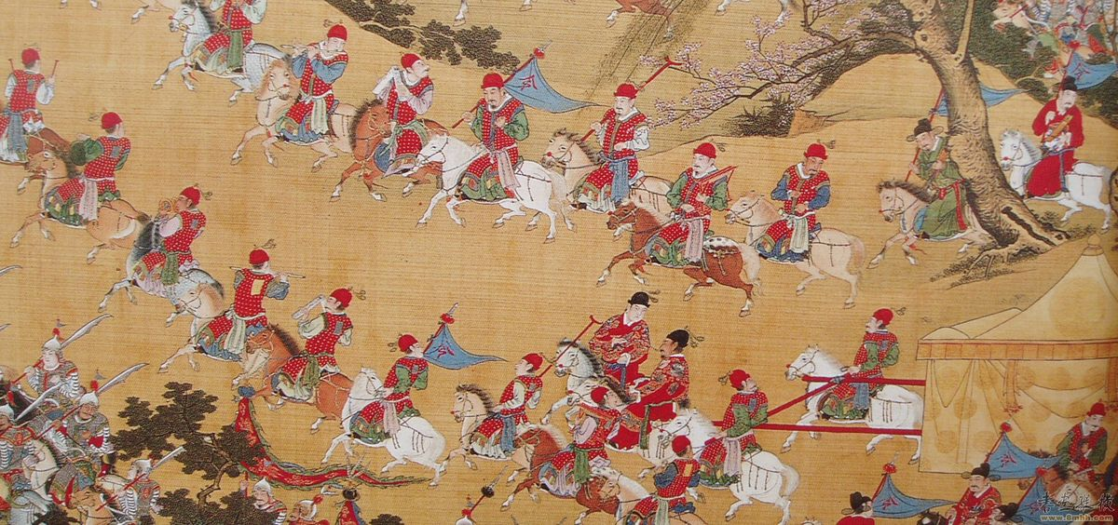
The Ming Empire!!!
By: Everett .L. Washington

Slide 2
The rise of the Ming Empire
“in 1279 the mongol leader Kublai Khan conquered China and founded the Yuan Dynasty. After Kublia Khan’s deth in 1294, the Yuan Dynasty weakened combined with the Chinese resentment of the Mongol rule rise of a new dynasty. In 1368 a peasant named Zhu Yuanzhang and his rebel army overthrew the last mongol emperor.

Slide 3
geography
To the north of china they had the great walls protection and to the east they had the yellow, East and Southern Chinese Sea and. To south west the frontier was protected by the Himalayas

Slide 4
Social classes
1:Centry scholars (the educated ) 2: Peasant farmers 3:Artisans and Craftsmen 4: Merchants and Traders. But over all the royal family

Slide 5
Politics!!!
Zheng He- a Chinese Muslim admiral led seven voyages around the Indian ocean as far as Africa.To show Chinese power he saild with a fleet of 300 ships that included trading ships and Immense tresure ships called Junks, (they where 400 feet long). Zheng He presented gifts from China , in return foreign leaders sent tributes to Chinas Emperor. After a new Emperor came to power he stoped all the voyages because they where to costly but also as well wanted to move toward isolationisam this gained full force in the 1500s (china becomes isolated)

Slide 6
EVEN MORE POLITICS!!!!
THE Ming empire also traded with Europeans silk and rice. After they became isolated from the world they only allowed trade from a few ports

Slide 7
Religon
In their Religon they had Taoism and Buddhism and later on Christianity spred to china.

Slide 8
Intellect:
In the year 1583 Matteo Ricci a European man arrived in china and adopted Chinese language and culture and customs his effort gained him entry into Ming Court from there he introduced Mathematics and sience

Slide 9
Economy
Improved methods of irrigation , increased farm production peasents produced huge amounts of rice crops in the southern river valleys in addition of new crops from the americas corn and sweet patatos these crops reached china in the 1500s and increased farm output . Stability and plentyfull they

Slide 10
technology
During the Ming Dynasty they invented wood block color printing ,paper ,Encyclopedia, the bristle tooth brush and ship rudders.

Slide 11
The Ming Decline
Weak rulers took the throne , began the raised taxes and lost crops . The government became corrupt and rebellion broke out. As the Ming China weakened to the north of them Manchuria saw there chance and took Beijing the capital . The last Emporer took his life before they got to him.

Slide 12
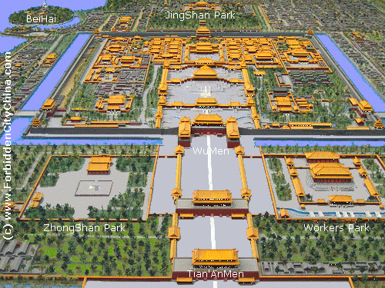
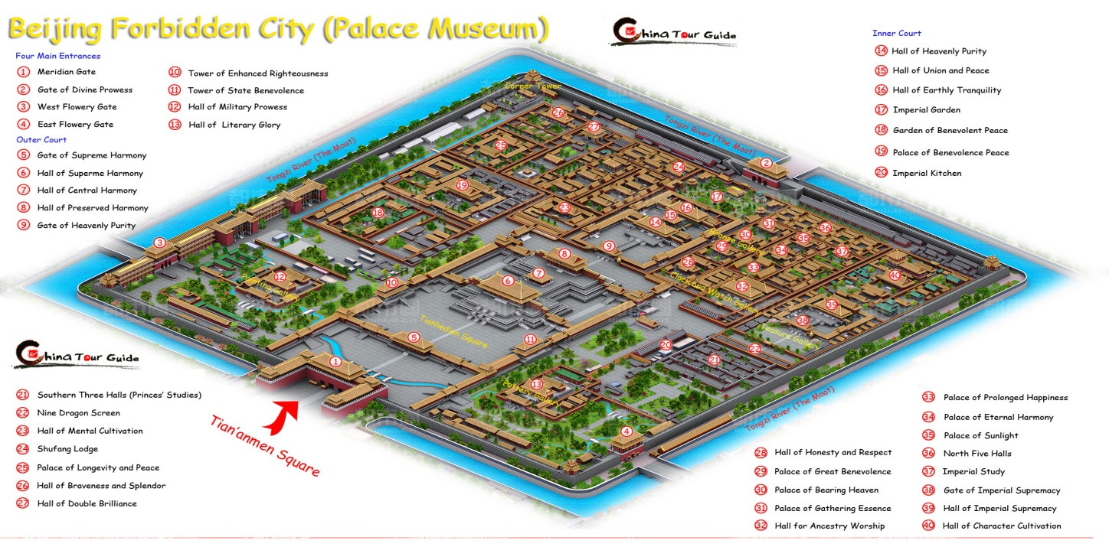
The fobiden city
The forbidden city was built in Beijing during the Ming Empire . Only the wealthy and government where allowed to go in to the city , The city got its name from the less wealthy pesseants that could not enter the city.

Slide 13
The Ming Empire flag

