Slide 1
What is a crusade?
What crusades have you been on in your life, or are planning to go on?

Slide 2
http://www.youtube.com/watch?v=e1yIhX9Jzu8&feature=related
Waning of an Empire—Beginning of the Dark Ages
Viewing Guide Questions:
How did life change from the Roman Empire to the Dark Ages. (list 5 examples)
What united the people of the Middle Ages?
Who is the new “Emperor” of the dark ages?

Slide 3
The Crusades
A Success of Failure?

Slide 4
Things you should know:
Islam spread far from its birthplace in the modern nation of Saudi Arabia. By AD1095, Muslim territory included land where Jesus Christ lived. Christians warriors of the era believed Christians, not Muslims, should control their holy lands.
The Crusades were a series of wars initiated by Christians to win back their holy lands from Muslims.
The Crusaders were ultimately unable to reclaim their holy lands, but the wars had another effect: Western Europeans had left their homes to fight in a distant war. The stories of the returning Crusaders encouraged their countrymen to look beyond their own villages for the first time.

Slide 5
The Crusades
After Muslims were threatening the Byzantine Empire (Christians), Pope Urban II calls for Christians from Western Europe to protect the Byzantine Empire and to capture the Holy Land from its Muslim inhabitants
First Crusade was launched at around 1096 C.E. (A.D.)

Slide 6
The Pope calls for crusades
If you were Pope Urban II, what would you be telling the people of W. Europe to motivate them to possibly sacrifice their lives and go to the Holy Land?

Slide 7
Reasons for the Crusades
Holy Land was holy to Christians, Jews and Muslims (especially Jerusalem)
Place where Jesus was born and died
Looking for adventure and riches
Few opportunities in feudal Europe
Hatred of Muslims

Slide 8
The Holy Land → Jerusalem
Judaism: spiritual homeland of the Jews.
Also the sight of the Western Wall, which was the
last remaining part of King Solomon's Temple.
Christianity: Jesus spent a lot of time there
spreading the word of God.
Islam: the home of the Dome or the Rock,
Where it is believed that Muhammad ascended into heaven.

Slide 9
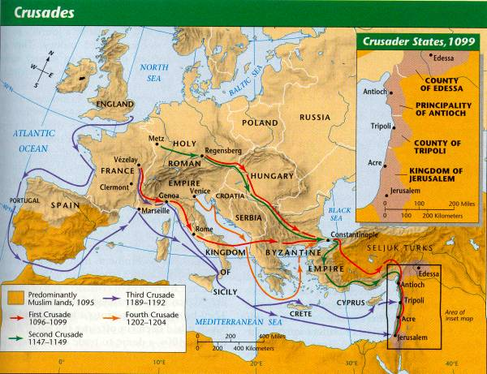
Four Different Crusades

Slide 10
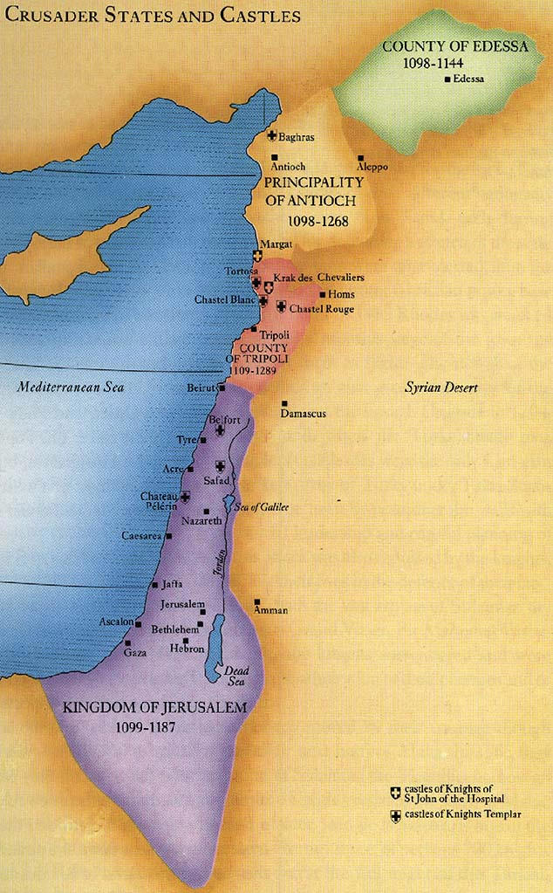
Christians set up four Crusader States in the Holy Land

Slide 11
End of the Crusades
Saladin, the famous Muslim ruler, leads a Muslim force that recaptures Jerusalem
Christians are left in only a strip of land along the coast, which they eventually lose too
Byzantine Empire was taken over by Muslim Turks

Slide 12
The Crusades in Pictures
In your notebooks, describe the following drawings
What is taking place?
Who are the characters?

Slide 13
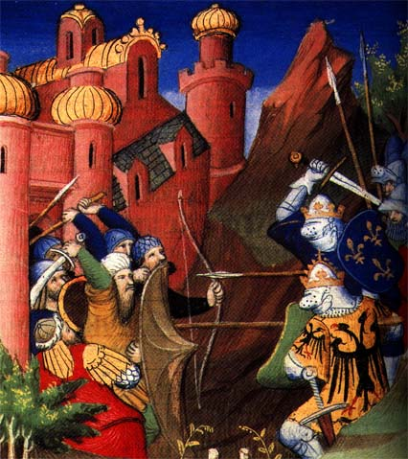
#1

Slide 14
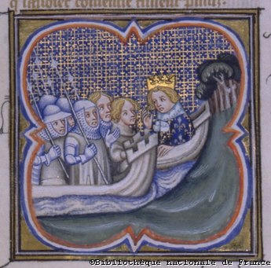
#2

Slide 15
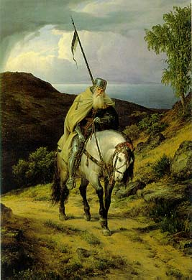
#3

Slide 16
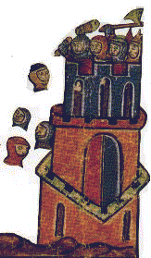
#4

Slide 17
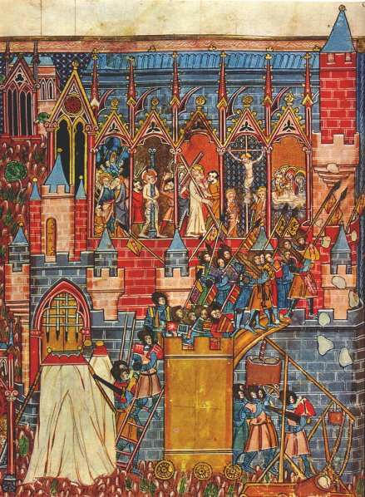
#5

Slide 18
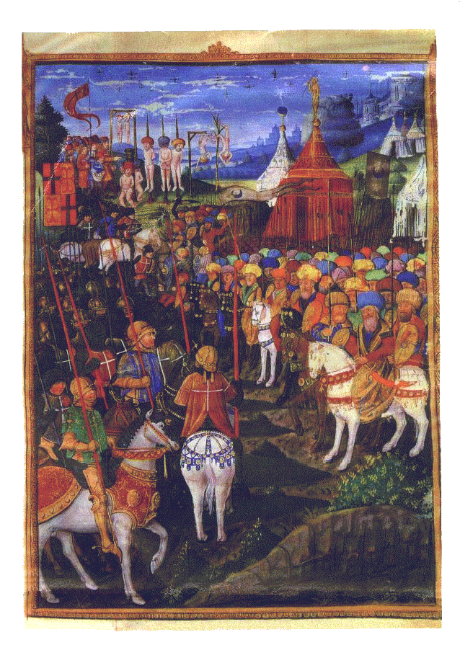
#6

Slide 19
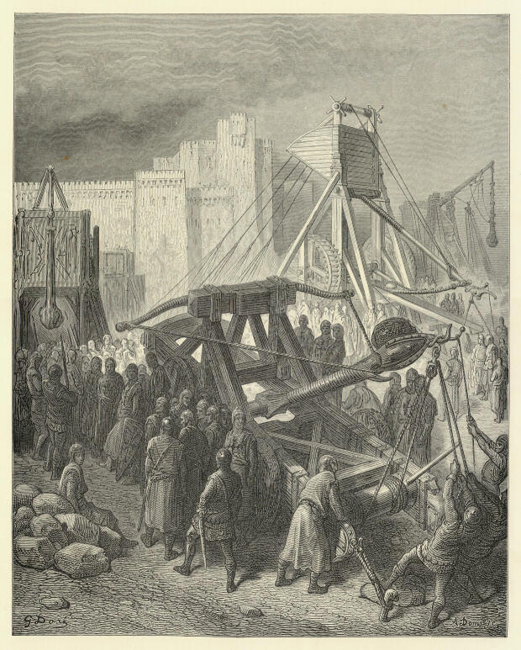
#7

Slide 20
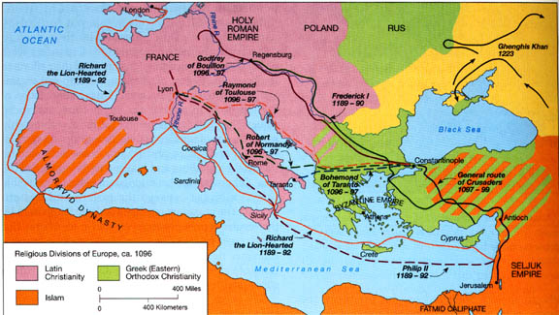
Summary: What were some of the long-term effects of the Crusades? Use the following pictures to discover the long-term effects

Slide 21
Long Term Effect #1
Interaction between Western Europe and Muslims in Middle East- Cultural Diffusion

Slide 22
Long Term Effect #2
Increased trade between Europe and Middle East

Slide 23
Long Term Effect #3
Italians act as middlemen in the trade between W. Europe and Middle East- they become wealthy- leads to renaissance

Slide 24
Long Term Effect #4
Legacy (long term effect) of distrust and hatred between Christians, Jews and Muslims

Slide 25
Long Term Effect #5
Growth of towns and cities along crusader routes; weakening of feudal system

Slide 26
Aim: Were the Crusades successful?

Slide 27
http://www.youtube.com/watch?v=z-niTeTY7pw&NR=1

Slide 28
Wrap up Activity
You will receive a large sheet of paper. Divide the paper into 4 parts/ sections.
Section 1: Causes of the Crusades
Section 2: a Visual Depiction (illustration) of how you interpret the Crusades. Choose a perspective: the pope, a Christian knight, a Muslim, Saladin, etc. How would the crusades look through the eyes of one of these key people?
Section 3: The Effects of the Crusades
Section 4: Your Opinion—where the crusades a success? Write a paragraph expressing your thoughts as to whether you think the crusades were a success.

