Slide 1
The Aztecs and Mayans. A GSPRITE experience
Power point made by: AJ Fulmore

Slide 2
The Rise of Power
Aztecs
Mayans
Fall of the Toltec empire in 1150
Became a small tribe in 1248
Became the most powerful state in 1427
Moved to southern Mexico due to overcrowding
Arrived in homeland around 1000

Slide 3
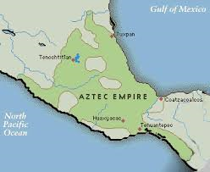
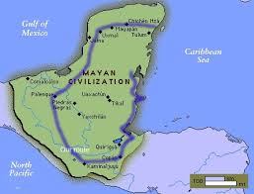
Geography
Aztecs
Mayans
Lived in valleys
Legend of the eagle and the snake
Centered around rain forest.
Benefited from good rainfall
Rich soils for farming
High lands for natural defenses

Slide 4
Social
Aztecs
Mayans
Gods
Gods
Priest
Kings, Nobles, Priest
Nobles, and commissioners
Merchants, Artisans
Slaves
Peasants and slaves

Slide 5
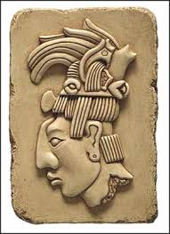
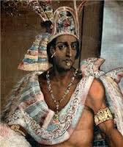
Political
Aztecs
Mayans
An empire
Split into city states
Each city state ruled by a leader
Had city states(18).
No central government.
King has main control.
City state connected through trade.
Had an upmost supreme military.

Slide 6
Religion
Aztecs
Mayans
Polytheistic(5 Gods)
Tezcatlipoca
Hanauti
Ehecatl
Quetzleoutl
Polytheistic
Had human sacrifices
Temples to worship the gods

Slide 7
Intelligence
Aztecs
Mayans
Education for everyone
Created chocolate and gum
They did math
Two calendars
Studied Astronomy
Observed movement with the sun and moon
Had a codex type of writing
Mayan temple

Slide 8
Technology
Aztecs
Mayans
Calendar
Tools of copper
Axe, blades, and drills
Spears for fishing
Bow and arrows
Used the slash and burn technique
They paved roads
Calendars
Stone tools
Canals

Slide 9
Economics
Aztecs
Mayans
Traded majority of their makings
Economy raised off of agricultural goods
Established many trade routes
No type of currency
Traditional economy

Slide 10
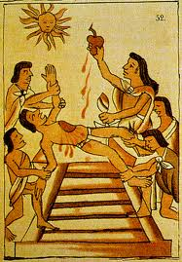
Fall of The Empire
Aztecs
Mayans
To many human sacrifices
Cortes’s troops had small pox
War with the Spanish
War within cities
Poverty
Famine
Disease

Slide 11
Questions
1.What made the Aztecs empire one of the strongest empires?
Their army, location, and government.
2.What were some characteristics of the Mayan empire?
Much larger than other civilizations, and they also had a well established government

Slide 12
Thank You

