Slide 1
Chapter 16—The South and the Slavery Controversy

Slide 2
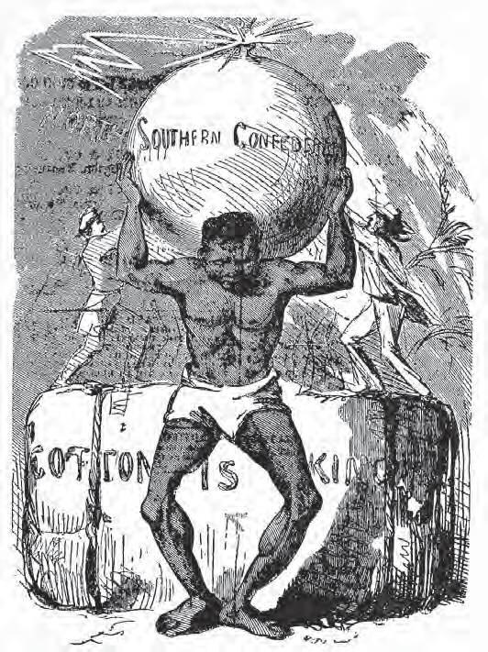

Slide 3
“Cotton is King”
Eli Whitney's 1793 cotton gin invention revolutionized the Southern economy. Added to mechanical jennies to spin yarn, power looms to weave, and sewing machines to sew, the demand (and profits) for cotton fiber skyrocketed.

Slide 4
Southerners scrambled to plant more cotton.
The land was usually worn out then discarded ("land butchery"). The result was a Southern thirst for still more land.
The demand for slaves to work the land also increased.

Slide 5
The "Cotton Kingdom" benefited the North as well since most of the South's cotton was woven on Northern looms.
In 1845, cotton made up 1/2 of all American exports. Also, 1/2 of the world's cotton was grown in the American South. (These numbers each swelled to 2/3 in 1861, when the Civil War began).
Notably, Britain relied heavily on Southern cotton. About 1/5 of the British population made their living in the cotton textile industry. 3/4 of the British cotton came from the American South.

Slide 6
Southerners believed their importance in the world's economy was set in stone. If war were to break out over slavery, the logic went, Southerners were sure that Britain would have no choice but to come to their aid. This logic, though sensible based on the numbers, never panned out.

Slide 7
Intro to planter “aristocracy” ….
Thomas Jefferson (1743–1826) wrote in 1786,
”What a stupendous, what an incomprehensible machine is man! Who can endure toil, famine, stripes, emprisonnent & death itself in vindication of his own liberty, and the next moment . . . inflict on his fellow men a bondage, one hour of which is fraught with more misery than ages of that which he rose in rebellion to oppose.”
Unlike George Washington, Jefferson freed only a couple of his slaves in his will; the rest were sold to pay off his large debts.

Slide 8
The Planter “Aristocracy”
The antebellum (pre-Civil War) South was an oligarchy (government by a few elite).
Only 1,733 families owned 100+ slaves in 1850. They ruled the South in a "cottonocracy."
Southern society is shrouded in myths. The scene, often shown in movies, of huge plantations with the Greek-columned "big house" overseeing hundreds of slaves was true, but only for those 1,733 families.

Slide 9
These elite families sent their sons off to Ivy League schools or to military schools like West Point, the Citadel, or VMI. The Southern belles were expected to marry and eventually run the plantation household.
Education in the South was lacking. This was because the rich elite simply hired private tutors and were thus unmotivated to establish free public schools.

Slide 10
Sir Walter Scott was the author of Ivanhoe and was very popular to Southerners. They liked the medieval world described in the novel and especially its code of chivalry with knights and damsels.
In the Southern-elite mind, Southern society was rekindling medieval society with military-trained, bright, and dashing young Southern gentlemen and the gentile Southern belles. Though real in the elite Southern mind, this society was also myth. And even if it came close to being real, it was still built on the backs of slaves.

Slide 11
Southern women had unique roles.
The mistress of the plantation managed the household. It was a large job where she gave daily orders to cooks, maids, seamstresses, laundresses, etc. as well as handling any personal issues that inevitably arise with a large "staff."
Though clearly to "take a backseat to the men" in terms of politics or officially running a business, these Southern women had real authority in running these areas as they saw fit. Few Northern women had such positions or authority.

Slide 12
The mistresses were sometimes very kind to their subjects and at other times very cruel.

Slide 13
Intro, to slaves of the slaves system…
Basil Hall (1788–1844), an Englishman,
visited part of the cotton belt on a river
steamer (1827–1828). Noting the
preoccupation with cotton, he wrote,
”All day and almost all night long, the
captain, pilot, crew, and passengers
were talking of nothing else; and
sometimes our ears were so wearied
with the sound of cotton! cotton! cotton!
that we gladly hailed a fresh inundation
of company in hopes of some change—
but alas! . . . ‘What’s cotton at?’ was the
first eager inquiry. ‘Ten cents [a pound ],’
‘Oh, that will never do!’”

Slide 14
Slaves of the Slave System
High cotton profits encouraged "land-butchery." New cotton land was always needed.
With the desire for more land, the small farmer began to get squeezed out. The small farm was often sold to the large plantation owner. Thus, the elite-run oligarchy society was perpetuated and reinforced

Slide 15
The King Cotton economy had faults…
Debts began to run high since many people over-speculated in land or in slaves. Slaves were profitable (due to their value), but were also risky since they might run away or die.
The Southern economy was based on one crop only—cotton. This was profitable, but also risky by "putting all their eggs in one basket."

Slide 16
Similarly, Southerners relied on the North for nearly everything, from manufactured goods to food.
Also, immigrants did not go to the South. The reasons were (a) labor competition from slaves, (b) the high price of land, and (c) ignorance of cotton cultivation. These hard-working immigrants wound up helping the North solely, at the South's expense.

Slide 17
The White Majority
Southern society had a social ranking system. The elite, large slave-owners were at the top.
On the rung just below the "cottonocracy," were small farmers who owned slaves. About 3/4 of Southern whites did not own slaves, and of the quarter that did, most owned only about 2 or 3 slaves, usually a family.

Slide 18
Next came whites who did not own slaves (3/4 of whites). An irony exists in that (a) they had a deep resent of the wealthy slave owners (the "snobocracy") yet (b) still held the "Southern dream" of one day becoming a wealthy slave owner.
Most of these whites were very poor. They were sneered as "poor white trash," "hillbillies," and "crackers."
They were called "clay eaters" because they chewed clay to get minerals they lacked in their diet. They also got hookworm from the clay.
Though slave-less, these whites were very racist. Their thinking was no matter how poor or how bad off they had it in life, they still viewed themselves as being above the slaves.

Slide 19
Slaveowning Families, 1850 More than half of all slaveholding families owned fewer than four slaves. In contrast, 2 percent of slaveowners owned more than fifty slaves each. A tiny slaveholding elite held a majority of slave property in the South. The great majority of white southerners owned no slaves at all.
1,733 own 100 or more slaves
6,196 own 50–99
29,733 own 20–49
54,595 own 10–19
80,765 own 5–9
105,683 own 2–4
68,820 own 1 each

Slide 20
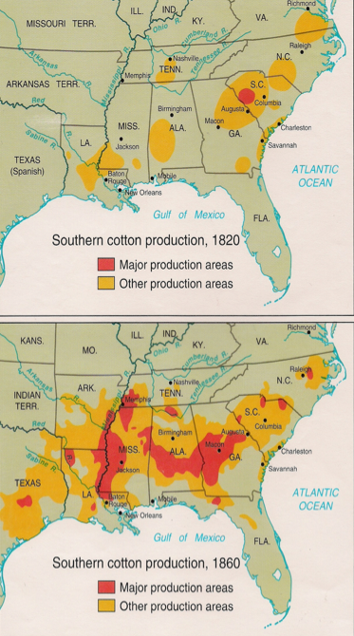

Slide 21
Whites that lived in the mountains (hillbillies) likely had the toughest life of all whites. They were incredibly isolated, living in coves and hollows separated from the rest of the nation. They were extremely poor and scratched a living out of the mountains.
Mountains whites were not strong supporters of slavery, if even supporters at all. They (a) had no need for slavery in the mountains and (b) despised the wealthy white plantation owners who usually ran their state.
The fact that mountain whites didn't support slavery can be seen when the Civil War broke out. West Virginia broke away from Virginia over this matter. And, many whites from the hills "volunteered" to fight for the North (as in Tennessee, the "Volunteer State").

Slide 22
Free Blacks: Slaves Without Masters
The next rung on the Southern social ladder belonged to free blacks. In 1860, there were 250,000 free blacks in the South.
Slaves may have been freed by one of many methods…
By a movement of emancipation after the American Revolution (usually the upper South).
By the slave owner. These were usually mulattoes, often the child of a white owner and black mistress.
By purchasing one's freedom. If a slave could save enough money, he could just buy himself, so to speak and thereby free himself.

Slide 23
Many freed blacks owned property, as in New Orleans. A few blacks even owned slaves.
Free blacks were 2nd, or 3rd, class citizens. The pro-slavery crowd didn't like them since they represented the possible end of slavery. Free blacks rights were limited compared to whites.

Slide 24
Northerners disliked free blacks as well. The Irish especially disliked blacks since both were in competition for the lower paying jobs.
When the North stood up to stop expansion of slavery into western lands, it was perhaps motivated more by economics of labor competition than by the desire to stop slavery.
The idea that the South hated blacks and the North loved them is a myth. Anti-black sentiment in the North was often fiercer than the South. It was said that the South liked the black individual (with whom they lived daily), but hated the race; but the North claimed to like the race (with whom they'd never lived), but hated the individual.
Frederick Douglass, the leading spokesperson for blacks and against slavery, was beaten several times in the North.

Slide 25
Segue from free blacks to plantation slavery…
“Arthur Lee, Freeman,” petitioned the
General Assembly of Virginia in 1835 for
permission to remain in the state despite
a law against the residency of free blacks.
After asserting his upstanding moral
character, he implored,
“He therefore most respectfully and
earnestly prays that you will pass a
law permitting him on the score of
long and meritorious service to remain
in the State, together with his wife and
four children, and not force him in his
old age to seek a livelihood in a new
Country.”

Slide 26
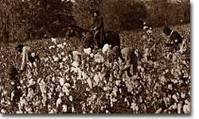
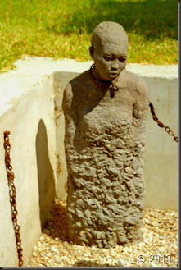
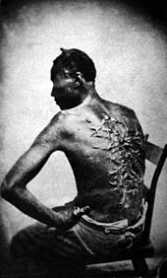

Slide 27
Plantation Slavery
At the bottom of the Southern social ladder were slaves. Though slaves were at the bottom in status, slavery (AKA the "peculiar institution") made up the foundation of Southern economics and society.
By 1860, there were 4 million slaves in America.
Slave importation had been banned in 1808, but it was a moot point. Slaves were still smuggled into America and penalties for doing so were infrequent. Also, by this time, slavery was self-supporting through natural childbirth.

Slide 28
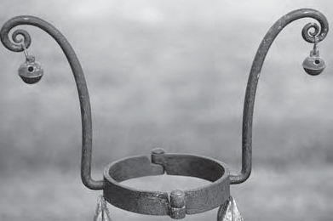
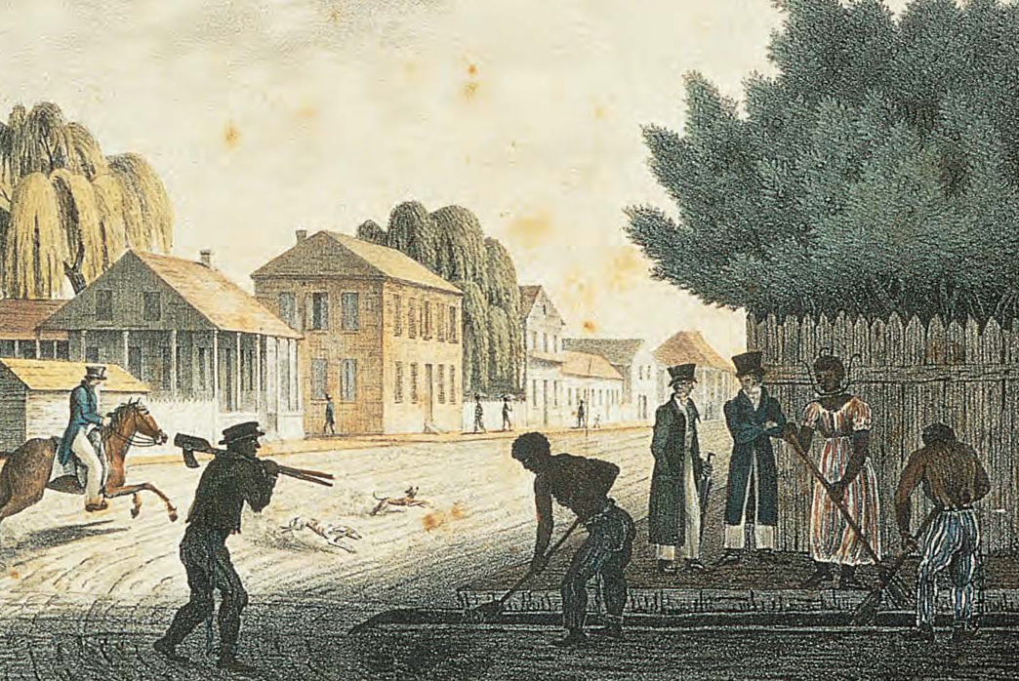

Slide 29
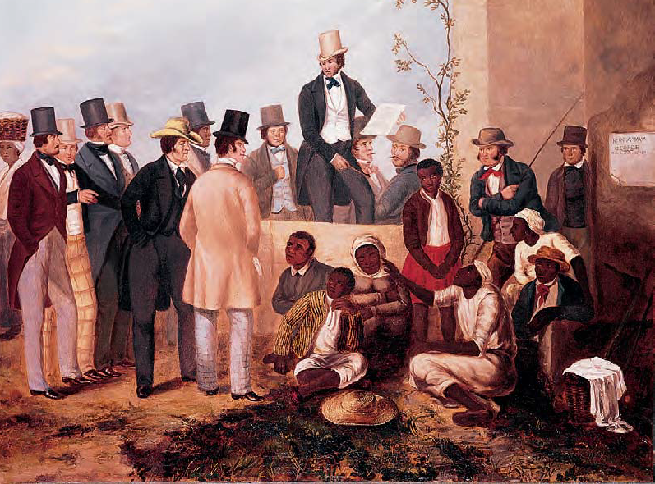

Slide 30
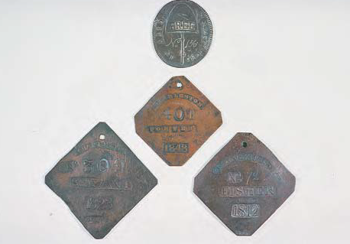

Slide 31
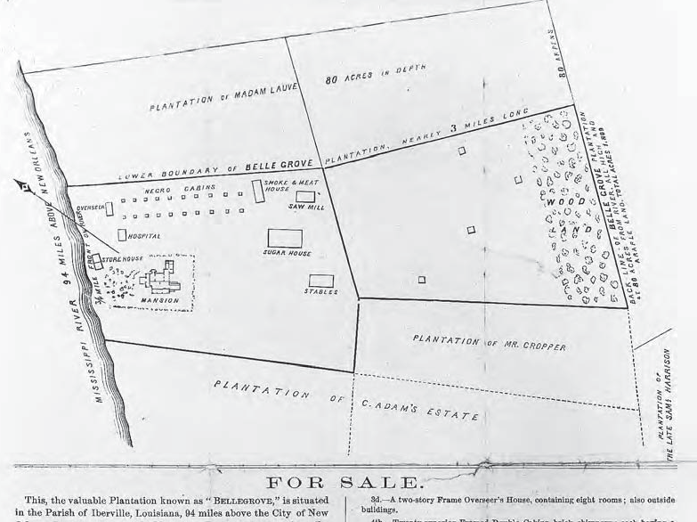

Slide 32
Slaves were viewed as an investment—one to be guarded. The most dangerous jobs were saved for a hired Irishman so as to not injure a valuable slave.
Strong, hard-working men, slaves with special skills, or women who gave birth to many children were especially prized.
Slavery followed the "Cotton Belt"—an arc swooping from Virginia down through to Texas. The heart of the Cotton Belt was from South Carolina to Louisiana, the "Deep South."
Slaves from the upper South were sometimes "sold down the river" to the Deep South.
This theme (being sold down the river) became the storyline for Harriet Beecher Stowe's novel Uncle Tom's Cabin.
It was fiction & played on readers' emotions to swell up abolition movement.
Its impact cannot be understated and was a considerable cause of the war.

Slide 33
Life Under the Lash
Life as a slave is hard to pin down. Sometimes a slave had a kind master, sometimes the master was extremely cruel.
In all situations, a slave was expected to work hard and abide by the rules.
Whippings were not uncommon.
On the one hand, whippings were a disincentive to getting "out of line."
On the other hand, excessive whippings left scars which hurt a slave's resale value.
Generally, life in the Deep South was tougher than the upper South.
The Deep South (Cotton of Slave Belt) accounted for about 75% of the black population.
On the good side, slave life and families tended to be more stable there.

Slide 34
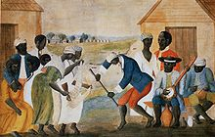
Despite huge obstacles, blacks showed great resilience.
A distinctive African-American culture emerged. This was played out through a mixture of language, religion (mix of tribalism and Christianity, focus on Moses' story), and music (bongos, banjos, then jazz).

Slide 35
The Burdens of Bondage
Slaves had no part in the "American dream" that nearly all other Americans enjoyed.
To "fight back," slaves employed techniques such as simply working very slowly.
The ultimate goal of slaves, unsurprisingly, was freedom.
This is seen in slaves' preference in religion for Moses' story of delivering the Israelites from bondage and in hymns that emphasized "flying away" or the freedoms provided by Jesus and of Heaven.
Also, slave revolts occurred.
Gabriel led a revolt in Virginia.
Denmark Vesey led a revolt in South Carolina.
Nat Turner was considered something of a prophet and led a revolt in Virginia.
All of these were unsuccessful and wound up terribly for the leaders. The overall result was to (a) scare the dickens out of the whites and (b) see the whites tighten security and black codes.
Booker T. Washington later noted that whites, in keeping blacks down in the ditch, had to get down into the ditch with them.

Slide 36
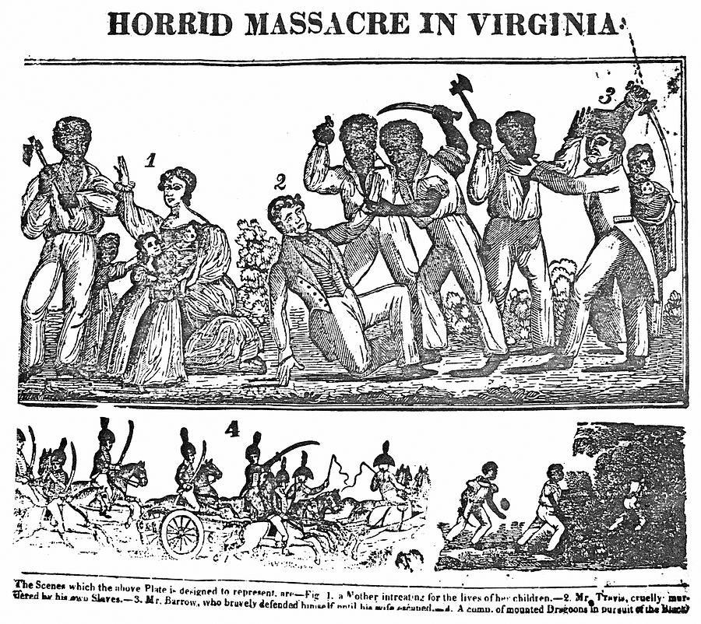

Slide 37
Early Abolitionism
The abolition of slavery began in America with the Quakers.
The American Colonization Society started with the goal of moving blacks back to Africa.
It succeeded in starting Liberia on the West Africa coast.
It failed because (a) most blacks considered themselves African-Americans, not Africans and (b) finances for the entire venture were very short for the huge task.

Slide 38
The 2nd Great Awakening of the 1830's fueled a surge in the abolition movement.
Theodore Dwight Weld was inspired by Charles Grandison Finney's preaching and became a leading anti-slavery spokesman.
Weld attended the Lane Theological Seminary which was headed by Lyman Beecher, the father of novelist Harriet Beecher Stowe, reformer Catharine Beecher and preacher-abolitionist Henry Ward Beecher.
The "Lane Rebels" fought slavery with words. Weld wrote a propaganda pamphlet titled American Slavery as It Is.

Slide 39
Radical Abolitionism
William Lloyd Garrison published a radical abolitionist newspaper titled The Liberator.
It made its debut on New Year's Day, 1831, and forcefully shouted against slavery for the next 30 years. Garrison's famous battle cry was I WILL BE HEARD!
Critics charged that Garrison fanned the flames of anti-slavery, but had no real solution.
Wendell Phillips helped start the American Abolitionist Society to further the cause.
A black abolitionist, David Walker, wrote Appeal to the Colored Citizens of the World urged military action to end slavery.

Slide 40
Another black abolitionist, Sojourner Truth, was a tireless spokeswoman for abolition and women's rights.
Martin Delaney seriously considered black colonization of Africa.

Slide 41
The greatest abolitionist was Frederick Douglass.
Douglass was a former slave who escaped to Massachusetts and became the cause's leading spokesman.
His autobiography Narrative of the Life of Frederick Douglass became a classic and remains so to this day.
Unlike Garrison, Douglass was more practical. He supported the Liberty Party, the Free-Soil Party, and then the Republican Party.
Finally, nearly all of the abolitionists supported the Civil War as the final solution to end slavery.

Slide 42
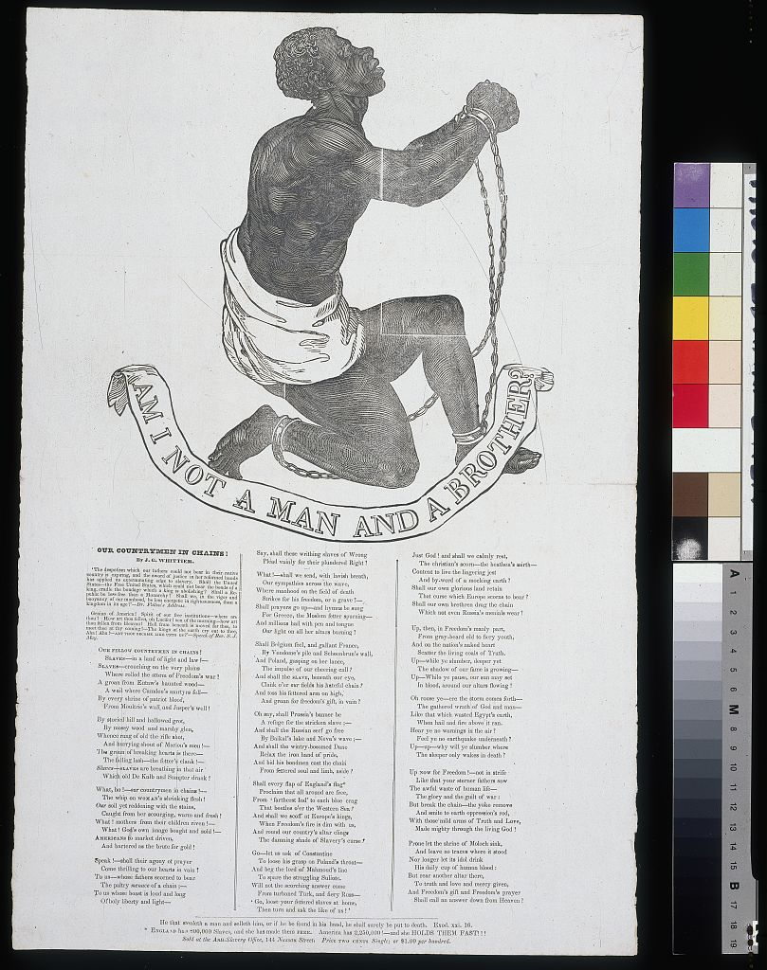
This image appeared in a pamphlet published by the Society for the Abolition of Slavery in England. It appears with a poem by John Greenleaf Whittier.

Slide 43
The South Lashes Back
1831 was a turning point for slavery in the South because (a) emancipation proposals were defeated in Virginia & (b) Nat Turner's bloody rebellion scared whites into tightening black codes.
Garrison's The Liberator popped on the scene at about the same time and was blamed for fanning the flames of rebellion. Rewards were offered for Garrison's arrest.
Whereas Northerners decried the horrors of the "peculiar institution", white Southerners cultivated a happier scene of slavery. Southerners defended slavery by arguing…
The Bible supported slavery. They referred to the several references of slaves in the Bible and more specifically the "curse of Ham", Noah's son and supposed patriarch of Africa, who was cursed to serve his brothers.
Slave owners encouraged religion amongst their slaves.

Slide 44
The idea of whites and happy "darkies" growing up and living together. This concept was best seen in the Stephen Foster folk songs such as "Old Folks at Home" and "My Old Kentucky Home" which sings that "the darkies are so gay."
The slave-owner relationship was akin to family ties, like a father-son relationship.
Perhaps the most forceful argument was economic in nature. It held that slaves had it better in comparison to Northern "wage slaves." Whereas the slaves were provided with food, clothing, shelter, and the owner had a vested interest in the slave, even when the slaves were old, Northern factory owners simply worked their employees for a tiny wage, then sent them on their way home to fend for themselves, or just fired them.

Slide 45
Southern politicians took steps to silence anti-slavery statements/literature. Gag orders were given & abolitionist propaganda, including drawings illiterate slaves could understand, was burnt.

Slide 46
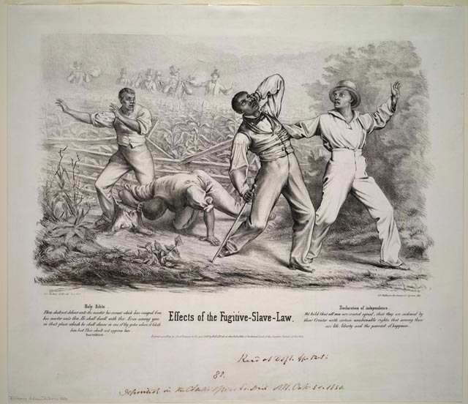

Slide 47
The Abolitionist Impact in the North
The extreme-abolitionists up North, like William Lloyd Garrison, were not popular amongst most Northerners.
Garrison's views were seen as annoying, disruptive, and divisive to Daniel Webster's calls for union.
Northerners also knew they had a very real stake in the South—Southern cotton helped fuel the Northern textile industry. For this reason, many Northerners sought to quiet the loud abolitionists.
Garrison was roughed up several times up North.
Rev. Elijah P. Lovejoy offended Catholic women and saw his printing press destroyed four times then was murdered by a mob.

Slide 48
Still, abolitionists had imprinted into Northerners' minds that the South was the land of the "unfree". And, there was a growing movement among politicians not to abolish slavery, but to prevent its spread. This "free-soil" position would soon be taken up by Abraham Lincoln.

Slide 49
