Slide 1
Gilded Age(1874-1914)
By; Amari Johnson
Stacey Moryas

Slide 2
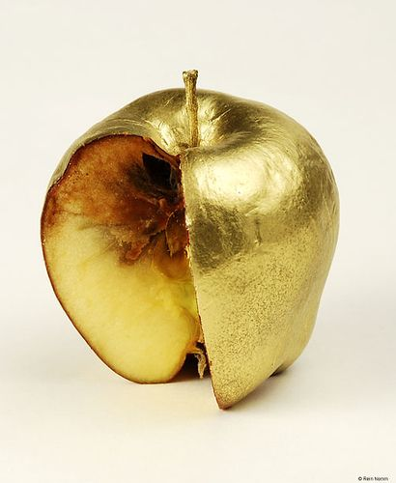
Introduction
Definition of Gilded: Covered with a thin layer of gold on the outside but not all the way through.
Gilded age (a name given by Mark Twain) can be summarized as “good on the outside but bad on the inside.”

Slide 3
What is the Gilded age?
The time of economic growth, the second industrial revolution, urbanization, immigration, and political/economic corruption.
It included the era of forgotten presidents (Hayes, Garfield, Arthur, and Harrison)
Congress and Businesses were more important and influential than the presidency during this time. It was the most highly competitive political time in US History.
The great industrial success of the US and the lifestyles of the wealthy hid the many social problems of the time, including a high poverty rate, a high crime rate, and corruption in the government.

Slide 4
Key Points
Rapid economic growth generated wealth during the Gilded Age
New products and technologies improved middle-class quality of life (Thomas Edison’s light bulb)
Industrial workers and farmers did not share in the new prosperity, working long hours in dangerous conditions for low pay
Gilded Age politicians were largely corrupt and ineffective
Most Americans during the Gilded Age wanted political and social reforms, but they disagreed strongly on what kind of reform

Slide 5
Why did industry thrive?
Natural resources (lumber, coal, oil, rivers)
Lots of labor (immigrants, former farm laborers)
Business-friendly government- Laissez faire the government does not tell the businesses what to do.
Entrepreneurial spirit

Slide 6
Business leaders were captains of the industry because they changed the way America did business. They introduced a different way to work and created a whole new industry. On the other hand, they were also robber barons because they would do anything to earn more money. They created massive business organizations, known as trusts, that enabled them to monopolize major industries which gave them the power to regulate the supply and price products and commodities.

Slide 7
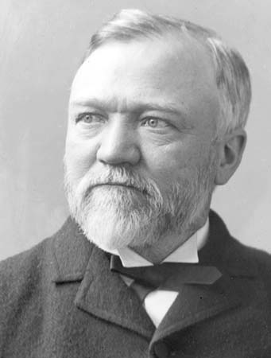
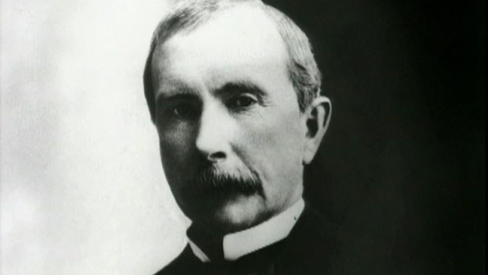
Robber Barons/ Businessmen
Andrew Carnegie
He made the famous bridge that made the steel industry popular.
His work made the car business very popular.
John D. Rockefeller
He transformed the petroleum industry (oil industry)
His company was the first business to succeed with business trusts.

Slide 8
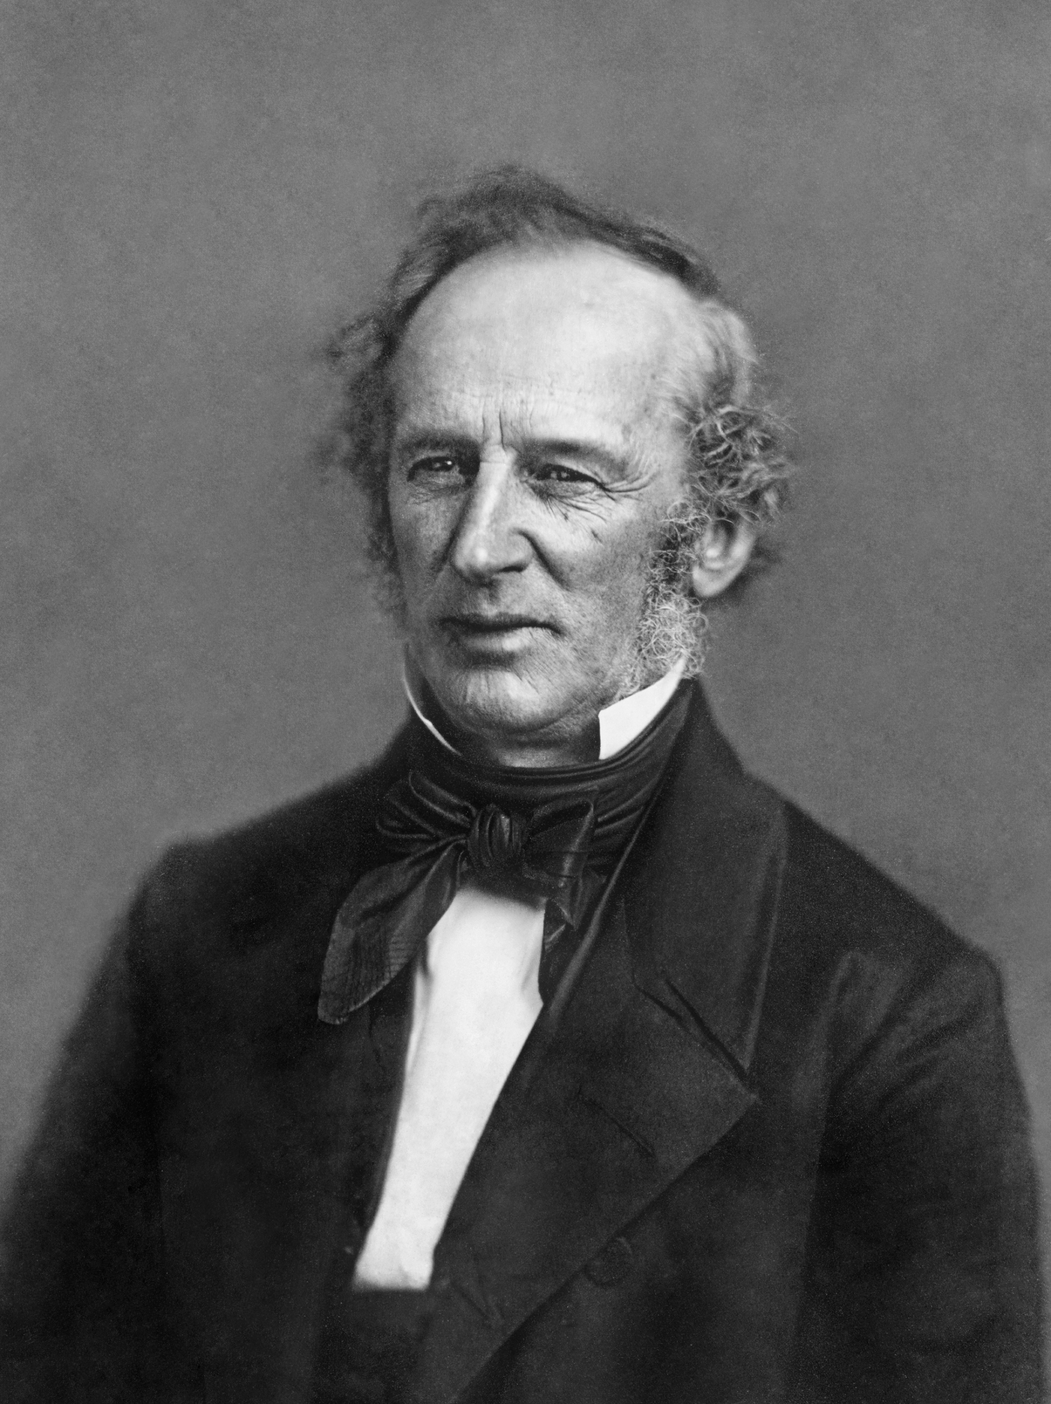
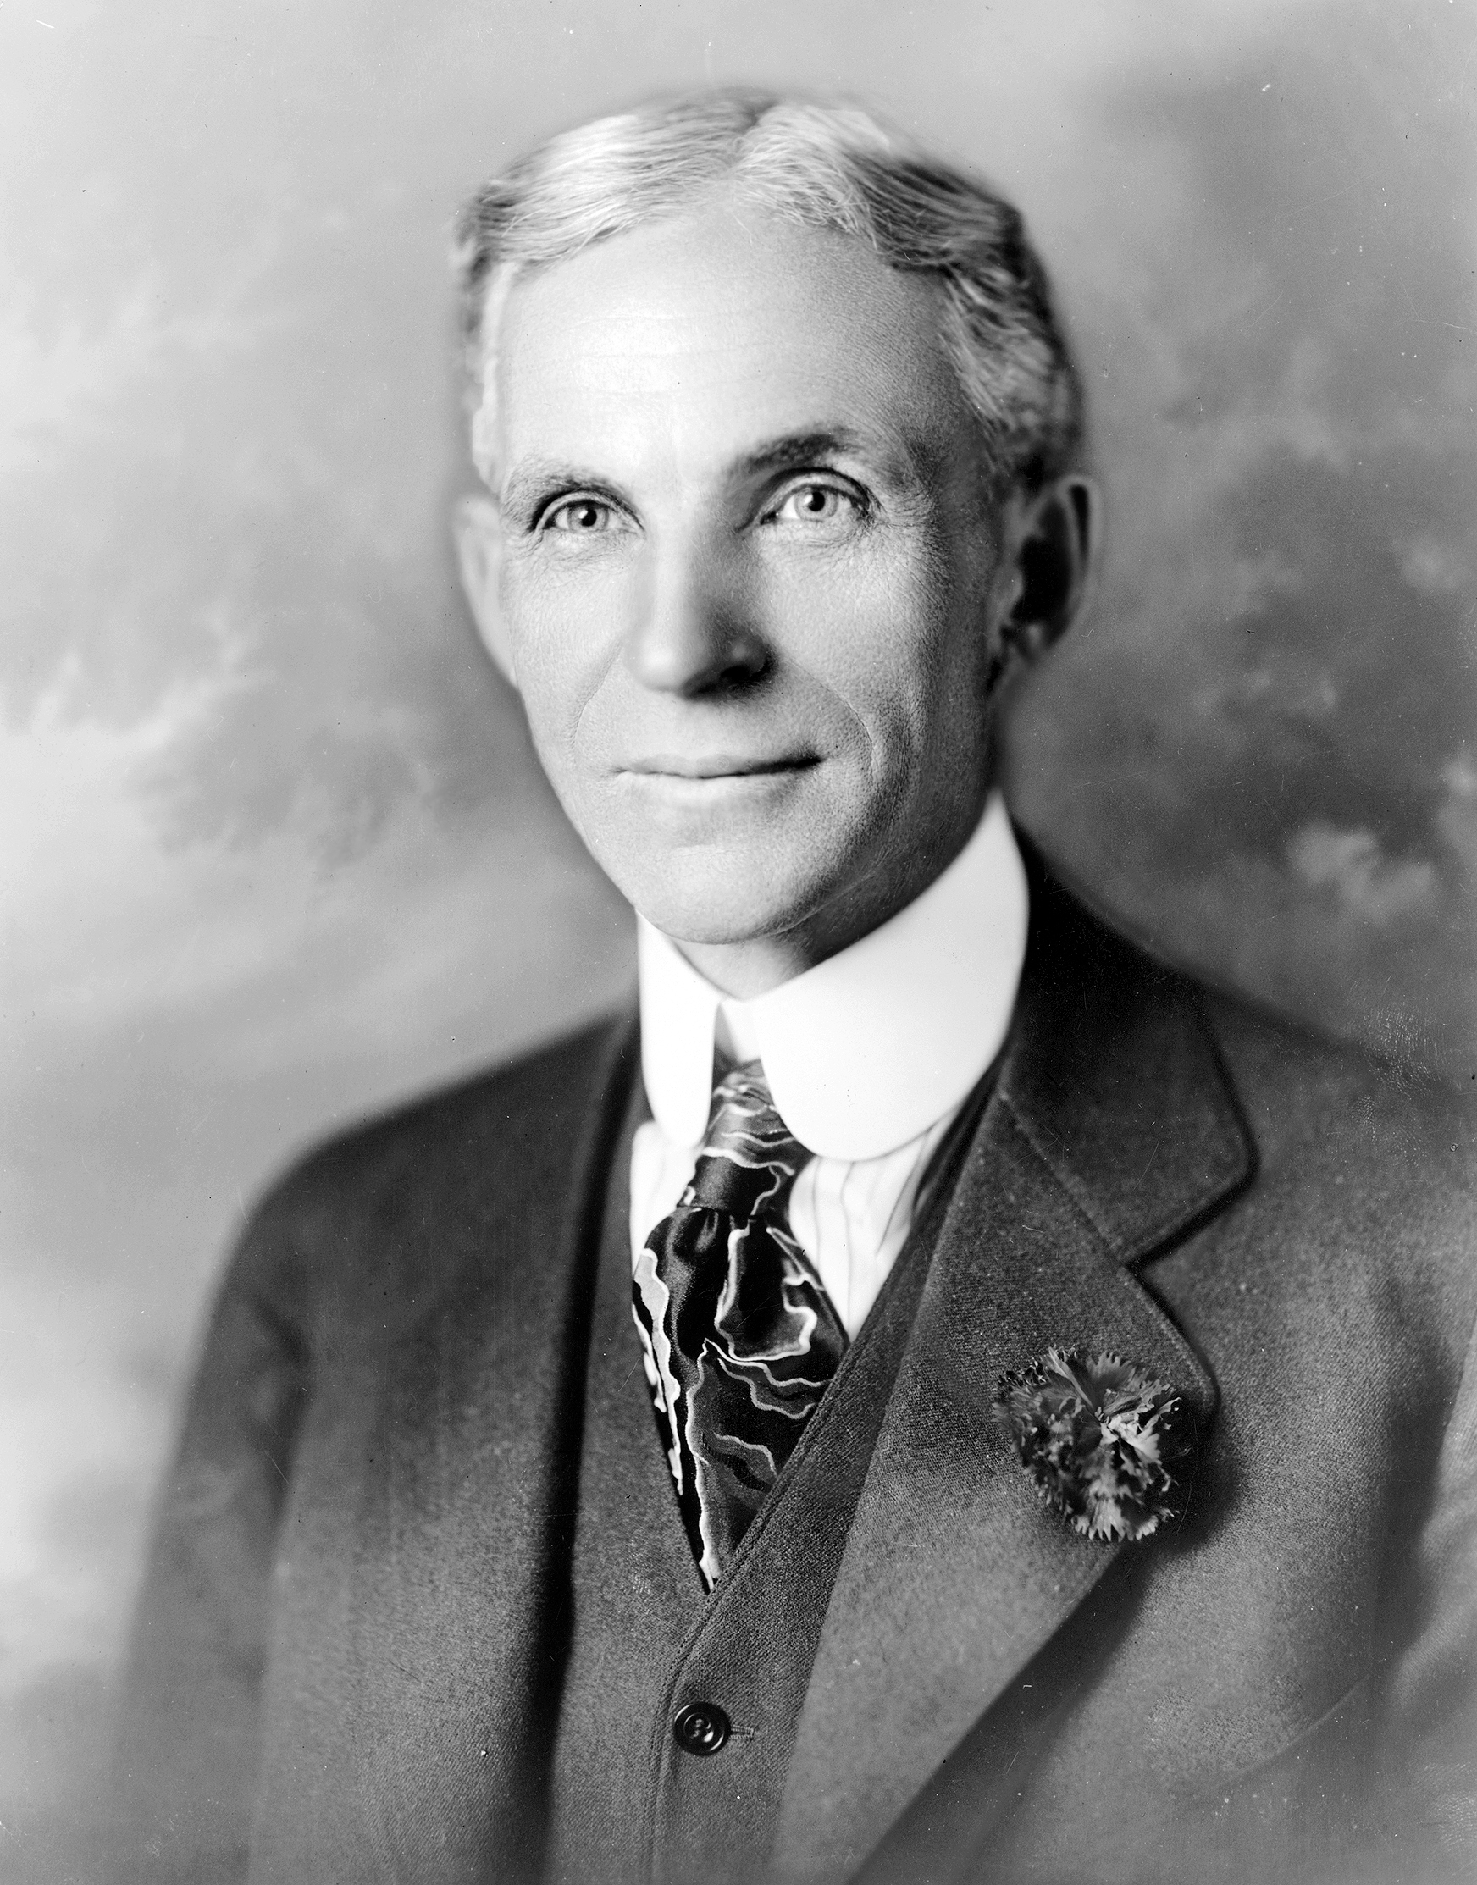
continued..
Cornelius Vanderbilt
Mastered the steamboat design and built his own ships.
After accomplishing his steamboat empire he created a railroad business.
Henry Ford
Revolutionized the industry with mass production and assembly line technique.
Also set a standard for the minimum pay for workers.

Slide 9
In what ways did businessmen/ robber barons increase their profits?
The Robber Barons could not be controlled by the federal government. Their goal was to increase their profits and they used any methods possible to achieve their goal. The Robber Barons…
Cared little for the working conditions and safety of the employees.
Kept wages at a minimum.
Workers were forced to work long hours.
Used bribery and corruption to gain support from politicians and government officials.
Made hard for competitors by monopolizing the major industries.
Artificially inflated the value of a company’s stock

Slide 10
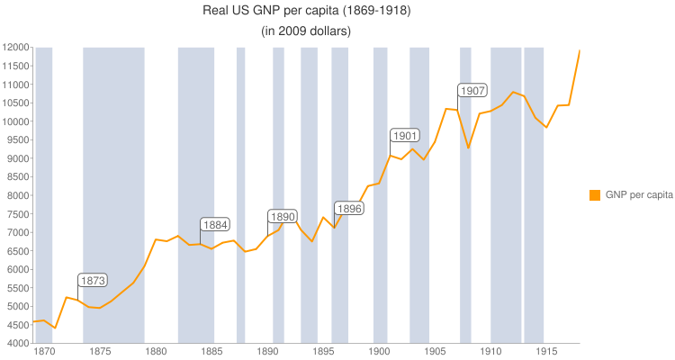
What problems resulted due to the rising consolidation of power among a select few?
The companies went bankrupt and stockholders had nothing left.
A lot of large railroads went through endless bankruptcies.
In 1860 the US debt was $16 billion by 1900 the national debt was $88 billion.

Slide 11
How did Robber barons/ Captains of the industry justify their wealth?
Social Darwinism justified economic inequality.
By using “survival of the fittest” William Sumner said that the social classes owe nothing to each other and that the poor are just simply lazy because they chose to stay poor.
It was believed that the rich were rich because they were intelligent and hard workers. The poor were lazy and unfit.
This principle also applied in businesses. Those who could not compete with the businessmen, deserved to die off.

Slide 12
What were the negative effects of urbanizations? Consider the boss system as well as life in the slums.
As the industries began to grow rapidly, people moved to the cities for job opportunities.
The population increased in the cities which caused:
Pollution
Natural habitats destroyed for housing purposes
Spread of diseases
Conflicts
Corruption

Slide 13
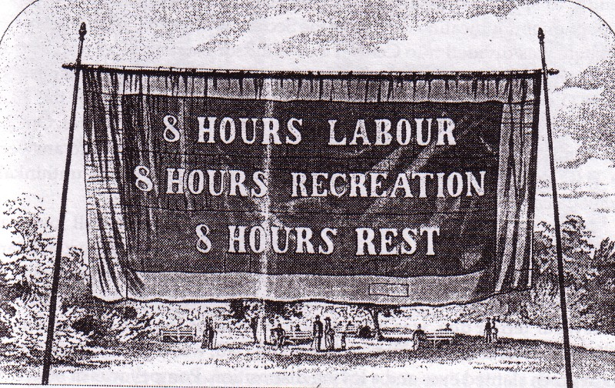
How effective were early labor unions in combating widespread misery?
The labor union were effective in developing a living wage and safety conditions.
The populist party which was formed(1892) by farmers were mostly affected.
Their main call was for inflation via free coinage of silver.
They wanted government regulation of railroads, direct election of U.S. senators, and a shorter workday.

Slide 14
Compare the motivations and methods used by Jane Addams and William Randolph Hearst in fixing the problems of the Gilded Age?
James Addams:
Addams sought to make changes on a more personal level by founding the Hull House. She was deeply dedicated to uplifting struggling urban people and was motivated by a desire to make a change. She affected people personally through direct contact.
Randolph Hearst:
Involved himself in the messy battle with Pulitzer which affected his motivations. He tried to make changes by reaching as many people as possible through the press. He didn't usually have direct contact with people he influenced.

Slide 15
How did the South essentially recreate slavery conditions following the Civil War?
After Reconstruction, the south created a system of peonage (paying of debt through labor when the slave doesn’t have sufficient cash) using the practice of share-cropping.
Black tenant farmers were always i debt and could never work hard enough to pay of their debts.
Share cropping kept African-Americans tied to the land.
There were “lack codes” which eventually developed into Jim Crow Laws which severely limited African American rights.

Slide 16
How did W.E.B. DuBois and Booker T. Washington differ in how they believed African-Americans should attain equality?
Booker T. Washington:
Washington was a well known black educator. He was a black American, born into slavery, who believed that racism would end once blacks acquired useful labor skills and proved their economic value to society, was head of the Tuskegee institute in 1881. He urged industrial education for African Americans so that they would gain respect from the whites. Washington often ignored discrimination. He was afraid that blacks who demanded equal rights would create ill will between themselves and white Americans. He wrote the book “Up from Slavery”
W.E.B. DuBois:
DuBois believed that academic education was more important than trade education. He said that receiving industrial education would keep African Americans trapped in lower social and economic classes. DuBois wanted African-Americans encouraged to succeed in the arts and sciences. DuBois encouraged African Americans to demand equal rights. Helped found The 1905 Niagra Movement for equal rights, helped create NAACP in 1910.

Slide 17
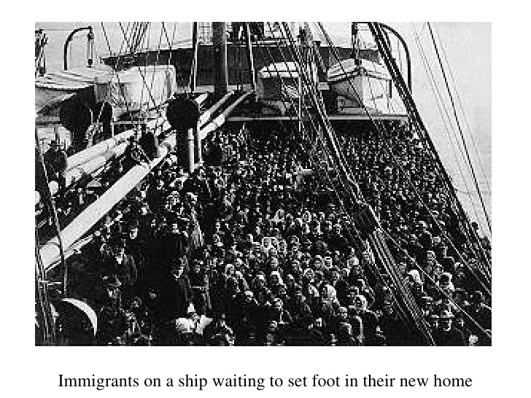
What were three positive and three negative effects of railroad explosion?
Positive:
Population increase in small towns.
Created more job opportunities.
Easier way of transportation to the West
Negative:
Destroyed Native american life
Increased pollution of natural landscapes.
Caused harsh working environment for the workers, accidents, diseases.

Slide 18
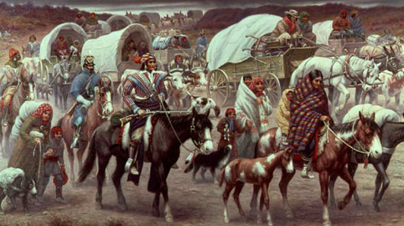
What effect did Western Expansion have on Native Americans?
Westward movement include the Native Americans having to give up their land, for the “white man” and their way of lif. The whites insisted in civilizing the Native American savages. Many Native American tribes were wiped out or removed to reservation far away from their land.

Slide 19
continued …...
The westward movement changed the way of life for Native Americans. Those moved west had to adapt to the land and climate. They had to become innovative and create organizations to safeguard their new way of life. While many people died while taming the West many others thrived and grew cities out of the once untamed territories. The Native Americans were forced to give up their way of life and their land.

Slide 20
What attempts were made during the Gilded Age to regulate industry and politics?
In 1887, congress passed the Interstate Commerce Act, which was created to oversee railroad activities. The act outlawed refunds and kickbacks. The bill had little effect. In 1890, congress also passed the Sherman Antitrust Act in an attempt to ban trusts , but this, too was an ineffective piece of legislation and was eventually replaced. The spoils system was widely used by both parties. Congress outlawed the political machines and parties struggled to become united again.

Slide 21
Compare and contrast the goals of the Granges, the farmers’ Alliance, and the Populists?
Granges- formed in 1867, a farmers’ protest in the south and midwest states against economic hardship and exploitation. It was a network of local organizations, employing cooperative practices and advocating ‘granger’ laws.
Farmers’ alliance (1880)- Designed to promote higher commodity prices through collective action by groups of individual farmers.
Populists- Based largely on its opposition to the gold standard. The farmers felt like they were not being represented and they wanted a say in the government.

Slide 22
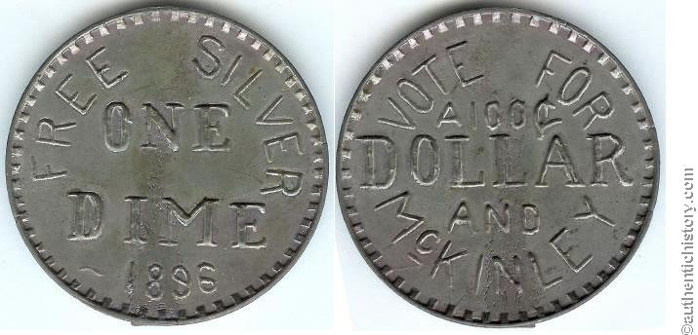
What types of people supported “free silver”? Why?
Free silver- Free, unlimited coinage of free silver, which would cause inflation.
Many populists(made up of farmers against capitalism, railroads, and banks) favored silver because it enabled debtors to pay their debts off in a cheaper way.
Farmers, laborers, and industrial workers usually had debts to pay and silver made it easier for them to pay.

Slide 23
Questions
Why is the gilded age significant?
What are the positives and negatives of the gilded age?
Why did the industry thrive in the gilded age?
Why were the businessmen referred to as robber barons?
How did the gilded age affect the Native American lives? Slaves?
How did the gilded age affect our lives today?
Sources : apush textbook chapter 17, http://www.digitalhistory.uh.edu/era.cfm?eraid=9, http://www.ushistory.org/us/36.asp, htthttps://www.youtube.com/watch?v=Spgdy3HkcSs ps://www.youtube.com/watch?v=A2d_zzadZD4,

