Slide 1
Ghana And Aksum
Dre
Jamon
Isaiah B
Jordan
Isaiah R

Slide 2
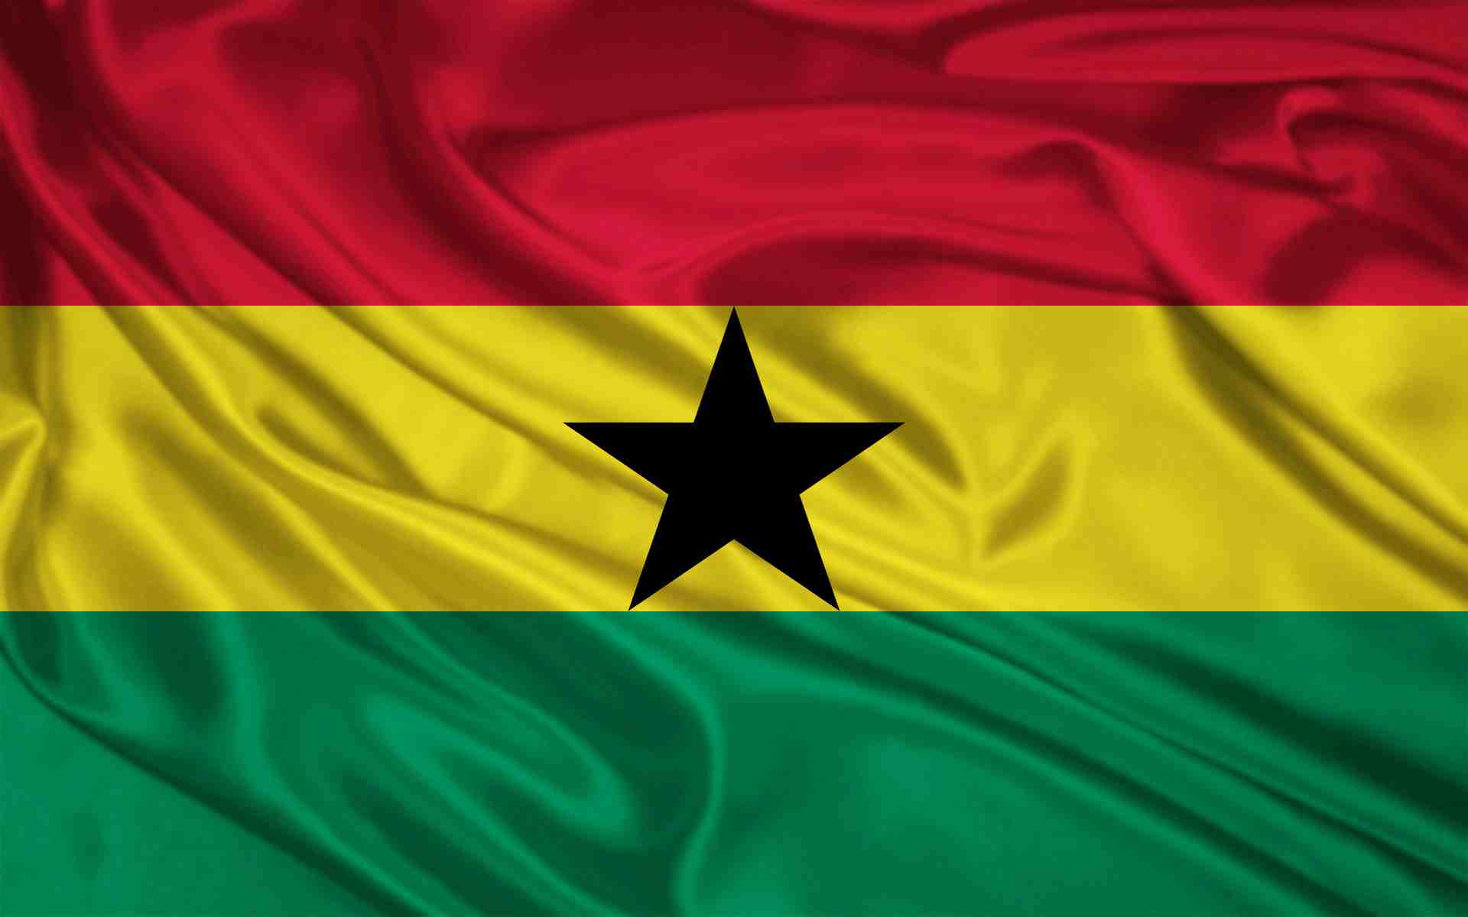
Ghana (before c. 830 until c. 1235)

Slide 3
Rise
Ghana rose to power as trade in gold and salt increased Ghana gained a lot of power built strong armies with top grade equipment which they used to take over merchants and north Africa

Slide 4
Geography
Ghana is located in West Africa
Size is equivalent to that of Oregon!!!
largest river in Ghana is the Volta
Ghana is a “natural gold mine’’

Slide 5
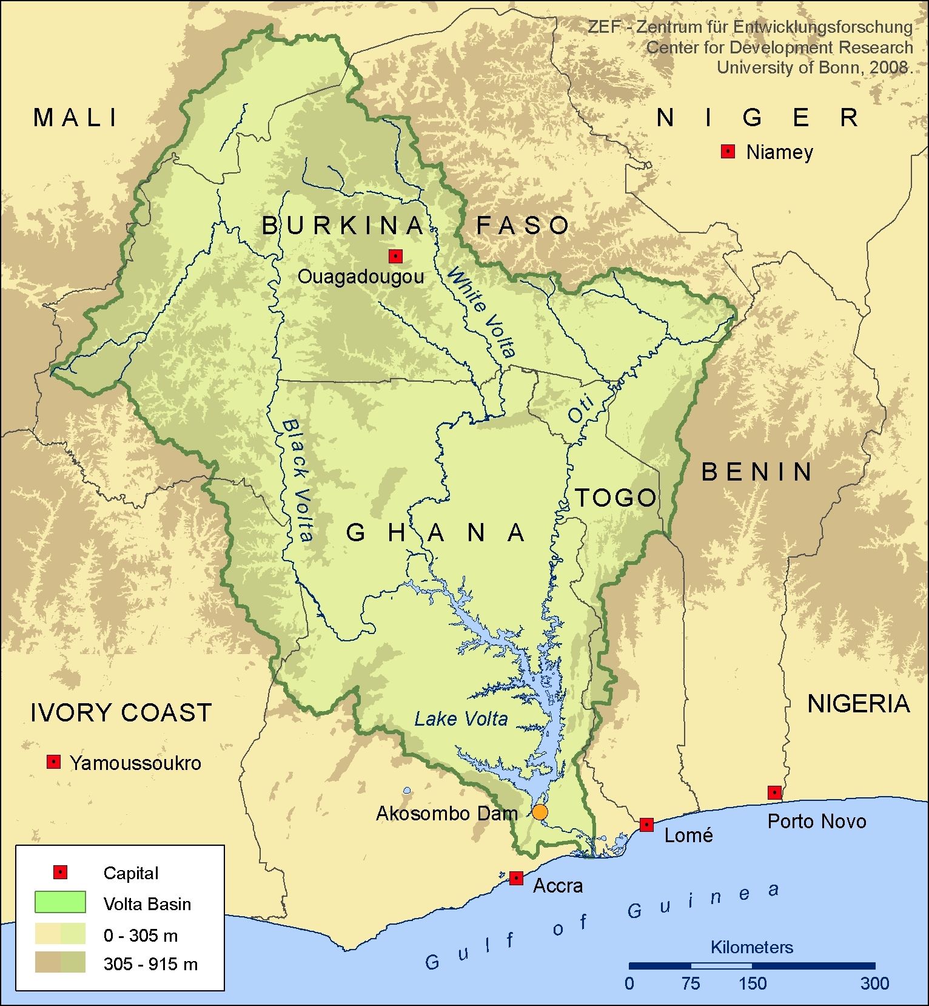
Volta River

Slide 6
Social
Africa speaks different languages especially Ghana including
Asonte
Ga
Fonte
Swahili
Triq

Slide 7
Political
Wealthy country because of their gold
President is John Dramani Mahama II
When kings ruled they had courts
These courts allowed people to vote/complain
Ghana achieved much with their trades Arabs

Slide 8
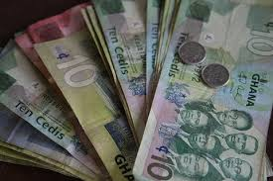
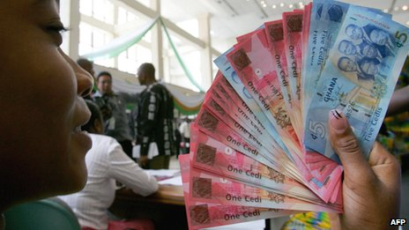
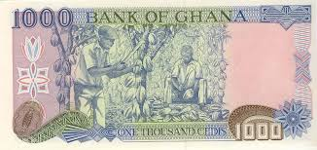
Currency Cedi

Slide 9
Religion
Islam's- religion practiced by Muslims
Believed that plants and animals had spirits
They believed in respect for ancestors
Disrespect leads to bad luck

Slide 10
Intellectual
They were introduced to camels
They began to urbanize and build schools
Timbuktu is the center of education etc.

Slide 11
Technology
First in Africa to create iron tools
Put gold collars on their dogs
Cloth manufacturing plants
Second largest producer of cocoa

Slide 12
Economy
The Monetary unit in Ghana is Cedi
They Currently have kings and queens
Ghana's economy is predominantly agricultural
The biggest cash crop is cocoa.

Slide 13
Collapse of Empire
Overgrazing was a huge part of Ghana's fall strong winds blew away soil forcing farmers to go out and find new land
It located in what is now Mali
They were conquered by the Sosso

Slide 14
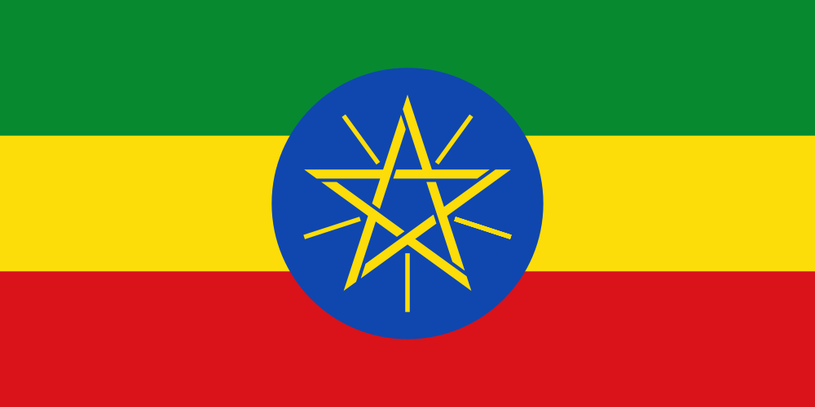
Aksum

Slide 15
Rise
Aksum's power came mostly from successful trading there titles grew Ezana, second ruler brought in Christianity and gave himself the nickname “ King of kings .

Slide 16
Geography
Located SE of Kush (East Africa)
Located on modern day countries Eritrea & Ethiopia
Very fertile land
Trade route on Nile

Slide 17
Social
Kings are the highest class
Priest was very important
Crafters and Farmers were the less fortunate
Junior kings ran smaller towns and cities

Slide 18
Political
Aksum was a pretty wealthy empire
Gained most of its wealth from trade
Empire had a strong army

Slide 19
Religion
Aksum's main three religions were:
Christianity
Muslim
Hebrew

Slide 20
Intellectual
Skilled architects and artisans
Language called Ge’ez
They were 1st to mint their own coins

Slide 21
Technology
Carved two churches from solid rock
Stone monument known as stelae
Most weapons in this empire made of iron

Slide 22
Economy
Resources enabled the country to maintain contacts with the world
Ethiopian traders exchanged gold, ivory, musk, and wild animal skins
For salt and luxury goods, such as silk and velvet
Most Ethiopians despised traders

Slide 23
Fall Of The Empire
The main factor leading to the decline of the kingdom was the Islamic Empire taking over control of the Red Sea.

Slide 24
Bibliography
http://archaeology.about.com/od/ironage/ig/The-Royal-Tombs-of-Aksum/Ethiopia-s-Emperors.htm
www.ask.com

