Slide 1
The Cold War
Jaren and Dekorey

Slide 2
What were the two main foreign policy issues facing America following World War II?
two main foreign policies following World War I were the forming of the United Nations and the division of Germany. The United Nations were meant to replace the League of Nations, the League of Nations was created to establish global peace. The other main foreign policy was the division of Germany, Germany separated into 4 zones. The British, United States, and France controlled the western region of the zones and The Soviet Union controlled the eastern region of the zones. The division of the zones showed a separation between communism and democracy.

Slide 3
To what extent were containment, NATO, and the Marshall Plan extensions of the Truman Doctrine?
The Truman Doctrine was one of the first policies concerning the Cold War. The Truman Doctrine stated the United States would support any democratic country that resisted communism, because of the Truman Doctrine more policies like NATO, Containment, and Marshall Plan. The Containment Plan was a plan made by George Kennan that wanted to implement long-term military, economic, and diplomatic strategies in order to contain the spread of communism. The North Atlantic Treaty Organization was a military alliance between the United States and Western European countries, this was to keep communism away from countries. The Marshall Plan was a plan to rebuild Western Europe after World War II. The plan helped stopped the growth of communism.

Slide 4
What international and domestic conditions led to the Red Scare
The rise of communism made people feel that the Soviet Union could not perform well alone so they had spies throughout the United States. When President Truman was President of the United States there was an attempt to get rid of Communists in America. The Truman Administration arrested communists that were in America. Truman also created the Loyalty Review Board which was made to investigate federal workers and see if they were spies for the Communist Party. Congress also investigated actors, directors, and writers in the entertainment industry, If they rejected to testify they would be blacklisted or arrested.

Slide 5
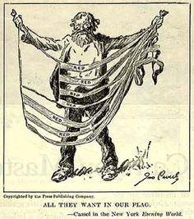
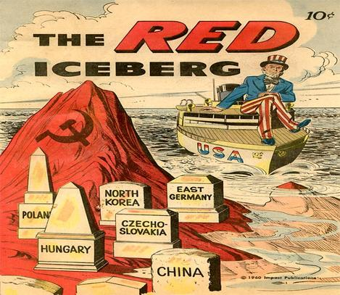

Slide 6
In what ways did Eisenhower’s “New Conservatism” translate to how the federal government dealt with labor relations
Eisenhower's “New Conservatism” was suppose to let businessmen hold new duties, be responsible for the action, not just from the loss of profit but from the loss of the communities. Eisenhower wanted to balance the budget after years of being in debt. He aspired to cut taxes, spending, and control the value of the dollar. Republicans were willing to keep inflation under control through the risk of unemployment. They ended up seeing the country undergo three recessions in 8 years.

Slide 7
During the 1950s in what ways was America taking steps forward toward racial integration?
During the 1950s America took steps forward racial integration because of the Brown vs. Board of Education which was a series of Supreme Court cases that overturned Plessy vs. Ferguson. Those cases signified that being separate was considered unequal. In 1955 when Rosa Parks was apart of the Montgomery Bus Boycott and refused to give up her seat. The first real test of integrating schools was in Little Rock, Arkansas. The “Little Rock NIne” enrolled into Central HS and the governor of Arkansas refused to segregate schools. President Eisenhower sent troops for the nine students to be escorted to school.

Slide 8
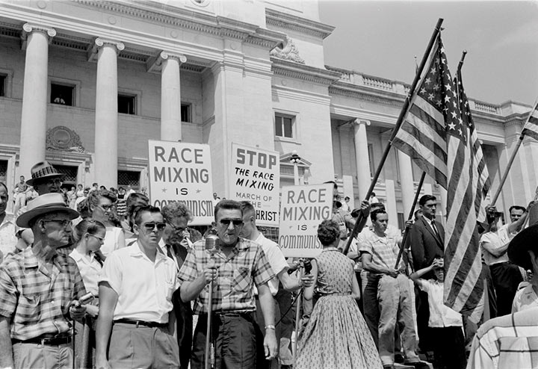

Slide 9
How did MacArthur and Truman differ on the handling of the Korean War
North Korea was divided by the 38th Parallel. United States were afraid that Communism would soon take North Korea and pose problems to other countries. The United Nations sent troops to South Korea, majority of them were U.S. troops. Macarthur was the appointed general that wanted to use atomic bombs to hit the mainland of China. Truman did not agree with this tactic and fired Macarthur.

Slide 10
What domestic policies did Eisenhower undertake during the 1950s
The 1950s was an era where the population exploded and the United States recovered from the World War. Woman would leave jobs to work back in the house. Television became popular and a lot more people started taking vacations away from home. People who did not fit in these types of stereotypes were seen as outcasts most of them were actors, musicians, and writers.

Slide 11
What were the various ideologies/policies of the 1950s to handle the spread of Communism
A few ideologies/policies created to help stop/spread the flow of communism was Mccarthyism which was the practice of accusing people of disloyalty, subversion, or treason without proper proof. Another ideology was Peaceful Co-existence which was the idea that Democracy and Communism can both exist in the world without harming anybody. The Geneva Summit was a gathering of world leaders to discuss on how to keep and maintain peace in the world. A policy was the Eisenhower Doctrine which stated that a Middle Eastern could request U.S. assistance if they felt threatened.

Slide 12
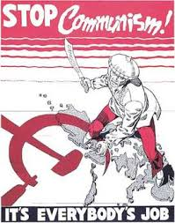

Slide 13
In what ways did America respond to nationalism in Third World nations
America responded to nationalism in third world countries by supporting government coups in Latin America. The United States planned to replace the governments with US friendly regimes.

Slide 14
What were links between Kennedy’s “New Frontier” and Johnson’s “Great Society”?
They were both their domestic policy programs. Both had on eye on fixing the problems with poverty and unemployment. Johnson wanted to keep doing what President Kennedy started.

Slide 15
To what extent was Cuba the sight of Kennedy’s greatest foreign policy success and worst foreign policy fiasco
The Cuban Missile Crisis was a success in Kennedy's foreign policy because he prevented war with Cuba and the Soviet Union .The biggest disappointment was the Bay of Pigs, it damaged the United States credibility badly. This happened because the Cuban Exiles were actually trained by the CIA.

Slide 16
To what extent was Johnson more successful with his social programs than Kennedy
Johnson was more successful because he added more policies to his “Great Society” he added Preschool education for the disadvantaged, Johnson also signed legislation protecting civil liberties for African Americans.

Slide 17
During the 1960’s how did african american methods of attaining equality evolve
During the mid 1960’s civil rights activists used nonviolent protests and civil disobedience to bring change , and the federal government created the voting rights act of 1965 which gave african americans the right to vote and the civil rights act of 1968 prohibited discrimination concerning the sale, rental and financing of housing based on race, religion, national origin and sex. while in this time period several african american icons came into popularity in the black community .

Slide 18
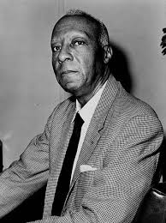
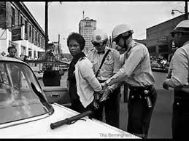
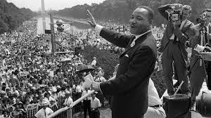
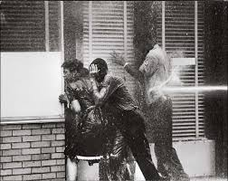
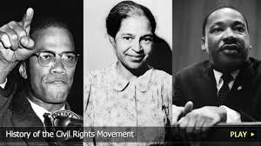
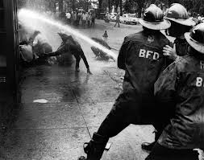

Slide 19
What elements of the protest created the new left
The new left started a civil right activist group . It started at the University of Michigan . Their goals were to influence african americans to become registered voters . The new left also apart of the counterculture and young people started protesting the vietnamese war and voicing their opinions .

Slide 20
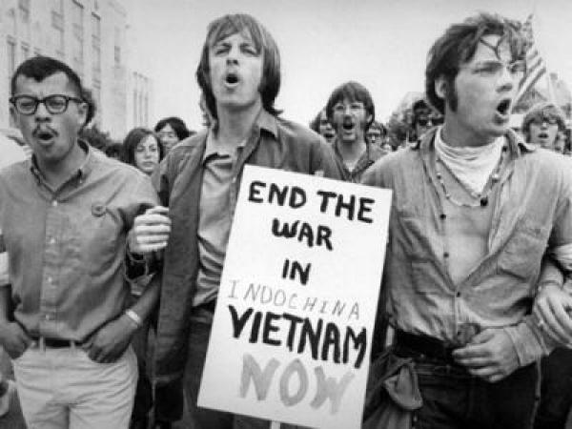

Slide 21
How did Johnson’s handling of Vietnam differ from that of his predecessors
John F kennedy and eisenhower sent supplies and military officers to South Vietnam. with the signing of the Gulf of Tonkin Resolution, Johnson was given unlimited powerin a time of war. Johnson began sending troops to Vietnam to help contain communism.

Slide 22
Why was 1968 considered a turning point in American history?
1968 was a year of riots, rebellion, assassinations, and political and economic change. Martin Luther King, Jr was assassinated as well as John F. Kennedy. Nixon defeated Humphrey in one of the closest elections in history. The United States also saw the height of the protest against the war in Vietnam. Young students conducted protests against the war and there was violence on many campuses.

Slide 23
What strategy was employed by Nixon to end American involvement in Vietnam?
Vietnamization was the withdrawal of troops from Vietnam and giving the burden of the war to the South Vietnamese. Kissinger the National Security Advisor, had secret negotiations with North Vietnamese and in 1973, the two countries reached an agreement the Paris Accords . The paris accords was intended to establish peace in Vietnam and an end to the Vietnam War

Slide 24
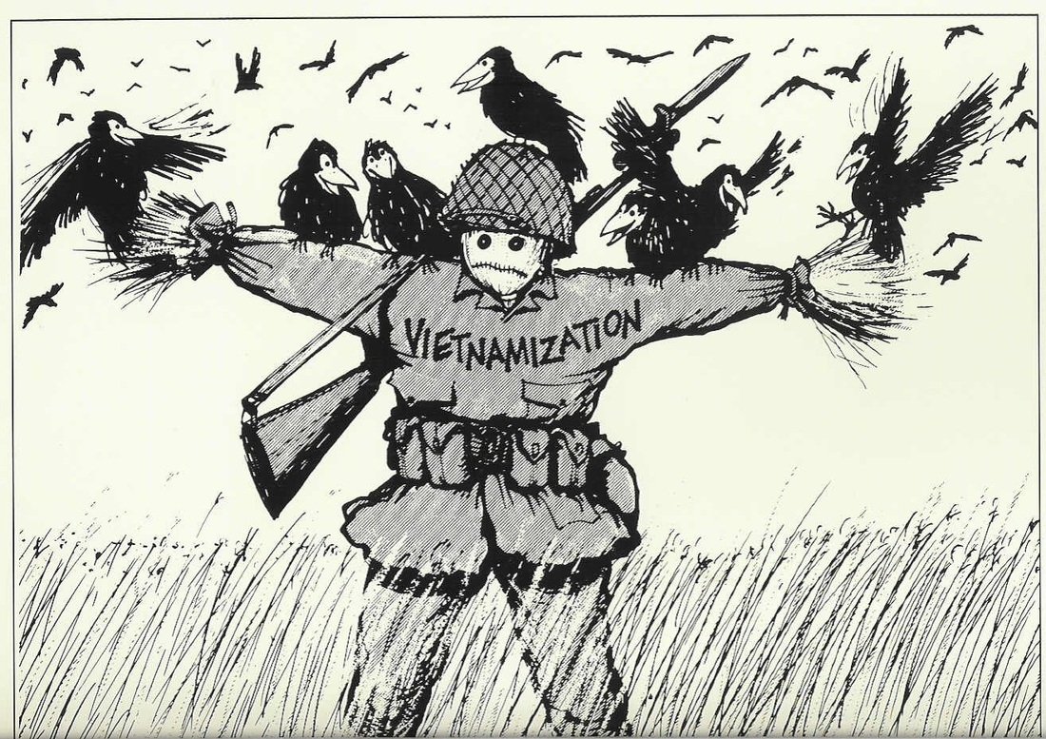

Slide 25
What events led to nixons resignation?
The Watergate Scandal was whenNixon feared being a one and done president. Five men broke into the Democratic National Office at the Watergate Complex. The break-in was covered up and Nixon announced he did not have any knowledge of the break-in . Nixon's popularity diminished and he finally turned over the tapes.Nixon resigned on August 1974.

Slide 26
What events led to Nixon's resignation?
The Watergate Scandal: Nixon didnt want to be a one and done president . Five men broke into the Democratic National Office at the Watergate Complex. The break-in was covered up and Nixon announced he did not know anything of the break in . Members of the White House testified to the Senate that Nixon knew about the cover up. Nixon's popularity fell and he finally turned over the tapes . Nixon resigned on August 1974. Gerald Ford replaces Nixon and he becomes the only president not elected to the role of president or vice-president in American history.

Slide 27
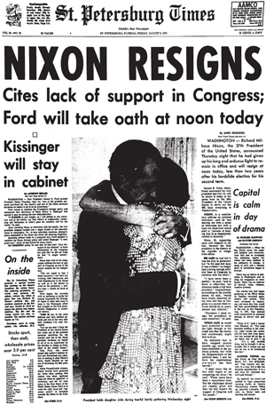

Slide 28
What foreign and domestic problems were blamed on Carter?
Iran Hostage Crisis -Because the Shah was allowed to come to the United States, the Embassy in Tehran was raided and 66 Americans were taken hostage. Americans attempted a rescue, but failed when the commandos lost control because of the helicopter. The hostages were not released until President Reagan's inauguration Day .
Domestic problems - Inflation was the primary issue. The American economy experienced both an increase in inflation and slowing economic growth. Adding to this was a rising unemployment. There was also increasing prices of gasoline due to the 1973 Arab oil embargo and 1979 revolution in Iran.

Slide 29
What were the negative effects of Reaganomics
National Malaise: An overall feeling of weakness or illness in the nation. Reagan implemented his economic policy of Reaganomics . The key goals were to reduce federal tax rates for businesses and wealthy American peeps . This led to a large increase in the incomes of upper class Americans. He also called for reduction of corporate tax rates, encouraged private investment and deregulation of over industries . Although this as not an overnight fix, the United States economy was improving by 1983. The GNP rose and inflation fell.

Slide 30
What role did America have in third world nations during the 1980s
The United States mainly supported the nations who were on the opposition of communism . The United States helped the following countries in their time of need Korea, Turkey, Tunisia and Costa Rica. For example .the United States bombed Libyan airbases and Libyan gunboats challenged American ships sailing close to Libya

