Slide 1
(1206-1368)
The Mongol Empire
By: Shiloh Shalom
And
Collin Weidman

Slide 2
The Mongol empire
The Mongol empire was originally a tribe of nomads that grew until it could build and sustain a sizable army, at which point they began to rise to power and overthrow other kingdoms. Although much of the data in the sources concerning the number of people killed during the Mongol conquests is exaggerated, it does reflect the reality that thousands died, and the Mongols were not above depopulating an area if the people rebelled, or if destruction simply suited their purpose.

Slide 3
G- Geography
The Mongolian empire stretched from southeast Asia to eastern Europe.
southeast Asia has rainforests, a wet climate and minor volcanic activity
It is surrounded by two seas, the south china sea and the Philippine sea.
Mongolia today is high, cold, and dry. It has an extreme continental climate with long, cold winters and short summers.

Slide 4
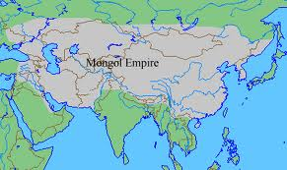

Slide 5
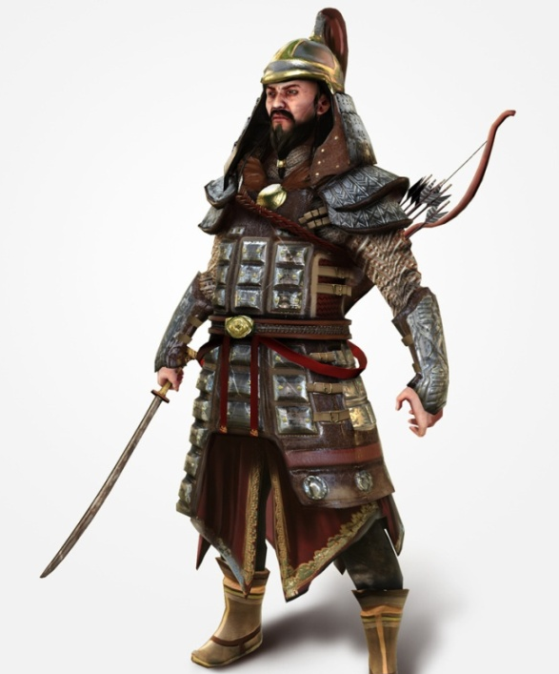
S- Social
Mongols were one tribe among many, that then united under Genghis khan (AKA chinngis khan)
-known as history’s most brutal
leader
broke into four different regions after
the death of Genghis khan.
Social organization focused on the family
of Genghis khan.
Women were treated unfairly, seen only as
tools for birthing and raising children ,

Slide 6
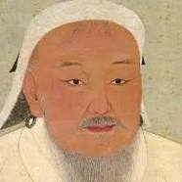
Genghis khan (1162-1227)
Birth name: Delüün Boldog
(or temujin)
Genghis khan means “universal ruler”
He decreed the adoption of the
“Uyghur script” as the Mongol empire’s writing system
Present day Mongolians regard him as the founding father of Mongolia
Before Genghis Khan died, he assigned Ögedei Khan as his successor and split his empire into khanates among his sons and grandsons

Slide 7
P- political
Government initialized by genghis khan
-Chose his successors,
-helped transition to democracy
Some believe many institutions of the ottoman state were inspired by Mongol practices.
Genghis khan was the leader of the early mongol army, until he died in 1227.

Slide 8
R- Religion
Religiously, mongols were “shamanistic”
They didn’t believe in eternal life or damnation
but they believe that after death they will live in another world and eat and drink.
In addition, a cult surrounding genghis khan emerged, earning his “demi-god” status among some mongols.
There were also some buddhists, in rare cases.

Slide 9
I- Intelligence
Mongols had knowledge of:
History
geography
Art
Medicine (primarily from other countries.)
Astronomy
Crude agriculture

Slide 10
T- technology
Items such as
Ceramics
Gunpowder
Mechanical printing
Blast furnaces
The Mongols also created weapons such as swords, bows, caltrops, maces, and spears.

Slide 11
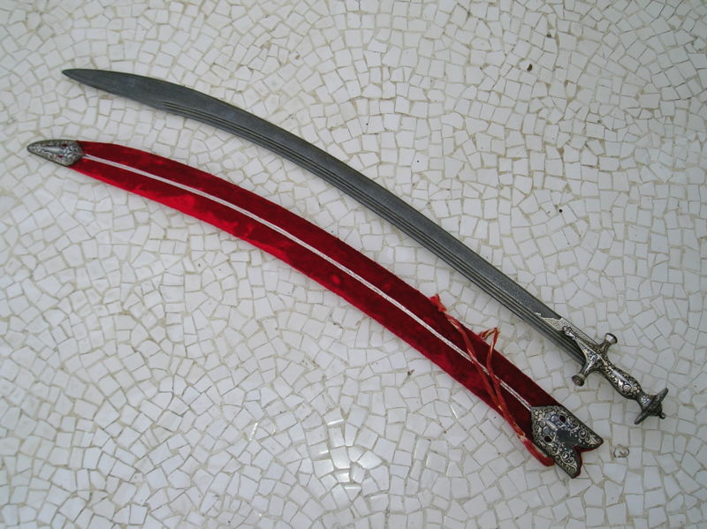
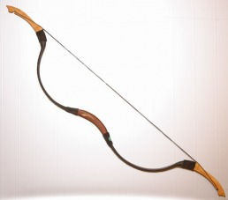
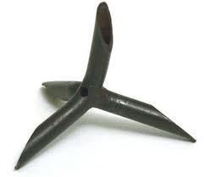
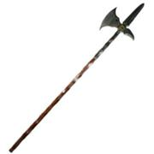
Weapons

Slide 12
E- Economy
the Mongols gained their wealth primarily through trade
Mongols traded on the silk road.
Some Mongolians traveled, as merchants to other countries.
What they did not gain through trade, they did through pillaging the places they overthrew.

Slide 13
Rise to power
The Mongol empire started when Delüün Boldog, a young warrior, brought together the many nomadic tribes of northeast Asia.
After founding the Mongol Empire and being proclaimed "Genghis Khan," he started the Mongol invasions that resulted in the conquest of most of Eurasia.
These included raids or invasions of the Kara-Khitan Khanate, Caucasus, Khwarezmid Empire, Western Xia and Jin dynasties

Slide 14
Achievements while in power
The Mongols’ conquest campaigns were often accompanied by the massacres of the native population – especially in the Khwarezmian controlled lands. By the end of his life, the Mongol Empire occupied a substantial portion of Central Asia and China.
As a result Genghis Khan and his empire have a fearsome reputation in local histories.

Slide 15
Fall from power
The yuan dynasty (formerly part of china) fell when Kublai khan sent the Mongol army out to wars of which they were outnumbered and unprepared.
More military losses made the Mongol army weak and vulnerable.
In 1368, a rebel army defeated the weakened mongols.

