Slide 1
The Furnace of Civil War

Slide 2
Bull Run Ends the “Ninety-Day War”
The North (as well as the South) expected a short war, about 90 days.
The Battle of Bull Run (AKA Battle of Manassas) squashed the short-war theories.
Neither side was properly prepared. Many citizens picnicked along the edge of the battle as though tailgaiting at a sporting event.
The battle went back and forth at first but Gen. Thomas "Stonewall" Jackson's men held their line and earned him his nickname.
The North fell into a hectic retreat. The South was just as disorganized and thus could not pursue.
On paper the South won, but the importance of Bull Run is that it showed each side the necessity of planning and preparation. The war then took a 9 month "time-out" for prep.

Slide 3
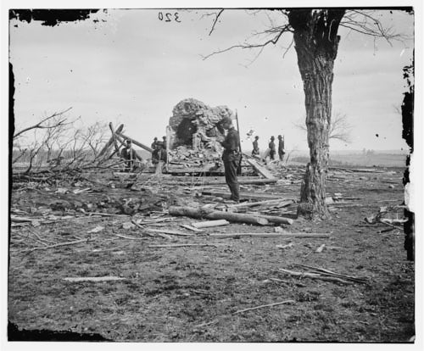
Confederate snipers used the house; Judith Henry was killed by a Union bullet meant for the snipers. She was the first civilian killed at First Bull Run, July 21, 1861. The Second Battle of Bull Run was also fought on this hill. (These battles are also sometimes called the First and Second Battles of Manassas.)

Slide 4
“Tardy George” McClellan and the Peninsula Campaign
34 year old Gen. George McClellan was a master organizer and planner. He was put in charge of getting the U.S. Army ready.
McClellan's weakness was that he never felt as though he'd prepared enough. He was always preparing, never fighting.
Lincoln got tired of waiting around, said McClellan had "the slows", and ordered him to take action.
McClellan's plan was to take Richmond, VA, the capital of the South. He still felt the North could win in one large battle and by taking the capital would likely accomplish that goal. He nearly pulled it off.

Slide 5
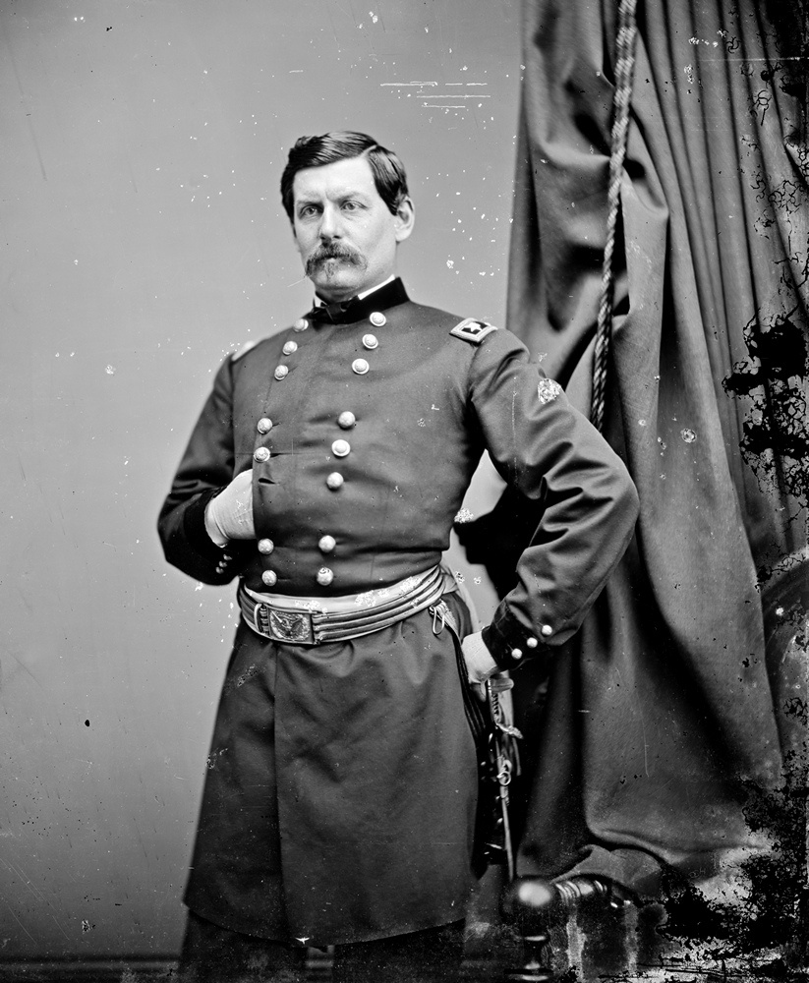
General McClellan

Slide 6
The Peninsula Campaign ensued. The North moved by sea to and then up the historic Yorktown peninsula.
Lincoln sent McClellan's reinforcements to guard Washington D.C. from Stonewall Jackson's bluff attacks.
Confederate Jeb Stuart's calvary rode completely around McClellan (it was a major no-no to allow such a thing).
Robert E. Lee struck back in the Seven Days' Battles and pushed McClellan back to the sea—a major win for the South. Casualties were in the ten-thousands and McClellan was demoted.

Slide 7
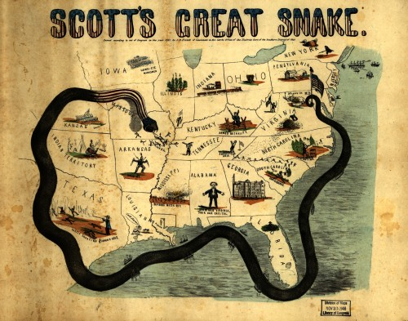

Slide 8
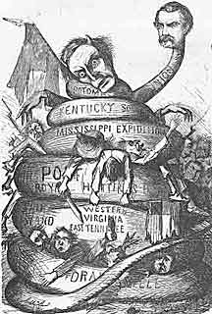

Slide 9
Lincoln began to move toward a draft to free the slaves. With the quick-strike plan a failure, the North now turned to total war. Summed up, the plan was to blockade, divide, and conquer. The specifics were to…
Put a naval blockade the South.
Free the slaves.
Divide the South along the Mississippi River.
Divide and crush the South by marching through Georgia and the Carolinas.
Capture the Southern capital of Richmond.
Engage the enemy anywhere possible and grind them into submission.
This plan was essentially Gen. Winfield Scott’s “Anaconda Plan” (a derogatory term that implied it was too slow). It was exactly what happened over the next four years.

Slide 10
The War at Sea
The North's blockade had many leaks. As the war went on, the blockade tightened up.
Britain could've run through it but chose to honor it. They didn't want to possibly get into a war.
"Running the blockade", or sneaking goods through, was risky but profitable business.
Smugglers often used the Bahamas as jumping-off points before entering the Confederacy. The ship papers would often have Canada as the destination but just sneak into the South.
Northern blockade-busters would often board British ships for an inspection. If the goods were thought destined for the South, they were seized. Britain complained, but never went beyond words.

Slide 11
Southerners created a legitimate threat to the blockade with the C.S.S. Merrimack.
The Merrimack was an ironclad—a ship heavily armored with iron and thus greatly protected from cannon fire.
The North responded with the Monitor, also an ironclad.
The Monitor and the Merrimack battled in Chesapeake Bay March 9, 1862. The Merrimack was chased away. The battle was a turning point in naval history in that…
…it showed that (a) the days of wooden ships were ending and (b) the days of sailing vessels were changing to steam.

Slide 12
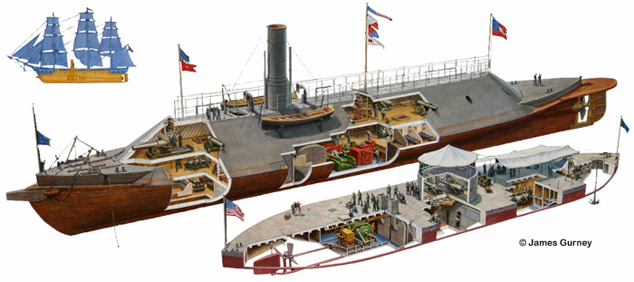

Slide 13
The Pivotal Point: Antietam
Shortly after the Peninsula Campaign, General Lee struck at Second Battle of Bull Run. Lincoln had placed Gen. John Pope in command.
Gen. Pope "talked a good game", but was beaten badly by Lee and the South at Bull Run II.
At this point, the South was clearly winning the war. But, Lee made his first mistake…he decided to invade the North at Antietam (AKA Sharpsburg, MD). The reason's for his decision were…
(a) to perhaps lure the Border States to the South, (b) to draw the war out of Virginia during the harvest season,
a victory on Northern soil would, (c) boost Southern morale and hurt Northern morale, and (d) perhaps stir up foreign/British support for the South.

Slide 14
Lincoln put Gen. McClellan back in charge.
Just prior to the fighting, Lee's battle plans were accidentally lost then luckily found by the North. Lee and the South lost the Battle of Antietam Creek, one of the largest battles of the war, on September 17, 1862.
This battle was critical. If the South had won, they just might have won the entire war. And, the North's victory likely convinced Europe to stay out of the war.
Also, it gave Lincoln a much awaited victory and a platform to announce the Emancipation Proclamation to free the slaves.
The Emancipation Proclamation gave the North's fight a moral foundation. The previous cause for the war was to force the South to remain with the North, against the South's will. After the Proclamation, the cause for war was to restore the nation and to end slavery.

Slide 15
“No other campaign and battle in the war had such momentous, multiple consequences as Antietam. In July 1863 the dual Union triumphs at Gettysburg and Vicksburg struck another blow that blunted a renewed Confederate offensive in the East and cut off the western third of the Confederacy from the rest. In September 1864 Sherman's capture of Atlanta reversed another decline in Northern morale and set the stage for the final drive to Union victory. These also were pivotal moments. But they would never have happened if the triple Confederate offensives in Mississippi, Kentucky, and most of all Maryland had not been defeated in the fall of 1862.”
— James M. McPherson, Crossroads of Freedom,

Slide 16
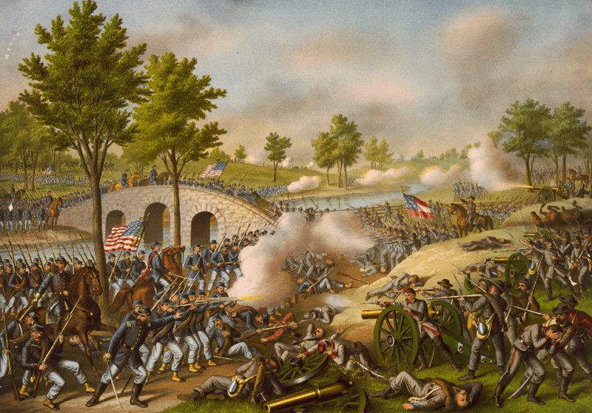

Slide 17
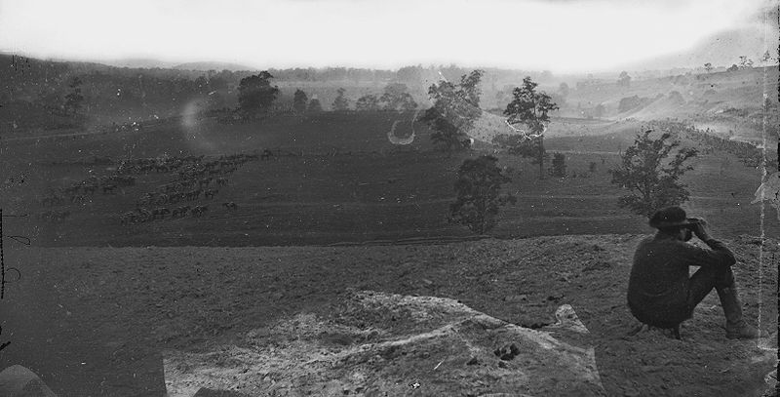

Slide 18
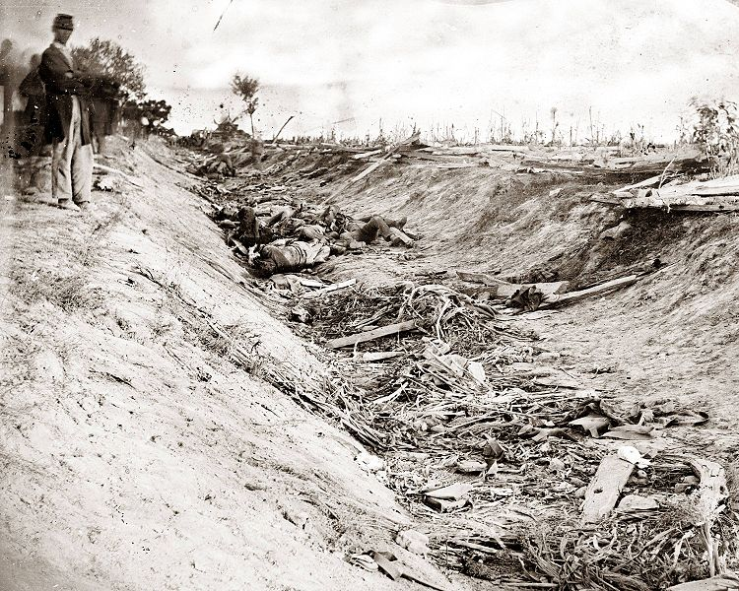

Slide 19
A Proclamation Without Emancipation
The Emancipation Proclamation had a few "hiccups" tied to it.
It freed the slaves only in the seceded Southern states. But, it did not free the slaves in the Border States. Lincoln specifically made this point because he did not want to anger the Border States and make them join the South.
The South considered itself a separate nation from the North. Why would anything a "foreign" president says be binding over them? In order for the Proclamation to go into effect, the North would have to win the war.

Slide 20
Also, there were legal issues tied to the Proclamation. Did Lincoln actually have the authority to free the slaves? The short answer is, "No." The Constitution at the time did support slavery. A president cannot simply make a proclamation and undue the Constitution. This fact would be evidenced by the 13th Amendment right after the war, which freed the slaves. If the Proclamation had legally freed the slaves, there would've been no need for Amendment 13.
Still, the Emancipation Proclamation was huge, if only symbolically, and gave the war its moral cause.
Practically, there were effects of the Proclamation.
If, and when, word of the Proclamation got to the slaves' ears, many slaves itched to up and leave. The Southerners complained that Lincoln was inciting slave rebellion.

Slide 21
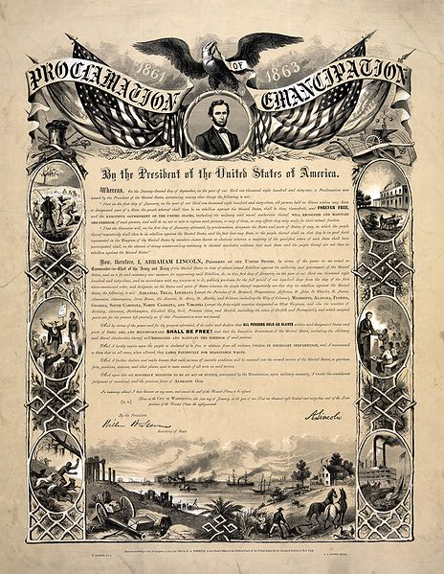

Slide 22
"That on the first day of January, in the year of our Lord one thousand eight hundred and sixty-three, all persons held as slaves within any State or designated part of a State, the people whereof shall then be in rebellion against the United States, shall be then, thenceforward, and forever free; and the Executive Government of the United States, including the military and naval authority thereof, will recognize and maintain the freedom of such persons, and will do no act or acts to repress such persons, or any of them, in any efforts they may make for their actual freedom." ...I, Abraham Lincoln, President of the United States, by virtue of the power in me vested as Commander-in-Chief, of the Army and Navy of the United States in time of actual armed rebellion against the authority and government of the United States, and as a fit and necessary war measure for suppressing said rebellion, do....order and declare that all persons held as slaves within said designated States, and parts of States, are, and henceforward shall be free
...And I hereby enjoin upon the people so declared to be free to abstain from all violence, unless in necessary self-defence; and I recommend to them that, in all cases when allowed, they labor faithfully for reasonable wages.
And I further declare and make known, that such persons of suitable condition, will be received into the armed service of the United States to garrison forts, positions, stations, and other places, and to man vessels of all sorts in said service. And upon this act, sincerely believed to be an act of justice, warranted by the Constitution, upon military necessity, I invoke the considerate judgment of mankind, and the gracious favor of Almighty God. By the President: ABRAHAM LINCOLN WILLIAM H. SEWARD, Secretary of State.

Slide 23
Blacks Battle Bondage
In the early years of the war, African-Americans were not allowed to enlist in the army. But, as numbers declined, the North opened up the army to black soldiers. They'd eventually comprise 10% of the Northern army.
Southern forces largely just executed black soldiers as opposed to the usual custom of treating captured enemies as prisoners-of-war. Black soldiers were even massacred after surrendering at Ft. Pillow, TN.
This event sparked the outcry by African-Americans, "Remeber Ft. Pillow!"
Emancipation came to Southern blacks when the Northern army came. The Emancipation Proclamation didn't simply release and allow slaves to walk off the plantation. The force of the U.S. army freed the slaves as it marched forward

Slide 24
Fort Pillow Massacre: April 12, 1864
On April 12, Forrest’s force, estimated at 1,500 to 2,500 troops, quickly overran the fort, suffering only moderate casualties. Though most of the Union garrison surrendered, and thus should have been taken as prisoners of war, some 300 soldiers were killed, the majority of them black. The Confederate refusal to treat these soldiers as traditional POWs infuriated the North, and led to the Union’s refusal to participate in prisoner exchanges.
Union survivors’ accounts, later supported by a federal investigation, concluded that African-American troops were massacred by Forrest’s men after surrendering. Southern accounts disputed these findings, and controversy over the battle continues today.

Slide 25
Lee’s Last Lunge at Gettysburg
Gen. A.E. Burnside (the originator of "sideburns") was put in charge of the Northern army following Antietam.
He was defeated soundly at Fredericksburg, VA when Union troops tried to swarm up a hill held by Confederates.
Gen. Joseph Hooker was then placed in charge but was also defeated at Chancellorsville, VA.
Gen. Lee was outnumbered but he out-maneuvered Hooker by splitting his forces and then sending Stonewall Jackson around to attack the flanks.
Jackson was wounded by his own men there and later died.
This battle is largely regarded as Gen. Lee's most impressive win.
Gen. George Meade was then placed in charge of the Northern army. Lee invaded the North again, met Meade at Gettysburg, PA.
The Battle of Gettysburg lasted 3 days (July 1-3, 1863). The South won the first 2 days by pushing the North out of town and into the hills.
The North won the 3rd day and the overall battle. The 3rd day was highlighted by Pickett's Charge where Gen. Lee futilely sent 15,000 Southern troops across an open field.

Slide 26
Gettysburg was "the big one". Although the war would drag on two more years, it essentially broke the back of the South and started the "countdown clock".
In the autumn, Lincoln returned to Gettysburg to give the Gettysburg Address. The purpose of the 2 minute speech was to rally the troops, boost morale, and assert that the men who'd died hadn't die in vain.

Slide 27
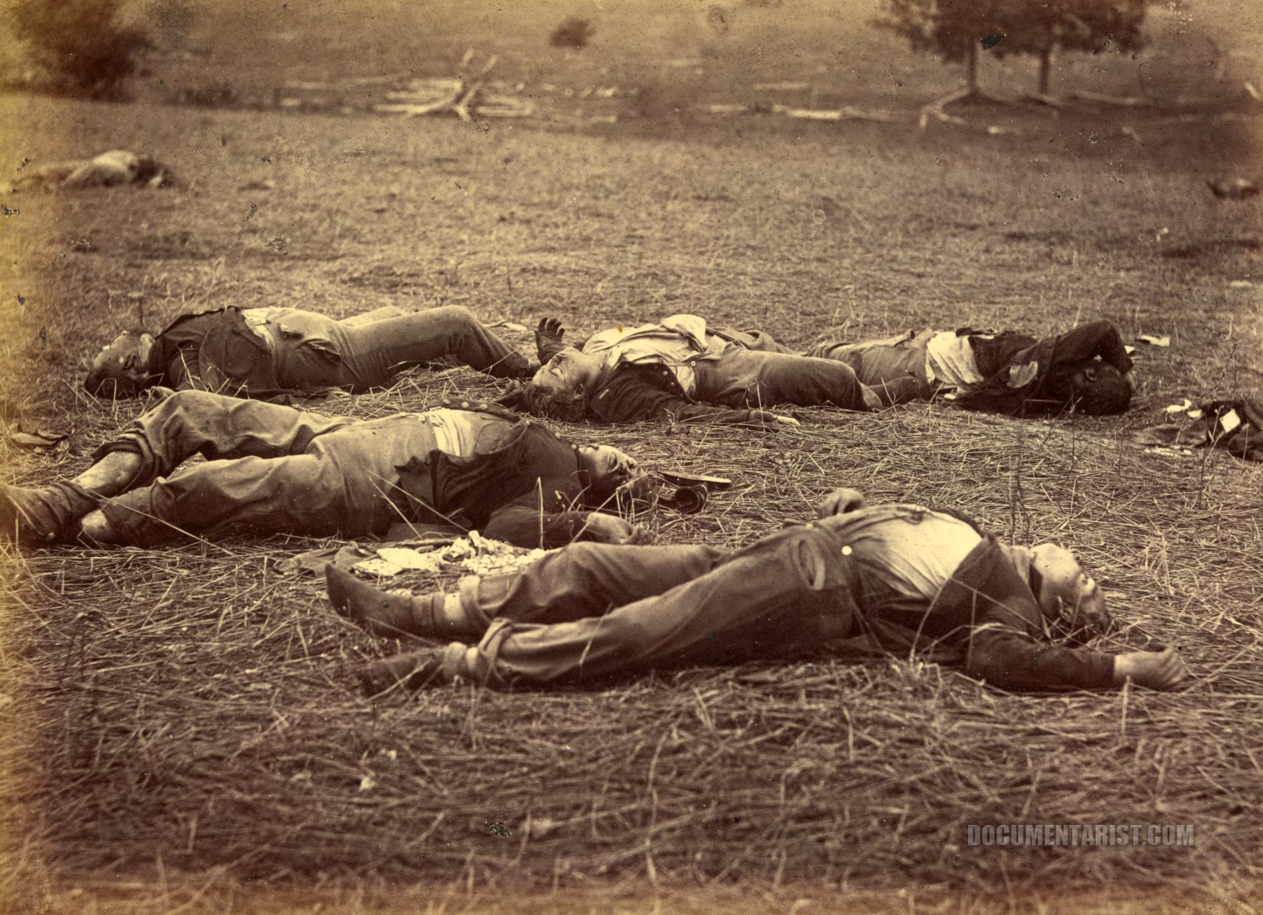

Slide 28
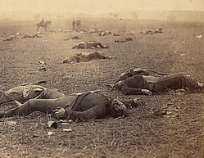

Slide 29
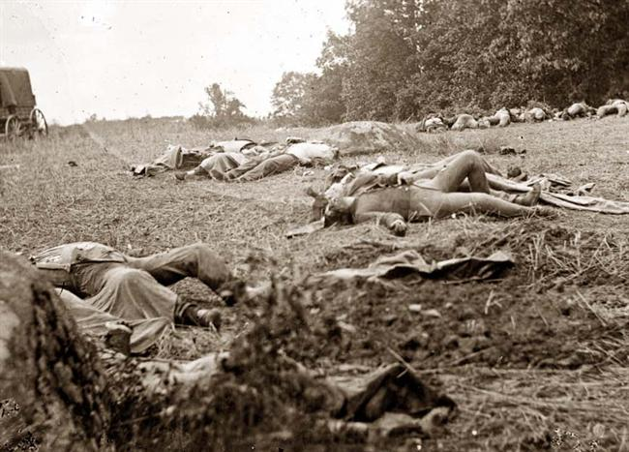

Slide 30
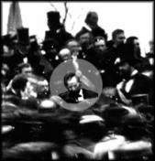

Slide 31
The War in the West
Lincoln was having terrible luck finding a general to get the job done. His answer was finally found in Gen. Ulysses S. Grant.
Grant had been mediocre to slightly above average most of his career.
He came on the scene by achieving "Unconditional Surrender" early in the western theater of the Civil War (the term stuck as his nickname due to his initials: U.S. Grant).
Grant was demoted after nearly getting wiped out at the Battle of Shiloh.
His big break and redemption came at Vicksburg, MS where he circled around the city, took the capital of Jackson, MS, and then seized Vicksburg.
Vicksburg came one day after Gettysburg and certainly pointed toward a Northern win. Also as certain, Southern hopes for foreign intervention were gone—no country helps the losing side in a war.

Slide 32
Sherman Scorches Georgia
The plan of "blockade, divide, and conquer" was coming to fruition.
The blockade was in place, the South was being divided down the Mississippi River, and now was to be divided through Georgia.
Gen. William Tecumseh Sherman was put in charge of dividing the South by land.
He pushed down from Chattanooga, TN and captured Atlanta, GA. Atlanta was burnt to the ground.
Sherman then led his "March to the Sea". He spread out his men and scorched Georgia from Atlanta to Savannah on the coast. Everything was destroyed—farms, houses, crops, railroads, warehouses, fields, etc.
Sherman declared "total war" meaning that even civilian property was to be destroyed. Thus the "conquer" part of the "blockade, divide, and conquer" plan was also being played out

Slide 33
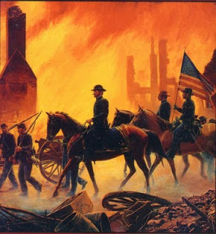

Slide 34
The Politics of War
Lincoln had his opponents up North, even among his fellow Republicans.
"Radical Republicans" felt Lincoln wasn't doing enough to win the war, help blacks, or punish the South.
Northern Democrats split over the war.
"War Democrats" supported Lincoln and the war.
"Peace Democrats" opposed Lincoln (calling him the "Illinois Ape") and the "Nigger War" that he led.
Clement L. Valandigham was Lincoln's loudest opponent. He leaned toward the South, was tried for treason, shipped down South, fled to Canada, there ran and lost a bid for governor of Ohio, then returned to Ohio.
This odd scenario inspired the fictitious story "The Man Without a Country."

Slide 35
The Election of 1864
War or not, elections go on. The 1864 presidential election saw Lincoln take on Gen. George McClellan (whom Lincoln had fired).
McClellan was the Democratic candidate. His position was that Lincoln was mismanaging the war.
Lincoln's most vicious opponents were called "Copperheads" since they "struck at Lincoln's heels." These critics usually came from the "Butternut Region"—southern Illinois, Indiana, and Ohio.

Slide 36
Lincoln would come out victorious in his 1864 re-election because…
He cleverly invented the "Union Party" which joined Republicans with War Democrats.
He came up with the simple but clear slogan: "You don't change horses midstream."
Union forces scored victories in New Orleans and Atlanta just prior to the election.
The popular vote was 212-21, the electoral vote was 2.2 million to 1.8 million.

Slide 37
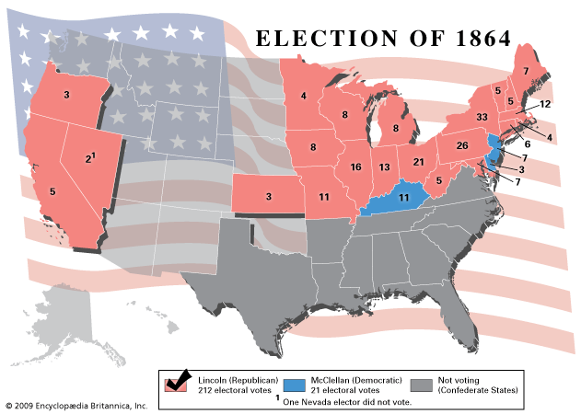

Slide 38
Grant Outlasts Lee
Ulysses S. Grant was known as the "meat-grinder" because he was willing to keep sending his men into battle even though they'd be killed. His motto was, "When in doubt, fight."
He was willing to sacrifice twice as many casualties as his enemy because he knew the South could not sustain the fight as long as he could.
Grant outlasted Lee over a string of battles including: The Wilderness, Spotsylvania Courthouse, Cold Harbor,and Petersburg.
These battles were known for being very bloody. They earned nicknames like the "Bloody Angle" and "Hell's Half Acre".
At Cold Harbor, soldiers pinned their names and addresses onto their backs. 7,000 men died in a few minutes.

Slide 39
Richmond, VA, the capital of the South, finally fell and was destroyed.
In April of 1865, surrounded, Gen. Lee surrendered to Gen. Grant at Appomattox Courthouse in Virginia.

Slide 40
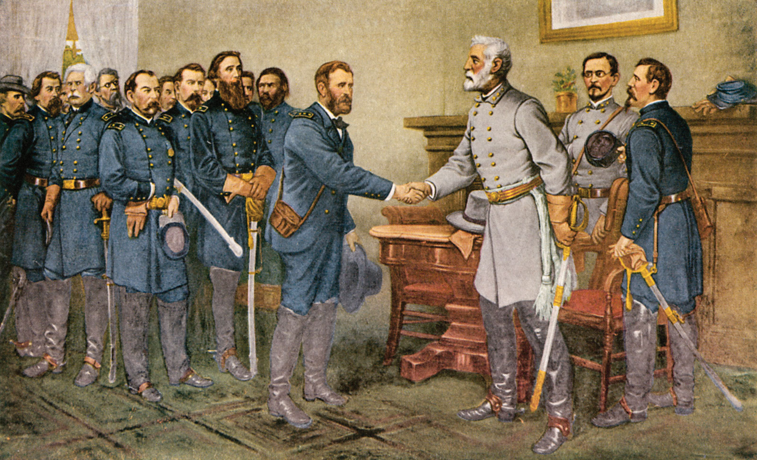

Slide 41
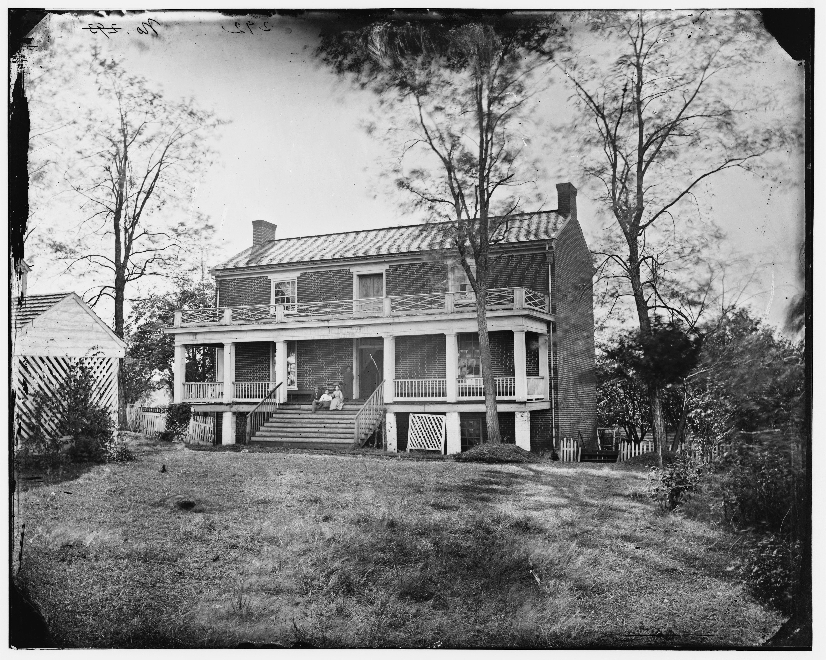

Slide 42
The Martyrdom of Lincoln
Only a few days after the South's surrender, Lincoln was assassinated. He was shot by John Wilkes Booth in the head while attending a play at Ford's Theatre in Washington.
Lincoln became an instant martyr—a hero who died fighting for the nation and freedom of blacks.
Southerners were glad to be rid of Lincoln. But, as irony would have it, things would turn much tougher for the South without Lincoln. The Radical Republicans who replaced Lincoln's authority were much less forgiving than Honest Abe would've been

Slide 43
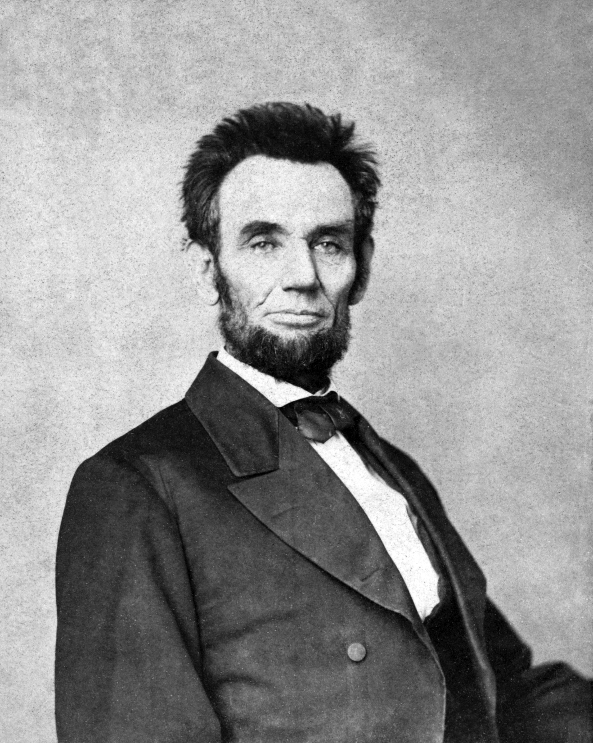

Slide 44
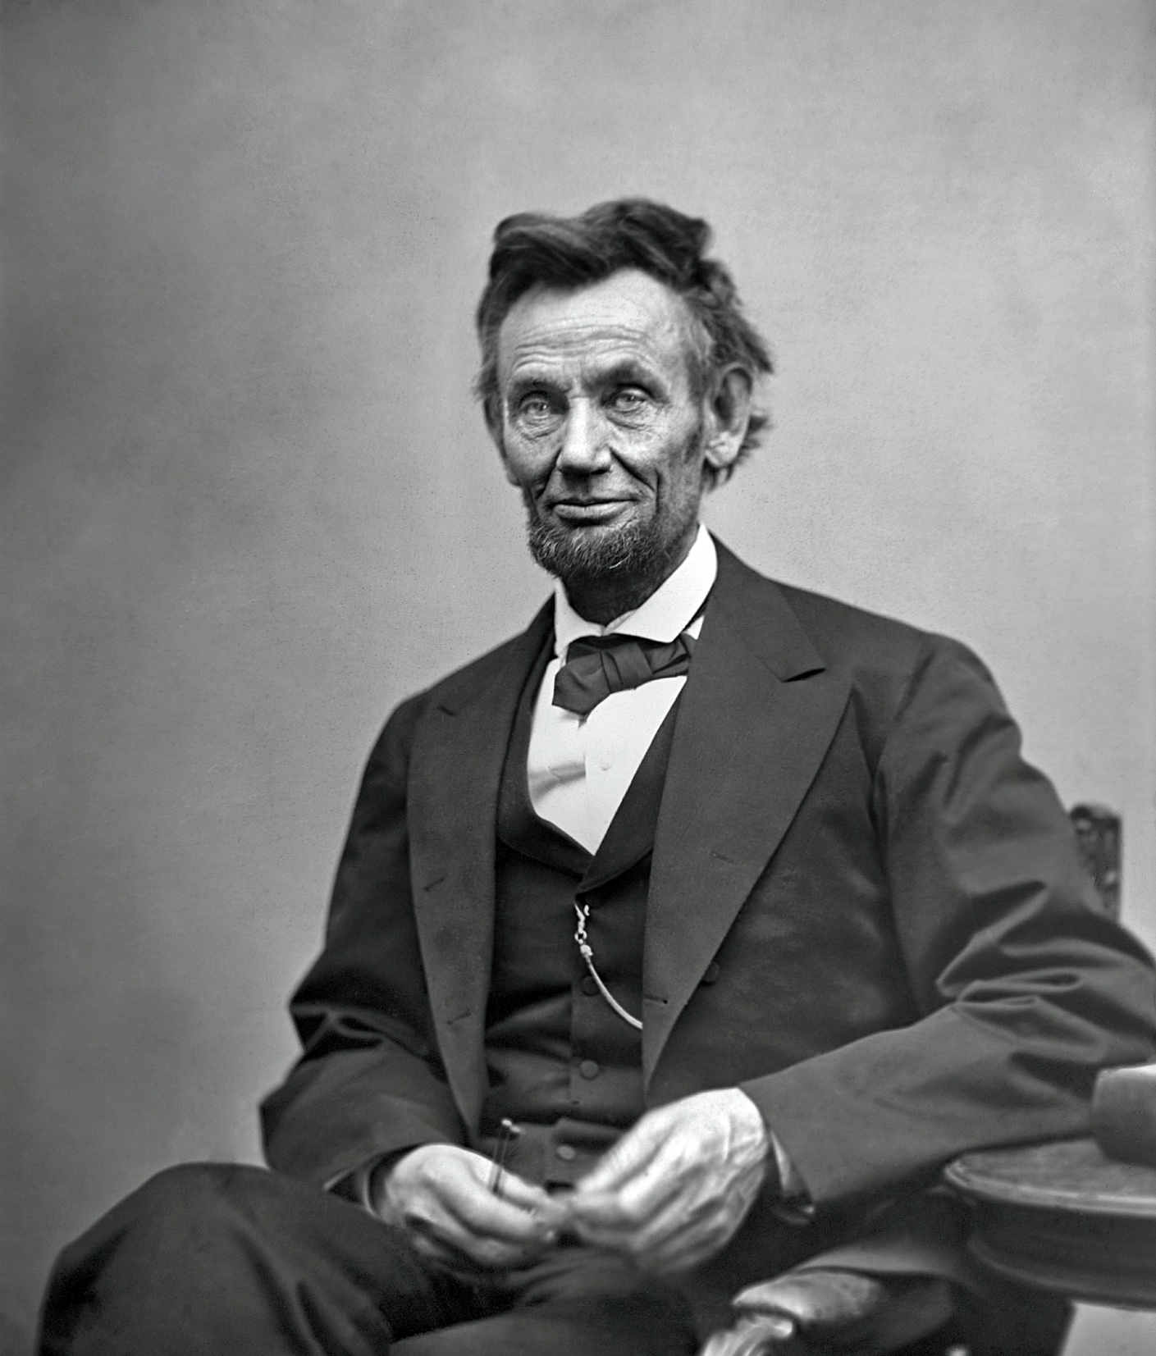

Slide 45
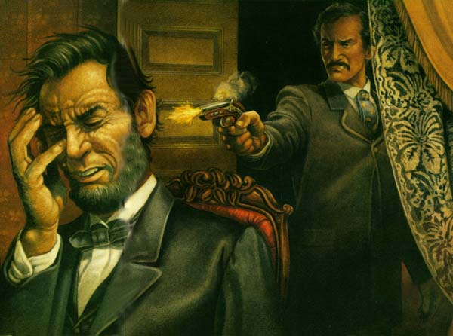

Slide 46
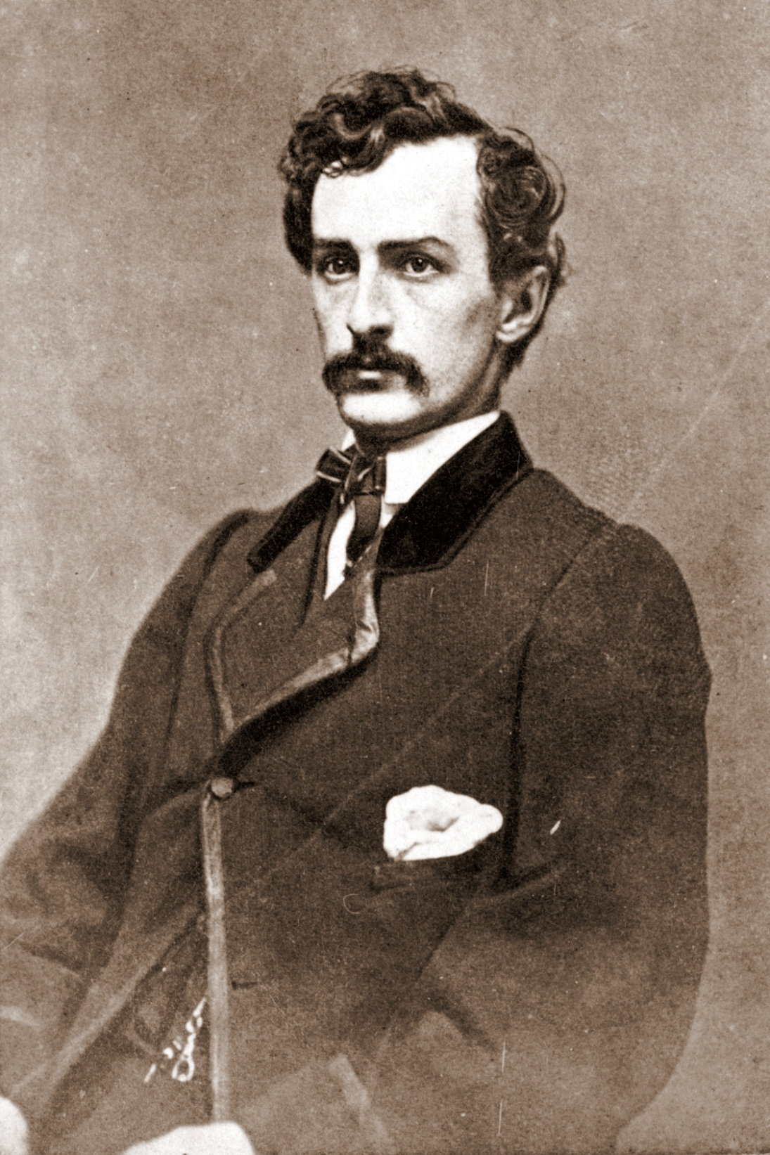

Slide 47
The Aftermath of the Nightmare
The Civil War was immensely costly in many ways…
It cost 600,000 lives, $15 billion, ripped away the best of a generation, instilled long-lasting animosity, and physically destroyed the South
There were some benefits to the Civil War…
It showed the resilience of the U.S. The nation had put itself through the ultimate test, and had survived.
Slavery was erased from the United States.
It put the U.S. onto the world stage as a major player and set up the U.S. to soon be the world leader.

Slide 48
Frame Routine
Look through notes and find three sub categories that encompasses the events of the civil war.
Ex: politics, battles, people
~20 min total.

Slide 49
What are we going to do now?
Can we create Peace?
Following the war, many questions lingered, such as…
What about the freed blacks?
How will be South be re-united with the North?
Who will make these decisions?
The South had been largely destroyed. It'd have to be rebuilt or reconstructed. How to do this was uncertain and many Southerners still stood staunchly against the North.
**Your task is to, within your groups or with a partner, design a reconstruction plan that will rebuild the south and address the concerns of the questions above. You must have a detailed plan, stating specifics of who, what, when, where, and how. This will be a quiz grade.

