Slide 1
Songhai and Mali
Anya Marcelin, Brianna Riddick, Andrew Smith, Christian Chukwu

Slide 2
Rise and Fall

Slide 3
Songhai & mALI Empire
Started out as a fishing and trading canter on the Niger River in a place called Gao where West Africa and Muslim traders visited often.
Just like Ghana and Mali, the Songhai people were influenced by Islam, and many people even converted.
For many years, Songhai people were ruled for many years by Mali, and were forced to pay taxes.

Slide 4
Songhai & MALI Empire
In addition the Songhai people were forced to kneel before Mali kings as a sign of submission.
In 1325, on the way back from Mecca, Mansa Musa took two of Songhai’s king’s sons as hostages.
One of the suns, Prince Ali Kolon, accepted his education but was always was very angry towards Mali. After 30 year's Ali Kolon to Songhai and established the Sunni Dynasty.
After 17 Sunni Dynasty kings ruled Songhai, Sunni Ali rose to power.

Slide 5
SONGHAI & MALI EMPIRE
Sunni Ali had a daring plan to conquer Mali which involved using his navy to control the Niger River and using his army to conquer the trading cities of Jenne and Timbuktu.
Sunni Ali asked for help from the governor of Timbuktu because he was angry for the high taxes they paid to Mali and the Arab nomads who controlled Timbuktu.
The Arab nomads that were guarding Timbuktu Were afraid the would lose to Sunni Ali’s large army and what would happen to them if they were captured. (since nobody was left to fight Sunni Ali took over Timbuktu)

Slide 6
SONGHAI & MALI EMPIRE
Sunnis Ali’s son was next in line for king.
He led a small army and increased to size of the military, created a new system of laws, encouraged new ideas for math and science
. The moroccans used advanced weapons to take over.
Drought & disease weakened the economy

Slide 7
Social Political Religion Intellectual Technology Economy

Slide 8
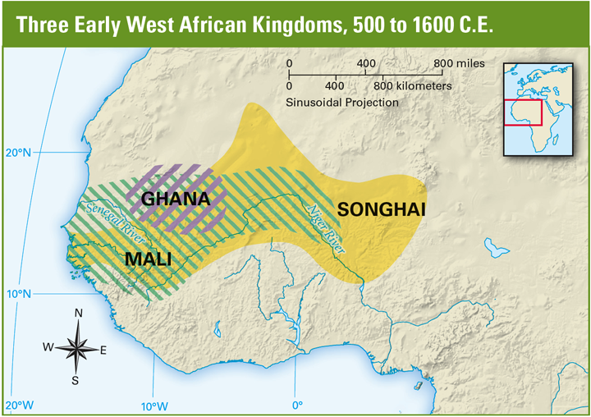
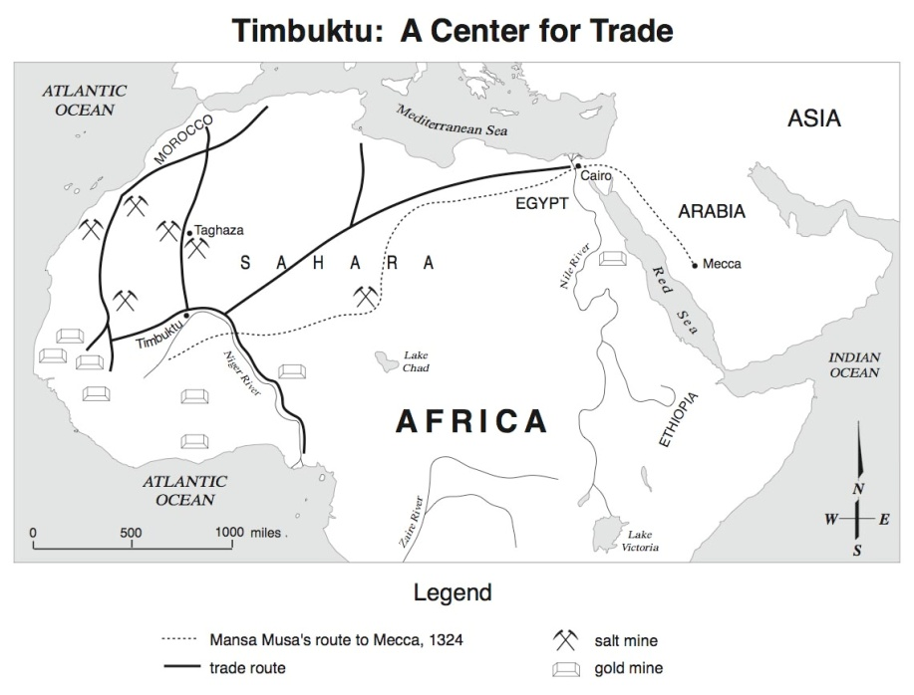
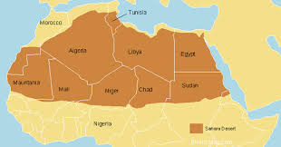
Geography
West Africa
Sahara Desert
Little-no water
Savannah or Grassland
Timbuktu Trading Center

Slide 9
Social
Each civilization in West Africa guinea more power than the last.
The civilizations were Ghana ,Mali, and Shanghai.
Ghana was eventually conquered by Mali.
It was a Mandinka empire. They allowed the spread of fits language, laws, and customs along the Niger River.
It expanded over a large area and had a lot of vassai kingdoms and province.

Slide 10
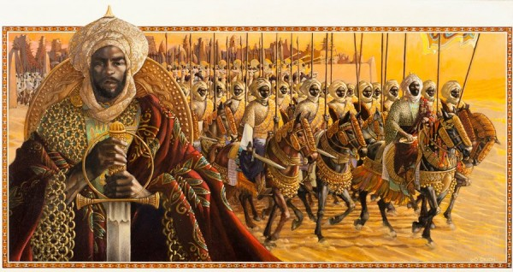
Political
They had 2 powerful rulers.
Sundiata and Mansa Musa Sundiata founded the Mali empire.
Mansa Musa expanded the Mali empire.
The Mali had a Monarchy based government.

Slide 11
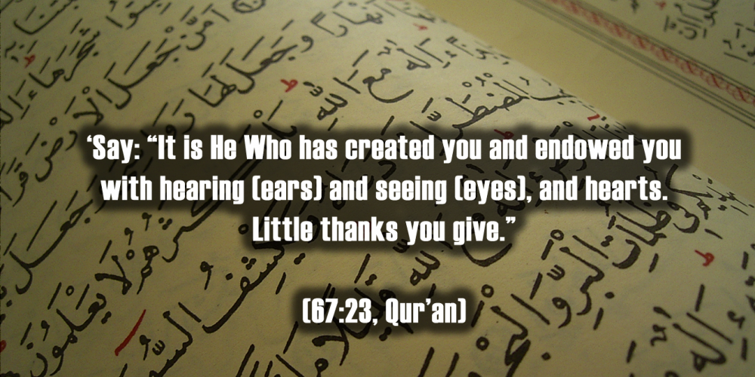
Religion
Malians are Muslim.
90% of them are their leader, Mansa Musa, was also Muslim.
They adapted their religion from Islam. They are still Muslim.

Slide 12
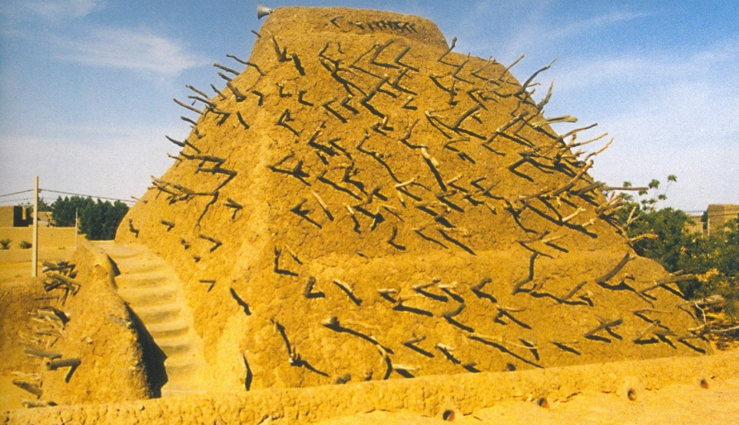
Intellectual
They built many mosques/churches.
Math
Science
Pin Tomb of Askia

Slide 13
Technology
They manipulated iron, horses, and ecology like beneficial climate shifts.
They also practiced farming and army.

Slide 14
Economy
The practiced silent bartering.
Traders didn’t speak each others language.
They traded gold for salt.
They mined gold and the people needed salt to preserve food.
They used camals.

Slide 15
Current Events
Malian officials say French forces killed a top Islamism militalla leader in mountains of northern Mali.
Omar Ould Hamaha, was killed last week by French airstrikes.
France’s defense ministry has not confirmed the death.
Hamaha was a long-time member of Al-Qaicla’ in the Islamic megnees and later becomes spokesmen for the MUJWA(movement for unity and jihad in the Islamic Maghreb).
The Malian military officials offered $3 million dollars for any information leading to Hamaha’s capture.

Slide 16
Question and Answer
Q. What effects did Mansa Musa’s travels have in Mali & Europe?
A. She had to trade more of her goods and she got it from other cultures.
Q. What kind government did Askia Muhammad create in Songhai?
A. Akia Muhammad induced policies that increased trade with Europe and Asia, standardized weights, measures, and currency. He also created positions for directing finance, agriculture, justice, interior, protocol, and waters and forests.

Slide 17
