Slide 1
World History Warm up→ 4/7/2016
Have a seat and remain quiet.
Place all cell phones and head phones in the colored bins on your table. Consider the following scenario and write your response:
Imagine you went home today and turned on the TV, and President Obama interrupted your regularly scheduled program to inform the nation/world that a NASA space station and crew have discovered life on another planet. This life includes walking, communicating life-beings, extraterrestrial plant life and vegetation, and other extraterrestrial animal life.
How would you feel? What questions would you ask? How would your world change?

Slide 2
The
Scientific
Revolution

Slide 3
Before we write:
________________________________________________________
What is a revolution?
Revolution = MAJOR CHANGE
So, what’s the Scientific Revolution?
Well, you’re about to find out Noseypants. Just cool your jets for a minute and label your notes “The Scientific Revolution” so we can get going.

Slide 4
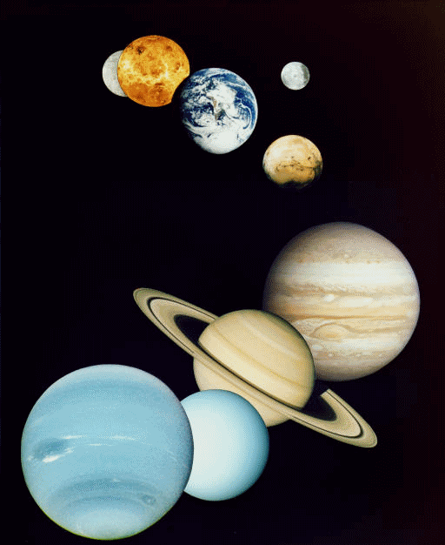
The Scientific Revolution
In the 1500s and 1600s the Scientific Revolution changed the way Europeans looked at the world.
People began to make conclusions based on experimentation and observation, using logic and reason, instead of merely accepting traditional ideas.

Slide 5
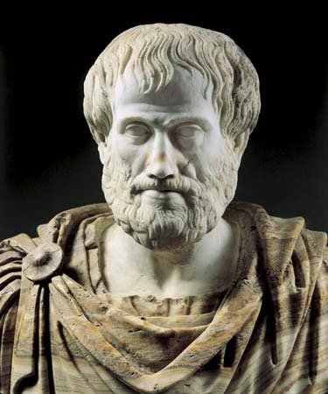
Scientific Revolution:
________________________________________________________
What was the old way of thinking?
Before the Scientific Revolution, scientific thinking is based mostly on…
- The Bible
- Aristotle

Slide 6
Scientific Revolution:
________________________________________________________
What was the old way of thinking?
ARISTOTLE
The earth is the center of the universe!
And nobody questioned him for 2,000 years.

Slide 7
Scientific Revolution:
________________________________________________________
Why did thinking change?
2,000 years is a loooong time. Why do people start to think differently?
Increased contact with Jews and Muslims exposed Europeans to new ideas
And what’s that called???
CULTURAL DIFFUSION!

Slide 8
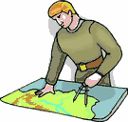
Scientific Revolution:
________________________________________________________
Changes in Europe:
Europeans realized that they were wrong about some things
Example: They had believed that there were only three continents, but explorers had now “discovered” more
They found MORE?!?! But I was just about finished!

Slide 9
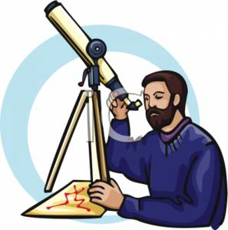
Scientific Revolution:
________________________________________________________
What was the new way of thinking?
People began to use reason and logic (not just faith) to explain the world
Science changed from what people thought to what people observed

Slide 10
Scientific Revolution:
________________________________________________________
Tension between religion and science:
Some scientific conclusions questioned and challenged the beliefs of the church and what is written in the Bible
Many scientists, however, were religious and saw science as a way of better understanding God’s world
So who were these new-think’n sci-guys?

Slide 11
So who are these new thinkers???

Slide 12
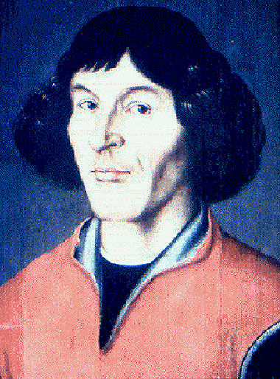
Nicolaus Copernicus
Copernicus was a Polish astronomer who studied in Italy.
In 1543 Copernicus published On the Revolutions of the Heavenly Spheres.
In his book, Copernicus made two conclusions:
The universe is heliocentric, or sun-centered.
The Earth is merely one of several planets revolving around the sun.

Slide 13
Nicolaus Copernicus
Copernicus’ model of the solar system:
Sun
Moon
Mercury
Venus
Earth
Mars
Jupiter
Saturn
Notice, the sun is first, not the Earth, as Ptolemy believed.

Slide 14
Nicolaus Copernicus
Copernicus came to these conclusions using mathematical formulas.
The Copernican conception of the universe marked the start of modern science and astronomy.

Slide 15
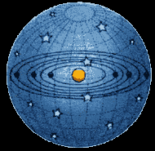
The Copernican Heliocentric Model

Slide 16
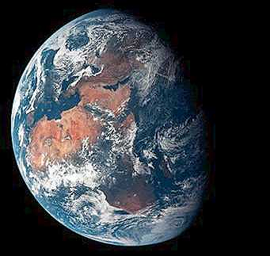
Reaction to Copernicus
Most scholars rejected his theory because it went against Ptolemy, the Church, and because it called for the Earth to rotate on its axis.
Many scientists of the time also felt that if Ptolemy’s reasoning about the planets was wrong, then the whole system of human knowledge could be wrong.

Slide 17
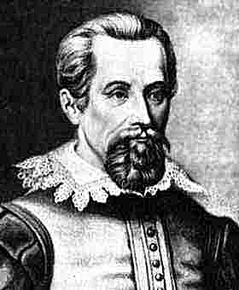
Johannes Kepler
After Brahe’s death, his assistant, the German astronomer and mathematician Johannes Kepler, used Brahe’s data to calculate the orbits of the planets revolving around the sun.
Kepler’s calculations supported Copernicus’ heliocentric theory.
His calculations also showed that the planets moved in oval shaped orbits, and not perfect circles, as Ptolemy and Copernicus believed.
Kepler’s finding help explain the paths followed by man-made satellites today.

Slide 18
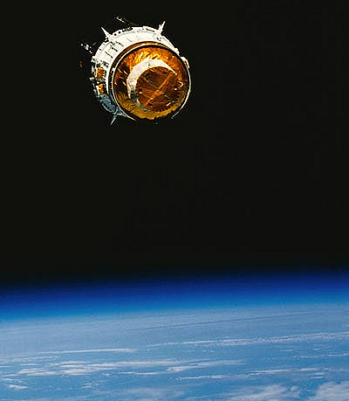

Slide 19
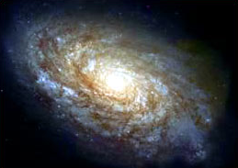
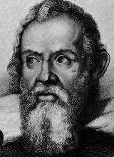
Galileo Galilei
Galileo Galilei was an Italian astronomer who built upon the scientific foundations laid by Copernicus and Kepler.
Galileo assembled the first telescope which allowed him to see mountains on the moon and fiery spots on the sun.
He also observed four moons rotating around Jupiter – exactly the way Copernicus said the Earth rotated around the sun.
Galileo also discovered that objects fall at the same speed regardless of weight.

Slide 20
Galileo Galilei
Galileo’s discoveries caused an uproar. Other scholars came against him because like Copernicus, Galileo was contradicting Ptolemy.
The Church came against Galileo because it claimed that the Earth was fixed and unmoving.
When threatened with death before the Inquisition in 1633, Galileo recanted his beliefs, even though he knew the Earth moved.
Galileo was put under house arrest, and was not allowed to publish his ideas.

Slide 21
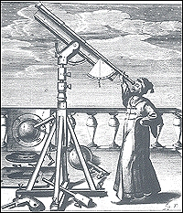

Slide 22
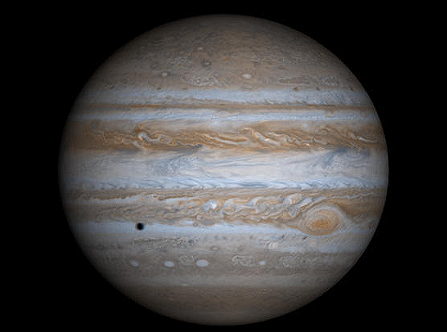

Slide 27
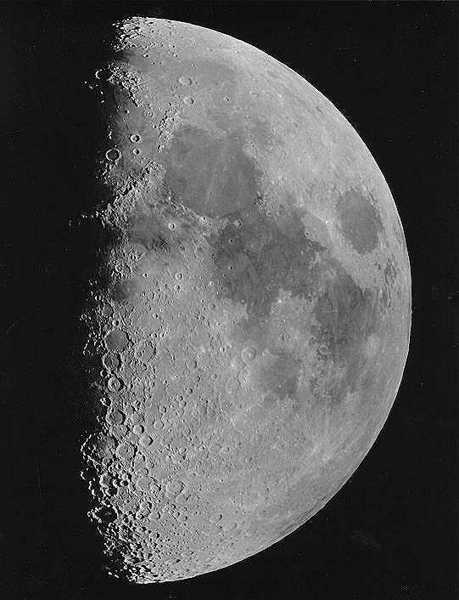

Slide 28
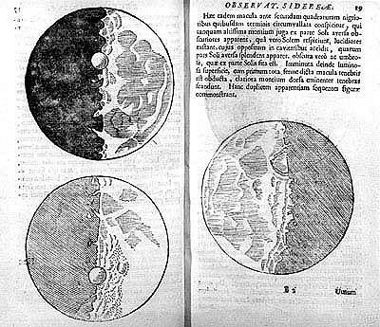

Slide 29
The Scientific Method
By the early 1600s, a new approach to science had emerged, known as the Scientific Method.
Scientific Method – painstaking method used to confirm findings and to prove or disprove a hypothesis.
Scientists observed nature, made hypotheses, or educated guesses, and then tested these hypotheses through experiments.
Unlike earlier approaches, the scientific method did not rely on the classical thinkers or the Church, but depended upon a step-by-step process of observation and experimentation.

Slide 30
The Scientific Method
State the problem
Collect information
Form a hypothesis
Test the hypothesis
Record & analyze data
State a conclusion
Repeat steps 1 – 6
Scientists soon discovered that the movements of bodies in nature closely followed what could be predicted by mathematics.
The scientific method set Europe on the road to rapid technological progress.

Slide 31
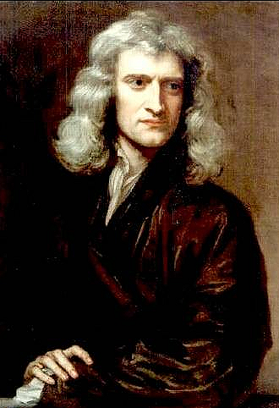
The Scientific Method
Newton
Sir Isaac Newton was an English scholar who built upon the work of Copernicus and Galileo.
Newton was the most influential scientist of the Scientific Revolution.
He used math to prove the existence of gravity - a force that kept planets in their orbits around the sun, and also caused objects to fall towards the earth.

Slide 32
The Scientific Method
Newton published his scientific ideas in his book Mathematical Principles of Natural Philosophy.
Newton
He discovered laws of light and color, and formulated the laws of motion:
A body at rest stays at rest
Acceleration is caused by force
For every action there is an equal opposite reaction
He invented calculus: a method of mathematical analysis.

Slide 33
The Scientific Method
According to a popular story, Newton saw an apple fall from a tree, and wondered if the force that pulled the apple to the Earth also controlled the movement of the planets. Newton argued that nature followed laws.

Slide 34
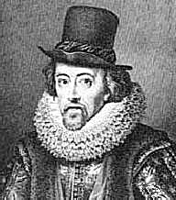
The Scientific Method
Francis Bacon was an English philosopher who wrote Advancement of Learning.
Francis Bacon
Bacon popularized the scientific method and used it with philosophy and knowledge.
Bacon argued that truth could not be known at the beginning of a question, but only at the end after a long process of investigation.

Slide 35
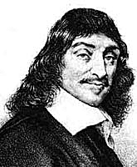
The Scientific Method
Descartes was a French scientist, mathematician, and philosopher.
René Descartes
Descartes emphasized human reasoning as the best road to understanding.
Like Bacon, Descartes also believed that truth was only found after a long process of studying and investigation.
“I think, therefore I am”

