Slide 1
Safavid Empire (1501-1722)
By Josue, Bruno, Cameron, and Irvin
Due Thursday Mar. 17th ,2014

Slide 2
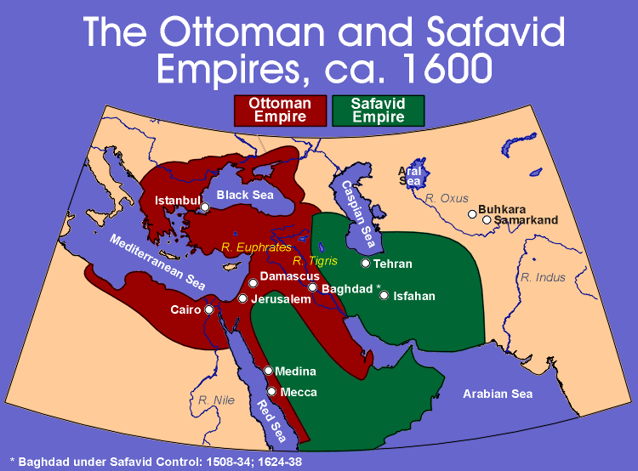

Slide 3
Important things to know
The Safavid Empire was based in what is today Iran.
The capital, Isfahan, is one of the most beautiful cities in the world.
When the Safavids came to power, Shah Ismail was proclaimed ruler at the age of 14 or 15, and by 1510 Ismail had conquered the whole of Iran.
The period of the Safavids, was the dynasty that took control of Persia in the early 16th century.
Important Ruler Shah Abbabs -1587-1629

Slide 4
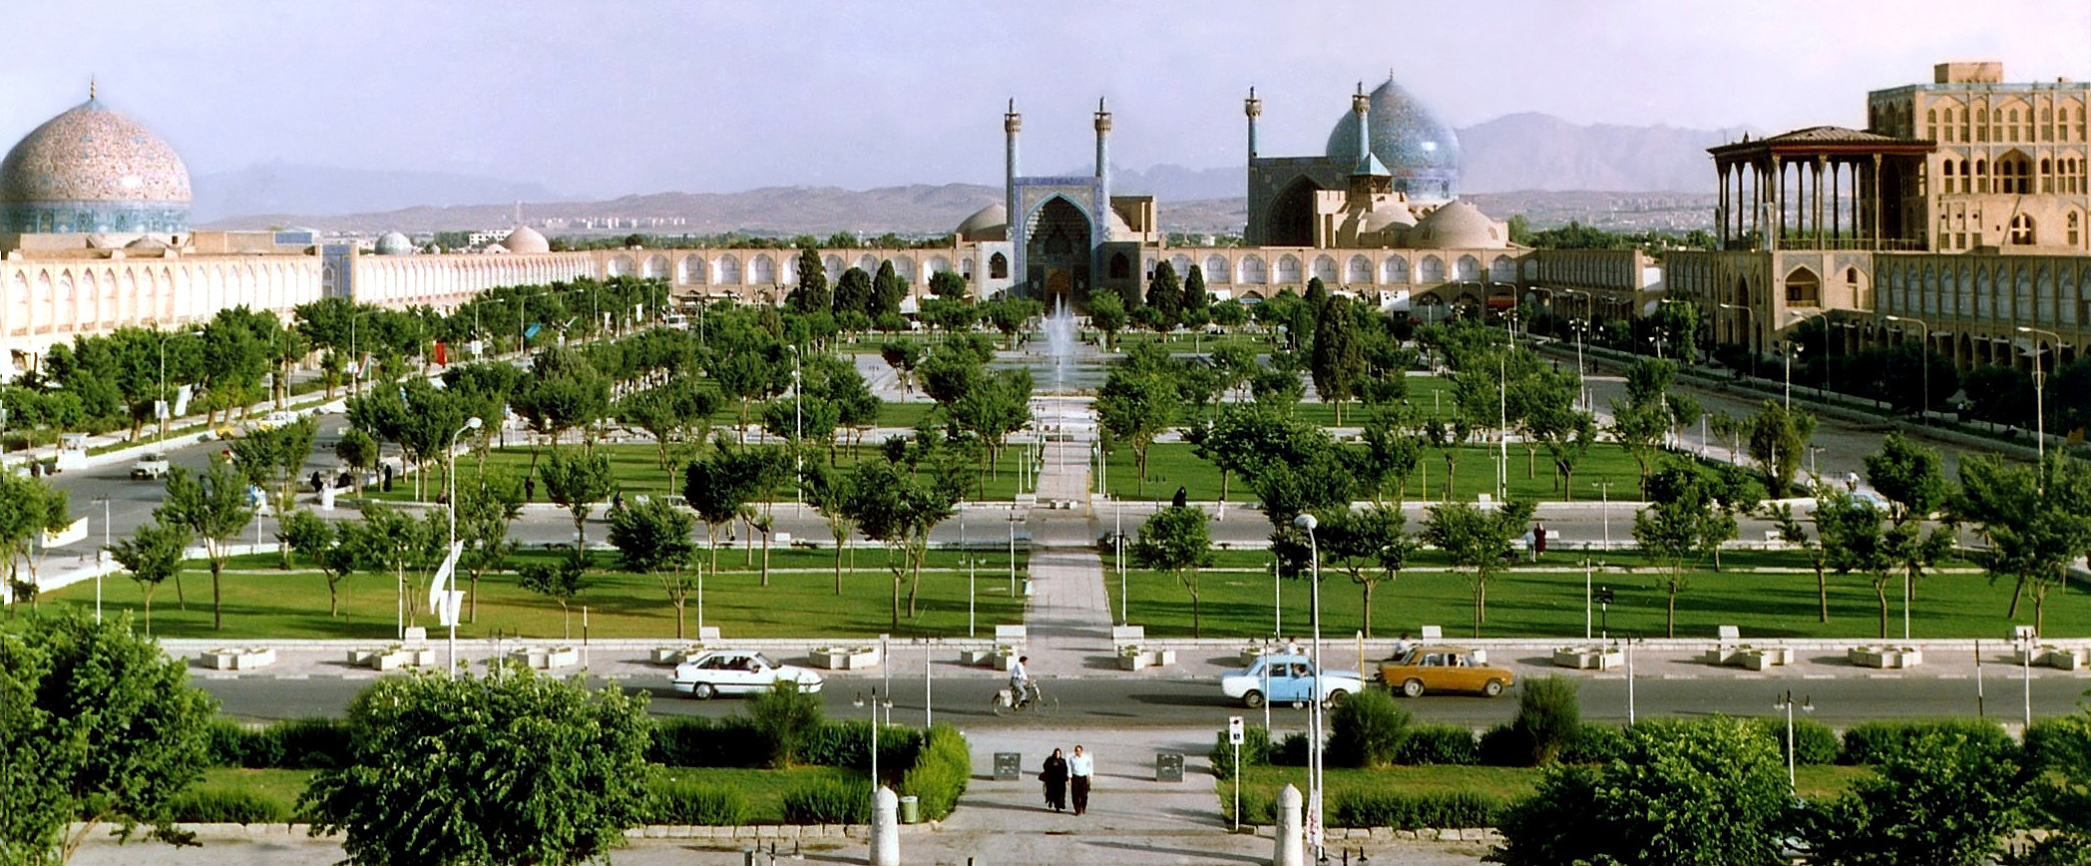

Slide 5
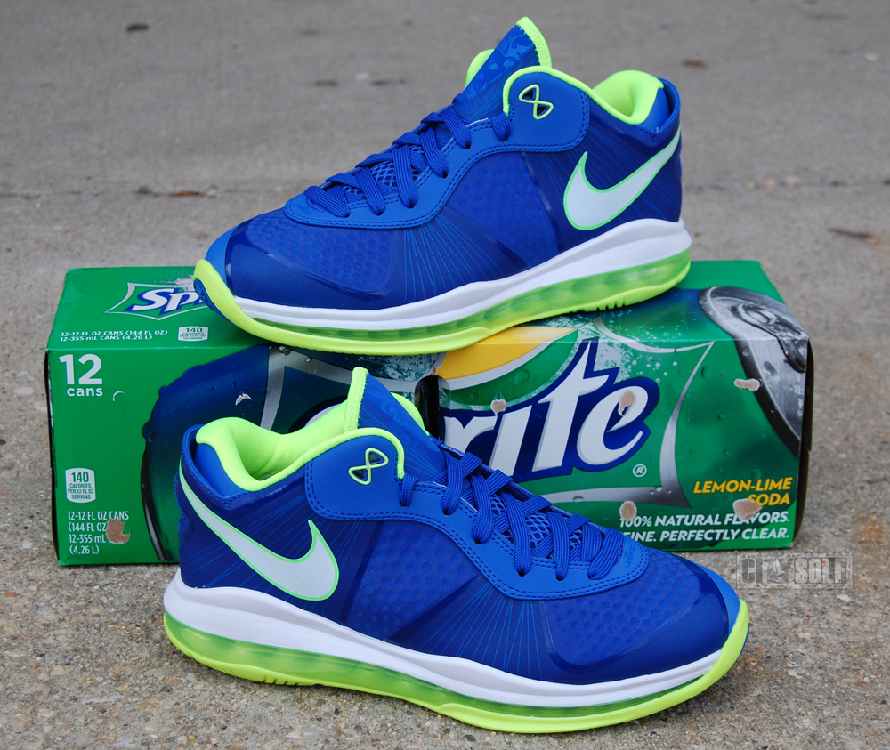
GSPRITE

Slide 6
GSPRITE (Geography)
The Empire's economic strength came from its location on the trade routes
It covered all of Iran, and parts of Turkey and Georgia
The Safavids benefited from their geographical position at the centre of the trade routes of the ancient world.
They became rich on the growing trade between Europe and the Islamic civilizations of central Asia and India.

Slide 7
GSPRITE (Social)
Women
o Not equal to men
o Divorce could be caused by either the wife or husband
o After death of Abbas the Great, women lost some rights
Social Structure
o King and royal class
o Nobility- filled administrative posts
o Rich merchant class
o Artisans (city-dwellers)
o Peasants

Slide 8
GSPRITE (Political)
• Capitals: Tabriz- Qazvin- Isfahan
• Centralized government
• Shah made decisions with the consultation of his advisors at the capital (mostly nobility)
• Made international Trades with Europeans. Gained control over Kurdish territories, Baghdad and Sha’a holy cities of Najaf and Karbala.
The Safavid Empire was a theocracy

Slide 9
GSPRITE (Religious)
The state religion was Shi’a Islam
All other religions, and forms of Islam were suppressed

Slide 10
GSPRITE (Intellectual)
The Empire made Iran a centre of art, architecture, poetry and philosophy.
During this period, painting, metalwork, textiles and carpets reached new heights of perfection.
Patronized arts, built places, mosques, schools, made Esfahan become cultural and intellectual capital of empire.

Slide 11
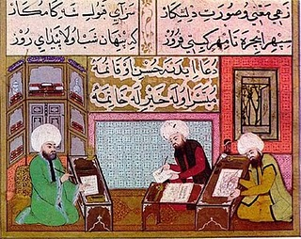

Slide 12
GSPRITE (Technology)
The Safavids were really good with Engineering.
Domes- huge mosques that still are a mystery on how they did it.
The Safavids were goo with City planning- squares, irrigation, sewage
The Safavids built Multistory buildings
Arches were It is 123 metres long with 24 arches, and also serves as a sluice gate.

Slide 13
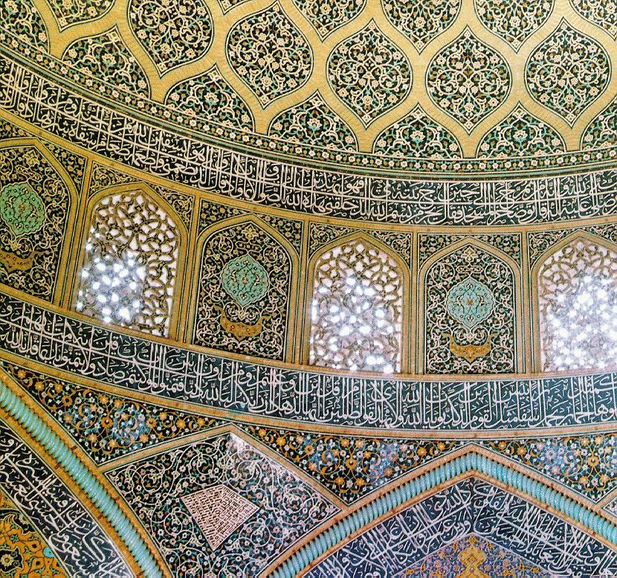

Slide 14
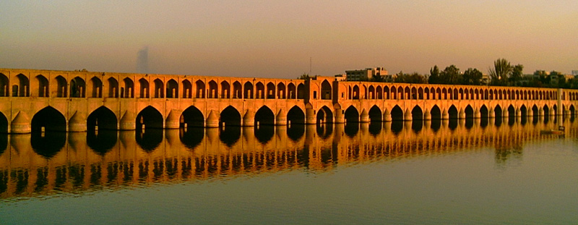

Slide 15
GSPRITE (Economics)
Trade was a major factor
The Silk Road ran through the north part of the empire
Trade with Europe, especially England (English East India Company)
Slavery- little or no slavery as a labor system

Slide 16
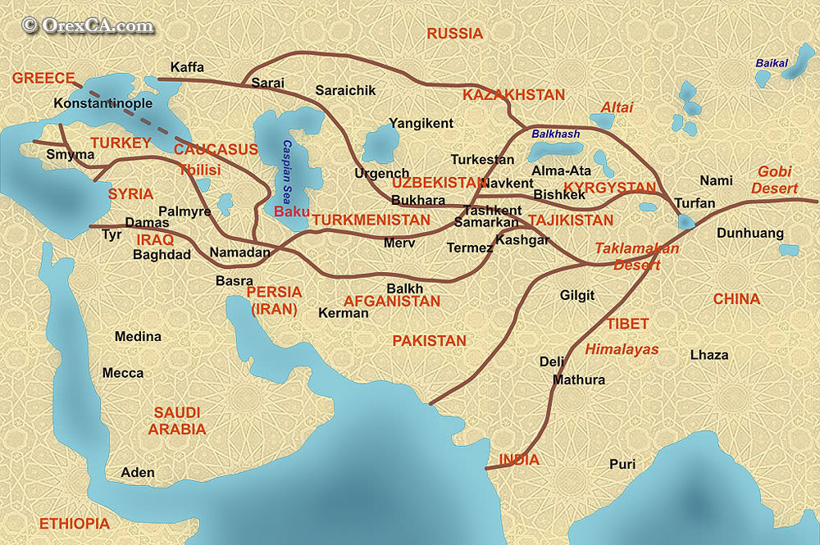

Slide 17
Safavid Empire Decline
In the seventeenth century the Ottoman threat to the Safavids declined. The first result of this was that the military forces became less effective.
With their major enemy keeping quiet, the Safavid Shahs had there guard down, and then corrupt and decadent.
In 1726 an Afghan group destroyed the ruling dynasty.

Slide 18
Safavids Legacy
The main impact the Safavids had on the Persian area today include that Iranians are still Shiites. In addition, the conflict between the Sunnis(Ottomans) and the Shiites(Safavids) still goes on today as the two main groups of the Muslim religion continue to fight in disagreement.

Slide 19
TimeLine
Height of Empire
Victory over Uzbeks in April, 1598 Recovers lost lands.
Capital moved to Esfahan. Allows more control over empire.
Shrine of Ali ar-Reza rebuilt. Rivals Shi’a holy places in Mesopotamia *Most successful through 1587-1629
The Safavids deafeted the Army of Alvand Beig of Qoyunlu, ruler of Azerbaijan , Armenia and Khorosan. Isma’il was declared Shah the king on March 11th, 1502.
Mainly includes rivalry between the Safavids and Ottomans. Ottomans had control over Arabia and Safavids had control over Iran. Ottomans were also Sunnis while Safavids were Shiites.

