Slide 2
Anasazi Cliff Dwellers (Utah, NM, Colorado, Arizona)

Slide 3
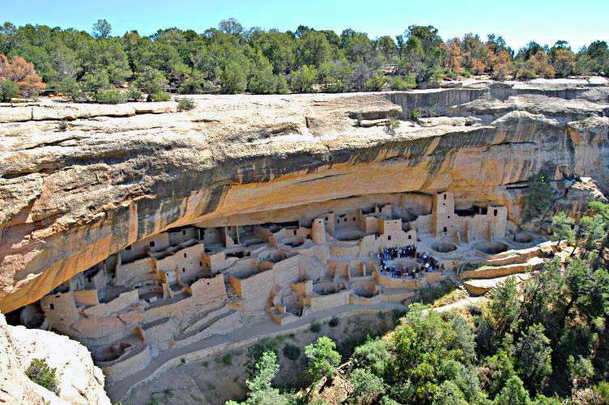
Anasazi Cliff Dwellers (Utah, NM, Colorado, Arizona)

Slide 4
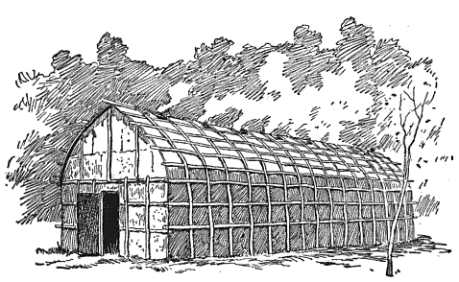
Iroquois Long House (Upstate New York)

Slide 5
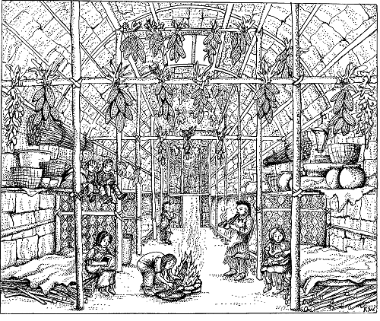
Interior

Slide 6
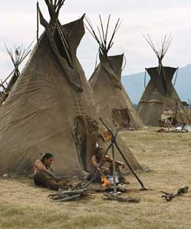
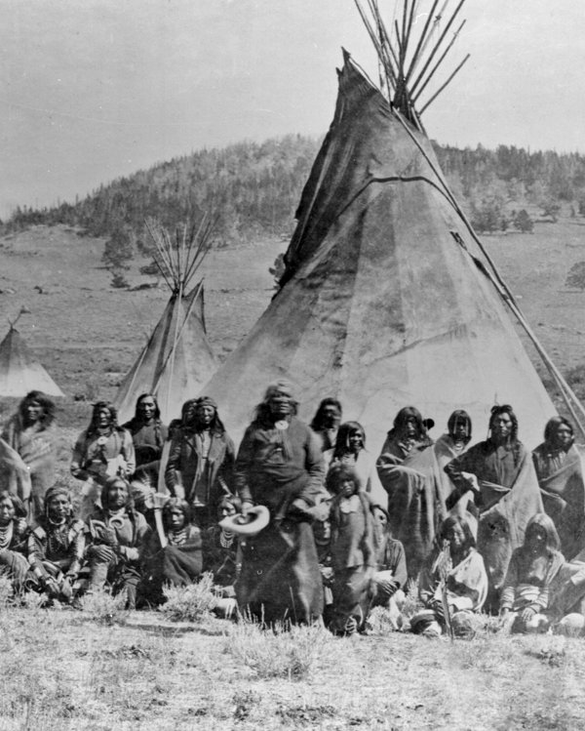
Teepee—Plains Native American Tribes

Slide 7
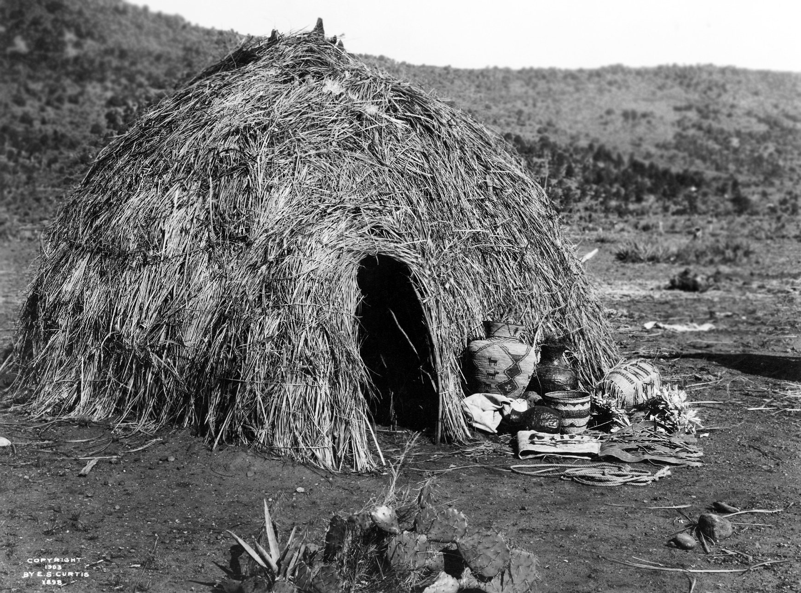
Wigwams—Algonquians and Apache (North American Natives)

Slide 8
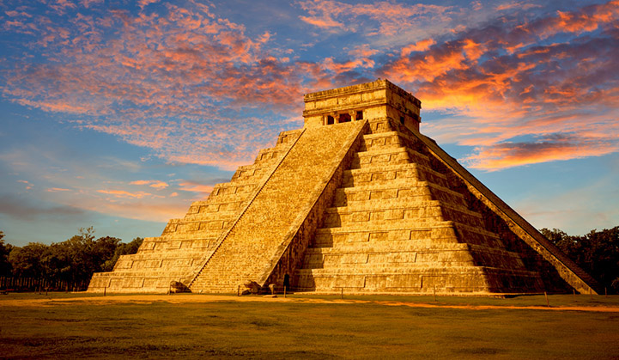
Mayan civilization remains

Slide 9
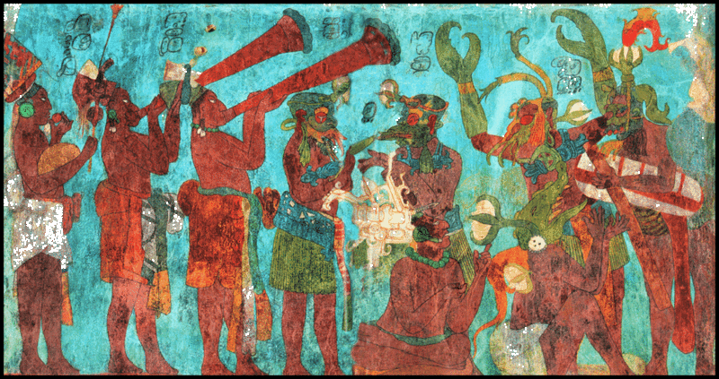
Mayan wall mural

Slide 10
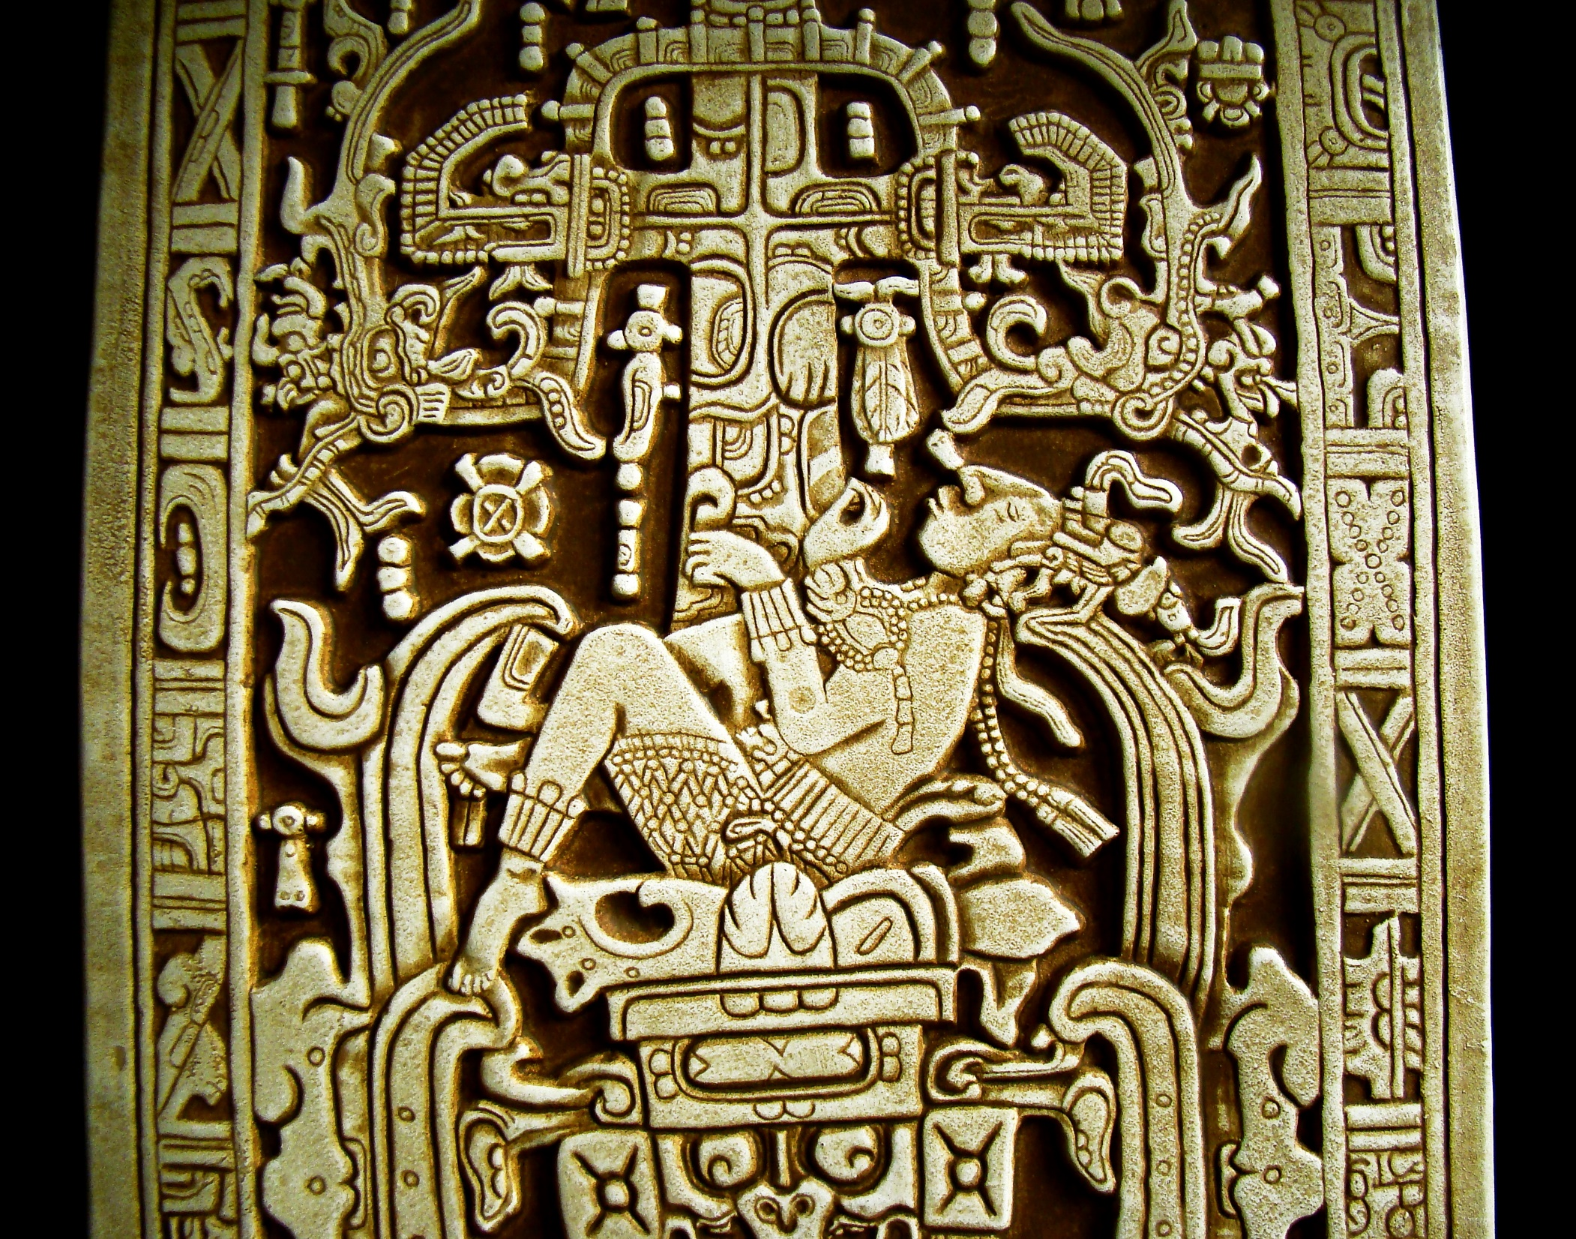
Mayan sarcophagus lid

Slide 11
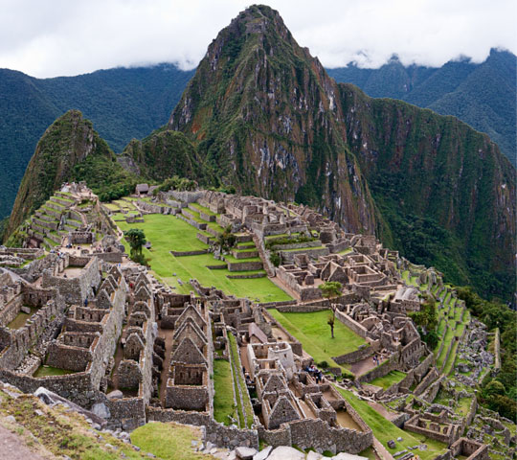
Incan Empire remains in Peru

Slide 12
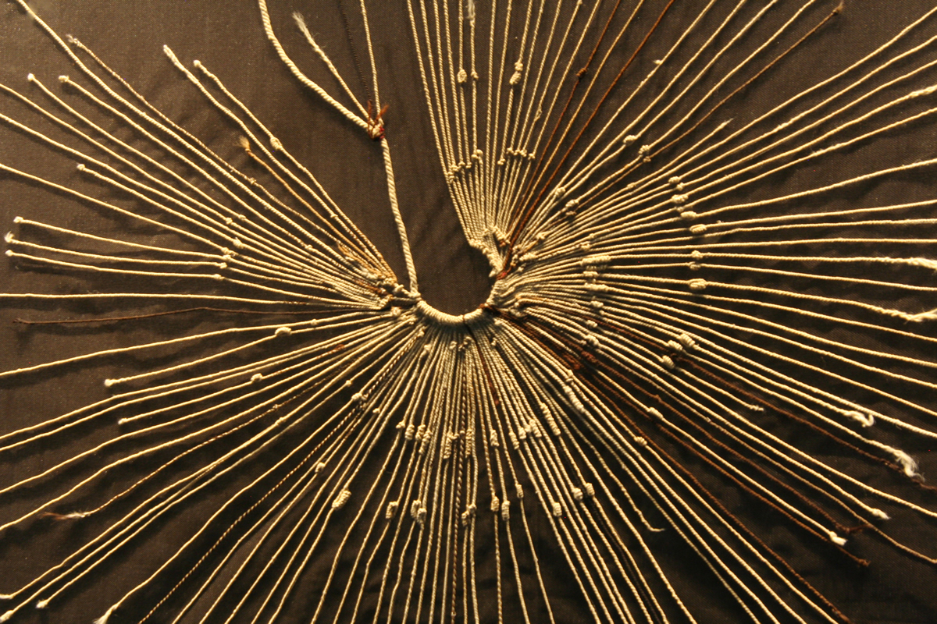
Incan Quipu

Slide 13
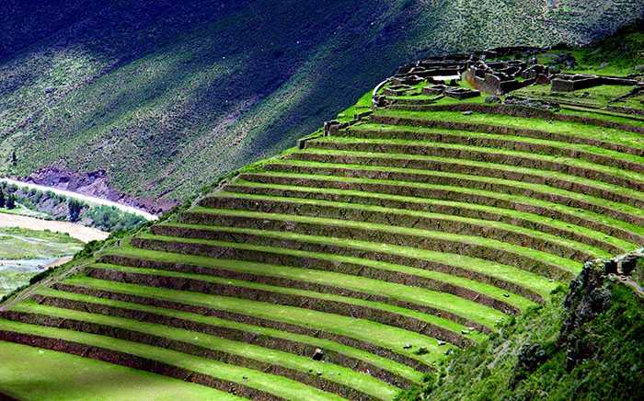
Incan Terraces

Slide 14
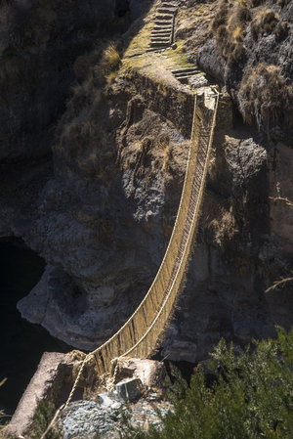
Incan Bridges

Slide 15
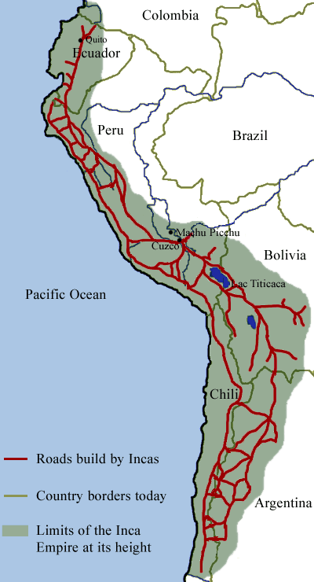
Incan Roads

Slide 16
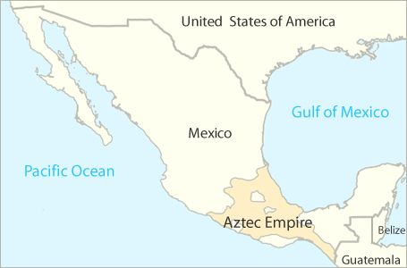

Slide 17
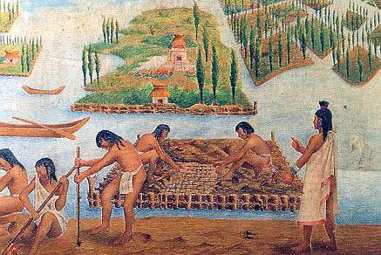
Aztec Chinampas

Slide 18
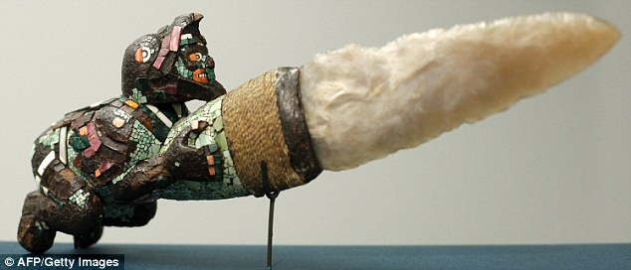
Aztec knife

Slide 19
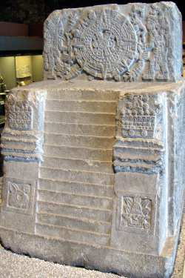
Montezuma's Throne (Aztec King)

Slide 20
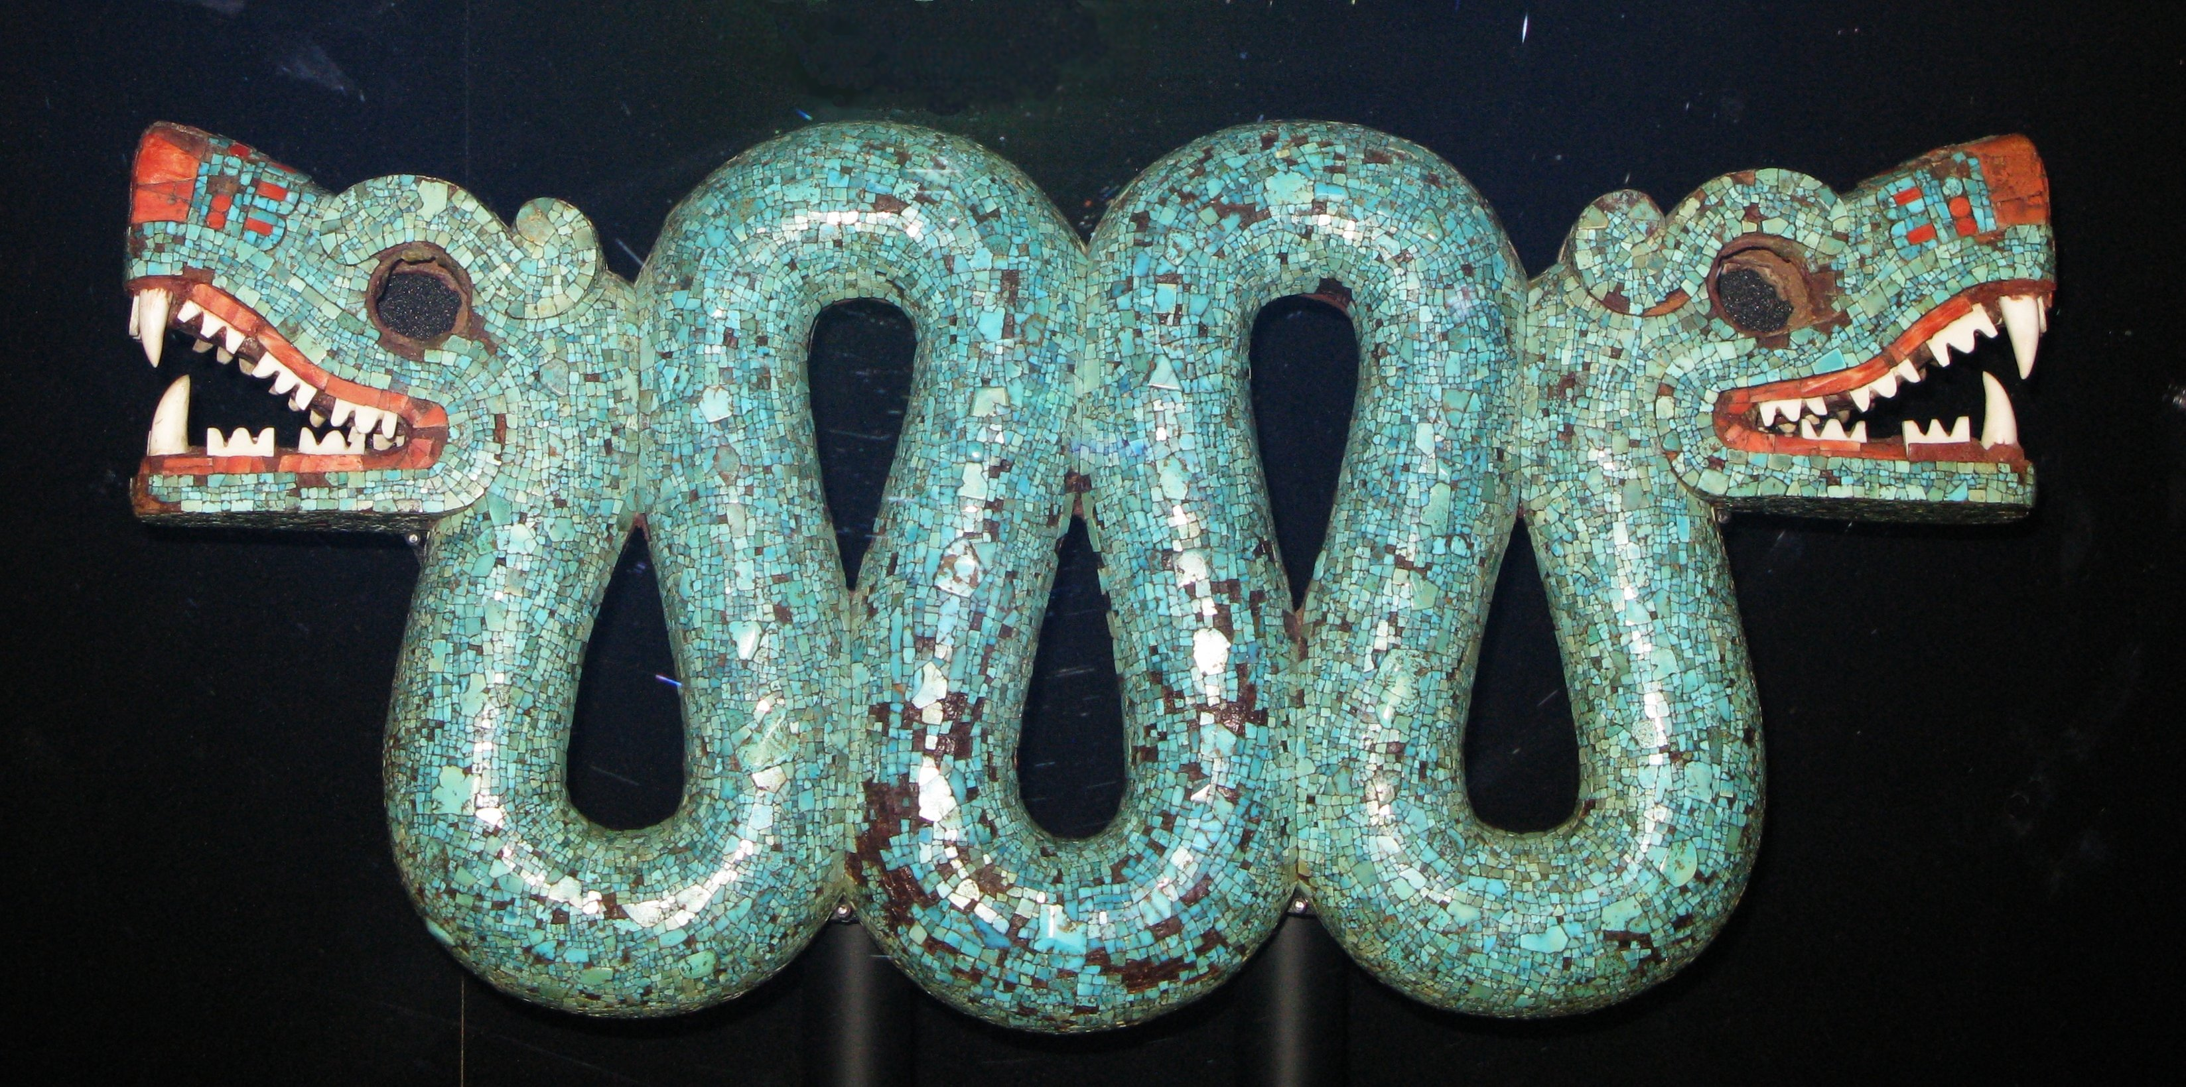
Aztec Pectoral

Slide 21
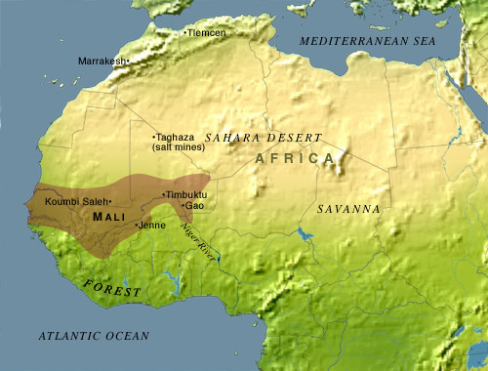
Mali Empire in Africa

Slide 22
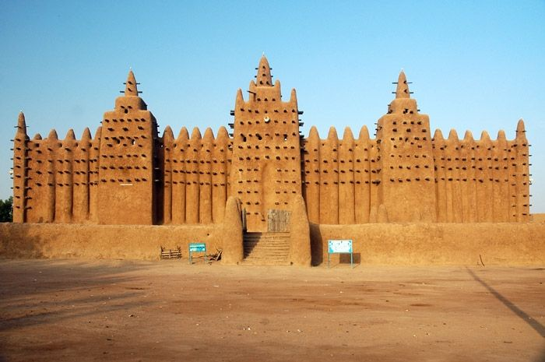
Mosque in Djenne, West Africa during the Mali empire

Slide 23
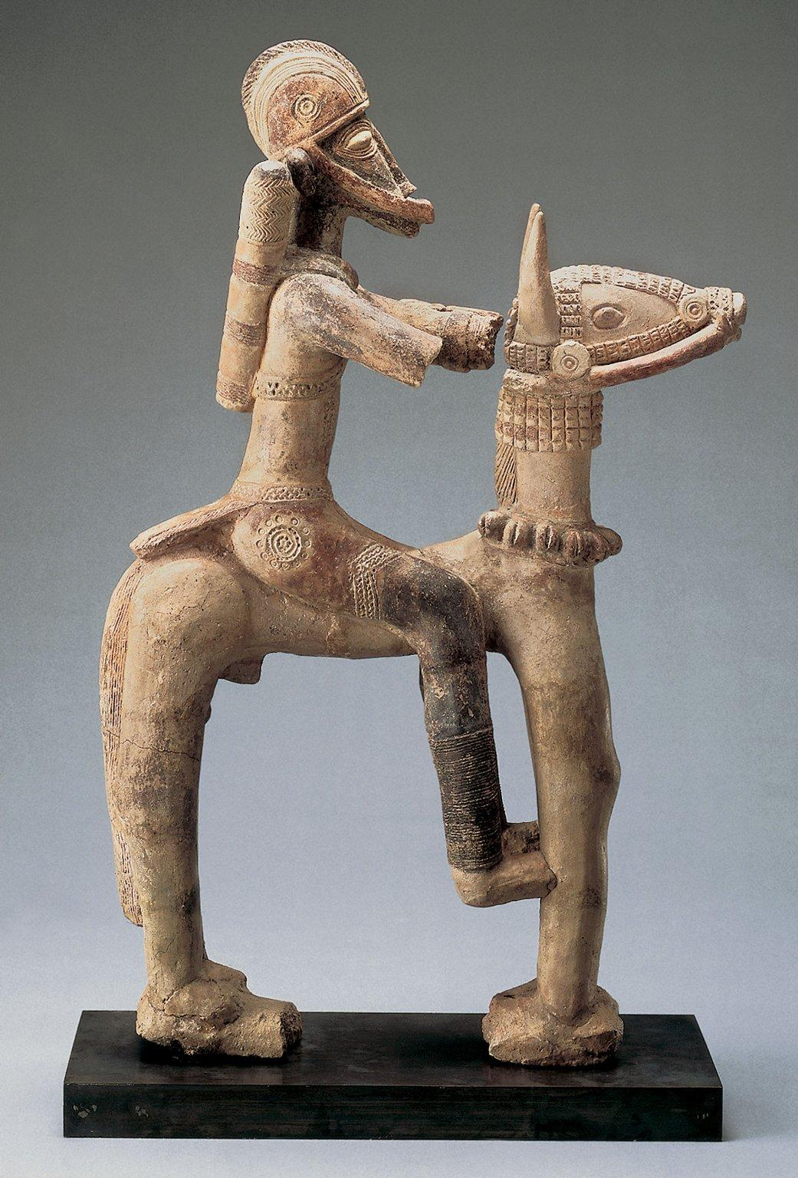
Terracotta artifact from Mali empire

Slide 24
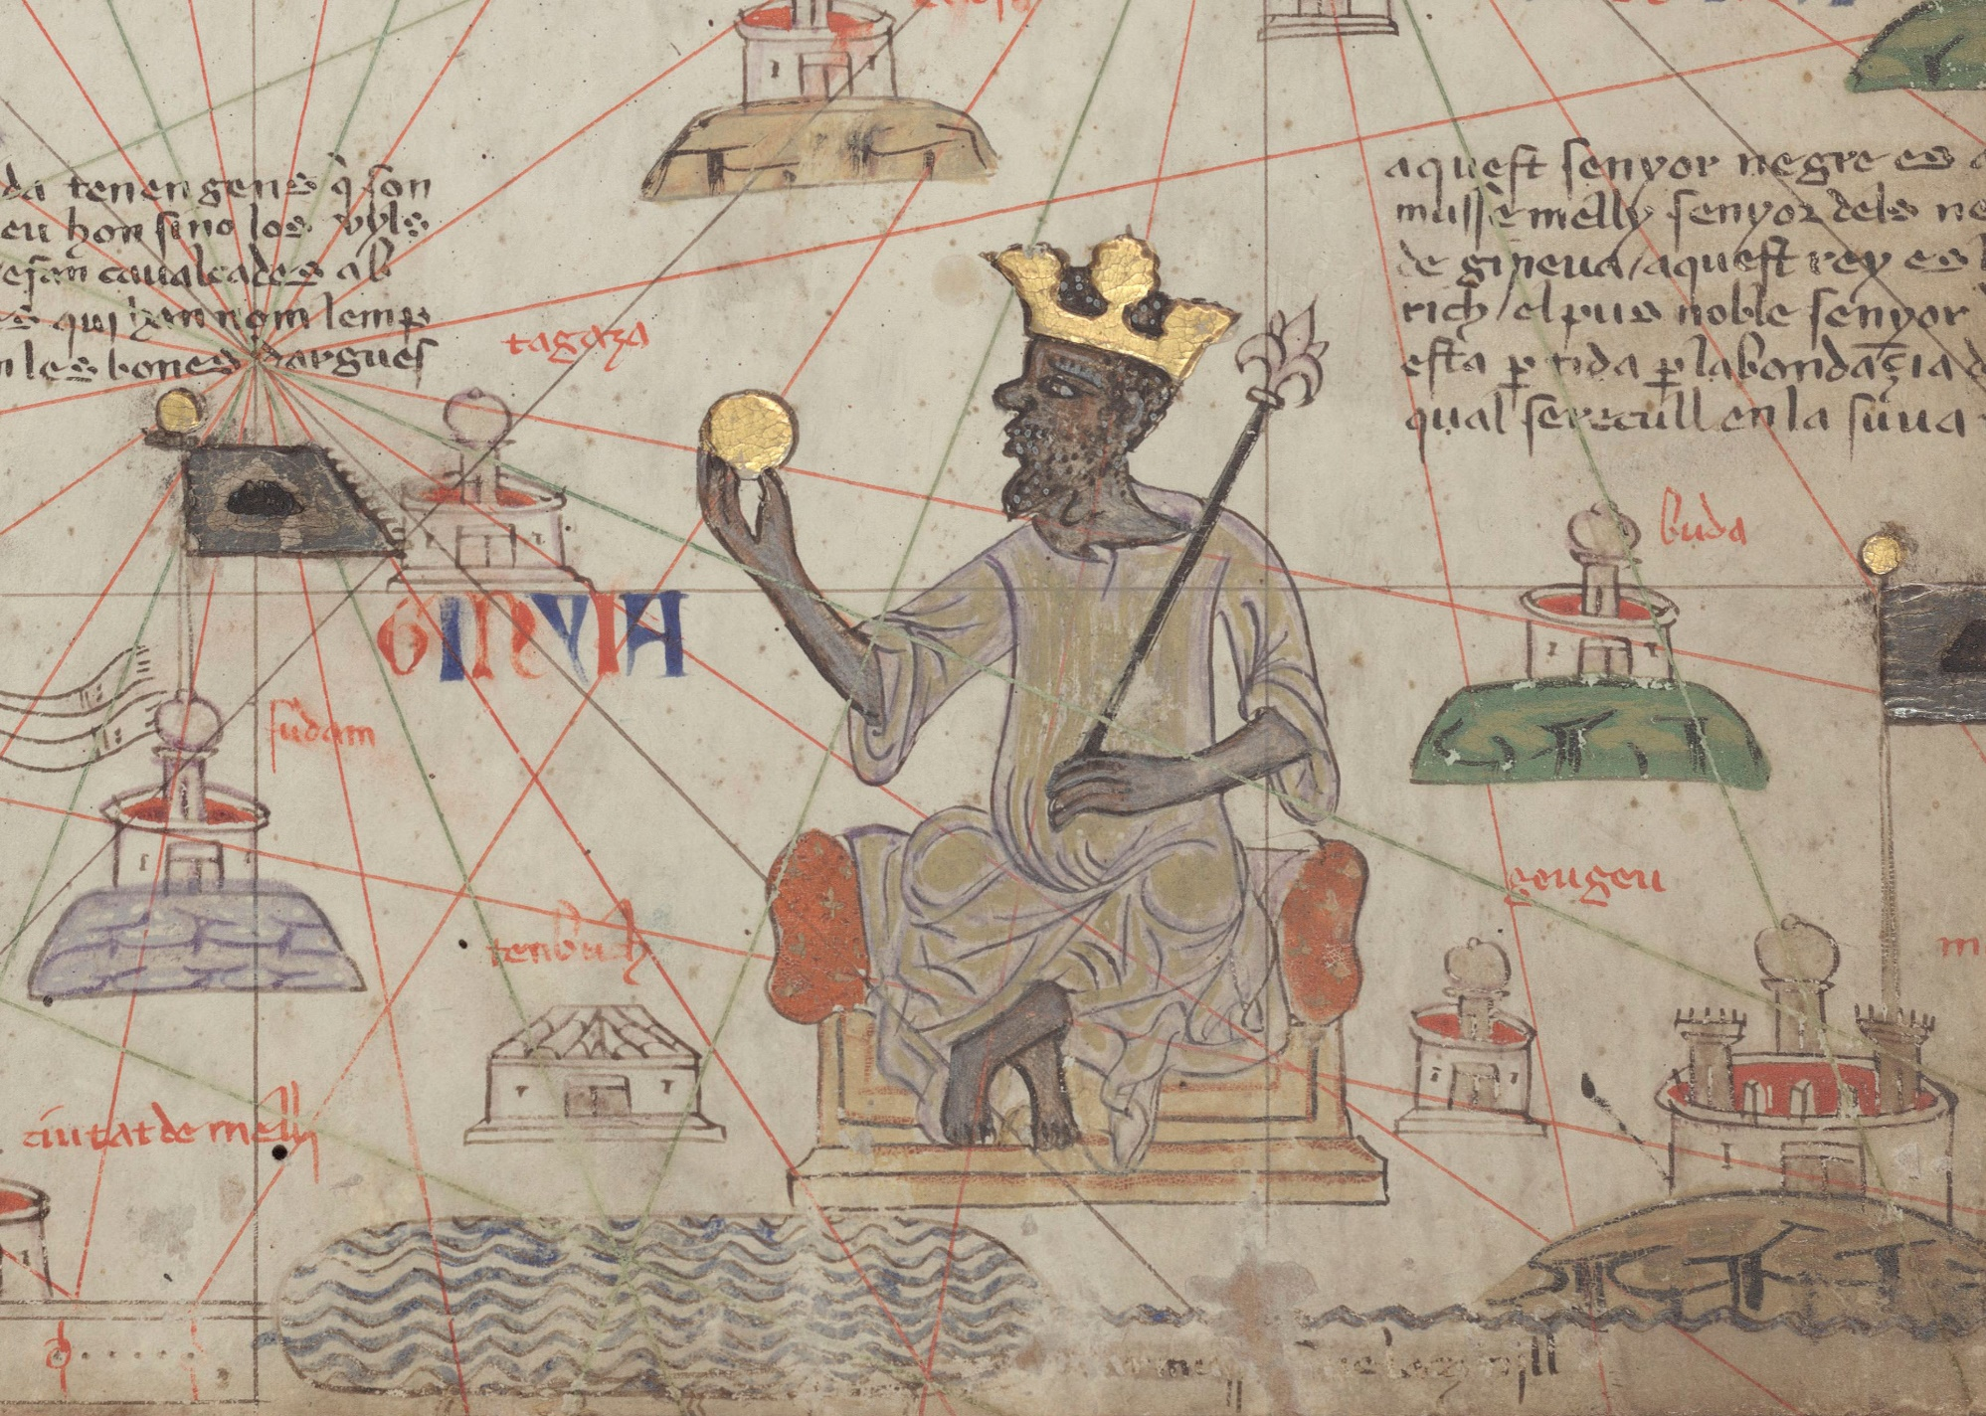
Catalan atlas depicting Mansa Musa, of the Mali empire

Slide 25
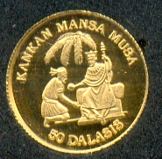
Gold Coin from Mali empire

Slide 26
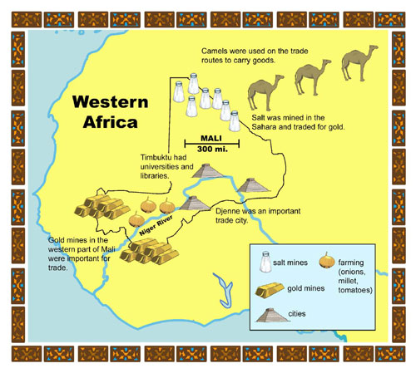

Slide 27
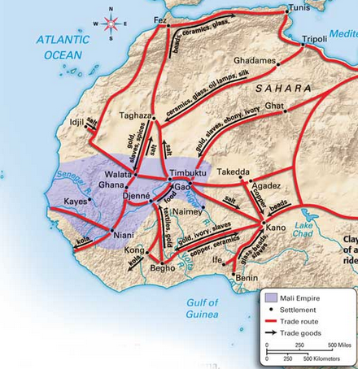

Slide 28
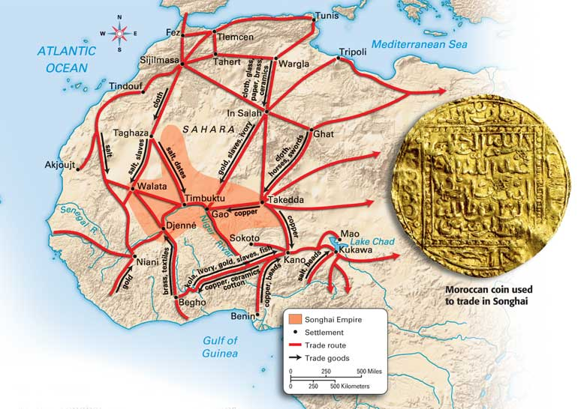

Slide 29
