Slide 2
The “Bloody Shirt” Elects Grant
In the 1868 presidential election, the Republicans offered Gen. Ulysses S. Grant. Although he had no political experience, the idea was that his war-hero status would carry him to victory.
The Democratic party was hopelessly disorganized. They agreed on their criticism of military Reconstruction, but little else. The Democrats nominated Horatio Seymour.
Seymour's popularity took a hit when he said he did not support redeeming greenback money at full value.

Slide 3
Consequently, Grant won, narrowly. His main technique was to "wave the bloody shirt," meaning to constantly remind voters of his military record and that he'd led the North to victory.
The close victory signaled a couple of things for the future: (a) tightly run and hard-fighting political parties and (b) narrow election margins of victory.

Slide 4
The Era of Good Stealings
Corruption became all too common in the post-Civil War years.
The corruption often came via the railroads, meddling with stock prices, and through corrupt judges.
Of special note were the exploits of "Jubilee" Jim Fisk and his partner Jay Gould. These two came up with, and nearly pulled off, a scheme in 1869 to corner the gold market to themselves. They tried, unsuccessfully, to get President Grant involved as well as his brother-in-law

Slide 5
In New York City, Boss Tweed ran Tammany Hall, a local political district. Boss Tweed used bribes, graft, and rigged elections to mooch money and ensure continual power for himself and his buddies.
Thomas Nast was a cartoonist who relentlessly attacked Tweed's corruption. Tweed despised Nast because, although many people in Tweed's district couldn't read about the corruption, they could understand those "them damn pictures."
Nast's cartoon's brought down Tweed. Samuel J. Tilden gained fame in prosecuting Tweed. Tweed eventually died in jail.
Tilden would ride the fame to become the nominee for president in 1876 vs. Rutherford B. Hayes

Slide 6
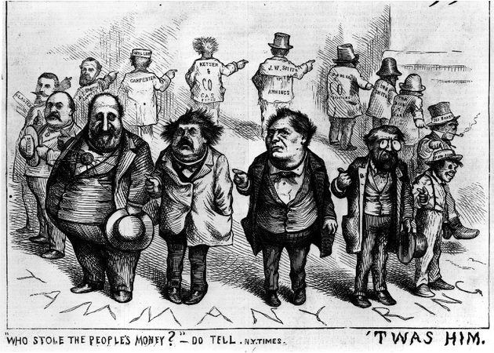

Slide 8
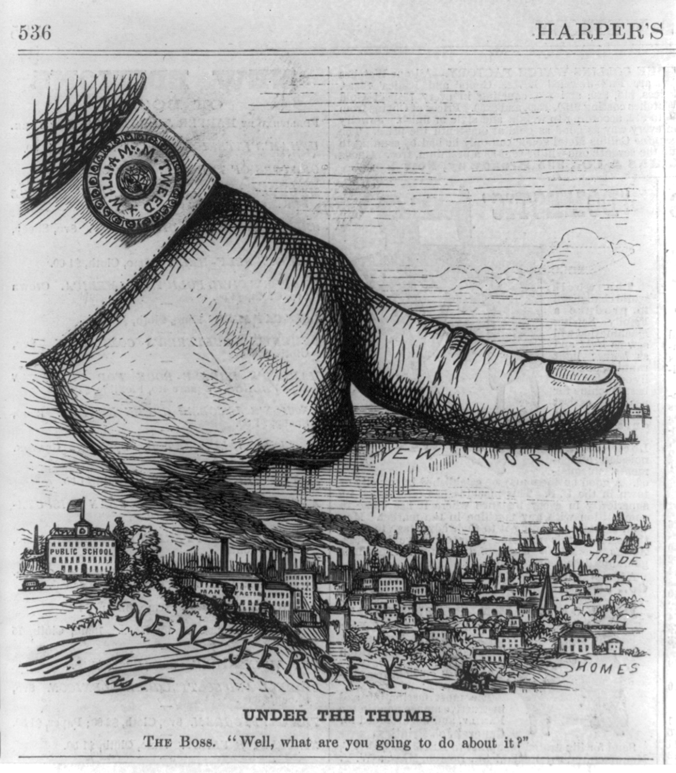

Slide 9
A Carnival of Corruption
President Grant was an honest man but there was much corruption underneath his administration. He either wasn't aware of it or failed to properly deal with it.
Many in the Dent family, his in-laws, obtained government "jobs" for themselves.
One of the worst situations was the Crédit Mobilier scandal
The company was constructing the trans-continental railroad and effectively sub-hired itself to get paid double.
They also gave stock to Congressmen in order to avoid getting busted.
A newspaper finally exposed the scandal, two Congressmen went down, and the Vice President of the U.S. had even taken payments. Though uninvolved, Grant's name was scarred.

Slide 10
The so-called "Whiskey Ring" also looked bad for Grant. Folks stole whiskey tax money from the government. Grant's own secretary was involved and, despite him saying "Let no guilty man escape," Grant helped let the thief off the hook.
Lastly, the Secretary of War William Belknap was caught swindling $24,000 by selling trinkets to the Indians

Slide 11
The Liberal Republican Revolt of 1872
By the 1872 election, many people had had enough. Reformers started the Liberal Republican Party to clean things up.
The Liberal Republicans nominated Horace Greeley, editor of the New York Tribune, as their candidate.
Strangely, the Democrats also endorsed Greeley since they were so eager to gain office.
Greeley had lambasted the Democrats through his paper, but he was soft on allowing the South to return to the nation, which the Democrats liked.
The campaigning was nasty, but colorful. Greeley was called an atheist, communist, free-lover, vegetarian, brown-bread eater, and co-signor of Jefferson Davis' bail bond. Grant was called a drunk ignoramus and swindler.

Slide 12
Grant won the election handily, 286 to 66.
The Liberal Republicans did spook the Republican Congress into passing some reforms. (1) An amnesty act was passed which removed restrictions that'd been placed on many Southerners. Also, (2) there was effort to reduce the tariff rates and (3) to clean up/out the Grant administration.

Slide 13
Depression, Deflation, and Inflation
The Panic of 1873 brought economic troubles.
It was started by over-spending with borrowed money, this time in railroads and factories. Growth was too fast and over-extended what the market could sustain.
The causes of the panic were the same old ones that’d caused recessions every 20 years that century: (1) over-speculation (or over-spending) and (2) too-easy credit given by the banks.
Initially, the panic was sparked when banks and businesses began to go bankrupt. The situation quickly snowballed from there.
Blacks were hit especially hard. Always last-to-be-hired, and now the Freedman's Savings and Trust Co. went bankrupt, black Americans lost some $7 million in savings.

Slide 14
The tough times hit debtors hard. They wanted inflationary policies to be pursued. Specifically, debtors wanted paper money ("greenbacks") printed to create inflation and thus make it easier to pay off debts. This strategy was called soft money or cheap money policies.
Opponents, usually bankers and the wealthy, favored hard money policies. That is, they favored keeping the amount of money stable (and backed by gold). To hike up inflation just to pay a debt would be unfair, they said, since the money paid back wouldn't be as valuable as when it was lent.
Grant vetoed a bill to print more money. Also, the Resumption Act was passed to actually start to (1) lower the number of greenbacks in circulation and (2) to redeem paper money at face value starting in 1879.

Slide 15
Cheap money advocates also wanted more silver to be coined—the more money in circulation, the more inflation. Games were played over the value of silver, but the bottom line is that more silver coins would mean more inflation and thus make it easier to pay off debt.
Under Grant's lead, the nation entered into a period of "contraction." This meant that the amount of money in circulation, per person, actually decreased during the 1870's
Contraction likely didn't help the recession, but it did raise the value of the dollar bill. Come 1879, few people turned in their greenbacks for gold.

Slide 16
The effect of Republican hard money policies was that the Democrats took over the House of Representatives in 1874.
And, the Greenback Labor Party was started in 1878 with the main mission of bringing cheap money policies to life

Slide 17
Pallid Politics in the Gilded Age
The term "the Gilded Age" was a phrase coined by Mark Twain to describe the late 1800's. It hinted that the times looked good (as if they were gilded or gold-covered), yet if one scratched a bit below the surface, there were problems.
The Gilded Age largely contained tight and hotly contested political races, much corruption, and shady business deals.
The Republicans of the day hinted back to Puritan ancestry and were supported in the North and West. The G.A.R., the Grand Army of the Republic, was a military veteran group that supported Republicans.
Democrats got most of their support from the South. They were supported by Lutherans and Catholics.

Slide 18
A split developed in the 1870's and 80's within the Republican party.
The Stalwarts were led by Roscoe Conkling.
The Half-Breeds were led by James G. Blaine.

Slide 19
The Hayes-Tilden Standoff, 1876
Pres. Grant considered running for a third term in 1876. The House soundly voted down that option and Grant backed off.
The Republicans nominated Rutherford B. Hayes. He was called the "Great Unknown", for obvious reasons.
He was neutral in the Conkling and Blained wars within the Republican party.
And, his greatest attribute, he came from

Slide 20
The Democrats nominated Samuel Tilden.
Tilden's claim-to-fame was that he'd nailed Boss Tweed.
Tilden got 184 electoral votes; he needed 185 to win.
20 votes were hanging in the balance due to questionable returns. Picking up only 1 vote would seee Tilden elected.

Slide 21
Both sides sent people to the questionable states (LA, SC, FL, and OR) and both men claimed victories there.
The question then became, "Which branch of Congress would count the states' votes?" Depending on who counted, the Democratic House or the Republican Senate, the vote would likely go that way.
Weeks passed and the election was at a stalemate

Slide 22
The Compromise of 1877 and the End of Reconstruction
With a president needed, Congress passed the Electoral Count Act that set up a commission to resolve the crisis.
There were 15 men (from the House, Senate, and Supreme Court) on the commission.
8 men were Republicans, 7 were Democrats
The Republicans had the upper hand and were heading toward victory among the disputed states. Democrats were outraged and began to filibuster to tie up the process.

Slide 23
Finally, a deal was made in the Compromise of 1877. True to a compromise, both sides did some give-and-take.
The North…
Got Rutherford B. Hayes elected as a Republican president.
The South…
Got a pledge that Hayes would removal of military occupation in the South.
This did happen, thus ending Reconstruction. The bad news for the freedmen was that Southern blacks were now effectively left alone to fend for themselves. The Civil Rights Act of 1875 supposedly gave equal rights to blacks, but the Supreme Court had struck much of it down. Also, white Southerners began to reclaim a strong hold on power.
Additionally, money would be spent on the Texas and Pacific railroad.

Slide 24
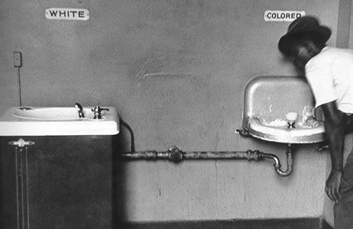
The Birth of Jim Crow in the Post-Reconstruction South

Slide 25
Because of the national compromise in 1877 to gain Southern support in the presidential election resulted in the last of the federal troops being withdrawn from the South. White Democrats had regained political power in every Southern state. These conservative, white, Democratic Redeemer governments legislated Jim Crow laws, segregating black people from the white population.

Slide 26
With the military gone, white Southerners reasserted their power over blacks. Fraud and intimidation were the tools.
Most blacks had no option but to become sharecroppers. They farmed land they didn't own, then paid hefty fees to the landlord come harvest time. The system was stacked against them so that they'd never get out of debt.
Now "free", blacks likely farmed the same land for the same man as before the Civil War.

Slide 27
Segregation (the separation of the races) also became institutionalized.
First, the states enacted codes called Jim Crow laws that legalized the segregation.
Then, the U.S. Supreme Court gave the federal okay. Plessy v. Ferguson (1896) stated that "separate but equal" facilities for the races were legal.
In reality, however, the races were indeed separate, but the facilities were hardly equal.
Segregation was carried out in nearly all public facilities such as schools, theaters, transportation, and restrooms.
Violation of these codes could have legal penalties. Or, worse, lynchings of blacks reached a record level as whites "enforced" the codes themselves.

Slide 28
Jim Crow Laws cont…
During the Reconstruction period of 1865–1877, federal law provided civil rights protection in the U.S. South for freedmen – the African Americans who had formerly been slaves. In the 1870s, Democrats gradually regained power in the Southern legislatures, sometimes as a result of elections in which paramilitary groups intimidated opponents, attacking blacks or preventing them from voting.

Slide 29
Between 1890 and 1910, ten of the eleven former Confederate states, starting with Mississippi, passed new constitutions or amendments that effectively disenfranchised most blacks and tens of thousands of poor whites through a combination of poll taxes, literacy and comprehension tests, and residency and record-keeping requirements. Grandfather Clauses temporarily permitted some illiterate whites to vote but using the same law prevented most blacks from voting.

Slide 30
Poll taxes and grandfather clause
A poll tax was used as implicit pre-condition of the exercise of the ability to vote. This tax emerged in some states of the United States in the late 19th century as part of the Jim Crow Laws. After the ability to vote was extended to all races by the enactment of the Fifteenth Amendment, many Southern states enacted poll tax laws as a means of restricting eligible voters; such laws often included a grandfather clause, which allowed any adult male whose father or grandfather had voted in a specific year prior to the abolition of slavery to vote without paying the tax.

Slide 31
Literacy Tests
The tests were usually administered orally by white local officials, who had complete discretion over who passed and who failed.
Examples of questions asked of Blacks in Alabama included:
Name all sixty-seven county judges in the state.
Name the date on which Oklahoma was admitted to the Union
How many bubbles are in a bar of soap?

Slide 32
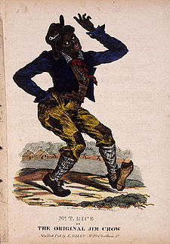

Slide 33
“Jump Jim Crow" is a song and dance from 1828 that was done in blackface by white comedian Thomas Dartmouth (T.D.) “Daddy” Rice . The first song sheet edition appeared in the early 1830s, published by E. Riley. The number was supposedly inspired by the song and dance of a crippled African slave named Jim Cuff or Jim Crow, who is variously claimed to have resided in St. Louis, Cincinnati, or Pittsburgh.
The song became a great 19th century hit and Rice performed all over the country as "Daddy Jim Crow".
"Jump Jim Crow" was a key initial step in a tradition of popular music in the United States that was based on the imitation of African-Americans

Slide 34
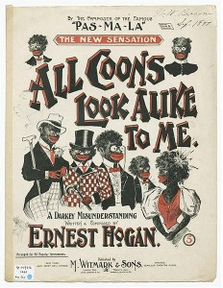

Slide 35
Class Conflicts and Ethnic Clashes
As well as ending Reconstruction, 1877 was a year of other conflicts…
The 4 largest railroads got together and decided to cut employee wages by 10%. The workers fought back by going on strike.
This railroad shut-down crippled the nation and President Hayes called in federal troops to stop the unrest amongst the striking workers.
The trouble went on several weeks but eventually ended with the workers losing on the losing side. This failed strike showed the weaknesses of the labor movement at the time.

Slide 36
Ethnic clashes were common.
The clashes came when the Chinese competed for low-paying jobs, usually with the Irish.
Most Chinese were young, poor men who'd emigrated to California. They frequently got jobs building the railroads. After the railroad boom, many returned to China, many stayed and looked for odd jobs.
Irishman Denis Kearney fired up the Irish against the Chinese in San Francisco. The argument was that the "rice eater" (Chinese) could afford to work for a cheaper wage than the "beef eater" (Irish).
The solution was for Irish gangs to take to the streets and deal their vengeance on the Chinese.
Finally, Congress passed the Chinese Exclusion Act in 1882. It forbade the immigration of Chinese to America.
This was the first immigration restriction America passed; until this point in history, immigrants simply came to America without hindrance.

Slide 38
Garfield and Arthur
The 1880 election pitted Garfield against Scott.
The Republicans nominated James A. Garfield and, as his running mate, Stalwart Chester Arthur.
Garfield was a "dark horse" candidate (a previously unknown person) but he came from the critical state of Ohio.
The Democrats nominated Gen. Winfield Scott, the Civil War hero.
Garfield won the election, but found himself trapped in the middle of the Republican feud between the Stalwarts and Half-Breeds.
Garfield's Secretary of State James Blaine (Half-Breed leader) battled his arch-enemy, Stalwart Roscoe Conkling (Stalwart leader) at every chance.

Slide 39
Garfield was assassinated by Charles J. Guiteau in September of 1881.
Guiteau said he was a Stalwart, like V.P. Chester Arthur, and his lawyers essentially used the insanity defense saying he didn't know right from wrong.
Regardless, he was found guilty and hanged.

Slide 40
As vice president, Chester Arthur became president.
Despite being considered a partisan politician, Arthur was actually reform-minded. He largely stood firm against his Stalwart buddies in their quest for the riches that come with power
The Pendleton Act was the height of political reform. It was called the "Magna Carta of civil service reform" meaning it required merit to get jobs, not simply knowing someone in a high position.
The Civil Service Commission awarded jobs based on performance rather than on how much "pull" a person had (how many buddies they had in high places).
The Pendleton Act first affected only 10% of federal jobs, but it (a) stopped the worst offenses of giving jobs to buddies and (b) it set the tone for civil service reform in the future.

Slide 42
The Blaine-Cleveland Mudslingers of 1884
The Republicans nominated James G. Blaine for president in the 1884 election.
Reform-minded Republicans didn't like this choice and went over to the Democrats. They were called "Mugwumps", supposedly with "their mug on one side and their wump on the other".
The Democrats nominated Grover Cleveland as their candidate.
The mudslinging reached the worst level up until that point during the campaign. A popular topic was Cleveland's affair and the child it had produced some 8 years earlier.
Despite the drama that Cleveland had fathered a bastard love-child, he won the election.

Slide 43
“Old Grover” Takes Over
Grover Cleveland was a Democratic president during a string of Republicans in the White House. He had a laissez-faire capitalism mindset, which made business folks very happy.
He helped bridge the North-South gap by naming two former Confederates to his cabinet.
Cleveland was a man of principle who tried to do the right thing. His initial thought was to award jobs based on merit (civil service reform).

Slide 44
Two former Confederates were named by Cleveland to his cabinet. He tried to follow the merit system (jobs went to the qualified), but was largely unsuccessful with this approach.
When pressure mounted, Cleveland fired about 80,000 of 120,000 federal employees. 40,000 were Republicans dismissed to open up jobs for Democrats.

Slide 45
Military pensions were a pain to Cleveland. The G.A.R. (Grand Army of the Republic) had considerable political clout and was mostly Republican. They pushed several bills through Congress that gave pensions to loads of veterans; many of the bills were simply money-grabbers.
Cleveland was a Democrat and not a veteran himself, thus he was in an awkward position to halt military pensions. Still, Cleveland did veto many of these military pension bills.

Slide 46
Cleveland Battles for a Lower Tariff
Cleveland had an unusual problem—a budget surplus. He couldn't justify the government profiting off of the people by taking in more than the government needed.
There were two ways to get rid of the surplus: (1) increase the spending by inventing things to spend it on, or (2) taking in less by cutting taxes. Cleveland chose the second option.
The extra surplus money largely came in from the tariff. Many people wanted it lowered. Businesses, which benefit from inflated foreign prices that a tariff provides, wanted to keep it high.
Pres. Cleveland asked Congress to reduce the tariff. The issue became a divisive one with Democrats favoring the lower tariff and Republicans favoring a higher one. Republicans began building their "war chest" of money for the next presidential campaign.

Slide 47
The tariff issue came to a full head of steam in the election of 1888.
Cleveland was up for re-election by the Democrats, Benjamin Harrison was up as the Republican.
Harrison won in a very close race in 1888. Cleveland became the first president voted out of office since Martin Van Buren.

Slide 49
The Billion Dollar Congress
After being out of the White House for 4 years, the Republicans were eager to assert their power in Congress.
The Republicans found their leader in Speaker of the House Thomas "Czar" Reed. Reed was a tall man, super debater, and had an acid-sarcastic tongue that cut at opponents. He ran the House of Representatives like a dictator.
Democrats planned to fight back by not answering to roll call and thus not achieving a quorum (minimum number necessary for a meeting).
Czar Reed solved the quorum battle by counting Democrats as present if they were there but hadn't answered the roll call.

Slide 50
With his quorum met, Czar Reed got down to business and had many bills passed…
The first "Billion Dollar Congress" where the U.S. government doled out that much money for the first time.
Pensions were liberally given to veterans.
More silver was purchased.
The McKinley Tariff (1890) hiked rates to roughly 48%, the highest peacetime rate ever.
The tariff was a double-edged sword: business folks loved the protection it gave, but farmers disliked the fact that manufactured goods were now more expensive.

Slide 51
The Drumbeat of Discontent
In 1892, a new political party emerged—the Populist Party (AKA the People's Party). It was made up of unhappy farmers and sprung out of the Farmers' Alliance.
The Populists demanded…
Inflation through "cheap money" policies of printing paper money and coining silver. They felt inflation would make it easier to pay off their debts. This was their top priority.
Other desires were: a graduated income tax (a person pays more with a higher salary); government regulation of railroads, the telegraph, and telephone; direct elections of U.S. senators by the people; initiative and referendum (so people can propose and pass laws themselves); a shorter working day; and immigration restrictions.

Slide 52
The Populist Party did surprisingly well in the election. They got 22 electoral votes by winning four western states.
The South was reluctant to vote for the Populists due to race reasons. The Populists had reached out to Southern blacks so Southern whites turned away. After the election, Southern whites tightened the screws on blacks.
Literacy tests and poll taxes were used more than ever to prevent blacks from voting.
"Grandfather clauses" were employed to allow anyone to vote whose grandfather could (thus only whites were grandfathered in).

Slide 55
Cleveland and Depression
"Old Grover" Cleveland won the election and became president again (after 4 years off).
However, the Depression of 1893 soon began. It was the first recession or depression during the industrial age. This completed the almost predictable, every-20-year cycle of panics during the 1800s (panics occurred during 1819, 1837, 1857, 1873, and 1893).
Nearly 8,000 U.S. businesses went out of business in 6 months. Railroads went under too and soup kitchens popped up to feed wandering hoboes.

Slide 56
There were other money problems to deal with…
Cleveland now had a budget deficit, whereas he'd enjoyed a surplus before.
The nation's gold supply was getting dangerously low.
The Sherman Silver Purchase Act (1890) had created a cycle: the government had to buy silver and print paper money to pay for it, the people could then turn in the paper money for gold, which they did.
The nation's gold supply once dipped below $100 million, the safe minimum.
Meanwhile, Cleveland had a malignant tumor removed from his mouth. If he'd died, Vice President Adlai Stevenson would've taken over. Stevenson was a "soft money" advocate and the gold problem would've likely worsened.

Slide 57
Congress debated repealing the Sherman Silver Purchase Act.
A young 30-year old named William Jennings Bryan became the foremost spokesman for silver and "cheap money."
Despite the arguing, the Sherman Act was repealed.
The exchange of paper money-for-gold continued still. This time the gold reserves fell to only #41 million.
Finally, Cleveland turned to J.P. Morgan. Morgan and his banker-friends agreed to lend the U.S. government $65 million in gold (of course the bankers made $7 million in profit).
This deal restored confidence and largely stemmed the problem.

Slide 58
Cleveland Breeds a Backlash
Grover Cleveland, who'd been seen as a "common-man's president", looked sneaky in his dealings in gold and with J.P. Morgan.
Cleveland was embarrassed again by the Wilson-Gorman Tariff.
Democrats had promised lower tariffs. The Wilson-Gorman barely changed the McKinley Tariff at all. Worse, the Wilson-Gorman law allowed for a 2% income tax on income over $4,000. The Supreme Court struck this down, but it looked like Cleveland and the government was giving in to the rich "fat-cats."
The Republicans began to benefit from Cleveland's recent actions.

