Slide 1
AP Psych
Have a seat, remain quiet and place all cell phones, head phones, hats and food away.
Take out project materials, as well as a Chrome book to pull up your paper.

Slide 2
Abstract
Points to be addressed:
State the research question, explaining why obtaining an answer to this question is valuable to society. (1-2 sentences)
State your hypothesis. (1 sentence)
Summarize what you did to conduct your experiment/study (1 sentence)
Summarize the results of your study. (1 sentence)
State whether results supported or disproved your hypothesis, and what these results mean for society. (1-2 sentences)

Slide 3
Introduction/Purpose
Points to be addressed:
Introductory sentence(s) that provide background or context to the research question. (3-5 sentences)
Re-state the research question, and explain why obtaining an answer to this question is valuable to society. (1-2 sentences)
State your hypothesis, providing a basis for the hypothesis. (1-2 sentences)
What is the overall purpose of your study. (1-2 sentences)

Slide 4
Background Sources
Discuss at least one previous study that influenced your study. State the purpose of that study, how it was conducted, and the results of the study.
Explain how your study is similar to but different to this previous study.
Pay attention to formatting!

Slide 5
Experimental Design/Materials
You should explain how you research study was designed.
Did you conduct an experiment, case study etc.?
Did you have an independent & dependent variable? At least define and discuss the variables used as well as how many conditions you had (if any)
Explain the process of our experiment/study:
How did you conduct the study? What did you do first, next, and so on…?
What materials did you need to complete the study?
Make sure you discuss how you obtained participants (conducting a random sample)
5-8 sentences

Slide 6
Results
What were the results of your study?
What happened during the study? Explain in detail, professionally and efficiently.
Reference table, graph or data (if available), but include the actual graph, chart at the end of the paper. Reference this in the paper as “Appendix A, B, and so on)
Was your hypothesis supported or rejected?
Did anyone make any mistakes or did something go wrong?
Could there have been any confounding variables?
6-10 sentences

Slide 7
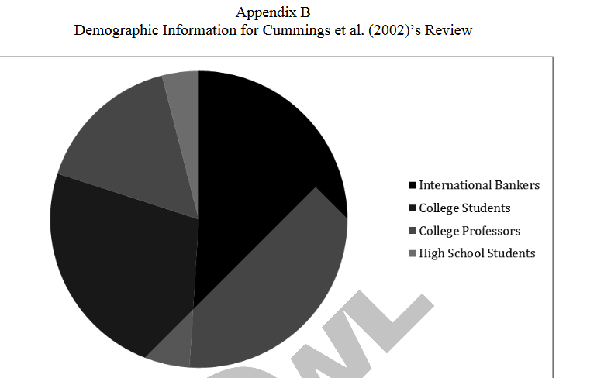

Slide 8
Discussion
What do the results tell us about society?
Were you surprised by anything?
What could’ve been done differently?
Recommendations for future studies interested in this topic.
6-8 sentences

Slide 9
Conclusion
Summarize the study.
Explain whether the hypothesis was supported and what that means for society.
Explain how your results fit into the larger context or background you discussed in the introduction.
3-5 sentences.

Slide 10
References
Need only 1 source
Make sure you format it correctly!
Try APA citation maker
References come first then appendix if applicable

