Slide 1
Learning
Chapter 6

Slide 2
Which is learned?
Sneezing when dust gets in your nose
Blinking your eye when a puff of air hits it
Drooling when you taste a lemon
Increasing heart rate when you see a spider

Slide 3
What is Learning?
Relatively permanent change in behavior or mental state based on experience
Relatively permanent change: Can be altered with future learning
Behavior: Some response to a situation or event
Mental state: knowledge, attitude, belief, strategy

Slide 4
What is NOT “learning?”
Instincts: behaviors that occur as a result of the organism’s genotype
Reflexes: behaviors that occur as a result of an automatic reaction to some environmental change or condition

Slide 5
Conditioning is another word for “learning”

Slide 6
What is Classical Conditioning?
A simple form of learning in which one stimulus calls forth the response that is usually called for by another stimulus.
This occurs when two stimuli have been associated with each other.

Slide 7
What is a stimulus?
Something that produces a reaction (response)

Slide 8
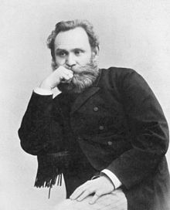
Ivan Pavlov
Russian psychologist who discovered that dogs, too, learn to associate one thing with another when food is involved.

Slide 9
Pavlov’s Experiment
What was he studying? Salivation, or mouth watering in dogs
What he discovered: Dogs mouths wouldn’t wait until they had received meat to start salivating.
For example: the dogs mouths started salivating when his assistants entered the laboratory or they heard the clinking of the food trays.
Why? Because the dogs had learned from experience that these events—the clinking of trays, the arrival of assistants—meant that food was coming.

Slide 10
Pavlov developed a new research question after observing this behavior of the dogs.
If the dogs could learn to salivate in response to the clinking of food trays because this clinking was associated with the bringing of meat, could they learn to salivate in response to any stimulus that signaled meat?
Pavlov predicted they could.

Slide 11
New stimulus: ringing of a bell
New Procedure:
He would ring a bell once dogs were strapped into harnesses
Half a second after the bell rang, meat powder was place on dogs’ tongues.
Pavlov repeated this process numerous times.
After several pairings of the meat and the bell, Pavlov changed the procedure but sounding the bell but presenting no meat.
The dogs salivated anyway.
This is classical conditioning!

Slide 12
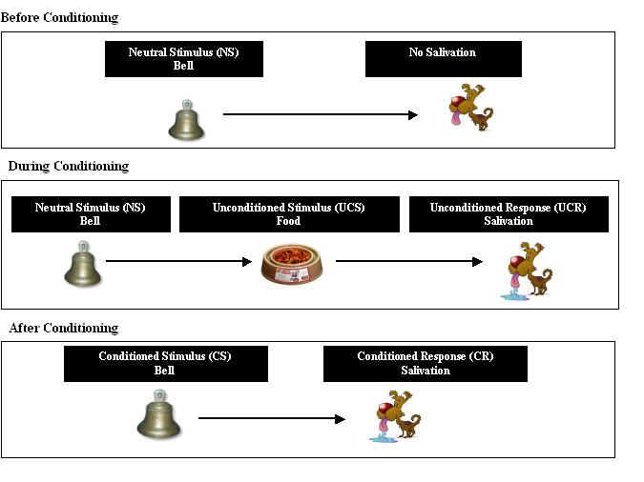
Learning

Slide 13
Unconditioned stimulus
A stimulus that causes a response that is automatic, not learned (the food/meat)
Unconditioned response
The automatic response (dogs’ salivation)
Conditioned stimulus
previously neutral stimulus that, after becoming associated with the unconditioned stimulus, eventually comes to trigger a conditioned response. (the Bell/tone)
Conditioned response
A learned response to a stimulus that was previously neutral (dogs’ salivation, to the bell)

Slide 14
What is a taste aversion?
A learned avoidance of a particular food.

Slide 15
What is extinction?
Extinction occurs when the conditioned stimulus is disconnected from the unconditioned stimulus. As a result, the conditioned stimulus no longer causes the conditioned response to occur.

Slide 16
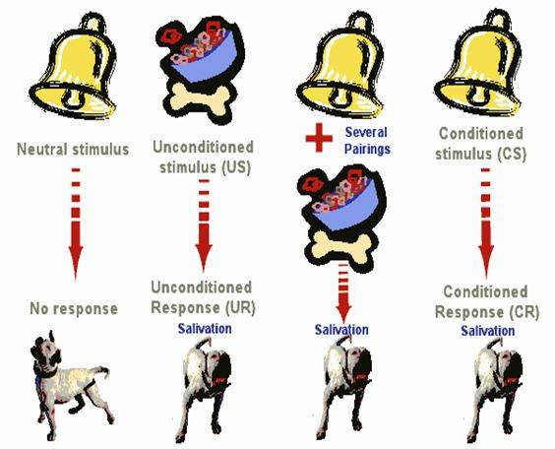
No pairing with Food
Eventually, dog will no longer respond
Extinction!

Slide 17
What is spontaneous recovery?
Organisms sometimes display responses that were extinguished earlier.

Slide 18
What is flooding?
A person is exposed to the harmless stimulus until fear responses to that stimulus are extinguished.
Ex:
A person with a fear of heights might look out a window on the sixth floor until she or he is longer upset.
A person with a fear of snakes would be put in a room with lots of harmless snakes.

Slide 19
What is systematic desensitization?
Used to help people overcome fears
First, people are taught relaxation techniques.
Then, they are exposed gradually to whatever stimulus they fear while remain relaxed.
For ex: people who are afraid of snakes will be first shown pictures of snakes, while they are relaxed.
Once they can view the pictures of snakes without losing that sense of relaxation, they will move forward to seeing actual snakes from a distance. They will practice their relaxation techniques at that stage and then, once they can remain calm, they will move forward to maybe touching a snake.

Slide 20
What is counter-conditioning?
A pleasant stimulus is paired repeatedly with a fearful one, to counteract that fear.

Slide 21
What is the Bell-Pad method?
Pg. 135

Slide 22
Operant Conditioning
What helps change behavior more, reinforcement or punishment?
Explain

Slide 23
What is operant conditioning?
People and animals learn to do things, and not to do other things, because of the results of what they do
In other words, people learn from the consequences of their actions.

Slide 24
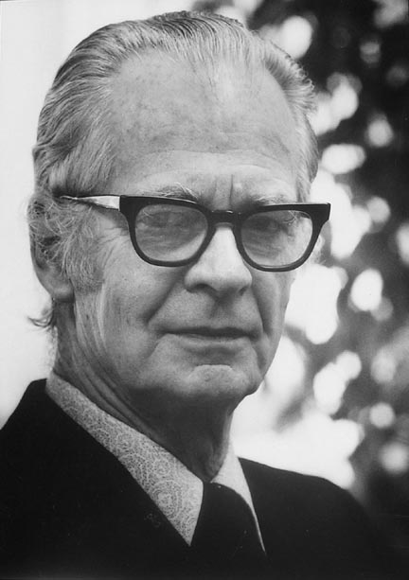
B. F. Skinner
American Psychologist
Skinner invented the operant conditioning chamber, also known as the Skinner Box
Skinner believed that the best way to understand behavior is to look at the causes of an action and its consequences. He called this approach operant conditioning.

Slide 25
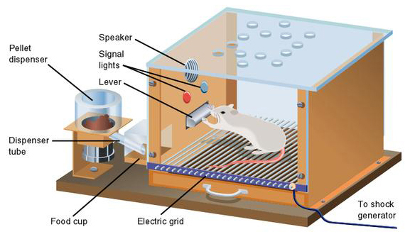
Skinner Box—Pigeon experiment
Skinner showed how positive reinforcement worked by placing a hungry rat in his Skinner box.
The box contained a lever in the side and as the rat moved about the box it would accidentally knock the lever. Immediately it did so a food pellet would drop into a container next to the lever.
The rats quickly learned to go straight to the lever after a few times of being put in the box.
The consequence of receiving food if they pressed the lever ensured that they would repeat the action again and again.

Slide 26
Reinforcement
The process by which a stimulus (in Skinner’s case, the food) increases the chances that the preceding behavior, (the pigeon’s pressing the lever) will occur again.
Reinforcement increases behavior.

Slide 27
Types of Reinforcers
Primary Reinforcers
People do not need to be taught the value of primary reinforcers.
Ex: food, water, adequate warmth
Secondary Reinforcers
Value must be learned
Ex: money, attention, social approval.

Slide 28
Punishments
decrease the frequency of behavior

Slide 29
When reinforcing behavior
Positive
Add something to change a behavior
Negative
Take something away to change behavior

Slide 30
Learning by Observation
Higher animals, especially humans, learn through observing and imitating others.
The monkey on the right imitates the monkey on the left in touching the pictures in a certain order to obtain a reward.
© Herb Terrace
©Herb Terrace
Notes:
Preview Question 14: What is observational learning, and how is it enabled by mirror neurons?

Slide 31
Imitation Onset
Learning by observation begins early in life. This 14-month-old child imitates the adult on TV in pulling a toy apart.
Meltzoff, A.N. (1998). Imitation of televised models by infants.
Child Development, 59 1221-1229. Photos Courtesy of A.N. Meltzoff and M. Hanuk.

Slide 32
Bandura's Experiments
Bandura's Bobo doll study (1961) indicated that individuals (children) learn through imitating others who receive rewards and punishments.
Courtesy of Albert Bandura, Stanford University

Slide 33
Applications of Observational Learning
Unfortunately, Bandura’s studies show that antisocial models (family, neighborhood or TV) may have antisocial effects.

Slide 34
Positive Observational Learning
Fortunately, prosocial (positive, helpful) models may have prosocial effects.
Bob Daemmrich/ The Image Works
Notes:
Preview Question 15: What is the impact of prosocial modeling and of antisocial modeling?

Slide 35
Television and Observational Learning
Gentile et al., (2004) shows that children in elementary school who are exposed to violent television, videos, and video games express increased aggression.
Ron Chapple/ Taxi/ Getty Images

Slide 36
Modeling Violence
Research shows that viewing media violence leads to an increased expression of aggression.
Bob Daemmrich/ The Image Works
Glassman/ The Image Works
Children modeling after pro wrestlers

