Slide 1
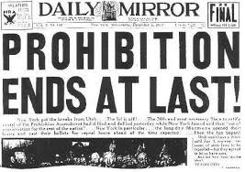
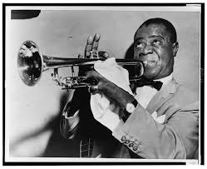
The Roaring 20’s/
The Jazz age

Slide 2
In what ways did the policies of Harding, Coolidge and Hoover reverse the successes of the Progressive Era?
The Progressive Era was a time where America began to expand their businesses, clean up corrupt governments, and to make the country more democratic. However after fighting a weary war and failed plans, America demanded stability again. Republican support grew, beginning with Warren G. Harding, a man who promised America a “return to normalcy” and our soon to be president. Harding implemented new policies that would capture the people’s eye, such as reducing taxes for corporations and wealthy individuals, enacting high protective tariffs, and limiting immigration. Harding’s reputation soon became tarnished once the people began to learn of his corrupt ways within his administration. The Teapot scandal, an incident where public lands were rented to oil companies in exchange for gifts and personal loans, provided proof Harding and his administration were corrupt.
Calvin Coolidge, Harding’s vice president, came into office after the death of Harding. Coolidge sought to clean up Harding’s corruptness by investigating the TeaPot-oil release scandal and dismissing Harding’s fraudulent attorney general. Fondness of Coolidge grew, once people realized his honesty and drive to restore faith in the government. Coolidge’s policies consisted of cutting taxes, limiting government spending, and setting high tariffs on imported good to shield the American industry. A famous quote by Coolidge states “The chief business of the American people is business.” After Coolidge’s, term as president, he decided against running again, stating “the physical strain, the death of his father, and his youngest son was depleting his energy”. Less than a year after leaving office, the US stock market crashed. Recognizing he bore some responsibility in the crash, Coolidge states his goal was to clean up corruption in the government but was well aware that he had avoided the “big problems”.
Hoover was elected as president once Coolidge stepped down from his chair. While Hoover was in office, America experienced an economic downturn, which was upon Hoover’s administration. Hoover planned to attack the Great Depression by cutting taxes and public work projects, but keeping money in the American’s pockets and people working. He contacted business pleading them to not cut wages or lay off workers. Hoover also supported the establishment of the Reconstruction Finance Corporation, which was an institution intending to help banks and factories in their recovery times. The American people turned towards blaming Hoover as responsible for their struggles, due to none of his approaches working. Hoover also made a critical mistake by signing the Smoot-Hawley-Act , which raised taxes on imports, and provoked other nations to turn their backs on American-made goods, although the country desperately needed the sales.

Slide 3
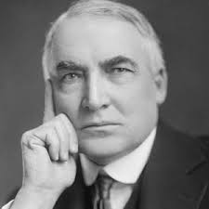
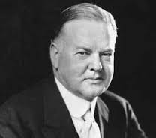
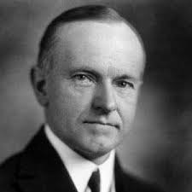
Presidents
Coolidge
Hoover
Harding

Slide 4
What was the effect of the consumer products of the 1920’s on social behavior
The Consumer products of the 1920’s displayed an advancement between the 1900’s and 20 years later. Household work began to change as the vacuum cleaner took the place of the carpet beater. Electric refrigerators, washing machines, and irons saved hours of work. Life was becoming more easier with these new inventions.
Women also introduced flappers, which was a basically a women dressed in a knee length dress and short hair, unbutton rainboots, and knee- length stockings. Many parents were against the fad, as they saw it portrayed the image that the attitude of premarital sex was accepted and replaced traditional ways making it more “modern”.

Slide 5
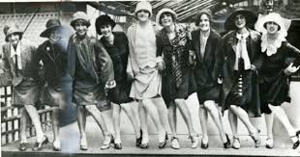
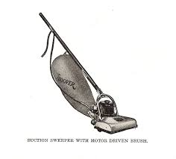
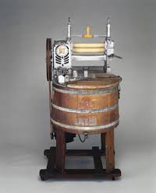
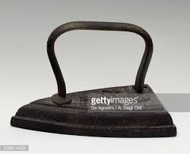
Products

Slide 6
How did the Harlem Renaissance represent a shift in the role of African- American society?
The Harlem Renaissance was an era in which African Americans began to explore new ideas, musically, poetically, and intellectually. African- Americans flocked to the North in hopes of a better chance at life. They began to write poems, make music, and act to create their own identity and culture. African American culture changed as the Harlem Renaissance blew up. People would travel to Harlem to listen to Jazz and poets speak of their poetry. During this time Langston Hughes was the ideal poet people loved. Hughes influenced other white poets with his poetic words and urged African Americans to stand up for what’s right. One of his famous poems “a dream deferred, created a different outlook for African Americans to have. People would push for their dreams and become their own person. In the Harlem Renaissance, one could see city dwellers from all over town journey to Harlem, just to listen to the good rhythms and instruments Jazz had to offer.

Slide 7
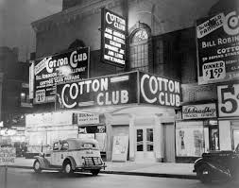
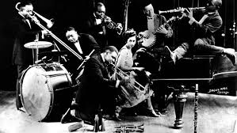
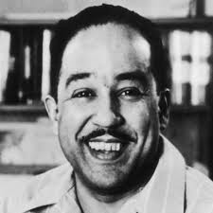
Harlem Renaissance

