Slide 1
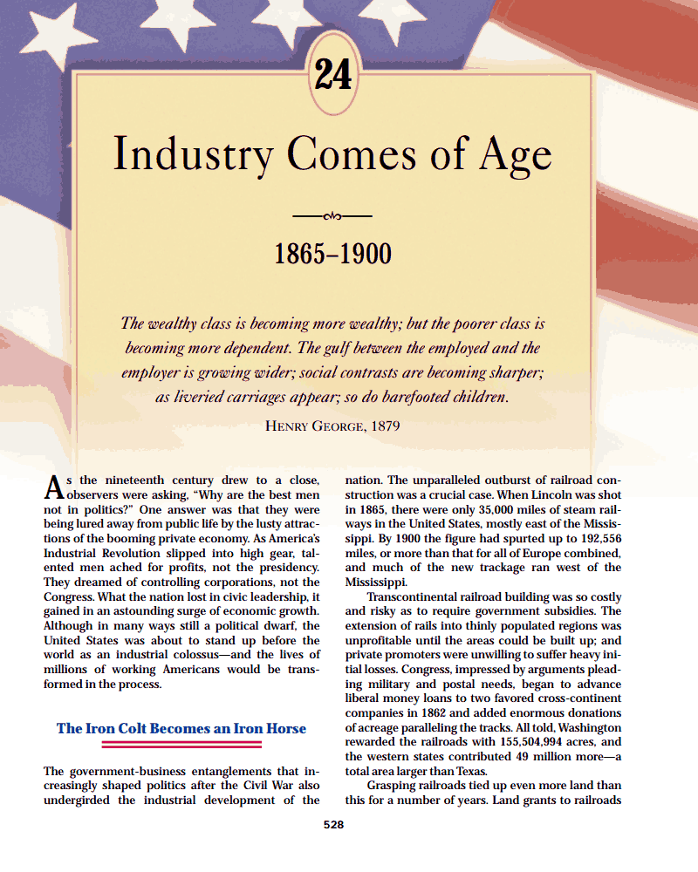

Slide 2
The Iron Colt Becomes an Iron Horse
Railroads skyrocketed after the Civil War. Track mileage increased from 35,000 miles in 1865 to over 192,000 miles by 1900.
Congress encouraged this boom by giving millions of acres of land to the railroad companies. The total acreage was greater than the size of Texas.
The land given to the railroad companies was in a checkerboard fashion along the track. Since it adjoined the track, it's value likely increased and the railroad company would then sell it for a huge profit.

Slide 3
There were arguments on both sides…
People said giving land for railroad companies to profit just wasn't right. Pres. Grover Cleveland fell in this category. He felt this system was wrong and ended it.
Others said the railroads were what gave the land most of its value. And, the value of the railroads themselves to the nation was undeniable.

Slide 5
Spanning the Continent with Rails
The ultimate goal for the rails was a transcontinental railroad (from coast to coast). The only question had been whether to build the transcontinental railroad in the North or South. With the South seceding from the nation, the North would get the railroad.
Congress commissioned the Union Pacific Railroad to push westward from Omaha, Nebraska to California.
For their efforts, the Union Pacific got (a) pay, (b) free land, (c) loans for more land or building.
The Crédit Mobilier company made fantastic profits.
Insiders in the company managed ridiculous profits for themselves through sneaky deals.
They also bribed Congressmen to look the other way.
Irish workers ("Paddies") did most of the labor on the Great Plains. Clashes with Indians were frequent.

Slide 6
The Central Pacific Railroad started in California and pushed eastward.
Leland Stanford headed up the railroad efforts from California.
He and his partners made fabulous profits but kept themselves clean and bribe-free.
Chinese laborers did most of the work.
The transcontinental railroad was completed in 1869 near Ogden, Utah. As a symbolic measure, a golden spike was driven into the track. The nation was connected by two ribbons of steel from coast to coast.

Slide 7
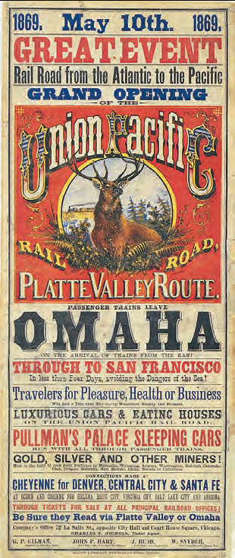
Promoting the Union Pacific Railroad, 1869
The Union Pacific Railroad--note the word “Union” --was commissioned by Congress to thrust westward from Omaha, Nebraska. The track grew at breakneck speed funded by generous land and monetary grants, with little regard for either worker safety or the Native Americans who often owned the land the tracks came to cross.
Union Pacific Railroad Museum Collection

Slide 8
Binding the Country with Railroad Ties
By 1900, four more transcontinental lines had been constructed.
The Northern Pacific Railroad from Lake Superior to Puget Sound.
The Atchison, Topeka, and Santa Fe from Kansas to California.
The Southern Pacific line went from New Orleans to San Francisco.
The Great Northern linked Duluth, MN to Seattle.
This line was constructed by James H. Hill, perhaps the greatest railroad constructor. He built railroads with a sense of public duty and shipped in cattle for the locals.
There were drawbacks to railroad construction as well. Some communities waged all they had on a railroad line increasing the value of the town. Oftentimes, tracks were laid that turned out to go "from nowhere to nothing." Bankruptcy usually followed.

Slide 9
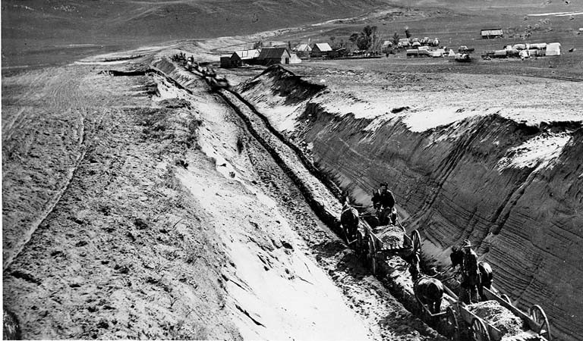
Title | Northern Pacific Railway grading crew in the Big Cut, Beaver Creek Valley, North Dakota, 1879

Slide 10
Railroad Consolidation and Mechanization
Back east where railroads were already built, changes were occurring. Cornelius Vanderbilt began consolidating the New York Central line. This meant he bought up the little railroad lines into his one company.
The results of railroad consolidation were cheaper fares/rates and faster travel times.
There were technological advances too.
Vanderbilt began to use steel rails, instead of iron. Steel was stronger, lasted longer, and didn't rust as fast as iron.
A standardized gauge (distance between tracks) made things uniform.
The Westinghouse air brake was invented which was much more efficient and safe.
Pullman Palace Cars (luxury passenger cars) were built and were very popular for travelers.
Other developments like the telegraph to communicate when tracks were open, double-tracking, and then the block signal made railroad travel safer.
Despite advances, accidents and tragedies on the track were not uncommon.

Slide 11
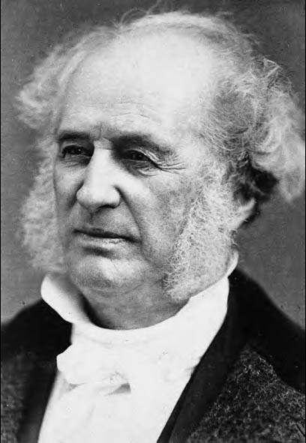
Cornelius Vanderbilt (1794–1877)
Vanderbilt established a shipping-land transit line across Nicaragua in response to the California gold rush. By the time of his death, his New York Central rail line ran from New York to Chicago and operated along more than forty-five hundred miles of track.

Slide 12
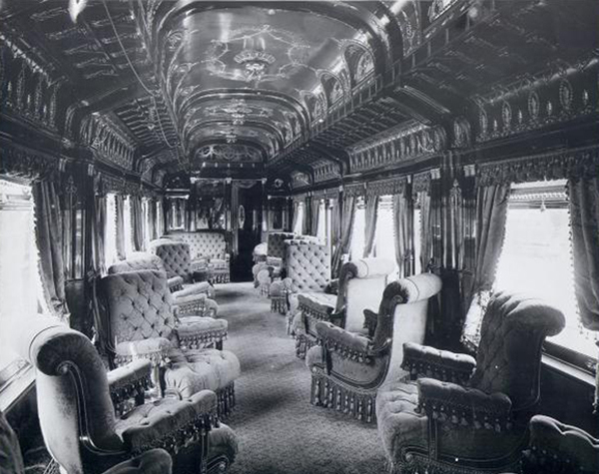

Slide 13
Revolution by Railways
The railroad network had the effect of physically linking the nation and psychologically impacted the way people looked at the country.
The greatest impact that railroads had was on business and industrialization.
Eastern and western markets were now linked.
Investors could pour money into new markets.
Travel was eased and the wide open west beckoned settlers as much as ever.
Farmers were taken out west and ore mined from the soil was shipped back east.
Cities boomed out west, notably Chicago, and the cities back east were brought whatever the West had to offer.
Fortunes and millionaires were also made by the railroads.

Slide 14
The land itself was also impacted by railroads.
The Midwestern plains became Midwestern cornfields and the great herds of buffalo began to die off ("go the way of the buffalo").
Before trains, cities and towns simply operated on their own local time. Since accurate timing was critical in safely running trains, time zones were created so that everyone would be coordinated.

Slide 15
Wrongdoing in Railroading
Railroading also had a large share of corruption.
The worst case was the Crédit Mobilier scandal where railroad men subhired themselves to get paid twice and bought Congressmen to go along.
Jay Gould boomed and busted railroad stock, making profit for himself all the way along.
A common technique was "stock watering" where railroads would artificially talk up the company so the stock would zoom upward.

Slide 16
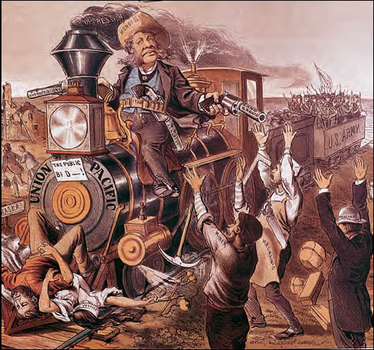
William H. Vanderbilt, Robber Baron
This 1885 cartoon takes aim at Vanderbilt’s notorious comment,
“The public be damned!”
Library of Congress

Slide 17
Other railroad tricks included…
Frequent bribes (AKA "kickbacks") were given to governmental officials and major customers.
The formation of "pools" (formally called "cartels") where competitors agreed to cooperate as if they were one mega company.
Rebates were given to large companies that shipped large quantities of goods. The complaint was that this created two rates: a cheap rate for the big companies and an expensive rate for the little guy. Railroads said they were simply rewarding their valued customers.
Free passes were often given to members of the press to ensure good publicity.

Slide 18
Government Bridles the Iron Horse
America has always believed in free enterprise—the notion that the government should stay out of private business. There was always the belief that in a free enterprise system anyone can rise from rags-to-riches or even millionaire.

Slide 19
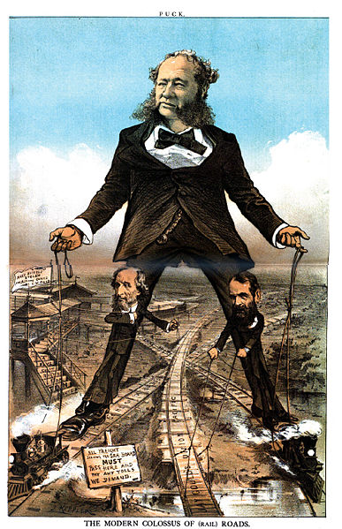
Cartoon, "The Modern Colossus of (Rail) Roads." Depicted in the center is William Henry Vanderbilt, President of the New York Central Railroad and several other railroads, as the most powerful tycoon in the U.S. railroad industry. Standing on his feet are two other powerful industry figures. On the left is Cyrus West Field, who controlled the New York Elevated Railroad Company. On the right is Jay Gould, who controlled the Union Pacific Railroad and other western railroads. The sign in the foreground reads, "All freight seeking the seaboard must pass here and pay any tolls we demand." The flag over Field's elevated railway station reads, "L Road; Many nickels stolen are millions gained; by C. W. Field." Composite cartoon created from original two-page publication.

Slide 20
Slowly the people/government did respond to the railroads and their shenanigans.
Farmers led the protest in the economic recession of the 1870's. Groups like The Grange pushed for regulation.
In the Wabash case, the supreme court said that states cannot regulate interstate trade only congress can. This meant that if any regulation were to be done, it would have to be by the U.S. Congress, not the local states.

Slide 21
Congress passed the Interstate Commerce Act (1887) that outlawed rebates and pools. It also required rates to be openly published and banned charging low rates for the long haul (to big businesses that shipped large quantities) and higher rates for the short haul (to small farmers who shipped small quantities).
Although the law intended to help the commoner, the powerful found ways around it. For instance, lawyer Richard Olney coldly concluded that the law can actually help railroads—it gave the public the image of government regulation when in reality the law did very little.

Slide 22
Alexander Graham Bell invented the telephone as a part-time hobby while teaching the deaf to speak.
Thomas Edison, the "Wizard of Menlo Park," came up with the light bulb along with many, many other inventions.

Slide 23
Miracles of Mechanization
Between 1860 and 1984 the U.S. rose from the 4th largest manufacturing nation to the 1st. The reasons were…
Liquid capital (money or a millionaire class) emerged to build new businesses.
Natural resources had always been a great asset in America. Those resources were now being put to full use.
For example, the Mesabi iron ore range of Minnesota was powering the national need for iron and steel.

Slide 24
Immigration on a huge scale kept labor cheap.
New technological advances were developed…
Eli Whitney started mass production and interchangeable parts.
Other inventions aided business and included: the cash register, the stock ticker, the typewriter (which brought women to work), the refrigerator car, the electric dynamo, and the electric railway.

Slide 25
The Trust Titan Emerges
Titans or giants of industry eventually began to emerge in each major business.
Andrew Carnegie switched from railroading to become the master of the steel industry with the U.S. Steel Corporation.
Carnegie used vertical integration to grow his business. This meant he bought out businesses that he used in the production process. For example, he'd buy the land that held the ore, then he'd buy the machines to dig it, then the ships and railroads to ship it, then the factories to forge it. Rather than pay a company along the way, he owned each step of the process.

Slide 26
John D. Rockefeller nearly monopolized the oil industry.
Rockefeller's Standard Oil Company used horizontal integration to take over the industry. In vertical integration, Standard would either force a competitor out of business or buy them out to grow even larger.
Rockefeller was very successful. The Standard Oil Company controlled 90-95% of the oil in the U.S. To get that large, he was ruthless in his tactics. It was said that his unofficial motto was "let us prey" (on the little companies).
He used a technique called interlocking directorates where his own men would be placed on the board-of-directors for "competitors." Their decisions would be to cooperate with their "competitors", not compete.

Slide 27
J.P. Morgan was a financier, not an industrialist, who gained great power and wealth. He used interlocking directorates by putting his own people on the boards of struggling companies then controlling them as one unit.

Slide 28
The Supremacy of Steel
Steel became king after the Civil War. Steel built the industrial revolution.
Right after the Civil War steel was expensive and used sparingly, as for cutlery.
Within 20 years, the U.S. had become the world's top steel producer and by 1900 the U.S. made more steel than Britain and Germany combined.
The main advance was the Bessemer Process where cool air is blown over red hot iron to burn off the impurities and produce stronger and cheaper steel.
A second reason for the growth of American steel was that the U.S. was blessed with loads of iron and coal, the two main ingredients for steel.
When the Bessemer Process and the materials were added to a seemingly endless labor supply, steel boomed.

Slide 29
Carnegie and Other Sultans of Steel
Andrew Carnegie, the son of Scottish immigrants, was the classic rags-to-riches story.
He worked his way up through good old-fashioned hard work.
He started as a bobbin-boy in a cotton mill making $1.20 per week.
His next stop was as a telegraph errand boy, then telegraph operator, then as a railroad executive's secretary.
After gaining some capital in railroading, Carnegie entered the steel industry.
Carnegie's U.S. Steel Corp. became dominant in steel largely because of his administrative abilities and knack for hiring excellent people.
By 1900, U.S. Steel produced 1/4 of the nation's Bessemer steel. Carnegie made $25 million, tax free.

Slide 31
J.P. Morgan was the premier financier of the day. Morgan made his money not by making anything, but by making deals—deals in railroads, insurance, banks, etc.
Carnegie was ready to retire in 1900 and wanted to sell U.S. Steel. A deal was made where J.P. Morgan bought Carnegie's steel empire for $400 million.
Carnegie devoted the rest of his life to philanthropy—giving the money away. He gave $350 million to build libraries, support the arts, and to other charities.
J.P. Morgan wasted no time and quickly built U.S. Steel into the world's first billion dollar company (it was valued at $1.4 billion).

Slide 32
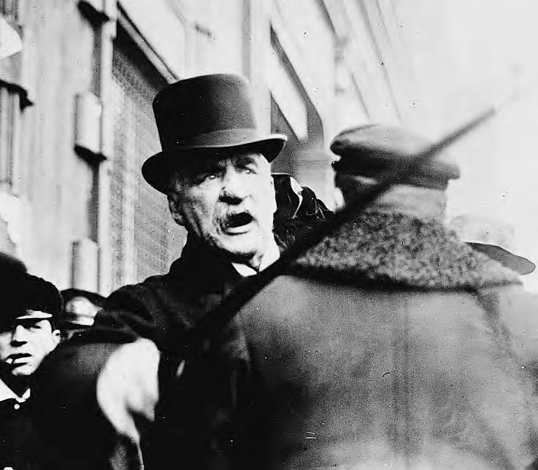
J. P. Morgan (1837–1913)
As the most influential banker of his day, he symbolized to many people the power and arrogance of “finance capitalism.” The chronic skin disorder on his nose inspired the taunt, “Johnny Morgan’s nasal organ has a purple hue.”
Library of Congress

Slide 33
Rockefeller Grows an American Beauty Rose
Drake's Folly" started the oil boom with a gusher in Pennsylvania. Kerosene (for lamps) enjoyed a mini-boom but its days were numbered.
Just as whaling (as chronicled in Herman Melville's Moby Dick) was replaced by kerosene, kerosene would be replaced by electricity and the electric light bulb.
Kerosene did foreshadow the age of oil, however. The internal combustion engine was being perfected at roughly the same time.

Slide 34
At first the oil industry was wide open to all. But, John D. Rockefeller got a leg up on the competition with his Standard Oil Company. Standard Oil eventually sold 95% of all oil sold in the U.S.
Rockefeller was criticized for his business practices as being ruthless.
He used horizontal integration to buy up competitors.
Or, he simply drove competitors out of business. "Undercutting", where he charged less for oil than the market price just to drive competitors under, was a common practice. This helped earn him the nickname "Reckafellow."
His tactics were aided by "economies of scale" where large companies produce a cheaper product and thus put even more pressure on the "little guy."

Slide 35
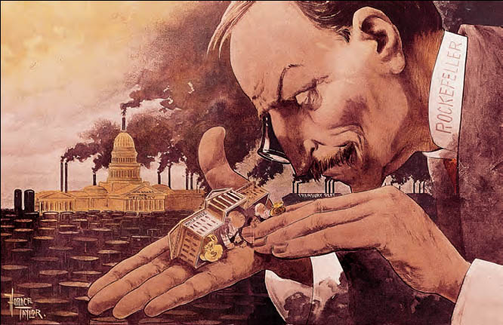
Washington as Seen by the Trusts, 1900
“What a funny little government,” John D. Rockefeller observes in this satirical cartoon. His own wealth and power are presumed to dwarf the resources of the federal government.
Library of Congress

Slide 36
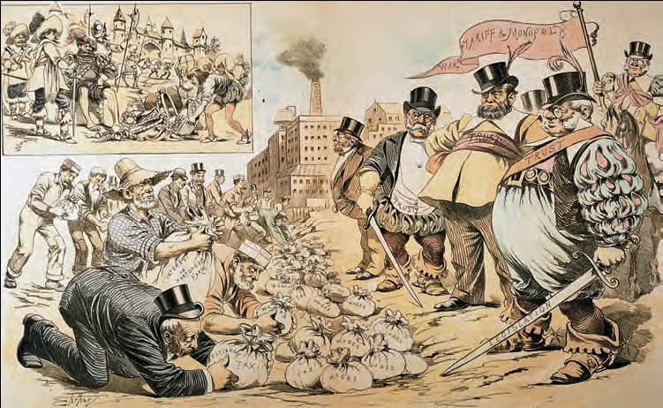
The Robber Barons of Today, 1889
This cartoon bitterly caricatures the alleged rapacity of the “Robber Barons.” Here an intimidated people pay servile tribute to the lordly tycoons.
The Granger Collection

Slide 37
Other trusts emerged as well including Gustavus F. Swift and Philip Armour, the meat packers and hot dog makers

Slide 38
The Gospel of Wealth
As a filthy-rich class emerged, so too did various views on wealth…
Some, like Rockefeller, felt their wealth came from God. This was similar to the old divine-right monarchies of Europe.
Carnegie spoke of a Gospel of Wealth saying the rich had a moral duty to spread the wealth (like spreading the Gospel).

Slide 39
Perhaps the most common idea was Social Darwinism.
Social Darwinism transposed Charles Darwin's new evolution and survival-of-the-fittest theories from biology to society.
The Social Darwinism idea said that the reason certain people were at the top of their business was because they were the best adapted at running that industry. The opposite, of course, would apply to anyone at the bottom of the social or economic ladder.
Strangely, it was a minister that did the most to promote Social Darwinism. Rev. Russell Conwell became rich himself while delivering his sermon/lecture Acres of Diamonds thousands of times. His theme was that people earn their lots in life, either good or bad.

Slide 40
By the later 1800's, a plutocracy or rule by rich plutocrats, had replaced the old slavocracy of antebellum days.
The rulings that only the U.S. Congress could regulate interstate trade left big business largely unregulated. The businesses could easily bribe state legislators to vote pro-business.
Also, corporate lawyers used the 14th Amendment to the benefit of the corporation. The amendment was written to give former slaves citizenship rights, but corporate lawyers got corporations classified as legal people with full citizenship rights as well.

Slide 41
Government Tackles the Trust Evil
The Sherman Anti-Trust Act (1890) was enacted in attempt to outlaw trusts or monopolies.
The law forbade "combinations" such as…
"pools" or cartels—where "competitors" got together and behaved as one mega-company.
interlocking directorates—where the same people sat on the board-of-directors of "competitors", then made the same decisions for each company, and thus the "competitors" behaved as one mega-company.
holding companies—where the holding company bought up controlling shares of stock in a group of competitors, then managed each "competitor" as one mega-company.

Slide 43
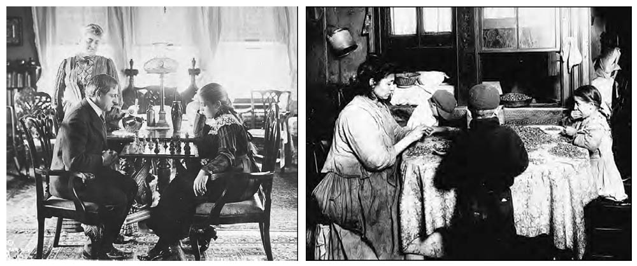
The New Rich and the New Immigrants
A well-to-do family plays chess at its parlor table (left), while a tenement family does “piecework” around its kitchen table--shelling nuts for commercial use. The young working girl seems to be “snitching” some nuts for herself. The apparently growing gulf between the rich and the poor deeply worried reformers in the late nineteenth century. They feared that democracy could not survive in the face of such gross inequality.
The Granger Collection/International Museum of Photography/ George Eastman House

Slide 44
The Sherman Anti-Trust Act was not effective because (a) proving combinations exist, especially with pools, can be difficult, and (b) it lacked real teeth in enforcement.
In 1914 the anti-trust movement finally gained real muscle to enforce its provisions.

Slide 45
The South in the Age of Industry
Whereas the Industrial Revolution mostly benefited the North, the South by 1900 was still struggling.
The South still produced less than before the Civil War and the farming was split up into small chunks, often done by sharecroppers who "rented" the land.
James Buchanan Duke gave the South a boost when the cigarette industry took off. His American Tobacco Company made him a fortune, enough to earn his namesake Duke University in Durham, NC.

Slide 46
Henry W. Grady, editor of the Atlanta Constitution, urged Southerners to beat the Yankees at their own game of industry. Still, old ways die hard and industry was slow to grow in the South.
The railroads were stacked against Southern industry as well. Rates for manufactured goods going southward were cheaper than northward. Rates for raw materials favored the South.
Cotton mills did begin to emerge down South.
The benefits of the mill jobs were mixed. It meant jobs, but it also meant cheap labor and the desire to keep labor rates low—often half of what Northern mill hands earned. Still, the mills were a thankful blessing to many Southerners.

Slide 47
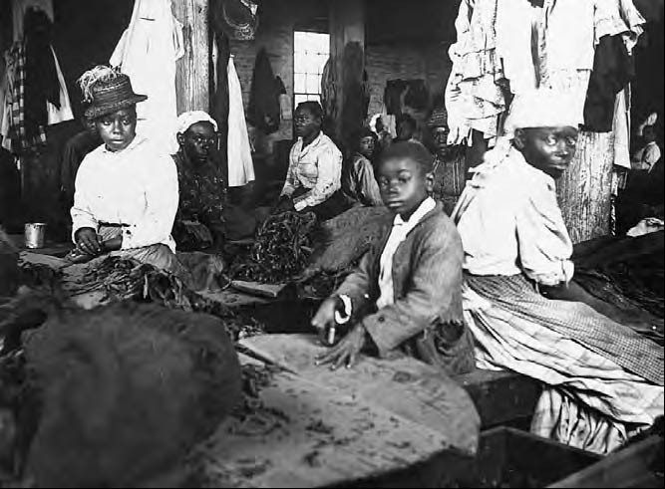
A Virginia Tobacco Factory, c. 1880
The employment of women and children was a common practice in late-nineteenth-century American industry, north as well as south.
Valentine Richmond History Center

Slide 48
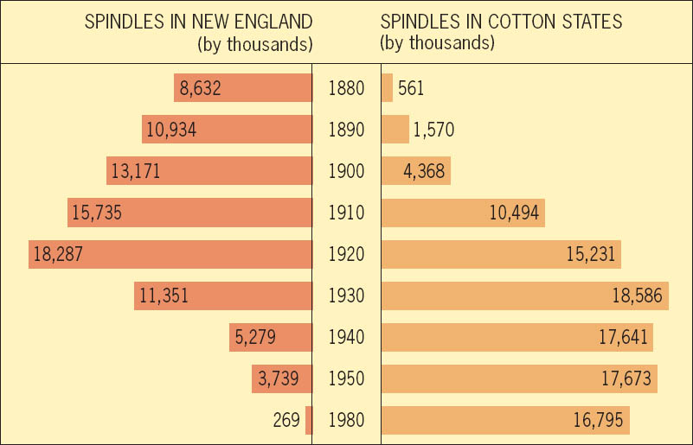
Cotton Manufacturing Moves South, 1880–1980
Textile manufacturing usually looms large in the early stages of industrial development. In the later stages, it gives way to higher-technology businesses. This trend can be seen here, both in the migration of textile manufacturing to the southern United States and in the decline in the number of spindles in the United States as a whole since the 1930s, as developing Third World countries became major textile producers.
Copyright (c) Houghton Mifflin Company. All Rights Reserved.

Slide 50
The Impact of the New Industrial Revolution on America
Despite its drawbacks, the Industrial Revolution caused the overall standard of living for Americans to improve.
The old Jefferson vs. Hamilton dispute had also been solved: Jefferson's ideals of small-town agriculture was being trumped by Hamilton's big-city business.
Lifestyles changed as well. The "can see, 'til can't see" farmer became a factory worker that labored from whistle to whistle.
Women gained increasing roles in business as well as secretaries and in clerical jobs.
This "new woman" was idealized by the "Gibson Girl," illustrations by Charles Dana Gibson of attractive, stylish, and athletic women active outside of the home.
Still, this increased role in the workplace shouldn't be over-stated. The traditional role of women as manager of the household was still the top "job" for women.

Slide 51
Society had been transformed from self-employed farmers to employed wage-earners.
The Industrial Revolution flooded the American market so businesses began to look overseas; American imperialism would soon follow.

Slide 52
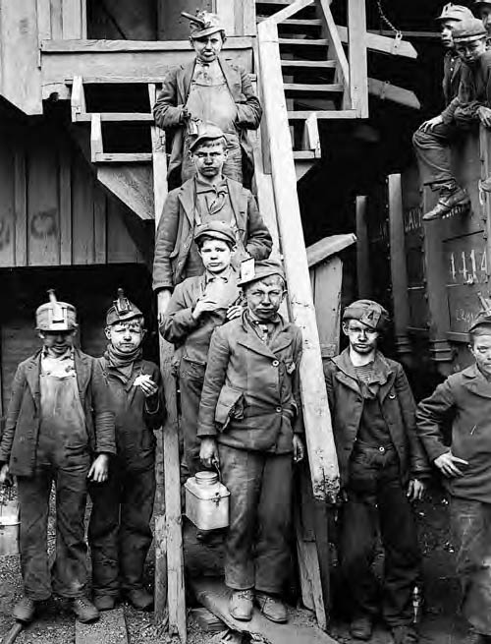
Breaker Boys at Woodward Coal Mining, Kingston, Pennsylvania, c. 1900
Photographer Lewis Hine captured the grimness of these mine helpers’ lives. For hours they sat on benches above a moving belt kicking large pieces of coal with their feet, breaking the lumps to uniform size for shipment. Photographs like this one became icons of the reform crusade against child labor, a campaign crowned with success only with the passage of the Fair Labor Standards Act in 1938.
Library of Congress

Slide 53
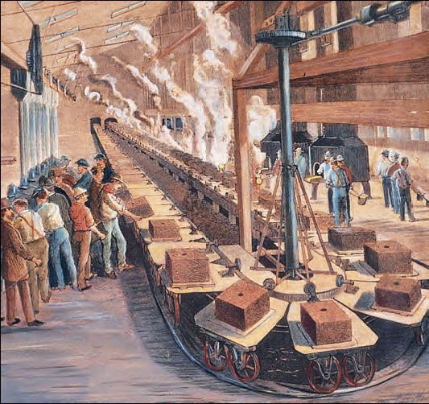
Assembly Line, Westinghouse Foundry, Pittsburgh, 1890
Technological innovations like this continuous assembly line created abundant employment opportunities for semiskilled workers, many of them immigrants from eastern and southern Europe.
© Bettmann/ CORBIS

Slide 54
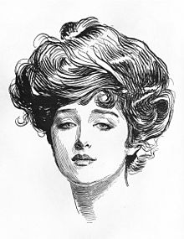
Gibson Girl, 1889.
Illustrator Charles Dana Gibson created a sensation with his drawings of healthy, athletic, young women. The image of the “Gibson Girl” inspired new standards of female fashion as the twentieth century opened, and came to symbolize women’s growing independence and assertiveness.

Slide 55
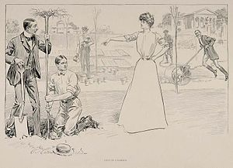

Slide 56
In Unions There Is Strength
The rise of industry meant the rise of the factory worker. This yielded both good and bad results.
The positive was that (a) there actually were jobs and (b) that the overall standard-of-living did in fact rise.
There were also many negative effects…
Immigration was increasing which meant wages were cheap. For employers, replacement of "uppity" or troublesome workers was easy enough with eager immigrants.

Slide 57
Workers united in unions in hopes of finding strength in numbers. The union's main weapon of striking was still not very effective because…
Employers could hire lawyers to wrangle around the issues.
"Scabs," or part-time replacement workers could be brought in and union leaders could be intimidated or beaten down.
Big-business could call on the courts to order strikers back to work.
Big-business could mandate "ironclad oaths" or "yellow dog contracts" where workers pledged to not join a union.
Big-business could "black list" troublesome workers meaning no other employer would hire that person.
Some businesses ran "company towns" where workers were paid "scrip" (not real money but company money good at the company store). Workers were also given easy credit meaning they usually got themselves into debt and never got out.

Slide 58
In a broader sense, the idea of Social Darwinism pervaded society and lended workers little pity. It said a person's lot in life was the result of his or her own doing (or lack of doing)—the rich had earned their position and the poor had the same opportunity to do so.

Slide 59
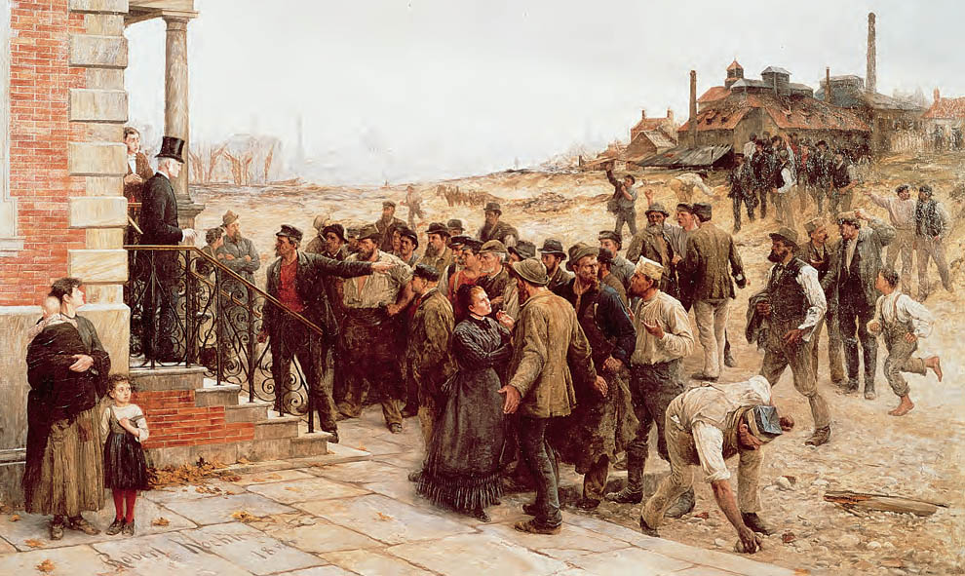
The Strike, by Robert Koehler, 1886
Scenes like this were becoming more typical of American life in the late nineteenth century as industrialism advanced spectacularly and sometimes ruthlessly. Here Koehler (1850-1917) shows an entire community of men, women, and children--many of them apparently immigrant newcomers--challenging the power of the “boss.” The scene is tense but orderly, though violence seems to be imminent as one striker reaches for a rock.
Deutsches Historisches Museum, Berlin, Germany/ AKG, London

Slide 60
Labor Limps Along
Labor unions began to grow in number after the Civil War.
The National Labor Union (1866) lasted 6 years and had 600,000 members—skilled, unskilled, and farmers.
Par-for-the-times, blacks and women were only slightly sought after and Chinese immigrants were excluded.
Their goals were (a) arbitration (settlement by a mediator) of worker complaints and (b) an 8 hour workday (which was granted to government workers).
The 1873 depression ruined the National Labor Union.

Slide 61
The Knights of Labor began in secrecy and then came out in 1881.
It welcomed skilled and unskilled, women and blacks. The only people banned were "non producers": liquor dealers, professional gamblers, lawyers, bankers, and stockbrokers,
The Knights sought workers' cooperatives (to pool their money and resources), better working conditions, and the 8 hour workday.
They had some success, led by Terence V. Powderly. They got the 8 hour day in several places and pulled off a successful strike against Jay Gould's Wabash Railroad (1885). After this their numbers bloomed to 750,000 members.

Slide 62
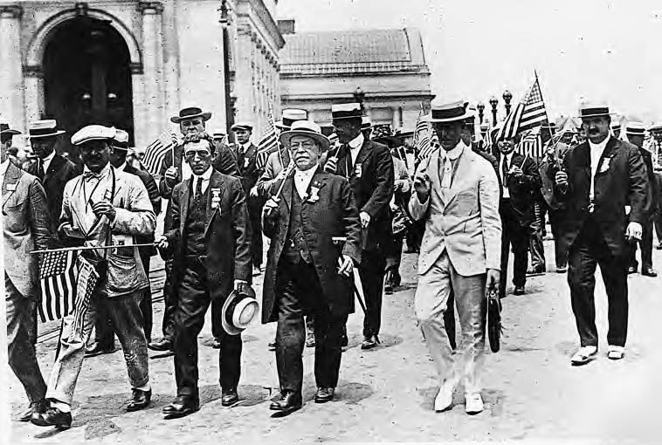
Samuel Gompers (1850–1924)
Gompers (second from the right in the first row) shown here marching in a labor demonstration in Washington, D.C., in 1919, once declared: “Show me the country in which there are no strikes and I’ll show you that country in which there is no liberty.”
Brown Brothers

Slide 63
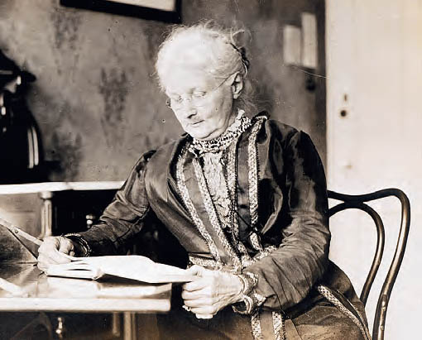
“Mother Jones”
Mary Harris Jones, better known as "Mother Jones," was a prominent figure in the urban industrial workers movement.
The Granger Collection

Slide 64
Unhorsing the Knights of Labor
The Knights became active in a series of May Day strikes. The strikes had mixed results. but more importantly, the strikes hurt the Knights public image.
The "Haymarket Square Incident" occurred in Chicago in 1886. There strikers were intermingled with a handful of anarchists calling for overthrow of the government.
A bombing took place and a handful of bystanders, including police, were killed or injured. The anarchists were the likely culprit, but the public placed blame on the Knights and unions.
Eight anarchists were arrested; five were given the death sentence and the other three were given hefty sentences. They were eventually pardoned by Governor John P. Atlgeld in 1892. These actions were unpopular and cost him reelection.
The end result of the Haymarket Square incident was a distrust in unions and a decline in their membership.

Slide 65
The AF of L to the Fore
The American Federation of Labor (called the "AF of L")was started by Samuel Gompers in 1886.
The AF of L was made up of small, independent unions. They were tied together by their association with the AF of L.
Gompers desire for workers was summed up simply as "more." He sought what unions always seek: better wages, shorter hours, better working conditions.
Gompers wanted "trade agreements" to allow the "closed shop" (businesses closed to non-union members, or in other words, you must join the union in order to work there).
His main weapons were the boycott and the strike. To boycott, "We don't patronize" sign would be placed on unpopular businesses. To strike, union dues would build up funds to hopefully see them through the strike.

Slide 66
The AF of L was made up of skilled craftsmen. Unskilled workers were not included because they were too easily replaced and thus weakened the union. (This exclusion of unskilled workers is a notable difference from the CIO which came later and included the unskilled).
They eventually garnered 500,000 members and were criticized as the "labor trust." Still, this amounted to only about 3% of the labor force in the U.S.

Slide 67
Around 1900, views on labor unions began to turn for the better. Workers were allowed to organize (unionize), collectively bargain, and strike. The most symbolic achievement for workers was the passage of Labor Day (1894) where workers, ironically, take the day off from work.
The rise of unions could be summed up as a long battle that was just beginning.
Strikes, negotiations, firings, hirings, etc. were to still very much to come.
In the grand scheme of things, despite unions' constant efforts, labor unions in the 1800's were largely ineffective mostly due to the never-ending stream of immigrants which always assured an eager labor force.

