Slide 1
Foreign Policy
What anti-imperialistic complaints were lodged against the building of the Panama Canal?
The building of the panama canal would lead to the US taking control of panama and would lead to problems like in Cuba.
The Panama Canal Treaty of 1903 gave the United States ownership of a path extending five miles on each side of the proposed canal. Essentially, the United States could treat this land as if it were U.S. territory.
The building of the canal would also lead to bad relations with Latin American country's
Panama was originally part of Colombia . How ever Colombia refused to give up the land needed for the construction of the panama canal. The US assisted Panamas independence.
Originally the US proposed the Hay-Herran Treaty to Colombia (rejected). So the US helped Panama gain independence so the canal construction could take place.

Slide 2
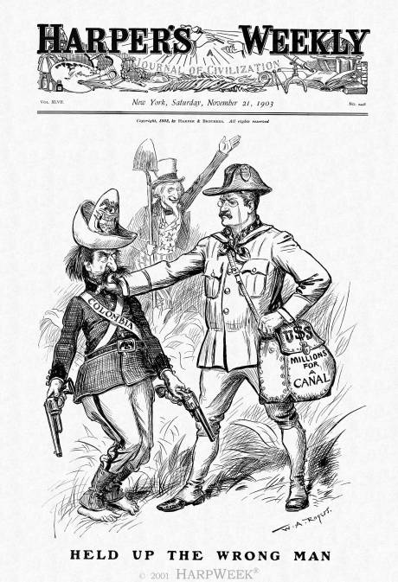
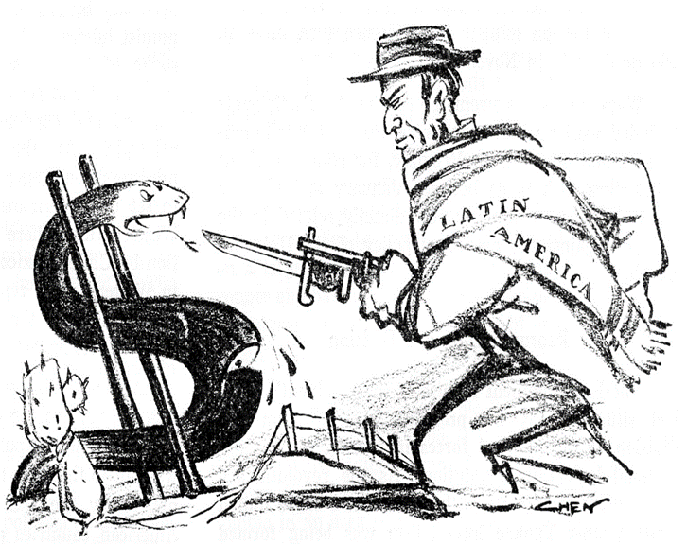

Slide 3
Foreign Policy
How did America become involved in World War I? Why did they enter on the side of the British?
The US was desperately trying to remain neutral however to follow things pushed the US to join WWI.
Propaganda: Stressed German barbarism, illustrated Kaiser as some sort of madman, Insisted Americans to support allies throughout neutrality
The sinking of several ships by German U-boats. -Lusitania was a Ship traveling from NY to Great Britain 128 Americans where killed in its sinking.
German attempt in the Zimmerman Note to get Mexico to declare war on the U.S.
U.S. Business Interests- US trade with the allies increased from 825 million in 1914 to 3.2 billion in 1916.
America was going to fight it was always going to be on the side of Britain & France they were simply far more closely ideologically aligned with these nations . The US also had a pretty close relation ship with Great Britain, and they where trading partners.

Slide 4
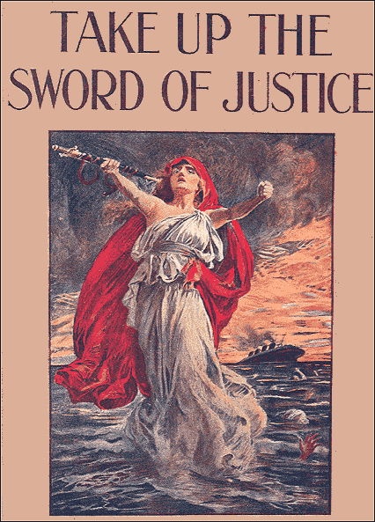
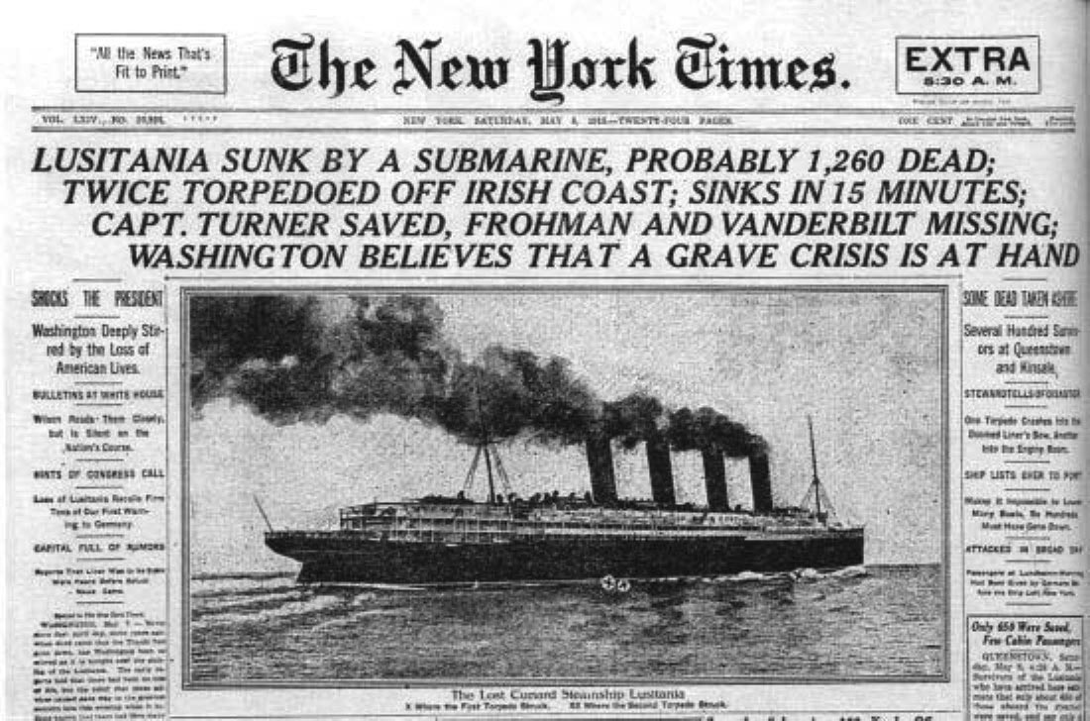
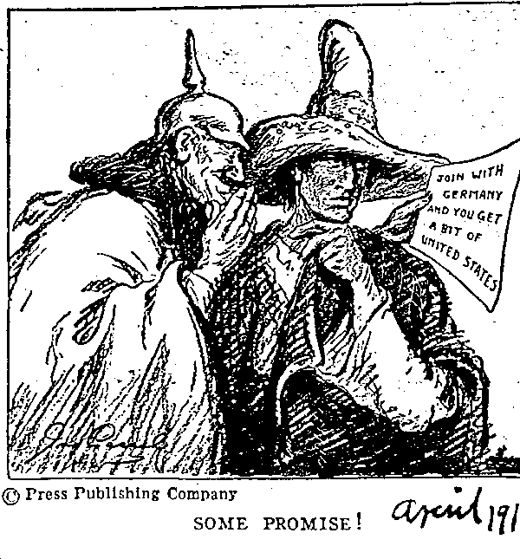
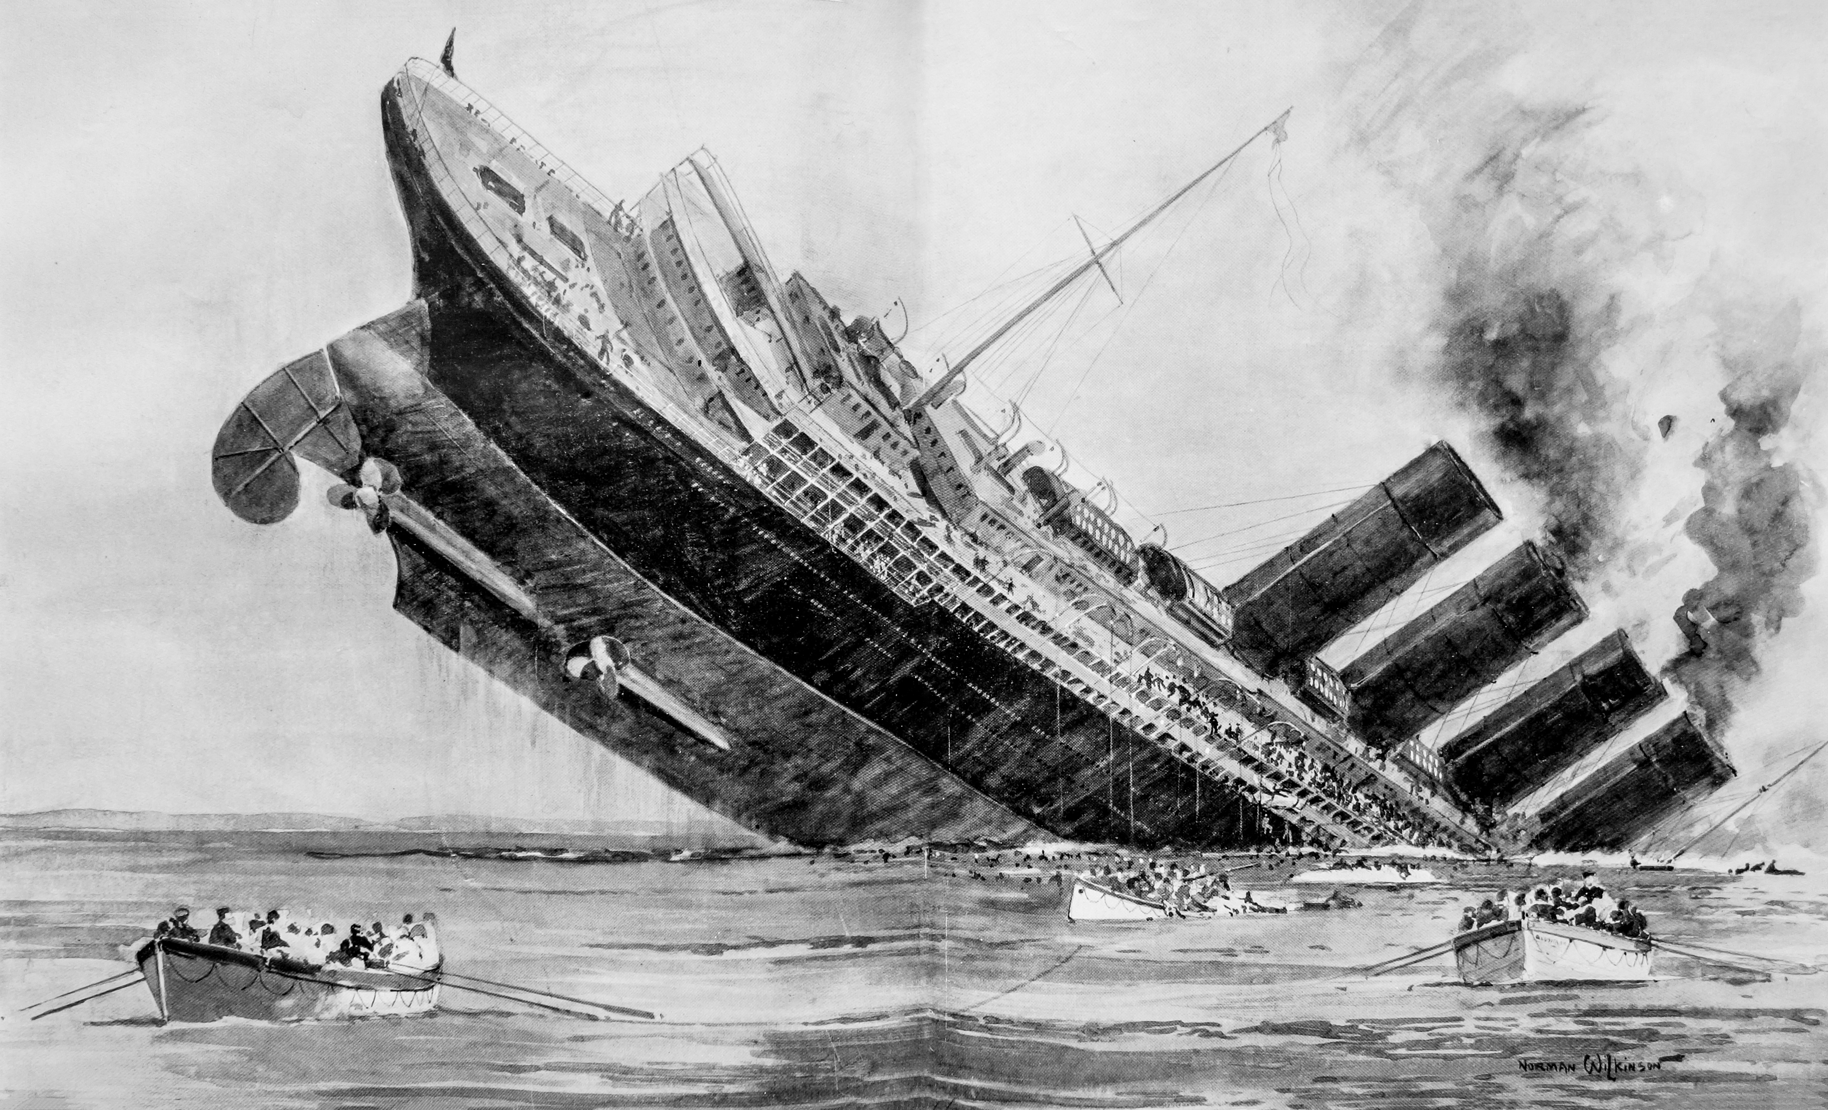
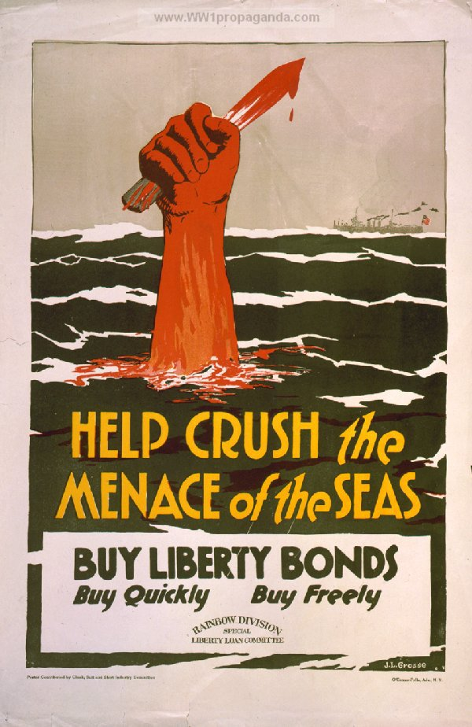

Slide 5
Foreign Policy
To what extend were Woodrow Wilson’s idealistic views accepted by Americans and the world?
Idealism: the practice of forming or pursuing ideals, especially unrealistically.
Woodrow Wilsons’s idealistic views where pretty much not accepted by the world, especially the United States its self.
His Fourteen Points , which where his goals in peace negotiations after WWI. These points where unrealistically “peaceful” and misleading. They where unrealistic because, they required a world without regional and cultural tensions , the likes of which dominated Europe during this time , at this time they couldn’t be applied with any hope of a positive affect. The European allies rejected the 14 points and implemented the harsh Treaty of Versailles.
As part of his 14 points Wilson proposed the-
The League of Nations: An international organization established after World War I under the provisions of the Treaty of Versailles. Its main goal to solve international disputes peacefully.
Congress disapproved of this. Congress believed that a membership in the L of N would involve America in disputes, perhaps even wars, that had nothing to do with the USA. – US didn’t ratify treaty of Versailles

Slide 6
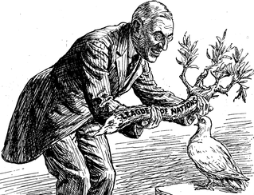
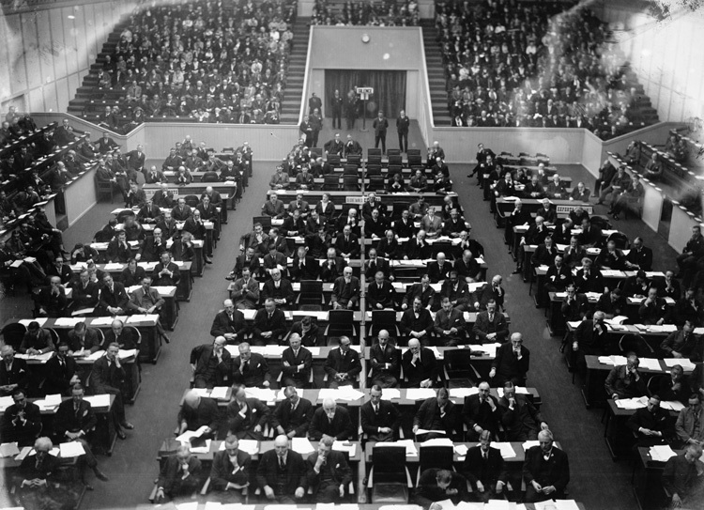
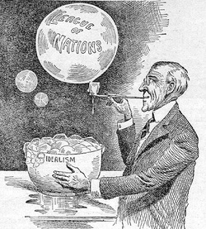

Slide 7
Foreign Policy
What events helped change American public opinion from one of neutrality to one of intervention?
In the years after the first world war it was clear that American Intervention in that war was a big mistake. So during the 1920’s and 30’s they pursued isolation and aimed at preventing war . Several peace societies played a big role in this, many of which were part of larger international movements. Their goals where large scale disarmament, and international treaties to abolish war. -1922: Great powers sign agreement to reduce battle ships. – 1928 most of the world's nations signed the Kellogg-Briand Pact, in which the cosigners pledged never again to go to war with one another.
(1930’s) :Events during this time made it clear to Americans that such agreements where not enough: Japan occupies Manchuria (1931) . German government authorizes a huge new arms buildup (1935) . Italy invades Ethiopia (1935).
^ In response to this. Congress passes the Neutrality Acts : a series of laws banning arms sales and loans to countries at war. Hoping this would avoid US intervention in any European conflict.
In (1939) when War did break out it was clear that Germany was the aggressor. President Roosevelt sought to provide assistance to the Allies while still keeping the US neutral. Roosevelt requested Congress to amend the Neutrality laws to allow arms sales to the allies. After France is overran by the Germans he asks congress to provide Britain with direct military aid. Legislature agrees to both proposals after an intense debate.
FDR’s proposals caused major controversy in the country. Some agreeing others disagreeing with his plans and intentions. This debate was still rampant when Japan attacked Pearl Harbor on December 7, 1941. The US would now be fully participating in WWII .

Slide 8
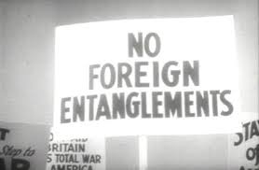
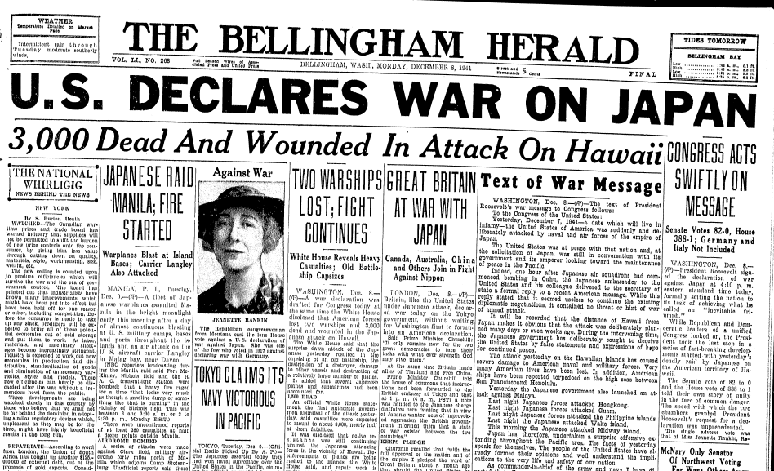
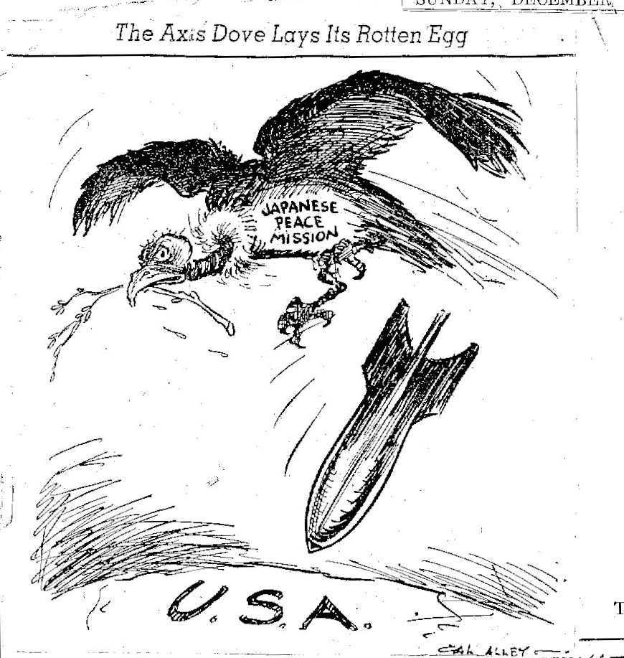

Slide 9
Progressive era
Definitions:
Monopoly: the exclusive possession or control of the supply or trade in a commodity or service.
Conservative: Conservatism was a political philosophy based on tradition and social stability, favoring obedience to political authority and organized religion.
Progressive: A political attitude favoring or advocating changes or reform. Progressivism is often viewed in opposition to conservative or reactionary ideologies. Such as equal rights of women etc.
Trust(noun) : an American English term for a large business with significant market power. is often used in a historical sense to refer to monopolies or near-monopolies in the United States during the Second Industrial Revolution in the 19th century and early 20th century.

Slide 10
Progressive Era
What role did Presidents take in the Progressive Movement?
(definition) Progressive Era: the Progressive Era, a period of uncertainty, social activism and political reform in the United States, had been established from 1890–1920. The main objective of the Progressive movement was eliminating corruption in government.
Theodore Roosevelt: 26th President of the United States and a supporter of the “New Nationalist” variety of progressivism. His administration pursued some extensively broadcasted anti-trust cases against big companies like the Northern securities. Through out his presidency , Roosevelt tried to bring balance between employees and employers in labor disagreements and promised to give a “square deal” that put a persons character over his class. – Also a believer on “conservationism”, making several national parks.
William Howard Taft: 27th president. He supported Teddy's policy of “square deal” : establishes department of labor, but soon it was obvious that he couldn’t please everyone. Taft lacked Teddy's personal charisma. Over his administration he pleased conservatives more than progressives. Appointing conservatives to several key government posts (leading to more controversy). However his administration did pursue more anti-trust suits than teddy’s.
Woodrow Wilson: 28th president. As he moved up from president of Princeton University to governor of New Jersey and final president, he was a prominent progressive, fighting for stronger federal government, antitrust legislation , and labor rights. Proposed the Underwood-Simmons Tariff reducing the nations protective tariff , hoping it would encourage market competition and weaken monopolization.

Slide 11
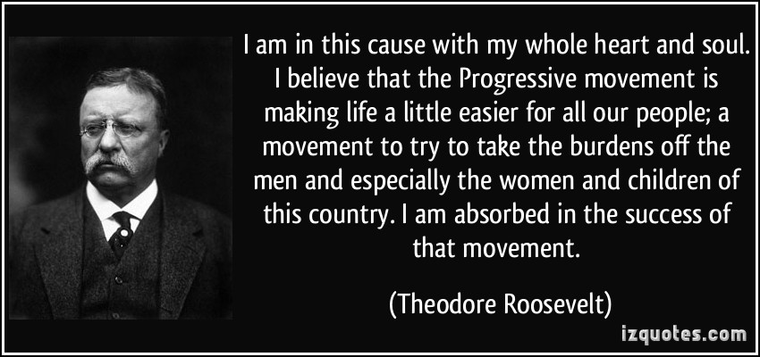
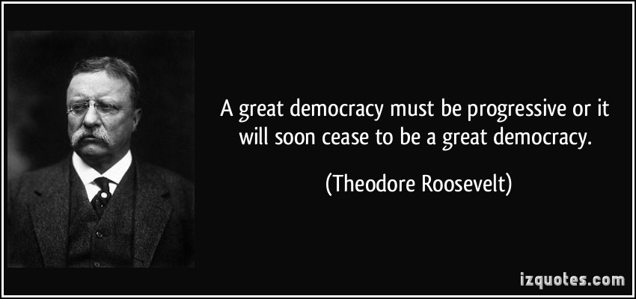

Slide 12
Progressive era
What steps were taken to reduce corruption at the city and state level?
Establishing new forms of city and state gov:
City gov
Commission Government- citizens chose a number of commissioners to administer city businesses instead of the mayor.
City Manager: manager hired to handle administrative duties .
State level
Direct Primary: A preliminary election in which a party's candidates for public office are nominated by direct vote of the people
- Initiative: A petition signed by a certain number of voters to force a public vote.
Australian Ballot: where voters vote in privacy on government printed ballots.

