Slide 2
Setting the Stage
Because of the Renaissance, and reformation Europe was
now ready to explore. Most countries
shared a desire to establish trade with
Asia. They were looking for an easy
way to get there.

Slide 3
Motives for European Exploration
Renaissance → curiosity about other lands and peoples.
Reformation → refugees & missionaries. (converting people to Christianity)
Monarchs seeking new sources of revenue (wealth).
Technological advances.
Fame and glory.

Slide 4
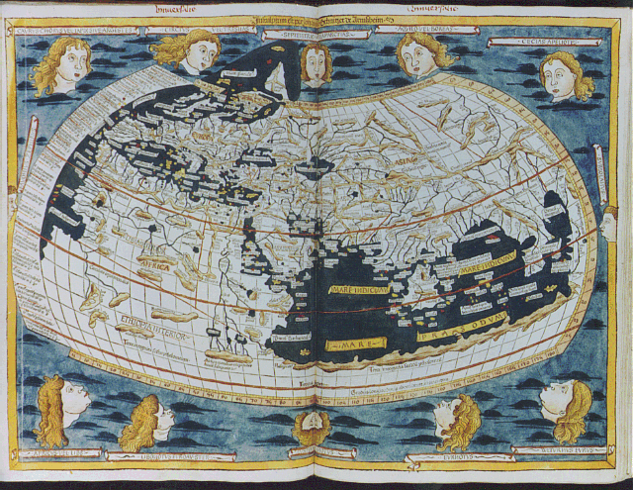
A Map of the Known World, pre- 1492

Slide 5
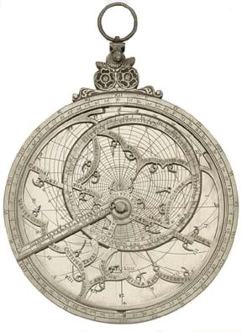
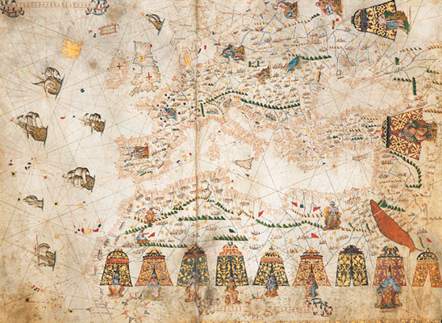
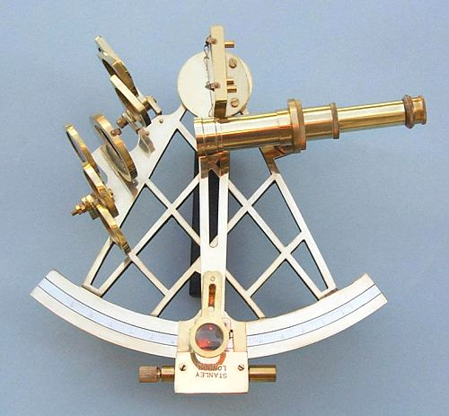
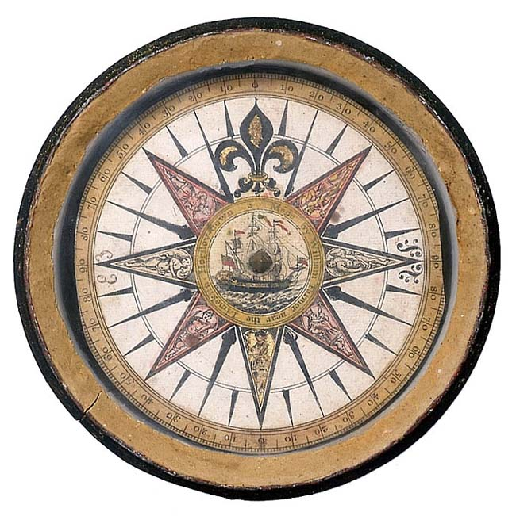
New Maritime Technologies
Better Maps [Portulan]
Hartman Astrolabe (1532)
Mariner’s Compass
Sextant

Slide 6
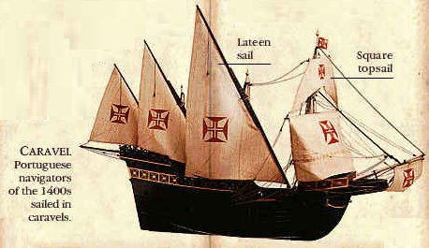
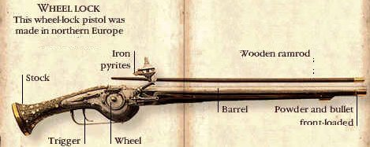
New Weapons Technology

Slide 7
Portugal Leads the Way
First European country to set up trading posts in west Africa
Prince Henry “The Navigator”
→ founded a navigation school
3. 1488: Bartolomeu Dias sails down African coast to southern tip
4. 1497: Vasco da Gama rounds tip of Africa → sails to Calicut, India
(27,000 miles)

Slide 8
Spain Also Makes Claims
1492: Christopher Columbus convinces King Ferdinand & Queen Isabella to finance voyage
His plan → sail west rather than east to reach Asia
3. Columbus reaches San Salvador in the Caribbean
→ thought he reached Asia
4. Rivalry begins be/ Spain & Portugal
→ Pope divides the World
→ Line of Demarcation:(West:Spain –
East: Portugal) Treaty of Tordesillas

Slide 9
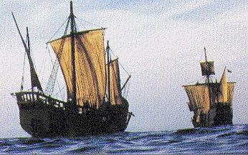
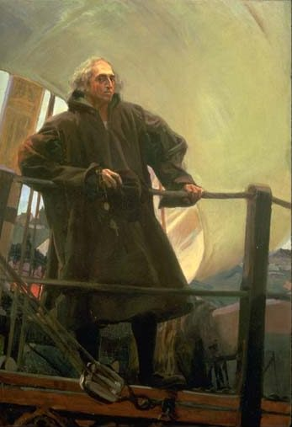
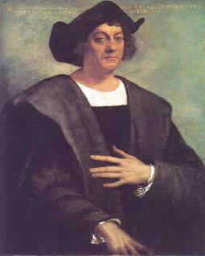
Columbus [1451-1506]

Slide 10
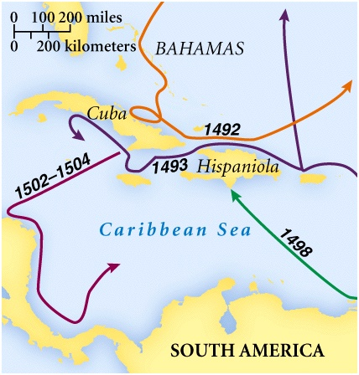
Columbus’ Four Voyages

Slide 11
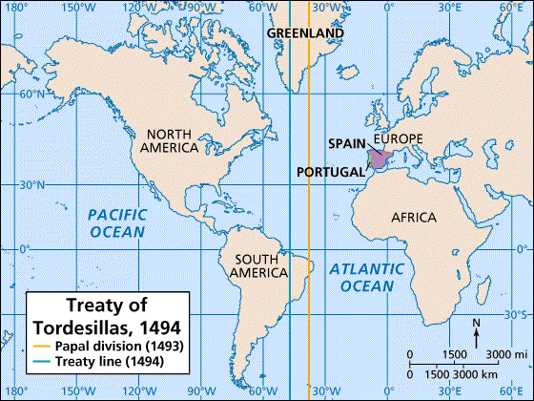
The Treaty of Tordesillas, 1494 & The Pope’s Line of Demarcation

Slide 12
Spanish Empire
Columbus financed by Queen Isabella & King Ferdinand
Treaty of Tordesillas divides the world be/ Spain & Portugal in 1494
Ferdinand Magellan: 1st to circumnavigate the world
Amerigo Vespucci suggested Columbus had discovered a “New World”

Slide 13
Spanish Empire
5. Hernando Cortes overcame Aztec Empire in central Mexico
6. Francisco Pizarro conquers the Incan Empire in the Andes
7. Missionaries converted 100,000’s of Native Americans to Christianity
8. Forced labor & European diseases decimate the natives

Slide 14
The Conquistadors
Conquistadors= “conqueror”
This term applied to the Spanish military leaders who fought against native peoples of the Americas.
What do they want?
European nations (Spain) wanted to set up colonies.

Slide 15
Mercantilism
New Economic policy developed by Europeans during exploration
Key principles of mercantilism:
A Nation’s wealth depends on its wealth measured in gold or silver
There is only a fixed amount of wealth in the world, and nations have to compete for their share of that wealth
Countries should seek to limit imports and maximize exports

Slide 16
Mercantilism cont…
3. A country needs its own source of raw materials to avoid depending on others
4. Colonies exist only as a way for the mother country to make a profit
5. A country’s colonies should not trade with any other countries. (This will cause problems with the 13 American colonies in particular and be a contributing factor in the American Declaration of Independence and American Revolution)

Slide 17
Mercantilism cont….
European countries wanted to set up colonies because these colonies had an abundance of raw materials (Raw materials are often natural resources such as oil, iron and wood).
The role of the colony was the provide the home country with these raw materials and then, they could only buy a finished product from that home country.

Slide 18
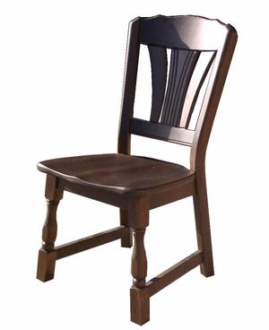
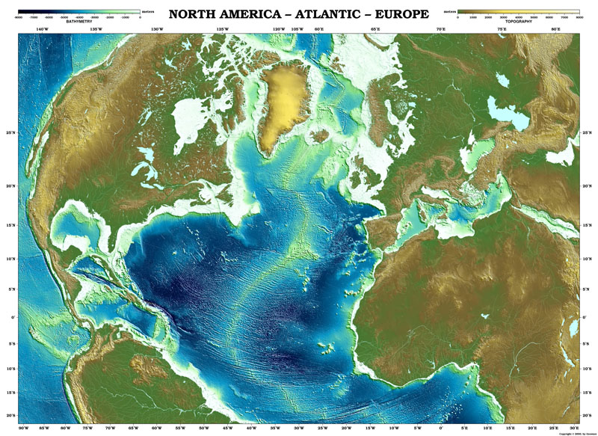
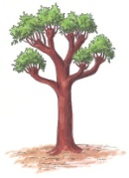
4. The Home country (a European country) manufactures a product and sells it back to the colonies.
2. Set up colonies and gather raw materials (timber/lumber/trees)
North America
3. Provide the home country with raw materials
England
Europe
1. Exploration/ conquest
Spain
1. Exploration/ conquest

Slide 19
Setting the Stage
The colonization of the Americas by
European countries resulted in the
exchange of items by both
hemispheres. Many people either by
choice or by force migrated to the
New World.

Slide 20
The Columbian Exchange
The global transfer of foods, plants, animals during the colonization period.
→ tomatoes, squash, pineapples, gold
→ tobacco, beans, horses, cattle
2. Most important
→ corn & potatoes: nutrients
3. Worst
→ Disease: led to death of millions of Native Americans

Slide 21
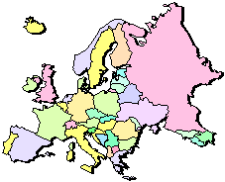
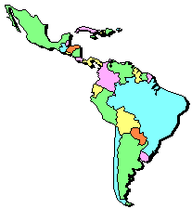
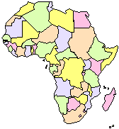
The “Columbian Exchange”
Squash | Avocado | Peppers | Sweet Potatoes
Turkey | Pumpkin | Tobacco | Quinine
Cocoa | Pineapple | Cassava | POTATO
Peanut | TOMATO | Vanilla | MAIZE
 | Syphilis
Trinkets
Liquor
GUNS
Olive | COFFEE BEAN | Banana | Rice
Onion | Turnip | Honeybee | Barley
Grape | Peach | SUGAR CANE | Oats
Citrus Fruits | Pear | Wheat | HORSE
Cattle | Sheep | Pigs | Smallpox
Flu | Typhus | Measles | Malaria
Diptheria | Whooping Cough

Slide 22
Global Trade
Increase of overseas trade
→ resulted in capitalism: based on private ownership and investment
2. Governments no longer sole owners of wealth
3. Merchants became very wealthy
4. Demand greater than supply → led to inflation

Slide 23
Why inflation?
The European colonies raided the native peoples and lands of North, South, and Central America, taking large amounts of gold and silver from these empires.
Europe was overflowing with gold and silver, and because of so much money in circulation, inflation occurred.
Inflation: when there's too much money in circulation, the value of the money goes down.
There as also not enough money in the treasuries (depleted the treasuries)because it was in the hands of people (merchants)

Slide 24
Rise of Capitalism
What is Capitalism?
System in which most economic activity is carried on by private individuals or organizations in order to seek a profit.

Slide 25
What happened to the Native Americans?
Many things were exchanged on the Columbian exchange, one of which was small pox.
The Native Americas had never been exposed to this disease that Europeans did, so they didn’t have a built up immunity to it.
This resulted in the deaths of millions of Native Americans, some groups even to extinction.

Slide 26
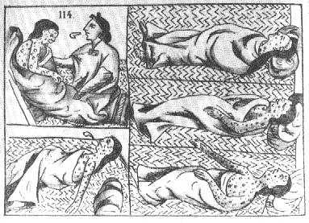

Slide 27
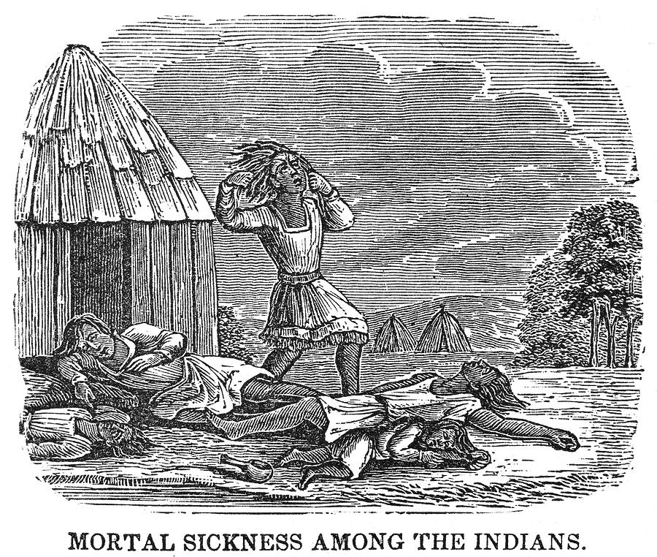

Slide 28
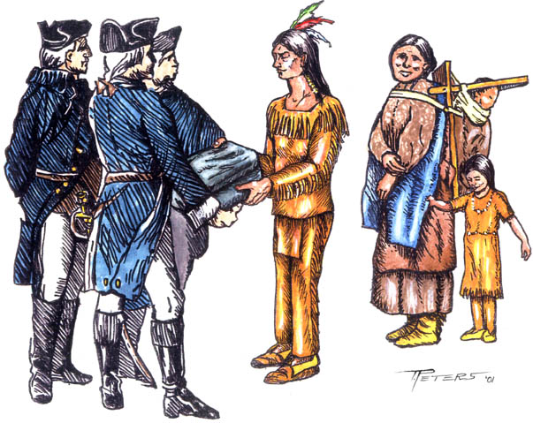

Slide 29
Activity
Readings

