Slide 1
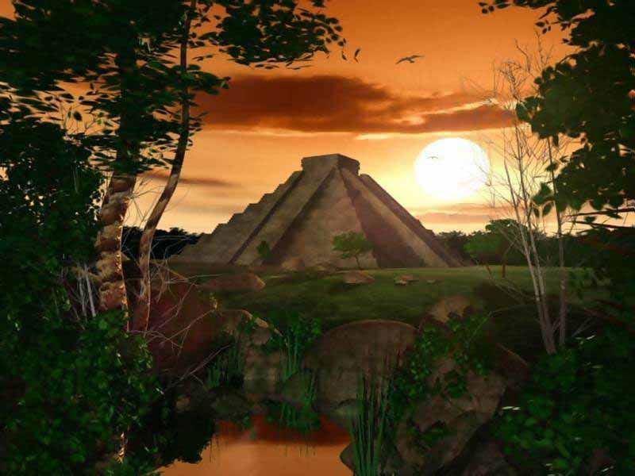
Empires

Slide 2
Introduction
Define empire:
Give an example of some famous empires:
Explain why YOU think civilizations and those in power or country of
a country usually desire to create an empire.
(this should be an informed opinion)

Slide 3
G geography
What does geography refer to?
Give an example of an empire that had great geography, and explain how did it influenced their development.
Give an example of an empire that didn’t have great geography, but explain how they used technology to adapt to their environment.
Lesson: (give advice on where one should look-like a place- to create an empire, and some ways they can make it work if the environment isn't that great)
If you’re going to create an empire…..

Slide 4
S social
What does social structure or social hierarchy mean?
Give an example of an empire that had great social structure, and explain how did it influenced their development and impacted their people.
Give an example of an empire that did NOT have great social structure, and explain how did it influenced their development and impacted their people.
Lesson: (give advice on how one should develop their social structure, inside their empire—to prevent it from eventually collapsing due to civil war and unrest)
If you’re going to create an empire…..

Slide 5
P political
What does a government do?
What are some types of government? Explain each.
Give an example of an empire that had great political/government structure, and explain how it influenced their development and impacted their people.
Give an example of an empire that did NOT have great political/government structure, and explain how it influenced their development and impacted their people.
Lesson: (give advice on how one should develop their political/government structure, inside their empire—to prevent it from eventually collapsing due to civil war and unrest)
If you’re going to create an empire…..

Slide 6
R religion
What is religion?
What does polytheism mean?
What are some other types of religions? Explain them.
Give an example of an empire that was influenced by religion, and explain how it impacted their people, laws and culture.
Lesson: (give advice on how one should develop their religious policies and strucutre, inside their empire—to prevent it from eventually collapsing due to civil war and unrest)
If you’re going to create an empire…..

Slide 7
I intellect
What is intellect?
Where does knowledge come from? How do we acquire knowledge as a society?
Give an example of an empire that was exceptionally intelligent. Explain how they gained this knowledge.
Lesson: (give advice on why one should focus on education, and how they can ensure their own legacy.)
If you’re going to create an empire…..

Slide 8
T technology
What is technology?
Give an example of four empires that had great technology was exceptionally intelligent. Explain how this technology influenced their development and made them strong.
Lesson: (give advice on why one should focus on developing technology, and how they can ensure their own legacy by having people smart enough to create new achievments.)
If you’re going to create an empire…..

Slide 9
E economy
What is an economy?
Give an example of how empires make a living for themselves? How do they manage their resources?
What is trade?
Why is trade important?
Lesson: (give advice on why one should focus on developing trade routes or networks, and explain how trade can benefit an empire .)
If you’re going to create an empire…..

Slide 10
Conclusion
Why do all empires end up collapsing?
Last word of advice!

