Slide 2
The Popular Sovereignty Panacea
The Mexican Cession lands opened a "can of worms" with the question, "What should be done about slavery in these lands?"
Further, with this question, the political parties (Whig and Democrat) were put into a tricky position. No matter which way they answered, half of the nation would be offended.
Largely, the parties simply chose to side-step the slavery-expansion question (give no clear answer) so as to offend no one, …….hopefully.

Slide 3
In the election of 1848, Polk was ailing and would not run again.
The Democrats nominated Gen. Lewis Cass who'd spoken previously for popular sovereignty (the people of a territory should decide and issue for themselves).
The popular sovereignty position was well-liked by politicians since it enabled them to take a neutral stance and rather say, "Let the people decide." During the campaign, however, he kept rather silent on slavery.

Slide 4
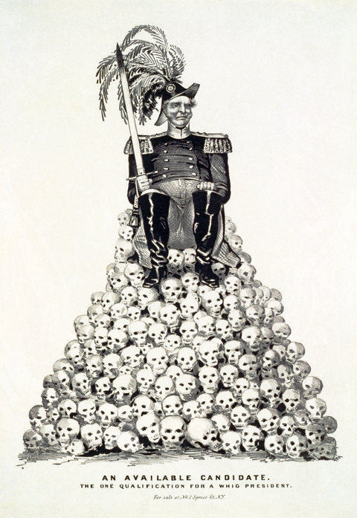
Political cartoon about General Zachary Taylor
This was a part of the Democratic campaign in 1848 charging that Taylor’s reputation rested on Mexican skulls.

Slide 5
Political Triumphs for General Taylor
The Whigs nominated Gen. Zachary Taylor in 1848. He had no political experience but was the "hero of Buena Vista" which went a long way—he won the election.
Taylor put the question of slavery expansion on the back burner and essentially had no official position on it. (this was typical of the Whig party. Eager to win at all costs they would often avoid taking a stand on controversial or divisive issues)
Notable in 1848 was the Free Soil Party that emerged when many Northerners were upset that neither party took a position on the expansion of slavery. They nominated Martin Van Buren and their position was clearly against the expansion of slavery.
The Free Soilers also favored federal money for internal improvements and free land for settlers out west.
The party attracted a wide mix of people: (a) folks upset over getting only 1/2 of Oregon, (b) people who didn't want blacks in the new lands, and (c) northern abolitionists who didn't like slavery.

Slide 6
“Californy Gold”
At Sutter's Mill in 1848, gold was discovered. The secret was quickly out and the California gold rush was on.
The next year, 1849, "Forty-Niners" flooded to California. Dreams of getting rich quick nearly always turned into either going bust or the constant hard work of moving dirt involved in mining.
Perhaps more people made their fortunes out of the myriad of things needed to accompany the miners: general stores, lumberyards, bars, barbershops, bakeries, opera-houses for entertainment, etc.
The overall result of the gold rush was that California had enough people to become a state, almost overnight. It applied to be a free state and thus threatened the 15-to-15 slave-to-free balance.

Slide 8
Sectional Balance and the Underground Railroad
By 1850, the South and slavery were on solid ground because:
(a) the president (Zachary Taylor) was a Virginia slave owner born/raised in Louisiana
(b) though outnumbered in the House, the South had equality in the Senate and could therefore block any unwanted laws
(c) the Constitution favored the South (this would later be upheld in the Dred Scott case).

Slide 9
Even though on solid ground, the South felt they were under attack or upset over the following issues…
The proposition of California as a free state threatened the free/slave state balance.
Texas had a disputed region, again, this time into the New Mexico/Colorado/Wyoming area.
Northerners were pushing hard to abolish slavery in Washington D.C.

Slide 10
The most bothersome to the South was the issue of runaway slaves.
The Fugitive Slave Law was supposed to "round up" runaways up North and ship them back South. This was largely not being done and the South took it as a personal offense.
The Underground Railroad was a secret “route” from "station to station" that led many “passengers”, runaway slaves, to the North and eventually to Canada. Harriet Tubman was the most well-known "conductor" of the "railroad." She snuck back into the South 19 times and led some 300+ slaves to freedom

Slide 11
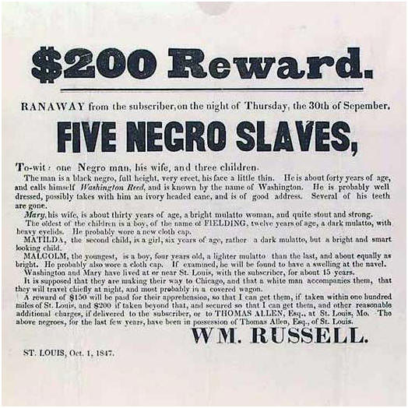

Slide 12
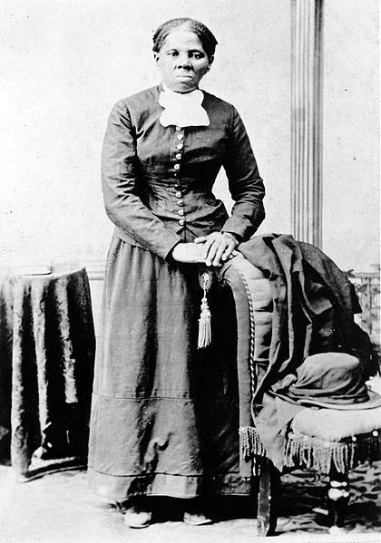

Slide 13
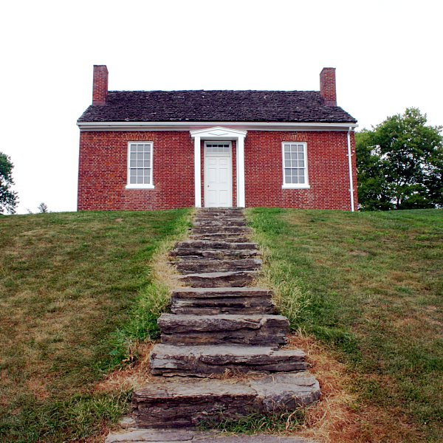
The Rankin House on Liberty Hill in Ripley, Ohio where thousands of runaway slaves stayed on their way north to freedom

Slide 14
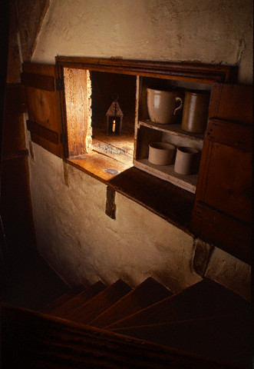
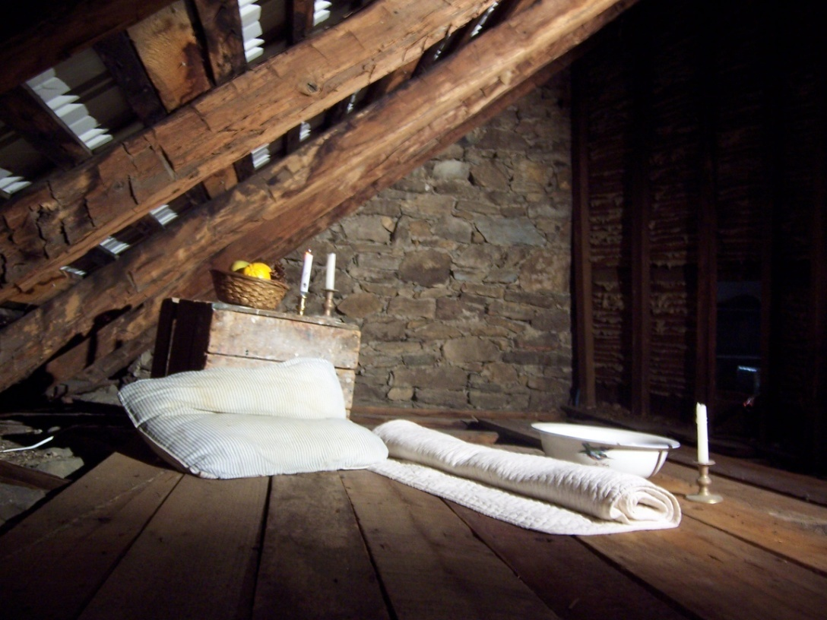

Slide 15
The south called for stricter Fugitive Slave Laws by 1850.
The abolitionist who rant he underground railroad did not personally gain from their lawlessness.
To slave-owners, the loss of slaves was more infuriating than hurtful financially.
In 1850, estimates indicate that the South was losing around 1,000 slaves in a year, our of a total of 4 million slaves.
In fact more blacks probably earned their freedom by self-purchase of a masters voluntary emancipation than anything else.

Slide 16
Slave-masters were upset on principles.
They felt the Constitution upheld slavery, and the laws on Congress provided for effective slave catching.
One southern senator said:
“Although the loss of property is felt, the loss of honor is felt still more…”
With these hot issues heating up, political compromise was needed to avoid violent conflict.

Slide 17
Twilight of the Senatorial Giants
California's request to be a free state forced all of these issues onto the Congressional floor.
The 3 leading senators of the past decades had one more round of greatness in them…
Henry Clay was known as the "Great Compromiser" and offered a compromise here. He was notably seconded by a young Senator Stephen Douglas who will take a larger role in events later. Clay urged both sides to make concessions and to compromise.
.

Slide 18
For the South, John C. Calhoun argued for states' rights (the same argument as in the tariff crisis of the 1830's). He wanted slavery to be left alone, the runaway slaves to be returned to the South, and state balance kept intact. (but he will die in 1850 before the debate is finished)
For the North, Daniel Webster had been opposed to slavery's expansion. But, in his famous "Seventh of March" speech he urged the North to compromise on the issue. He felt that the lands of the Mexican Cession were too dry to grow cotton and therefore wouldn't need slavery anyway.
Abolitionists, like poet Whittier, sharply criticized Webster as a traitor to the cause.

Slide 20
Deadlock and Danger on Capitol Hill
A "Young Guard" of politicians were emerging in Congress. They were more interested in purifying the nation than in preserving it.
Chief among the Young Guard was William H. Seward of NY. He was staunchly against slavery and argued that, when it came to slavery, Americans must follow a "higher law" (God's law), above the Constitution.
This moral high road may have cost Seward the presidency in 1860.
Pres. Zachary Taylor came under Seward influence. He appeared ready to veto any concessions on the matter. The chance for compromise seemed bleak.

Slide 21
Breaking the Congressional Logjam
Suddenly, Pres. Taylor died. Vice-President Millard Fillmore took over and was more open to compromise.
The Compromise of 1850 emerged.
Senate leaders Henry Clay, Daniel Webster, and Stephen Douglas all urged the North to compromise.
Southern "fire-eaters" were still very much a against concession/compromise. Yet, calmer minds prevailed, the South went along, and the Compromise of 1850 passed.

Slide 23
Balancing the Compromise Scales
What the North got…
California admitted as a free state. This tipped the balance to the free side, permanently.
Texas gave up its claims to lands disputed with New Mexico.
The slave trade in District of Columbia was banned, but slavery was still legal. This was symbolic only. It was symbolic in that the nation’s capital “took a stance” against the trade. However, it was impractical because the trade only was illegal, not slavery, and since a person could easily buy a slave in next-door Virginia.

Slide 24
What the South got…
Popular sovereignty in the Mexican Cession lands. This was good for the South because prior to this, there was to be no new slave lands (the 36°30’ Missouri Compromise line had drawn that). On paper, this opened a lot of land to slavery, possibly. This was bad for the South because those lands were too dry to raise cotton anyway and therefore would never see slaves.
Texas was paid $10 million for the land lost to New Mexico.

Slide 25
A new, tougher Fugitive Slave Law of 1850 had real teeth in it. Details held that:
(a) runaway slaves weren't given "due process" rights if caught
(b) the official that handled the case received $5 for a slave's freedom but $10 for a slave's return
(c) officials were demanded to catch runaway slaves despite their personal convictions on the matter.
This Fugitive Slave Law proved to the be most controversial of the measures.
Northerners hated being forced to catch slaves. In places, they passed "Personal Liberty Laws" which stated local officials didn't have to chase and return fugitive slaves.
Southerners were outraged that the law was not enforced or was ignored. It was supposed to be one of their major concessions in the Compromise, and it appeared to have been thrown out the window.
Anthony Burns personified the law. He was a runaway slave, captured and tried. But, violent protests eventually saw him bought out of slavery. He then went on to college and became a preacher.

Slide 26
All told, the North got the better of the Compromise of 1850. This is true because (a) the balance tipped their way, (b) the Fugitive Slave Law was largely not enforced, and (c) it bought time before war while the North could build up their resources.

Slide 27
Defeat and Doom for the Whigs
In the election of 1852, the Democrats nominated unknown Franklin Pierce. Pierce was not a great leader, but had no enemies.
The Whigs put Gen. Winfield Scott ("Old Fuss and Feathers"), the hero of the Mexican War, on the ballot.
The largest issue of the day, slavery, was soft-pedaled so as to not offend anyone. As a result, the campaign was full of silliness and personal attacks.
Slavery did split the Whigs, however. Northern and Southern Whigs disagreed on the party platform and the party candidate.
Additionally, the new Free Soil Party garnered 5% of the Northern vote (hurting Scott).
As a result, Pierce won in a landslide, 254 to 42 in the electoral vote.

Slide 28
Expansionist Stirrings South of the Border
The California Gold Rush had instilled interest in Central America (since many 49'ers had crossed there). And, the British influence in Central America was strong, and perhaps growing, despite the Monroe Doctrine.
There were some U.S.-British tensions, but the Clayton-Bulwer Treaty eased them. It said neither the U.S. or Britain would take over the area without the other's agreement. This would later prove to be a roadblock to Teddy Roosevelt's construction of the Panama Canal.

Slide 29
Activities in Latin America succeeded in throwing fuel on the “slavocracy” theory (a conspiracy theory where the South was supposedly always seeking to add new slave lands).
In the summer of 1856, Southerner William Walker tried to take over Nicaragua. He did so, sort of, named himself president, legalized slavery, and wished for Pres. Pierce to annexed the region. Meanwhile, Nicaraguans reclaimed their land and executed him.
Southerners also looked to Cuba.
Americans offered to buy Cuba from Spain but were turned down. So, in 1850-51, two groups of filibusteros ("freebooters" or pirates including some leading Southerners) invaded Cuba. Their half-baked plan was to somehow take over and claim Cuba for the U.S. They failed miserably.
In 1854, Cubans seized the American ship Black Warrior on a technical issue. Pierce then had a reason to go to war, if he wished, and win Cuba.
Meanwhile though, Pierce sent delegates to speak with Spain, England, and France in Ostend, Belgium to make a deal. The Ostend Manifesto said the U.S. would offer $120 million for Cuba, and if Spain rejected it, the U.S. would be justified in taking Cuba by force.
When the Ostend Manifesto details leaked out, Northern free-soilers were up-in-warms. The slavocracy theory seemed more real than ever with these secret dealings. As a result, Pierce backed away from the deal embarrassed.

Slide 30
The Allure of Asia
Following the British example, America sought to expand her influence in Asia.
Pres. Tyler sent Caleb Cushing to China to work a deal favorable to the U.S. An agreement was reached to start diplomatic relations and grant "most favored nation" status to the U.S. (opening up trade).
The door also opened for thousands of American missionaries to spread the Gospel in China.

Slide 31
Next, the U.S. wanted to link up with Japan.
Since Japan was a traditional country that considered westerners to be heathens, they were reluctant to deal with the Americans.
The U.S. sent Commodore Matthew Perry to Tokyo in 1852-54. Through a mix of diplomacy and threat, Perry got Japan to open itself to trade in the Treaty of Kanagawa.
This broke Japan’s centuries-old traditional of isolation, and started them down a road of modernization and then imperialism and militarism.

Slide 32
Pacific Railroad Promoters and the Gadsden Purchase
After gaining California and Oregon, Americans wanted a transcontinental railroad to link the east and west coasts.
Both the North and South clamored to have the line built in their region (for prestige and financial success). The Southern route was eventually chosen as best.
There were two reasons the Southern route was considered better: (1) the land was organized meaning any Indian attacks could be repelled by the U.S. Army and (2) geography—the plan was to skirt south of the Rocky Mountains.
There was one problem: a portion of the land ran through Mexico.

Slide 33
James Gadsden was sent to Mexico to work a deal for the land. The Gadsden Purchase bought the southern chunk of present Arizona and New Mexico for $10 million, a hefty price tag in comparison to other "purchases."
Regardless of the price, the transcontinental railroad seemed ready to be built with Southerners happy.

Slide 34
Douglas’s Kansas-Nebraska Scheme
Stephen Douglas threw a wrench in the railroad plans. Being an Illinois senator, he wanted the railroad up north with Chicago as a major terminus.
He proposed to organize Kansas and Nebraska through the Kansas-Nebraska Act and move the transcontinental railroad up north.
Southerners certainly wouldn't do this, unless they got something substantial in return. The stage was set for a deal to be made…

Slide 35
The North got the transcontinental railroad moved up North. Also, Kansas and Nebraska were officially organized as territories.
The South was awarded popular sovereignty in Kansas and Nebraska. To do this, the Missouri Compromise of 1820 was repealed (because it forbade slavery above the 36°30’ line).
Southerners were very happy with the possibility of slavery open to so many lands (the Mexican Cession accepting California, and now Kansas and Nebraska which had been closed to slavery).
Slavocracy theorists said, "There goes the South again, always trying to get more slave land."

Slide 36
Despite disagreement, the Kansas-Nebraska Act passed in 1856, repealing the Missouri Compromise, and opened Kansas and Nebraska to popular sovereignty.

Slide 38
Congress Legislates a Civil War
The Kansas-Nebraska Act may have had the railroad and compromise as its motivation, but it split the nation.
It erased the Missouri Compromise and undercut the Compromise of 1850 because it re-opened the slavery issue.
The Fugitive Slave Law was simply left to die by Northerners. This infuriated Southerners.
The Democrats were split down the middle over the slavery issue.
Another political party, the Republicans, were born. Republicans drew a wide group of people, but they essentially stole the Free Soil position against the expansion of slavery.

