Slide 1
Byzantine Empire
Mersadie Moore, Amiee Osorio, Kideem Griffith, Terry Williams

Slide 2
The rise of a new Empire

Slide 3
Constantinople – Greek for “the city of Constantine” became the capitol of the Roman Empire under Emperor Constantine.
1000 years from 395 to 1453 they were the seat of the Eastern Roman Empire-which became known as the Byzantine Empire.

Slide 4
Geography

Slide 5
Located at the bridge between Eastern Europe and the Middle East with satellite regions in North Africa and Southern Russia.
Surrounded by the Aegean Sea, the Black Sea, the Gulf of Cyprus, and the Caspian Sea.
https://www.youtube.com/watch?v=AU7X6lWavwE

Slide 6
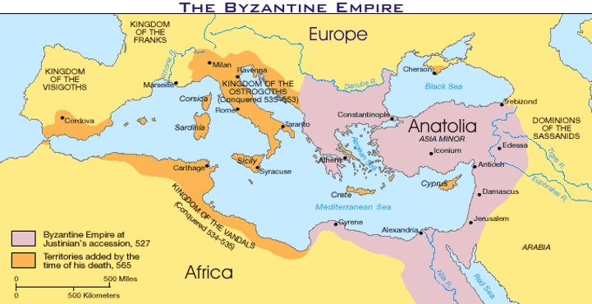
M A P

Slide 7
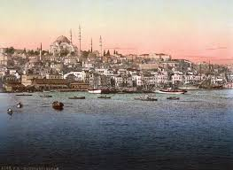
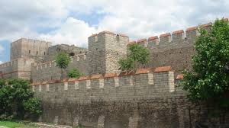
The Constantinople wall
The City Constantinople

Slide 8
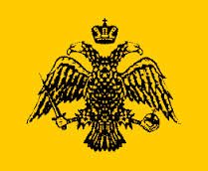

Slide 9
Social

Slide 10
Kings were usually hereditary-kings sons were to become kings when they were older.
Foreigners had no rights and, unless protected by some treaty between their state and Rome, they could be seized like owner less pieces of property by any Roman.

Slide 11
3 classes:
Upper class-local aristocrats, government officials, senior military officers, and large landowners.
Middle class included merchants, industrialists, and owners of medium-sized landed properties.
The lower class included wage-earners and very poor people.
Clergy (people who held religious services) however, didn’t have a specific social class but they received special privileges and they were distributed throughout all of the social classes.

Slide 12
Political

Slide 13
They had an absolute monarchy
They were also considered a Caesaropapism because the supreme ruler was secular.
Justinian was one of the co-rulers
Made laws called Justinian's law

Slide 14
religion

Slide 15
They were Christians.
Churches contained icons.
people who objected them were iconoclasts- meaning icon breakers.
A hand above a cross symbolized the Christian flock or community on Earth.

Slide 16
Hagia Sophia is the most famous church in Constantinople
Hagia Sophia means holy wisdom
The Hagia Sophia has been home to many religions- including Orthodox and Roman Catholic
The Hagia Sophia had many pieces of beautiful artwork called mosaics

Slide 17
It was made out of ashlar and brick
Length: 82 m (269 ft)
Width: 73 m (240 ft)
Height: 55 m (180 ft)
They began building it in 532
They completed it in 537; 1477 years ago

Slide 18
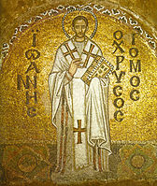
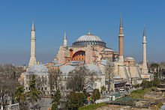
The Hagia Sophia
A Mosaic in the Hagia Sophia

Slide 19
Intellectual

Slide 20
Greek science and literature remained alive in the Byzantine world, and Byzantine philosophy drew heavily on Plato, Aristotle, and the Neoplatonists, even if it was now Christian in tone.
An important figure was Gregory Palamas who developed a mystical movement known as Hesychasm, which involved the use of the noetic Jesus prayer to achieve a vision of the uncreated Light also called the Illumination or Vision of God.

Slide 21
technology

Slide 22
They built a wall to protect them and the city.
They had churches- the main one was Hagia Sophia.

Slide 23
Economy

Slide 24
When Justinian died he left the government bankrupt.
They charged high taxes to fund monument during the collapse of the empire.

Slide 25
How the empire lasted

Slide 26
A new Rome- Constantinople remained the capitol of the Eastern Empire long after Rome fell.
Even before the fall of Rome, Constantinople was a larger, richer city than Rome.
Justinian wanted to restore fame so he went to conquer the western part.

Slide 27
A Falling Empire

Slide 28
When Justinian died in 565, he left the government nearly bankrupt from the expense of taking back the Empires territory.
He expanded the Empire beyond what the government could effectively administer.
After his death, the western provinces again fell to migrating tribes.

Slide 29
Lasting Legacies

Slide 30
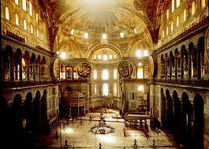
The Hagia Sophia is a major lasting legacy
It is now a beautiful museum which holds many old pieces of artwork

Slide 31
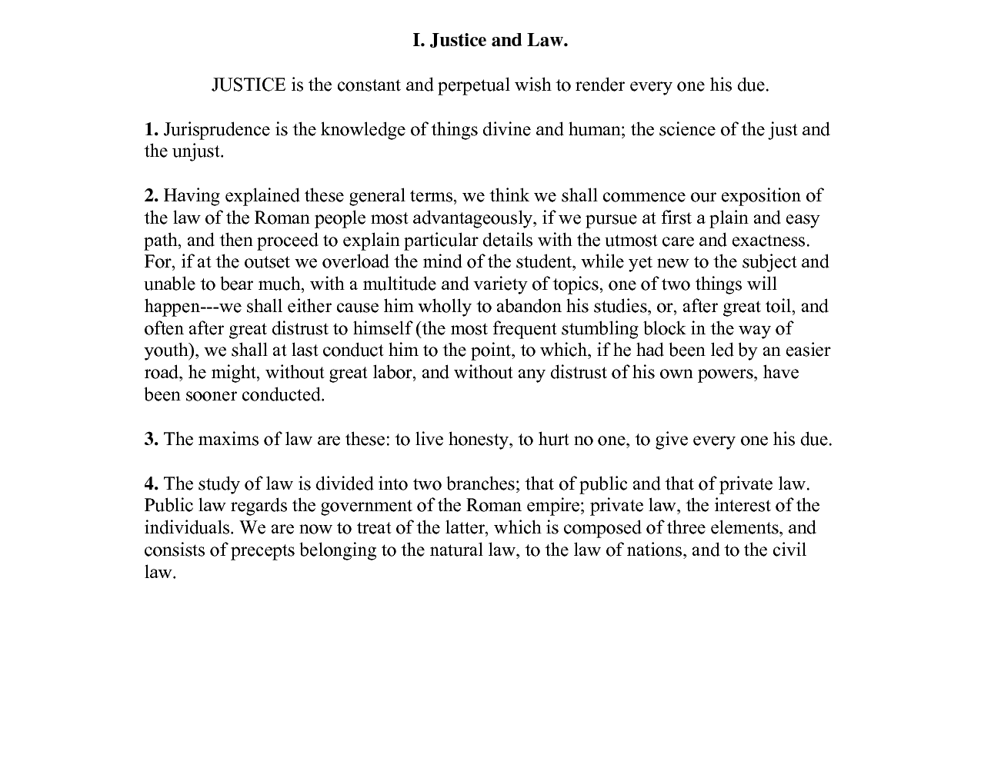
http://orthodoxwiki.org/Code_of_Justinian

Slide 32
Current Event
When the great Irish poet William Butler Yeats prayed for some kind of connection to permanence and immortality, his thoughts turned to Byzantine art as the most perfect emblem of the profound, eternal state of creative grace he was after.
His art will now be placed at the Getty Villa
http://www.latimes.com/entertainment/arts/culture/la-et-cm-preview-getty-byzantium-20140316,0,4865610.story#ixzz2vx3kJU00

Slide 33
Questions About The Byzantine Empire
Q: How did Byzantine emperors rule their empire from Constantinople?
A: They could control trade while being protected
Q: What were some important features of Byzantine culture?
A: Art, architecture, and literature
Q: What led to the decline of the Byzantine Empire?
A: Pressure from migrating tribes and internal conflict.

