Slide 1
Biology and Behavior
Chapter 3

Slide 2
Intro
Biological psychologists study the ways in which our behavior and psychological processes are linked to biological structures and processes. Sensation, perception, memory, and thinking are all psychological processes that have at least a partly biological basis.

Slide 3
What are neurons?
Nerve cells that send and receive messages from other structures in the body, such as muscles and glands.
Components of a neuron:
Cell body
Dendrites
Axon
Myelin sheath
Axon terminals
Synapse (the communication process)

Slide 4
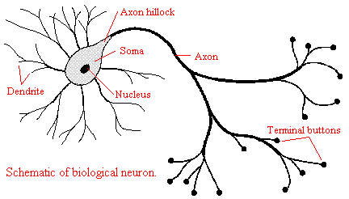
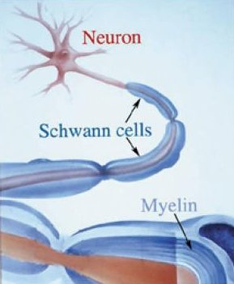
How does it work?
The cell body produces energy that fuels the activity of the cell.
Dendrites, which are thin fibers that branch out from the cell body, receive information from other neurons and pass the message from through the cell body.
The axon take that information or “message” and carries it away from the neuron to get ready to be sent to another neuron
Axons are covered in myelin, (myelin sheath) which helps insulate and protect the axon, and also helps speed up the transmission of the message.
At the end of the axon are small fibers that branch out called axon terminals.
Axon terminals act like a button, and they release the message across the synapse (or synaptic gap) into the dendrites of another neuron.
***messages can only be sent in one direction
***new synapses can develop between neurons not previously connected, when we learn something new

Slide 5
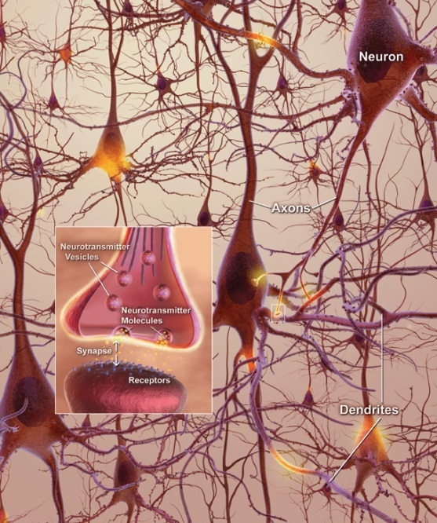

Slide 6
Neurotransmitters
The messages that neurons send across the synapses of one nerve cell to another are called neurotransmitters.
(neurons can fire five hundreds of times every second)
There are several types of neurotransmitters and each has a its own structure and fits into the receptor sites on the next neuron much like a key fits into a lock.
Neurotransmitters are involved in everything we do.

Slide 7
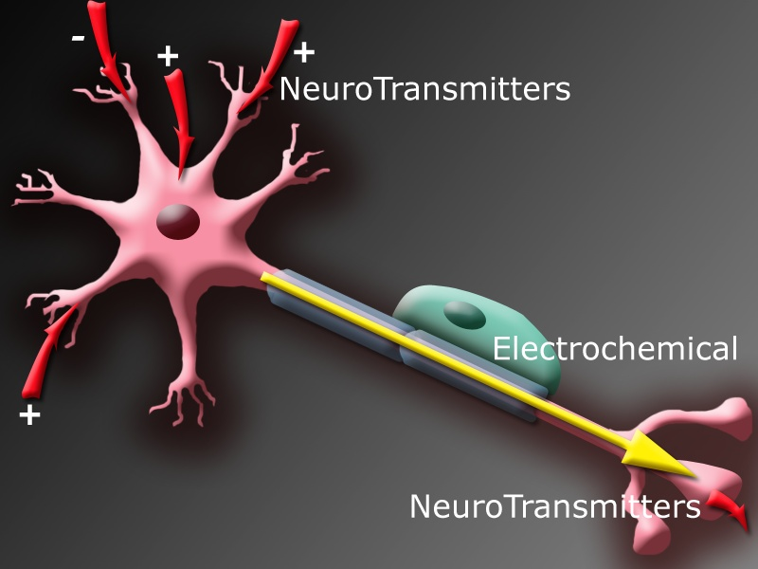

Slide 8
Neurotransmitters
Acetylcholine
Norepinephrine
Dopamine
Serotonin
Glutamate
GABA

Slide 9
Major Neurotransmitters
Acetylcholine
Enables muscle action, learning, and memory. When there’s too little causes Alzheimer’s disease.
Norepinephrine
Regulates mood and physical and mental arousal. Undersupply can depress mood.
Serotonin
Affects mood, hunger, sleep, and arousal. Under supply can cause depression.

Slide 10
Major Neurotransmitters
Dopamine
Influences movement, learning, attention, and emotion. Excess causes schizophrenia, undersupply causes Parkinson’s disease.
Glutamate
A major excitatory neurotransmitter; involved in memory. Oversupply of this can cause migraines.
GABA
A major inhibitory neurotransmitters. Undersupply of this can cause seizures or tremors.

Slide 11
Major Neurotransmitters
Epinephrine
An excitatory neurotransmitter. Controls attention, arousal, cognition, and mental focus.
Melatonin
Controls the sleep-wake cycle. Controls mood and sexual behavior

Slide 12
More neurotransmitters
Endorphins
Endorphins are the neurotransmitters that resemble opioid compounds, like opium, morphine, and heroin in structure. The effects of endorphins on the body are also quite similar to the effects produced by the opioid compounds. In fact, the name 'endorphin' is actually the short form for 'endogenous morphine'. Like opioids, endorphins can reduce pain, stress, and promote calmness and serenity. The opioid drugs produce similar effects by attaching themselves to the endorphin receptor sites. Endorphins enable some animals to hibernate by slowing down their rate of metabolism, respiration, and heart rate.

Slide 13
Ex: how to treat schizophrenia
Chlorpromazine
Blocks a variety of receptors in the brain, particularly dopamine.
Improves disturbed thoughts, feelings and behavior.
Haloperidol
Blocks receptors for the neurotransmitters specifically the dopamine on the nerves.
As a result the nerves are not “activated” by the neurotransmitters released by other nerves.

Slide 14
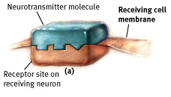
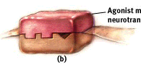
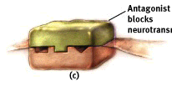
Neural Communication
Neurotransmitter
molecule
Receiving cell
membrane
Agonist mimics
neurotransmitter
Receptor site on
receiving neuron
Antagonist
blocks
neurotransmitter

Slide 15
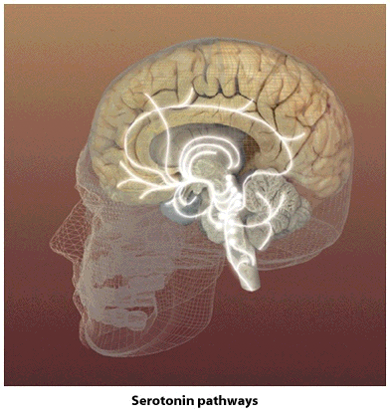
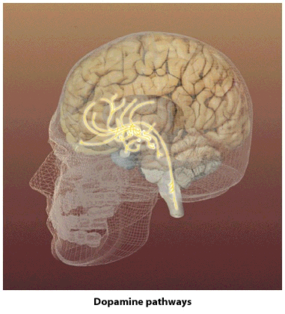
Neural Communication
Serotonin Pathways
Dopamine Pathways

Slide 16
The Nervous system
The human nervous system is involved in thinking, dreaming, feeling, moving and much more. It is working while we are active, still, awake, or asleep, is involved in how we react to the world, how we learning, remember, and also regulates our internal functions.
Ex: when we learn something new, the nervous system registers that experience and changes to accommodate its storage.

Slide 17
The Nervous System
Nervous System
the body’s speedy, electrochemical communication system
consists of all the nerve cells of the peripheral and central nervous systems
Central Nervous System (CNS)
the brain and spinal cord
Peripheral Nervous System (PNS)
the sensory and motor neurons that connect the central nervous system (CNS) to the rest of the body

Slide 18
The Nervous System
Nervous
system
Peripheral
Central
(brain and
spinal cord)
Autonomic (controls
self-regulated action of
internal organs and glands)
Skeletal (controls
voluntary movements of
skeletal muscles)
Sympathetic
(arousing)
Parasympathetic
(calming)

Slide 19
The Nervous System
Nerves
neural “cables” containing many axons
part of the peripheral nervous system
connect the central nervous system with muscles, glands, and sense organs
Sensory Neurons
neurons that carry incoming information from the sense receptors to the central nervous system

Slide 20
The Nervous System
Interneurons
CNS neurons that internally communicate and intervene between the sensory inputs and motor outputs
Motor Neurons
carry outgoing information from the CNS to muscles and glands
Somatic Nervous System
the division of the peripheral nervous system that controls the body’s skeletal muscles

Slide 21
Autonomic Nervous System
Involuntary. (happens automatically)
Regulates the bodies vital functions such as heartbeat, breathing, digestion, and blood pressure.
These functions happens automatically because the are essential in keeping us alive
The autonomic nervous system has two parts:
The sympathetic nervous system
The parasympathetic nervous system
***these two systems generally have opposing functions

Slide 22
Peripheral Nervous System
Two parts
The Somatic Nervous System:
Voluntary
Transmits sensory messages to central nervous system
Activated by touch, pain, changes in temperature, and changes in body position.
Ex: allows us to feel sensations of hot and cold, pain or pressure.
Helps us adjust for posture or balance

Slide 23
The Central Nervous system
Ex: touching a hot stove
From sensory neurons in peripheral nervous system to the central nervous system through the spine to the brain and then message to remove hand come back down from brain to motor neurons to move your hand away.

Slide 24
The sympathetic nervous system
This system is activated when a person is going into action, perhaps because of some stressful event
It prepares the body to either confront the situation or run away
Called the “fight or flight” response
Ex: being attacked by a dog
Think of “Stress”. “S”tress→ “S”ympathetic

Slide 25
Parasympathetic Nervous System
This system restores the body’s reserves of energy after an action has occurred.
Ex: after a stressful situation (dog attack), the parasympathetic nervous system will normalize your heart rate and blood pressure, breathing is slowed, and digestion is returned to normal.
Think of “peace”
“P”eace→ “P”arasympathetic

Slide 26
The Nervous System
Autonomic Nervous System
the part of the peripheral nervous system that controls the glands and the muscles of the internal organs (such as the heart)
Sympathetic Nervous System
division of the autonomic nervous system that arouses the body, mobilizing its energy in stressful situations
Parasympathetic Nervous System
division of the autonomic nervous system that calms the body, conserving its energy

Slide 27
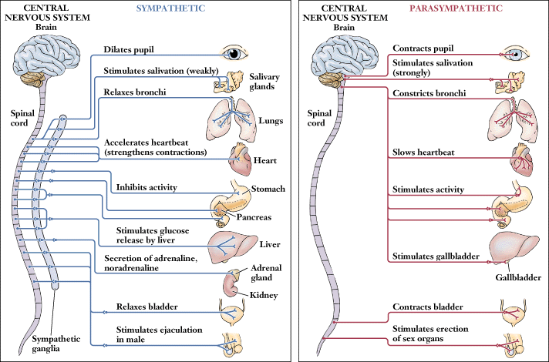
The Nervous System

Slide 28
The Nervous System

Slide 29
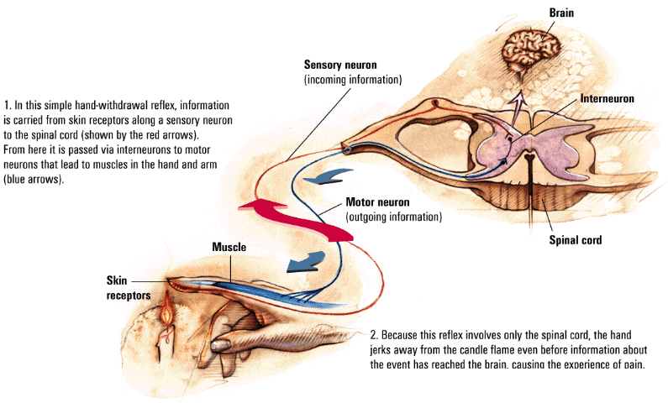
The Nervous System
Reflex
a simple, automatic, inborn response to a sensory stimulus
Brain
Sensory neuron
(incoming information)
Interneuron
Motor neuron
(outgoing
information)
Muscle
Spinal cord
Skin
receptors

Slide 30
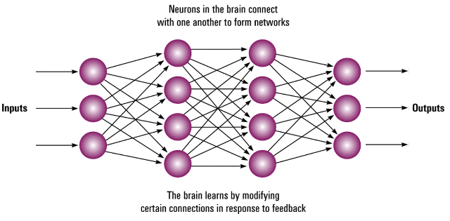
The Nervous System
Neural Networks
interconnected neural cells
with experience, networks can learn, as feedback strengthens or inhibits connections that produce certain results
computer simulations of neural networks show analogous learning
Neurons in the brain
connect with one
another to form networks
Inputs
Outputs
The brain learns by modifying
certain connections in
response to feedback

Slide 31
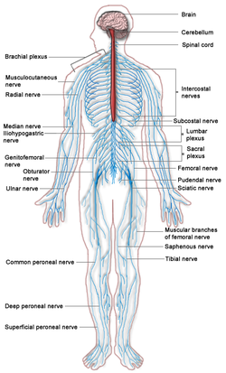
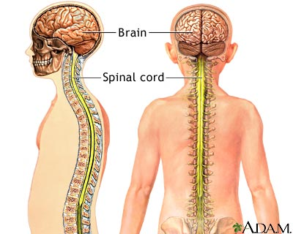
Nervous System: Two Main Parts
The Peripheral Nervous System
Made up
Of nerve cells
That send messages
Between central
Nervous system
And all parts of the
body
The Central Nervous System
Consists of brain and spinal cord

Slide 32
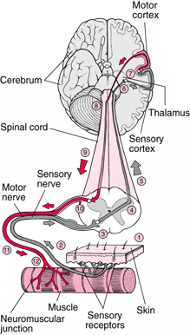

Slide 33
QUIZ

Slide 34
Explain the Neural Transmission Process Utilizing the following terms in your answer, and the diagrams above as a guide. You should explain the process from the time a Neuron receive a neural impulse to the time it is reabsorbed into the pre-synaptic neuron
Word Bank (must use all words)
dendrite
Synapse (or Synaptic gap)
Myelin sheath
Neurotransmitters
Axon
Cell body
Receptor sites

Slide 35
Explain how the schizophrenia, depression, Alzheimer’s, Parkinson’s, or bipolar are affected by neurotransmitters. Then explain what medicine does to help treat this disorder. (Does it act as an agonist, or antagonist?)

