Slide 1
Great Depression, New Deal And World War 2
By Nelson Lopez, and Andrew Roman
AP United States History
Notes:
Andrew did 3 Slides, then didn’t do anymore work and left me to the rest, so he doesn’t deserve to have his name on the Cover. I trusted you and you failed. I’m disappointed. -Nelson

Slide 2
The Great Depression
and
The New Deal

Slide 3
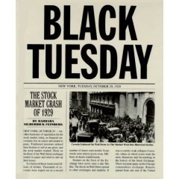
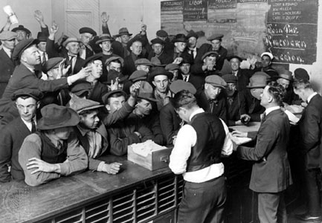
Top 5 Causes of The Depression
The Stock Market Of 1929- This crash led to the loss of 50 billion dollars of American dollars. This massive loss of money destroyed the American economy.
Easy Credit- The banks were lending too much money to consumers. Then the consumers were not able to pay the banks back. When the banks started to fail the consumers went to take their money back, but the banks couldn’t give them their money back. This lead to the next reason Bank Failures.
The Bank Failure- Throughout the 1930s over 9,000 banks failed. Bank deposits were uninsured and thus as banks failed people simply lost their savings. Surviving banks, unsure of the economic situation and concerned for their own survival, stopped being as willing to create new loans. This exacerbated the situation leading to less and less spending.

Slide 4
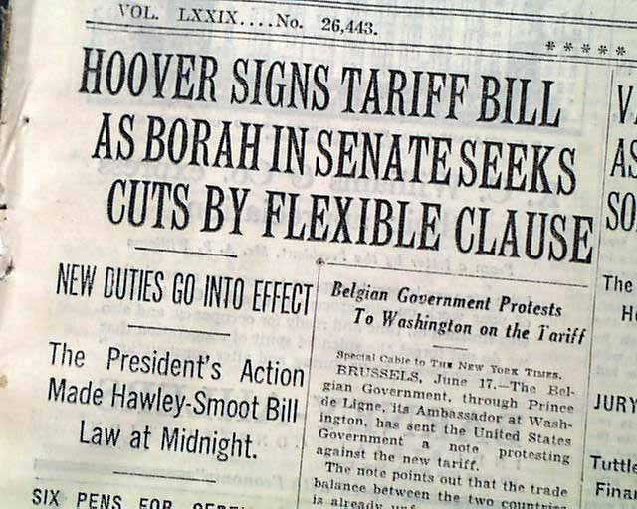
Top 5 Causes Of The Depression Cont.
4. American Economic Policy With Europe- As businesses began failing, the government created the Smoot Hawley Tariff in 1930 to help protect American companies. This charged a high tax for imports from foreign countries. The unintended consequence of this tariff was that less trade occurred between America and foreign countries. In addition, some countries retaliated economically against the US.
5. Reduction In Purchasing- The stock market crash and the bank failures led to consumers getting very scared. As a mean to have financial security they decided to limit spending which actually really hurt the american economy.

Slide 5
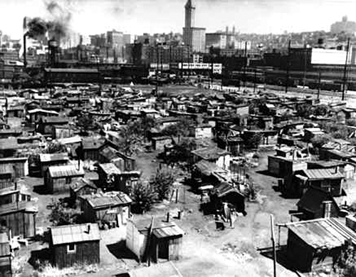
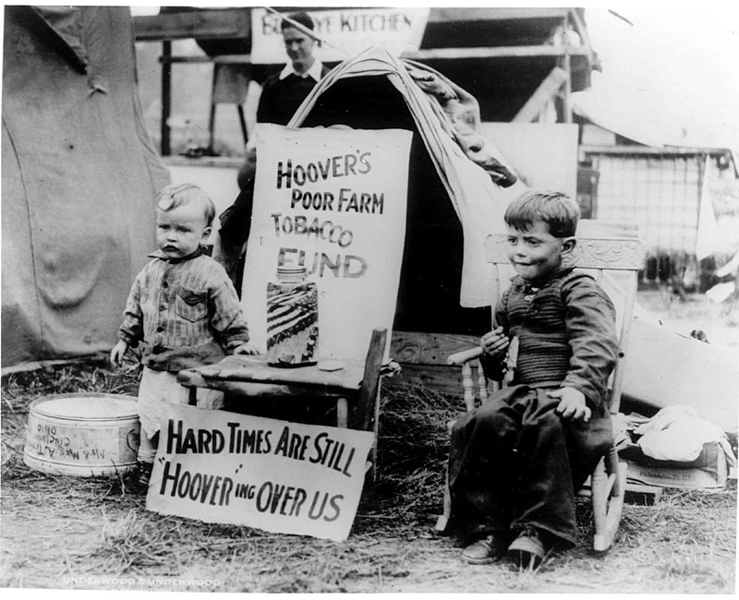
2. How Did The Poor And The Farmers React?
Most common folk that were poor didn't really do anything actively.
They believed that they were at fault for the economic failure. They proceeded to make a community of slums known as Hoovervilles (shantytowns where people lived in packing crates). In those communities you would find items like Hoover blankets( newspapers used as blankets).
Obviously the poor city people were highly upset with president Hoover. In all honesty they had the right to do so as well.
The farmers at the time period reacted much more actively, instead of coining terms and phrases to show their distaste of the current situation they responded much more actively.
Many farmers banded together to protest against the shrinking prices for their goods. An example was the Farmers Holiday Association. They barricaded many roads leading to cities to prevent their underpriced goods from getting to urban cities.
Notes:
Is it working

Slide 6
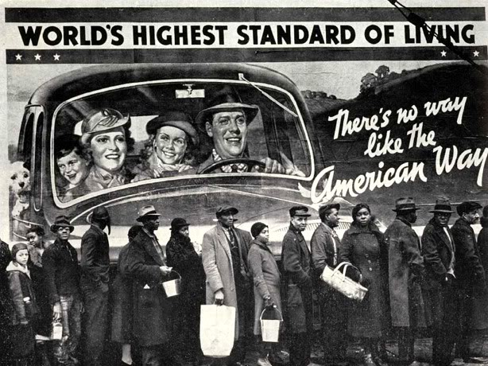
3. What choices made by Herbert Hoover guaranteed that he would not be reelected in 1932?
Herbert Hoover made questionable decisions in 1932, those decisions cost him the 1932 Election.
For example, one of those decisions was the Hawley-Smoot Tariff, which hiked up import rates up 60%. When the Great Depression Hit, this ensured that other countries would not trade with the United States, and in turn, increased the amount of isolation the US would experience, especially during the important years of the 1930’s.
Another Decision was that he was hesitant on passing aid during the depression, as he thought the depression would clear on it’s own, and that it was part of a standard business cycle.
Yet another Decision was the Decision to evict the “Bonus Expeditionary Force” from Washington, which easily hurt his public reputation, as it showed that he cared more about the refugees from other countries than America’s own Veterans.
Lastly, was the model he was trying to show to America. He was known for “Rugged Individualism”, and tried to instill in people Self-Sufficiency. This caused people to try and tough it out, and created poor communities known as “Hoovervilles”

Slide 7
4. What choices made by Roosevelt improved the banking situation?
President Franklin D. Roosevelt was a very wealthy aristocrat who, surprisingly, inspired millions of Americans. While in office he passed a series of laws to try America out of the Great Depression, known collectively as “The New Deal”. He made reforms in the most important area Banking.Some of the decisions can be seen below:
To Close Every Bank in the US for a few Days. This was to ensure that Congress had enough time to pass emergency laws to saving the Financial Sector.
To take America off the gold standard, as European Countries were taken advantage of the Gold-Backed Money. This also allowed the Federal Reserve to lower interest rates which had been increasing and harming the economy.
He created the Federal Deposit Insurance Corporation with the Glass-Steagall, which allowed the Government to insure banks with a certain amount of money, so that, if they failed, the people would not lose their money. Which in turn gave americans security and encouraged them to make deposits.

Slide 8
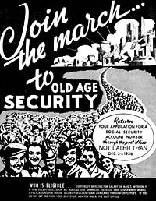
5. What Programs did Roosevelt create to deal with Massive Unemployment?
During F.D.Roosevelt’s Tenure as President, Unemployment was, at it’s worst 25% Percent, so he created various programs to try and put America’s workforce, to work.
He created the Tennessee Valley Authority, which allowed construction of Dams along the Tennessee River, creating Jobs, and cheap Hydroelectricity
He passed various laws relating to Construction (Like the Public Works Administration, or the Works Progress Administration so that more Americans could be Employed, reducing the Unemployment Rate.
He passed the Social Security Act, which allowed Elderly and Unemployed People to receive care and insurance, along with Pensions.

Slide 9
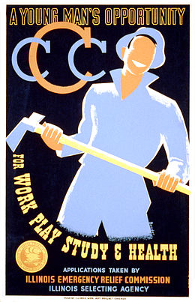
5. What Programs did Roosevelt create to deal with Massive Unemployment? Cont.
The Federal Emergency Relief Administration provided welfare for million unemployed Americans.
The Civilian Conservation Corps (CCC) came into effect when Republicans had the Civil Works Administration abandoned. The CCC gave 250,000 young men reforestation and conservation work. They built thousands of bridges, roads, trails, and other structures in national and state parks.

Slide 10
6. What complaints did both Conservatives and Liberals have with Roosevelt’s Policies?
Roosevelt’s Policies with the New Deal were very large and wide reaching with the intended purpose being the Restoration of the American Economy. However, even with the amount of help it did, it received its fair share of complaints, from both the Left Side of the Aisle, and the Right Side of the Aisle. The majority of the Concerns and Critics were about giving more power to the people, and trying to spur the American Economy faster.

Slide 11
6. What complaints did both Conservatives and Liberals have with Roosevelt’s Policies?
Most Populists said that the New Deal was not doing enough to revitalize the Economy
Francis Townsend spoke for the elderly. He said that the new deal didn't do enough for the elderly and that they should pay them a monthly sum of 200$ (3,300). This spurred a lot of support from people all around America.
Critics of the Right “fought” against the “reckless spending” and “socialist reforms” of the New Deal.
FDR used Strong-Arm Tactics to try and get the provisions passed, like “Packing The Court”
The NAM thought that the laws and acts were anti-business and would harm the U.S in the long run.

Slide 12
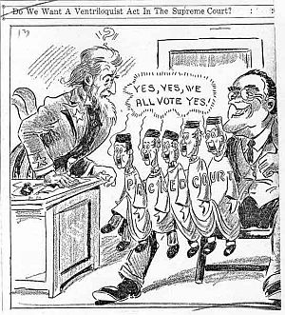
7. Why did Roosevelt attempt to “Pack the Courts” and what was the reaction to his choice?
At the time of F.D.R’s presidency the Supreme Court was in control of elderly, conservative minded judges. These Justices had already struck down various parts of the New Deal and with the many pivotal acts about to be decided by the courts Roosevelt took desperate measures. He proposed to put a new judge in for every judge over 70. This proposal would have brought 6 new judges to the stand. Due to the nature of his proposal it failed to pass. Once this plan was announced, the majority of the Justices allowed his policies to pass.

Slide 13
8. Why did America Re-enter a Recession in 1937?
After the Various New Deal policies that were introduced, America started to grow back from the Depression. However, less than 6 years later, America entered a Recession.
The New Deal involved the Federal Government spending money in order to revitalize the economy. The amount of Money the Federal Government had was limited, like all governments so when money was starting to run out, the economy appeared it could stabilize, the programs were starting to be cut or funding was cut. Without those programs, many people struggled to remain in the workforce and keep those jobs. For example unemployment went from 25% to 14%, but when government programs were cut it jumped back up to 19%.

Slide 14
9. To what extent was the New Deal Successful and Unsuccessful?
The series of programs in the New Deal was meant to revitalize the American Economy and help end the depression. Some Parts of it were a Success, while others were a failure.
Success | Failure
Restored Public Confidence in Banks | Did not solve Crisis Entirely
Put America’s Unemployed to Work | Increased US Isolation
Created Lasting Programs and Changes | Limited In Scope

Slide 15
Foreign Policy during the 1930’s
Notes:
Everything after this was done by Nelson

Slide 16
10. What steps in the 1920’s were taken to keep America Isolated and maintain peace?
After WWI, various people were disillusioned and wanted to remain out of Foreign Affairs. Congress, and the President introduced isolation acts in order to keep America away from others.
Some examples are the rejection of US Entry into the League of Nations, The First Neutrality Act (which prohibited exports of Arms and Munitions), The Neutrality Act of 1937 (US Citizens couldn’t travel on Vessels from Warring Nations, those ships are barred from entering US Waters), and the Neutrality Act of 1939 (which repealed the Export Bans and created the Concept of Cash-and-Carry. If you could pay in cash and then carry the good with you in your own ship, you could purchase it. Another Provision was the Lend-Lease program, in which a foreign country could be lent/leased equipment to defend itself if it’s defense is deemed important by the President, with the supplies to be paid back at a later date.)

Slide 17
11. How did America’s Foreign Policy towards Latin America change during the 1920’s and 1930’s?
America’s foreign policy prior was that No one should touch the Latin American Countries and that they should be left alone to their own development.
However, slowly, but surely, the United States decided to entrench their own hands into each country. The reasons given were for the purpose of “protecting US Interests and National Defense”. Another was that it was American Sovereignty and it’s duty. In essence, America tried to create it’s own empire. Fueled by Ideals of Manifest Destiny, the US Armed Forces occupied many countries.

Slide 18
12. What Choices were made during the Roosevelt Administration to keep America out of the war?
While Franklin D. Roosevelt was a supporter of American Internationalism unlike his predecessors, he still passed and created some laws to keep america out of World War 2. One example was the various Neutrality Acts passed during the time period. They stated that US Citizens couldn’t be in war zones, couldn’t travel on Warships, US Ships couldn’t be in Disputed Waters, and similar laws. Another way was that most Trade was stopped between Warring Nations.

Slide 19
13. Though America was technically Neutral, what choices showed they were participating in WWII?
America passed many isolation laws, trying to limit the Western Hemisphere to just themselves, and to remove themselves from many future world conflicts. However, on President Franklin D. Roosevelt’s behalf, those acts passed by Congress had a few caveats that led for discreet American Participation. They are the Lend-Lease program and the Cash-Carry Program.
Lend-Lease is when America loans equipment to its allies for defense in exchange for late repayment
Cash-Carry was when you could buy American Goods outright in Cash, but you had to carry them back to your country yourself. “Think No-Shipping on Online Goods”

Slide 20
14. What events led to the Japanese Attack on Pearl Harbour?
Various events led to the Japanese Surprise Bombing of the Naval Station Pearl Harbor. The Japanese Invasion of Manchuria outraged the US which Condemned the Attack. This insulted the Japanese which then started to build up its forces. The US then embargoed Japan, which starved Japan of its oil, which Japan was heavily reliant on. Due to the increase in Japanese resources due to Japan taking control of Manchuria, they started to move along the pacific, taken a few islands and provoking the US. They made secret agreements with Germany, and in order to end US Pacific Influence, decided to try and take out the United States Pacific Fleet in one large attack, which at that point in time was stationed in Naval Station Pearl Harbor, Honolulu, Hawaii. The Japanese destroyed a sizeable chunk of the US Pacific Fleet but was unable to Destroy any Aircraft Carriers, Fuel, or Munitions, due to the Aircraft Carriers undergoing movement in the pacific and the Japanese Negligent in Attacking. Shortly before, Japan declared War on US. After the attack, Germany Declared War on the US. The next day, the US Declared War on Japan, then Germany, followed by the UK declaring War on Japan, who then declared War back on the UK. This effectively insured which side each country would take in the war, setting the stage for the Allies, composed of the United States, the United Kingdom, and the Soviet Union, among others against the Axis, Composed of Germany, Japan, and Italy among others.

Slide 21
World War II

Slide 22
15. How was 1944 a shift in where and how America fought Germany?
1944 was a shift because it was the year the Allies stormed the Stormy Beaches of German-Controlled Normandy* in France and gained a foothold in Axis-Controlled Territories. With that, the Allies were no longer confined to General Long-Range Air Strikes and could now advance by the Ground and could gain territory in Europe, pushing back the Germans by advancing from country to country now. It also allowed Bombers to have Fighter Escorts when flying to-and-from targets, which increased American Survivability rate and decrease the likelihood of an axis shoot down an allied plane.
*The battle for the beach of Normandy took place in June 5th, 1944, as was known as D-Day. It was a pivotal point for America in the war. Both sides took heavy casualties.

Slide 23
16. How did the Government take control of the Economy during World War II?
After the Roosevelt Administration’s various policies and laws that attempted to spur the American Economy during the Great Depression, they had various administration and departments that it could use to direct companies to produce War-Related Goods in a timely manner to prepare for war. Some examples are the Food and Drug Administration, and the Office of Strategic Services, along with Civilian Conservation Corps which took care of Rural Facilities .

Slide 24
17: In what ways was World War 2 a “total war” effort?
World War II was a Total War Effort in both the civilian front and on the Military Front. Some examples on the Civilian Front are that Every Able-Bodied Male was called to War with the draft, and American Industry was shifted into producing War Goods and Supplies. It was also a total war on the military front because of how the sides conducted themselves in relation to the enemy. For example, the Germans used Genocide and Chemical Warfare to disrupt the enemy, the japanese used Kamikaze Effort, and America used Nuclear Warfare. They disregarded all conventional rules of warfare.

Slide 25
18. What were the goals of Yalta and Potsdam?
The Yalta Conference was a meeting between Franklin D. Roosevelt, Winston Churchill, and Joseph Stalin, the leaders of the Allies. The topic at hand was how to deal with the Japan, and the post-war world. The Soviet Union would declare war on japan, and in return, would gain lost territory from Japan.
The Potsdam Conference was a meeting between Harry S. Truman, Clement Attlee (British Prime Minister), and Joseph Stalin, along with china, and was held to determine how to divide post-war germany. It divided up the land, set procedures and laws for elimination of nazi influence and trials for war criminals. It also led to the formation of East and West Germany. It also called for the surrender of Japan or face annihilation.

Slide 26
19. Why did America drop the Atomic Bombs? Why was the choice criticized?
In 1945, America dropped the Atomic Bombs on the Japanese Cities of Hiroshima and Nagasaki. The combined Death Toll was up to 226,000. To America, those lives taken were justified because had the US Proceed with Operation Downfall (Operation Olympic, and Operation Coronet) ,the projected amount of United States casualties was 500,000- 1.1 Million.
It is criticized because of few groups that said it was unnecessary to secure allied victory, constituted as a War Crime, inhumane, and not justified.

Slide 27
FIN
“That means End/Finish”

