Slide 1
Take out notes and have a seat
Remain quiet
Thanks ☺

Slide 2
Ancient India

Slide 3
The Indus River Valley
The first civilizations in ancient India emerged in the Indus River Valley, which flows across the northwest edge of the Indian subcontinent.
A subcontinent is a large landmass that is part of a continent.

Slide 4
G geography

Slide 5
Indus River Valley geography
The Indian subcontinent has three geographic zones:
In the north there are the Himalaya and Hindu Kush mountains, which separate India from the rest of Asia.
In the south there is the Deccan Plateau; a high plateau that receives less rain than other parts of the subcontinent.
Between the mountains and the plateau are the Northern plains, where society first developed in India.
Here, flood deposits from three rivers—the Indus, Ganges, and Brahmaputra—enrich the soil of plants, making it very fertile.

Slide 7
Monsoons!
Much of the rain that added fertility to the northern plains were brought to India by seasonal winds called monsoons.
During summer months monsoon winds from the southwest bring warm air and heavy rains from the Indian Ocean. Most of India’s annual rain occurs during that time.
India’s first civilizations depended on these monsoons to bring water that their crops needed. The rivers would flood and leave behind silt, which helped farmers grow crops.
***Down side: if monsoon rains were too heavy, it could devastate crops, homes, and lives could be lost. In contrast, if the rains were too little, people wouldn’t be able to grow crops and famine could set it. ***

Slide 8
Indus Valley Civilization
Date back to 2500BC, when people learned to farm in this region and developed a system of writing
The firs ruins of Indus Valley civilization were the remains of two large cities:
Harappa and Mohenjo-Daro.
These cities are often referred to as the Harrapan Civilizations.

Slide 9
City Structure
Indus settlements were well planned out. Streets were laid in a grid pattern.
People drew water from wells
They had public drainage systems that carried away waster water.
This structure planning suggests that central authority held power over the civilization.

Slide 10
E economy

Slide 11
Economy and trade
Traditional economy (based on agriculture and trade)
They had specialized workers (artisans) who made things such as pottery, metalwork, and jewelry.
They traded food and goods with nearby villages as well as distant civilizations—some as far as Mesopotamia!

Slide 12
SILK ROAD
***The Silk Road was a vast system of trade routes that connected China with the West.
Stretched about 4,000 miles from China to Mesopotamia.
Only luxury goods were carried on the Silk Road.
Goods Included: silk, spices, teas, porcelain, ivory, textiles, pepper, woolen and linen clothes, glass, and precious stones

Slide 13
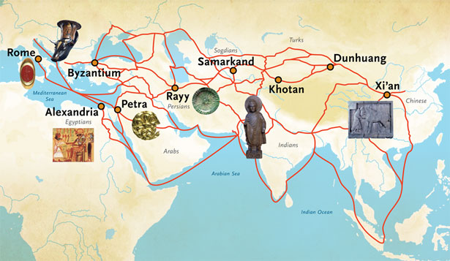

Slide 14
Society
Not must can be known about Indus Valley civilizations because although people in the Indus River Valley civilization had a writing system, historians can not yet read it.
Based on material evidence, scholars believe the Indus civilization was a single society, rather than broken into city states.
Many cities and towns throughout this region were very similar.

Slide 15
The Verdic Period
After the decline of the Harrapan Civilizations in the Indus River Valley, a new people took control of India. They were called the Aryans.
Everything we know about the Aryans come from their secret writings called the Vedas—which is why we call the period of time where the Aryans were in power the Verdic Period.

Slide 16
Society
Regional leaders called “Rajas”—war leaders responsible for protecting the people
Social Structure was divided into four social classes called “varnas”.
Each varna played a particular role in society
Each varna was created from the body into a single being
Therefore, the part of the body in which your varna was created was tied to your duties
The four Varnas over time because known as castes. This caste system is still used in society today.

Slide 17
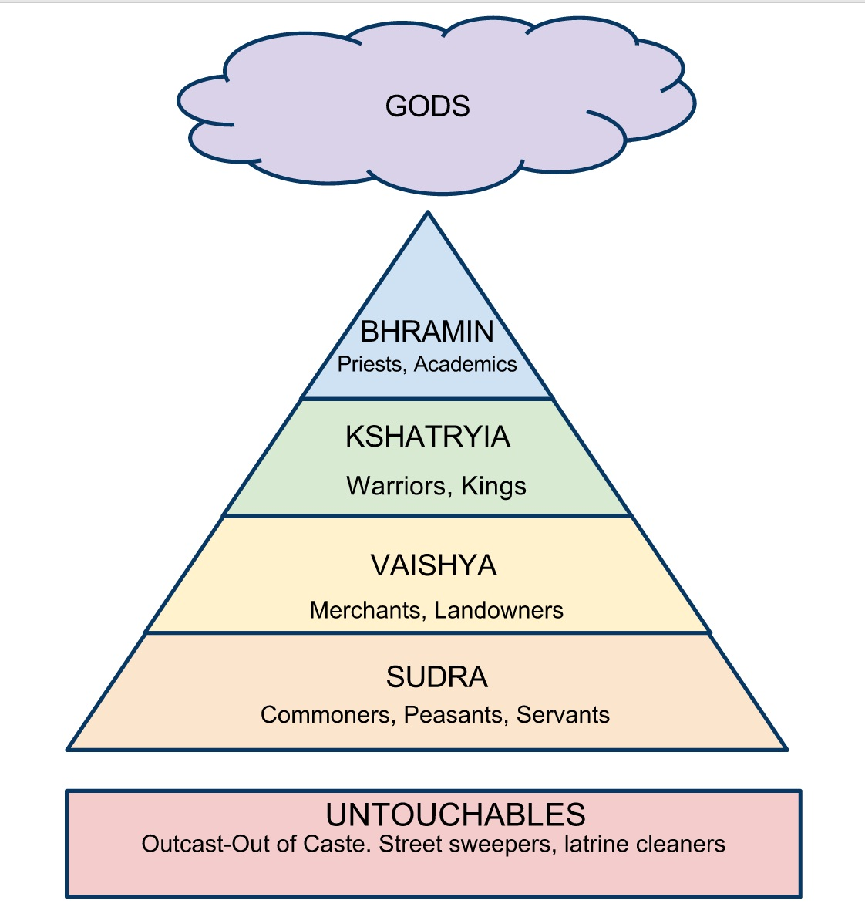
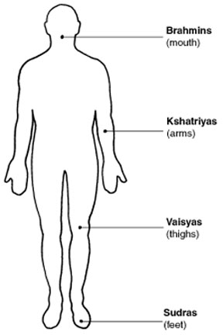
For example: Brahmins came from the mouth, the source of speech and wisdom. Thus, their duty in society was to be priests.

Slide 18
Religion
Polytheistic
Major religion that emerged: Hinduism
Hinduism has no founder
Basic Hindu beliefs:
Dharma
A person’s spiritual duties and obligations, which he or she must follow to achieve liberation
Karma
The sum effect of a person’s actions, both good and bad, which helps shape future experiences.
Samsara
Reincarnation; the cycle of birth, death, and rebirth a person follows before achieving liberation
Moksha
Liberation; release from the cycle of reincarnation, and joining the atman

Slide 19
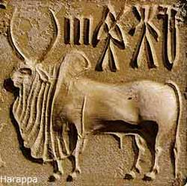
Language & Art
Sanskrit

