Slide 1
1.3 Psychology Statistics
AP Psychology

Slide 2
Descriptive Statistics
Definition…
Describe a set of data
Measures of Central Tendency
Measures of Variation
Skewed Distributions

Slide 3
Measures of Central Tendency
Mean
Average score
Extreme scores have a greater impact on the mean than on the mode or median
Median
Score that divides a frequency distribution exactly in half, so that the same number of scores lie on each side (middle)
Mode
Most frequently occurring score (bimodal)

Slide 4
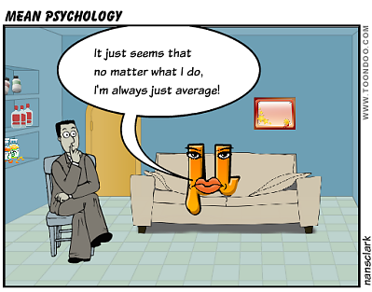

Slide 7
Measures of Variation
Definition
Measure of variation in a single score that presents info about the spread of scores in a variation
Range – highest minus the lowest
Standard Deviation – a standard measurement of how much the scores in a distribution deviate from the mean
The most widely used measure of variation
Z-score (standard score) – the distance of a score from the mean in units of standard deviation

Slide 8
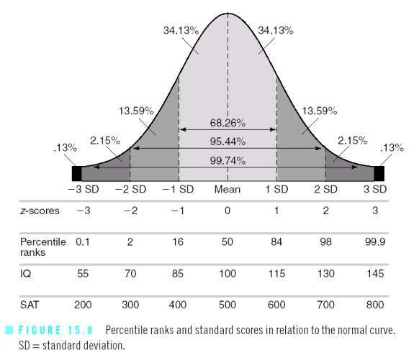

Slide 9
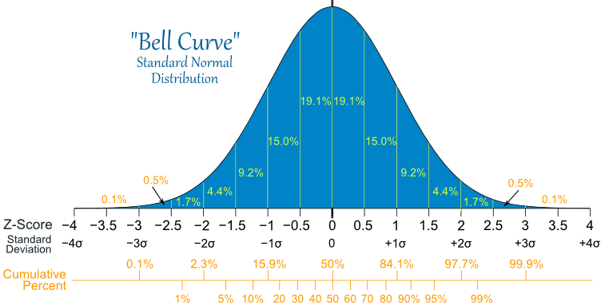
Normal Distribution
Form a bell-shaped or symmetrical curve

Slide 10
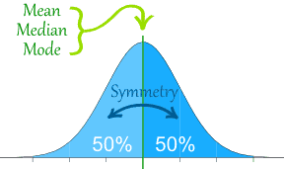
Normal Distribution
The percentage of scores that fall at or above the mean is 50…the percentage that fall below (or at) the mean is also 50

Slide 11
Normal Distribution
One-third of the scores fall one standard deviation below the mean and one-third fall one standard deviation above the mean
Example…Wechsler IQ Tests
Mean = 100 / Standard Deviation = 15
One-third score 85-100
Another third score 100-115

Slide 12
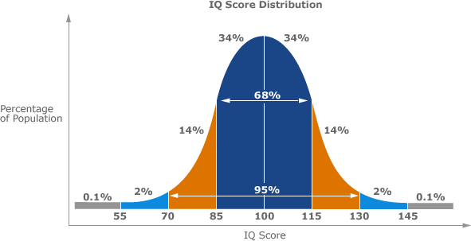

Slide 13
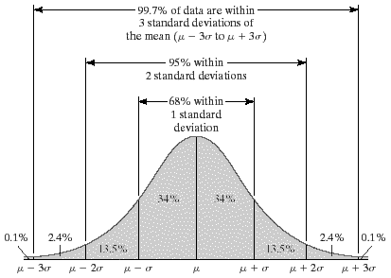
68-95-99.7 Rule
68% of scores fall within one SD
95% of scores fall within two SD
99.7% of scores fall within three SD

Slide 14
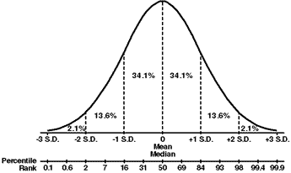
Percentile
Distance of a score from “0”
Examples
90th percentile – score better than 90%
38th percentile – score better than 38%

Slide 16
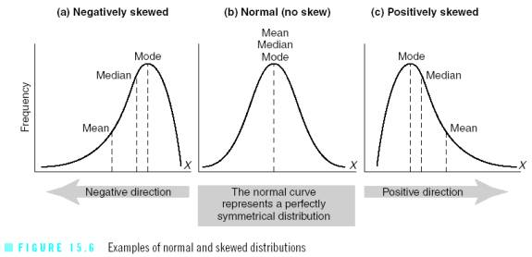
Skewed Distributions

Slide 17
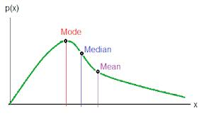
Skewed Distributions
Positively Skewed Distributions
Contain a preponderance of scores on the low end of the scale (looks like “P” lying on back
Mean is higher than the median
Thus the median is a better representation of central tendency in positively skewed distributions

Slide 18
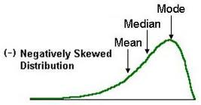
Skewed Distributions
Negatively Skewed Distributions
Contain a preponderance of scores on the high end of the scale
Mean is lower than median
Thus the median is a better representation of central tendency in a negatively skewed distribution

Slide 19
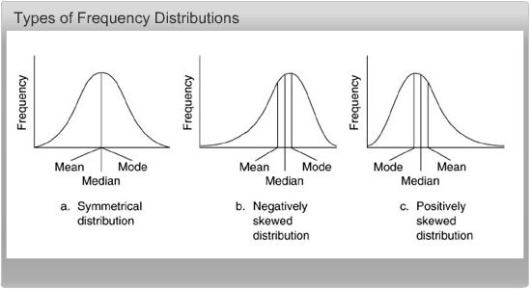

Slide 20
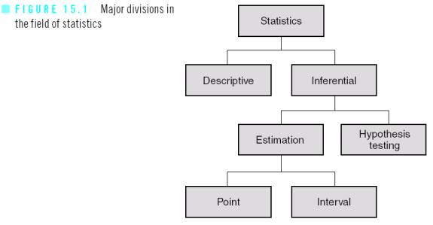

Slide 21
Inferential Statistics
Key points…
Most experiments are conducted with a small sample of subjects
Psychologists want to generalize the results from their small sample to a larger population
IS are used to determine how likely it is that a study’s outcome is due to chance and whether the outcome can be legitimately generalized to the larger population from the sample selected

Slide 22
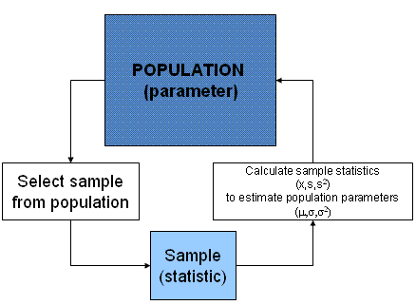

Slide 24
The P-Value
Probability of concluding that a difference exists when in fact this difference does not exist
A statistically significant difference is a difference not likely due to chance (shows up 5% of the time or less)
Smaller the p-value, the more significant the results
Can never be “0” (researchers can never be 100% certain the results did not occur by chance)

Slide 25
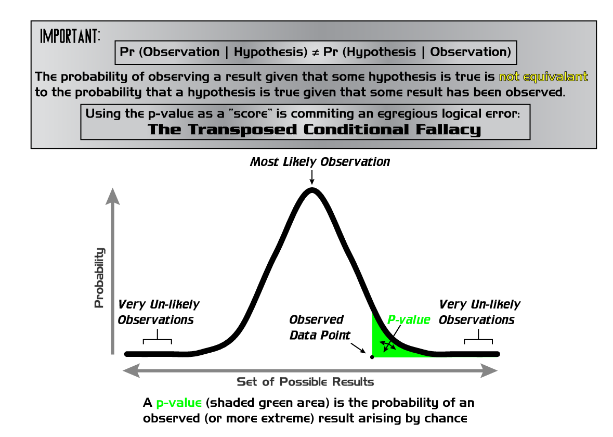

Slide 26
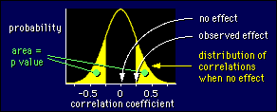

Slide 28
Standard Deviation
Find the variance.
a) Find the mean of the data.
b) Subtract the mean from each value.
c) Square each deviation of the mean.
d) Find the sum of the squares.
e) Divide the total by the number of items.
Take the square root of the variance.

Slide 29
Standard Deviation Formula
The standard deviation formula can be represented using Sigma Notation:
Notice the standard deviation formula is the square root of the variance.

Slide 30
Find the variance and standard deviation
The math test scores of five students are: 92,88,80,68 and 52.
1) Find the mean: (92+88+80+68+52)/5 = 76.
2) Find the deviation from the mean:
92-76=16
88-76=12
80-76=4
68-76= -8
52-76= -24

Slide 31
Find the variance and standard deviation
The math test scores of five students are: 92,88,80,68 and 52.
3) Square the deviation from the mean:

Slide 32
Find the variance and standard deviation
The math test scores of five students are: 92,88,80,68 and 52.
4) Find the sum of the squares of the deviation from the mean:
256+144+16+64+576= 1056
5) Divide by the number of data items to find the variance:
1056/5 = 211.2

Slide 33
Find the variance and standard deviation
The math test scores of five students are: 92,88,80,68 and 52.
6) Find the square root of the variance:
Thus the standard deviation of the test scores is 14.53.

Slide 34
Standard Deviation
A different math class took the same test with these five test scores: 92,92,92,52,52.
Find the standard deviation for this class.

Slide 35
Hint:
Find the mean of the data.
Subtract the mean from each value – called the deviation from the mean.
Square each deviation of the mean.
Find the sum of the squares.
Divide the total by the number of items – result is the variance.
Take the square root of the variance – result is the standard deviation.

Slide 36
Solve:
A different math class took the same test with these five test scores: 92,92,92,52,52.
Find the standard deviation for this class.

Slide 37
The math test scores of five students are: 92,92,92,52 and 52.
1) Find the mean: (92+92+92+52+52)/5 = 76
2) Find the deviation from the mean:
92-76=16 92-76=16 92-76=16
52-76= -24 52-76= -24
3) Square the deviation from the mean:
4) Find the sum of the squares:
256+256+256+576+576= 1920

Slide 38
The math test scores of five students are: 92,92,92,52 and 52.
5) Divide the sum of the squares by the number of items :
1920/5 = 384 variance
6) Find the square root of the variance:
Thus the standard deviation of the second set of test scores is 19.6.

Slide 39
Analyzing the data:
Consider both sets of scores. Both classes have the same mean, 76. However, each class does not have the same scores. Thus we use the standard deviation to show the variation in the scores. With a standard variation of 14.53 for the first class and 19.6 for the second class, what does this tell us?

